Slide 1
Click “Slide Show”
Click “From Beginning”
or
“From Current Slide”

Slide 2
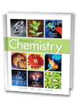
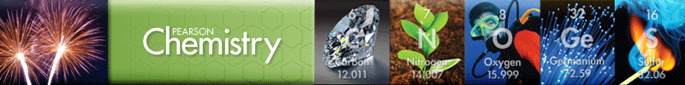
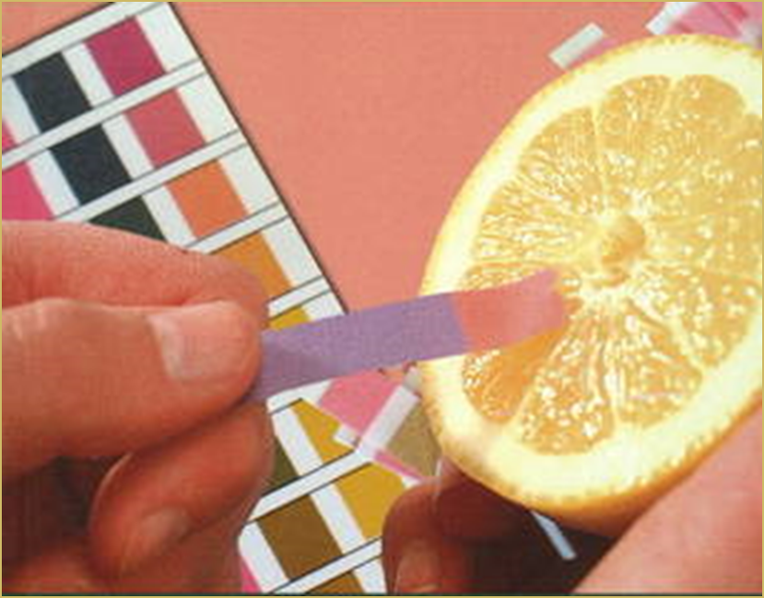
Chapter 19
Acids, Bases, and Salts
Acid-Base Theories
Hydrogen Ions and Acidity
Strengths of Acids and Bases
Neutralization Reactions
Salts in Solution
Notes:
2

Slide 3
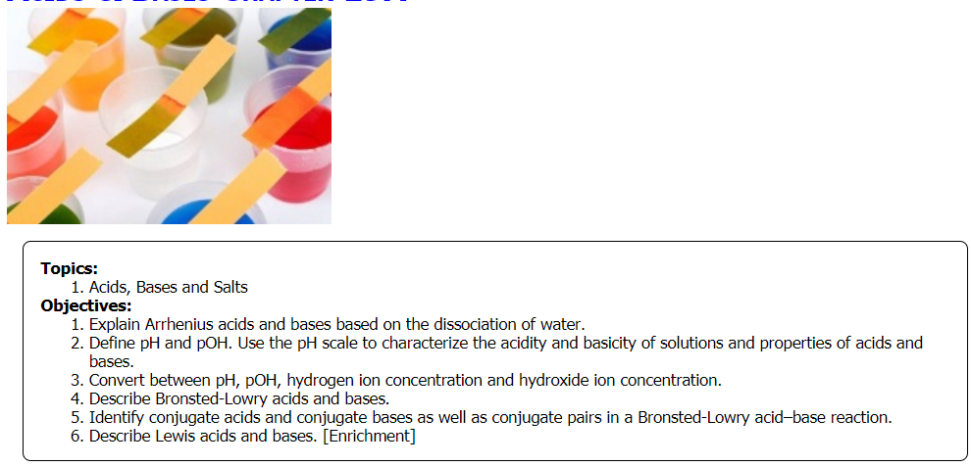
Notes:
3

Slide 4
Lesson Objectives
  Explain Arrhenius acids and bases based on the dissociation of water.
  Define pH and pOH. Use the pH scale to characterize the acidity and basicity of solutions.
  Convert between pH, pOH, hydrogen ion concentration and hydroxide ion concentration.
  Describe Bronsted-Lowry acids and bases.
  Identify conjugate acids and conjugate bases as well as conjugate pairs in a Bronsted-Lowry acid–base reaction.
  Describe Lewis acids and bases. [Honors]
Notes:
Acids and bases are an important part of chemistry, and dissociation is a key process underlying the formation of acids and bases and how they interact with other substances.
In this lesson, we explore the general chemical and physical properties of acids and bases.

Slide 5
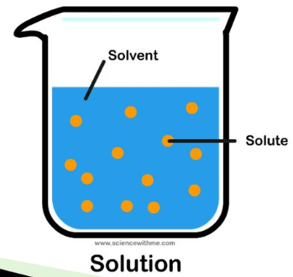
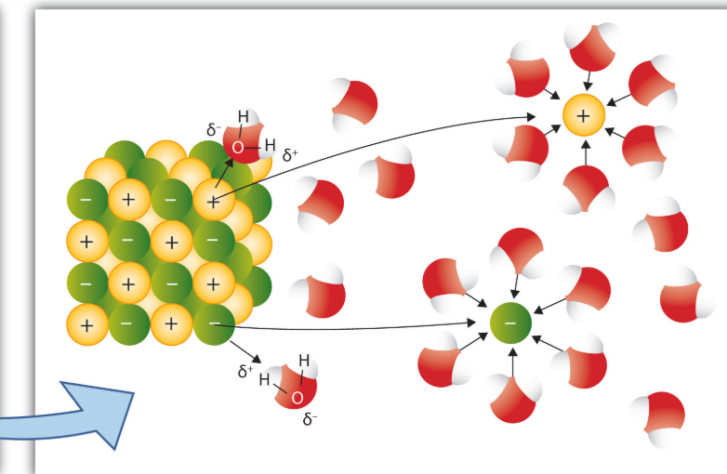
Dissociation of Water
The most important solvent to the chemical world is water due to its polarity … it is easy to forget the important role of water compared to the role of the solute. For example, milk, orange juice, coffee, tea, soft drinks, etc. etc. all have water as the solvent.

Slide 6
Dissociation of Water
Water breaks up the solute → dissociation
Water surrounds the cations
and anions → hydration

Slide 7

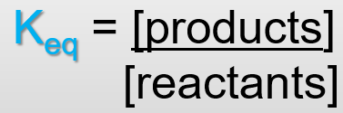
Dissociation of Water
Write the K_{eq} of water’s dissociation.

Slide 8
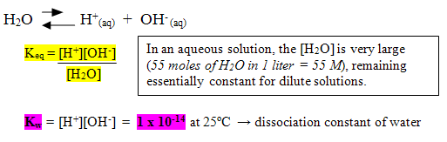
Dissociation of Water
This means that water only SLIGHTLY dissociates into ions.

Slide 9
Ion-Product Constant for Water
Since water only slightly dissociates into ions:
We can use the same principle as K_{sp} = [H⁺][OH⁻] .
Notice the [H₂0] is omitted. For aqueous solutions:
[H⁺][OH⁻] = 1.0 × 10⁻¹⁴
Notes:
9

Slide 10
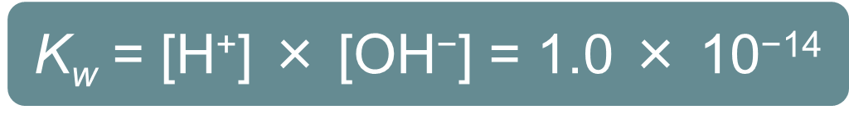
Ion-Product Constant for Water
The product of the concentrations of the hydrogen ions and the hydroxide ions in water is called the ion-product constant for water (K_{w}).
Notes:
10

Slide 11
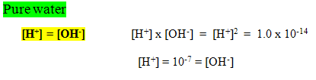
Dissociation of Pure Water
  In pure water at 25 ⁰C, the concentration of hydrogen ions ([H⁺]) is only 1 × 10⁻⁷M.
  The concentration of hydroxide ions ([(OH)⁻]) is also 1 × 10⁻⁷M because the numbers of H⁺ and (OH)⁻ ions are equal in pure water.

Slide 12
Summary: Acid – Base Theories
  Arrhenius
  Acid → H⁺ ions
  Base → (OH)⁻ ions
  Bronsted-Lowry
  Acid → donates H⁺ ions
  Base → accepts H⁺ ions
  Lewis
  Acid → accepts electrons
  Base → donates electrons
pH scale
Conjugate acid-base pairs
Most inclusive definition
Notes:
Timing ≈ 0.5 min
Acids increase the concentration of hydrogen ions whereas bases decrease it.
Acids and bases have characteristic properties.

Slide 13
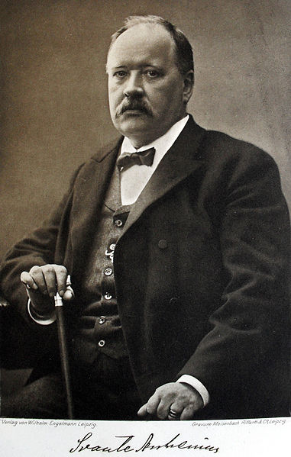
The Arrhenius Concept
  Arrhenius acid: a substance that when dissolved in water increases H₃O⁺ (or H⁺) concentration.
  Arrhenius base: a substance that when dissolved in water increases (OH)⁻ concentration.
  k_{w} = [H⁺][(OH)⁻] … water
Notes:
Swedish chemist Svante Arrhenius defined acids and bases according to the types of ions produced when these substances were dissolved in water.
When many acids are dissolved in water, hydronium ions are produced as hydrogen ions move from the acid to associate with water molecules. Chemists often simply say that hydrogen ion concentration has increased in these cases.
When many bases are dissolved in water, hydroxide ions are formed.
If you compare these definitions to those that we have been using, there are similarities and differences.
The two definitions of an acid are the same: an acid is a substance that increases hydrogen ion concentration in solution.
However, the two definitions of a base differ. In the earlier definition we had been using, a base was defined as a substance that decreases the hydrogen ion concentration in a solution. The Arrhenius definition of a base defines it as a substance that increases the concentration of hydroxide ion in solution.
Source:
photo of Svante Arrhenius: http://commons.wikimedia.org/wiki/File:Svante_Arrhenius_01.jpg; public domain; accessed 7/9/12

Slide 14
Arrhenius Acids
Acidic Solutions
  A substance that increases the concentration of H⁺ (H₃O⁺) ions in solution.
    H⁺: hydrogen ion … H₃O⁺: hydronium ion
k_{w} = [H⁺][(OH)⁻] = 10⁻¹⁴
  In acidic solutions, the hydrogen-ion concentration is greater than the hydroxide-ion concentration.
  [H⁺] > [(OH)⁻]
The [H⁺] is greater than 1 × 10⁻⁷M.
  The [(OH)⁻] is less than 1 × 10⁻⁷M.
Notes:
14

Slide 15
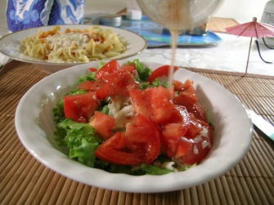
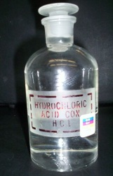
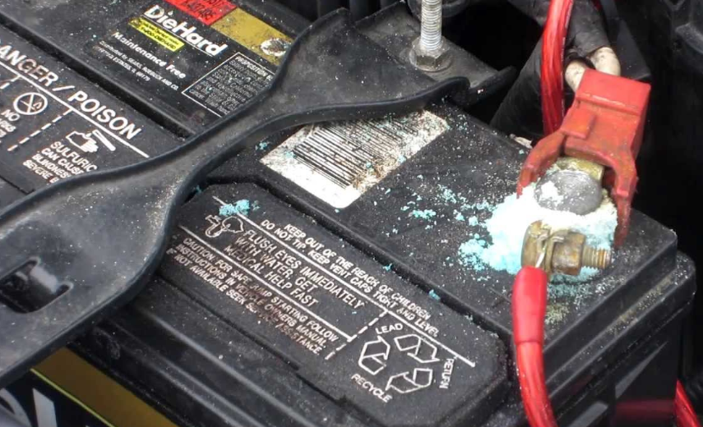
Examples of Acids
    Hydrochloric acid (HCl) …stomach acid
    Sulfuric acid (H₂SO₄) … battery acid
    Acetic acid (HCH₃COO) … vinegar
    Nitric acid (HNO₃) … explosives, fertilizer
    Carbonic acid (H₂CO₃) … soda water
Notes:
The zest of some foods that we love is thanks to acids. But, we want to keep our distance from many other acids. [animate 1st bullet] An acid is a substance that increases the hydrogen ion, or hydronium ion, concentration in solution.
[animate sub bullets] You will often see H+ and H3O+ used interchangeably in discussions of acids and bases. H+ is the hydrogen ion. H3O+ is the hydronium ion. We often use H+ as a shorthand for H3O+ when we are dealing with aqueous solutions, because H3O+ is simply H+ plus a water molecule, and aqueous solutions have abundant water molecules. In reality, an aqueous solution will not contain any actual H+ ions; they are all H3O+. However, for simplicity, we will use H+ often as well.
[animate each remaining bullet as it is discussed] Let's look at a few examples of common acids.
Hydrochloric acid is commonly used in the chemistry lab. It is also the primary acid found in the human stomach, where it helps to digest food.
Sulfuric acid is used frequently in industry, and it is also a main component of acid rain.
Acetic acid is the acid found in vinegar. It is also used in the production of aspirin and other industrial applications.
Oxalic acid is a toxic acid that is found in some foods such as potatoes and rhubarb.
Carbonic acid forms when carbon dioxide dissolves in water. It is therefore found in almost all water on Earth, as well as in carbonated beverages and in the bloodstream.
Notice that all of these acids contain one or more hydrogen atoms bonded to ions or other atoms. [teacher circle initial H atom(s) in each example] The formulas for acids are often written with the H first to emphasize this property. [teacher show how acetic acid can be written as H₄C₂O₂ but that doesn't show the acidic H as well] Therefore, one way you can identify many acids is by looking for an initial H atom in the chemical formula. Not all acids have this property, but many do.
Source:
http://www.morguefile.com/archive/display/99197
http://en.wikipedia.org/wiki/File:Hydrochloric_acid_05.jpg

Slide 16
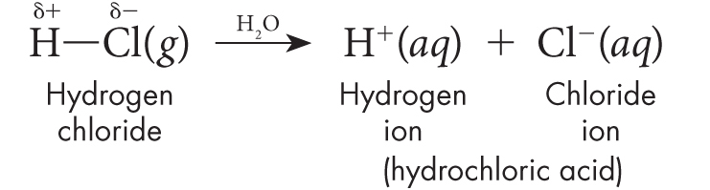
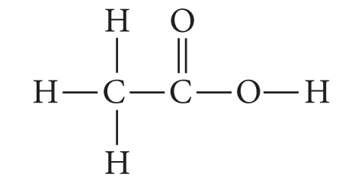
Arrhenius Acids
Not all compounds that contain hydrogen are acids.
Only a hydrogen that is bonded to a very electronegative element can be released as an ion.
Such bonds are highly polar.
Acetic acid (ethanoic acid) contains hydrogens that do not ionize and a hydrogen that does ionize.
Notes:
16

Slide 17
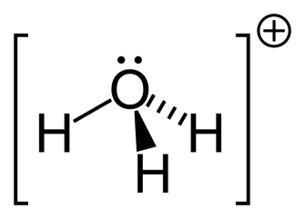
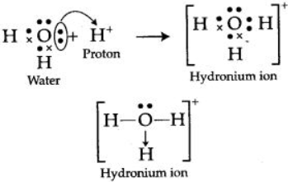

Arrhenius Acids
In an aqueous solution, hydrogen ions are not present. Instead, the hydrogen ions are joined to water molecules as hydronium ions.
A hydronium ion (H₃O⁺) is the ion that forms when a water molecule hydrates a hydrogen ion [H⁺].
2H₂O H₃O⁺_{(aq)} + (OH)⁻ _{(aq)}
₁₆
Notes:
17

Slide 18
Hydration of Water Around H+ ions
Water surrounds the H⁺ cations in the dissociation process. This is represented by hydronium ion (H₃O⁺).

Slide 19
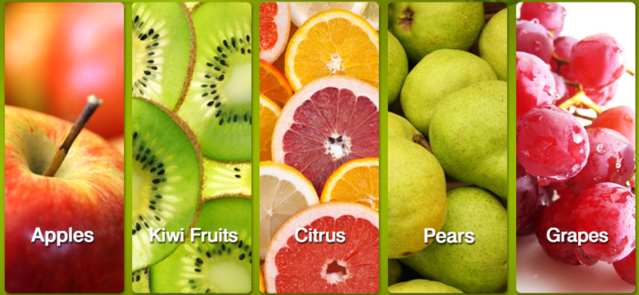
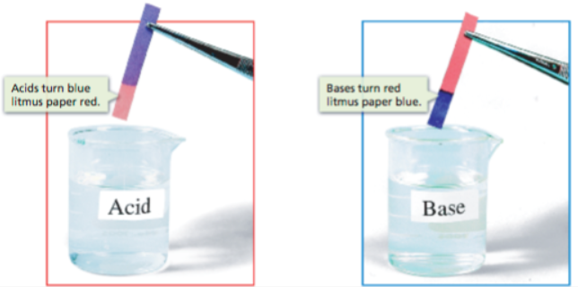
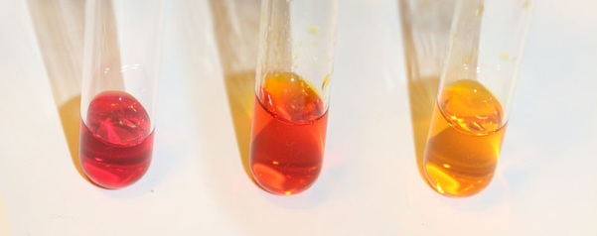
Chemical and Physical Properties of Acids
  Have a sour taste
  Turn blue litmus paper red
  Are neutralized by bases
  ---------------------------------
  React with metals
  Turn methyl orange solution red
  React with carbonates and bicarbonates
Notes:
Timing ≈ 1 min
Although each acid has some unique properties, all acids have some things in common. [animate bullets as each is mentioned]
All acids taste sour. [teacher note and emphasize that students should NEVER taste laboratory chemicals, but point out that many sour foods, such as vinegar and lemon juice, are sour because they contain acids]
Certain substances called indicators react to acids and bases by changing color. Blue litmus, for example, turns red in acidic solution.
Similarly, the indicator methyl orange turns red when it is in acidic solution [teacher point to leftmost test tube showing methyl orange in acidic solution]
Acids react with carbonates and bicarbonates to form carbon dioxide. In fact, a common test for limestone, a carbonate mineral, is to place a few drops of acetic or hydrochloric acid on it. If it fizzes and bubbles, limestone or another carbonate mineral is present.
Acids can be neutralized by bases. This means that acids and bases react to form salts and water.
Acids react with metals to form metal salts and hydrogen gas.
Source:
http://commons.wikimedia.org/wiki/File:Color_transition_of_Methyl_red_solution_under_different_acid-base_conditions.jpg

Slide 20
Arrhenius Bases
Basic Solutions
  A substance that increases the concentration of (OH)⁻ ions in solution.
k_{w} = [(OH)⁻][H⁺] = 10⁻¹⁴
  In basic solutions, the hydroxide-ion concentration is greater than the hydrogen-ion concentration.
  [(OH)⁻] > [H⁺]
The [(OH)⁻] is greater than 1 × 10⁻⁷M.
  The [H⁺] is less than 1 × 10⁻⁷M.
  Basic solutions are also known as alkaline solutions.
Notes:
20

Slide 21
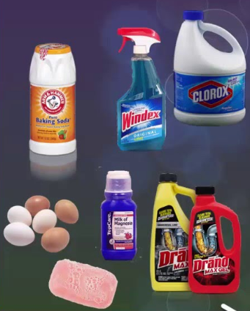
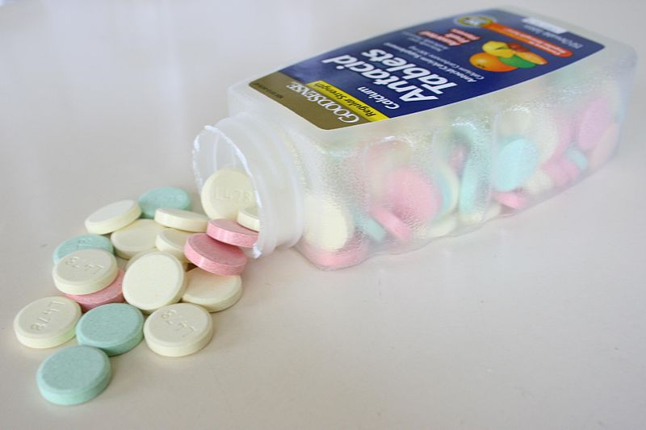
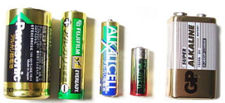
Examples of Bases
    Deodorant: Al(OH)₃
    Drain Cleaner:
    Sodium hydroxide (NaOH)
    Fertilizer/soap:
    Potassium hydroxide (KOH)
    Limewater:
    Calcium Hydroxide Ca(OH)₂
K(OH)
Notes:
An upset stomach after a big meal may be due to stomach acids. When heartburn hits, you want something to help decrease the amount of acid in your upper digestive tract: you may reach for a base. [animate 1st bullet] A base is a substance that decreases the hydrogen ion, or hydronium ion, concentration in solution.
[animate each remaining bullet as it is discussed] Let's look at a few examples of common bases.
Ammonia is a common household cleaner, and is also present in many biological wastes.
Sodium hydroxide is used in many laboratory procedures. It is also used in soap making and as a powerful drain cleaner.
Potassium hydroxide is also used in soap making and in corrosive cleaning agents.
Calcium carbonate forms a basic solution when it dissolves in water. It is a common ingredient in antacid tablets and calcium supplements, as well as the main component of most seashells.
Notice that two of these bases contain hydroxide ions [teacher circle initial OH ion in each example] Substances that contain hydroxide ions are bases. However, not all bases contain hydroxide ions.
Source:
http://commons.wikimedia.org/wiki/File:Antacid-L478.jpg

Slide 22
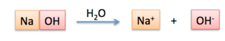
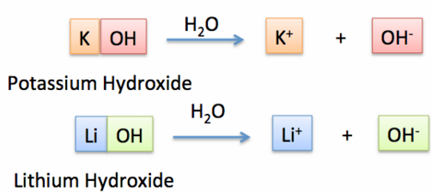
Arrhenius Bases
Ionic compounds that dissociate into (OH)⁻ ions in an aqueous solution.
Notes:
22

Slide 23
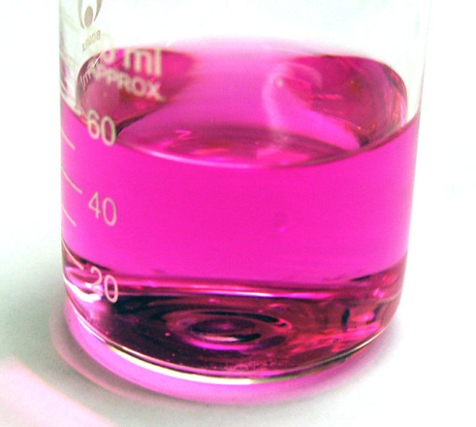
Chemical and Physical Properties of Bases
  Taste bitter
  Are slippery
  Turn red litmus paper blue
  Turn colorless phenolphthalein pink
  Neutralize acids
  --------------------------------------------------
  May react with some metal salts
  May react with carbon dioxide
Notes:
Although each base has some unique properties, all bases have some things in common. [animate bullets as each is mentioned]
All bases taste bitter. [teacher note and emphasize that students should NEVER taste laboratory chemicals, but point out that many bitter foods, such as some vegetables, taste bitter because they contain bases]
Certain substances called indicators react to acids and bases by changing color. Red litmus, for example, turns blue in basic solution.
Similarly, the indicator phenolphthalein turns pink when it is in basic solution [teacher point to image showing color of phenolphthalein solution in basic solution]
As we have learned, acids and bases neutralize each other.
Some bases can react with certain metal salts to form insoluble compounds.
Similarly, some bases can react with carbon dioxide to form insoluble compounds.
Source:
http://commons.wikimedia.org/wiki/File:Phenolphthalein-at-pH-9.jpg

Slide 24
Arrhenius Acids and Bases SUMMARY
Arrhenius’ theory defines acids, bases, and salts based on the dissociation of water: H⁺(OH)⁻. He used observable properties:
acids taste sour; bases taste bitter
acids/bases conduct electricity (electrolytes)
strong acids & bases are corrosive
litmus turns red in an acid and blue in a base
indicators change color based on pH
Arrhenius also used the ion-product of water concentrations to define acids [H⁺], bases [OH⁻] and salts [H⁺OH⁻].
Notes:
24

Slide 25
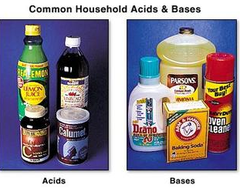
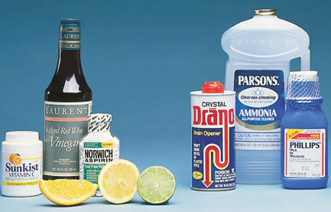
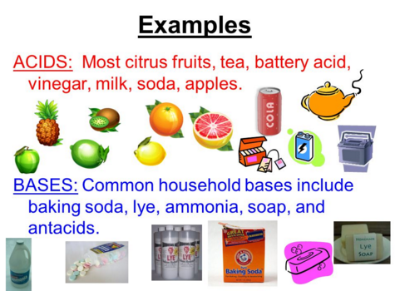
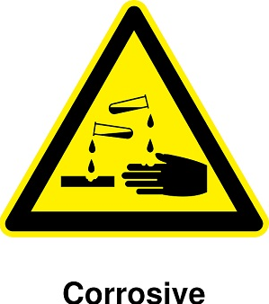
Notes:
25

Slide 26

Muppets Take Chemistry!
Rainbow Connection
http://somup.com/cFX603niZO (4:04)

Slide 27
Using the Ion-Product Constant for Water
If the [H⁺] in a solution is 1.0 × 10⁻⁵M, is the solution acidic, basic, or neutral? What is the [(OH)⁻] of this solution?
Notes:
27

Slide 28
Using the Ion-Product Constant for Water
If the [H⁺] in a solution is 1.0 × 10⁻⁵M, is the solution acidic, basic, or neutral? What is the [OH⁻] of this solution?
k_{w} = [H⁺][OH⁻] = 10⁻¹⁴
[H⁺] is 1.0 × 10⁻⁵M, which is greater than 1.0 × 10⁻⁷M. Thus, the solution is acidic.
When dividing exponents, subtract superscripts
[OH⁻] is 1.0 × 10⁻⁹M
K_{w}
1.0 × 10⁻¹⁴M
[OH⁻] =
[OH⁻] =
[H⁺]
[1.0 × 10⁻⁵M]
Notes:
28

Slide 29
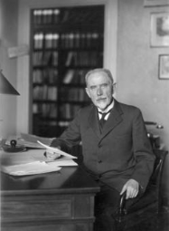
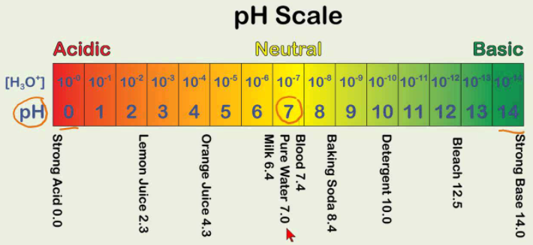
pH
Expressing hydrogen-ion concentration in molarity (Moles/liter) is often not practical or easy.
So, rather than focus on [H⁺], Sorenson suggested that concentration values be expressed as a power of 10 that arises when hydrogen ion concentrations ([H⁺]) are put in scientific notation.
Notes:
29

Slide 30
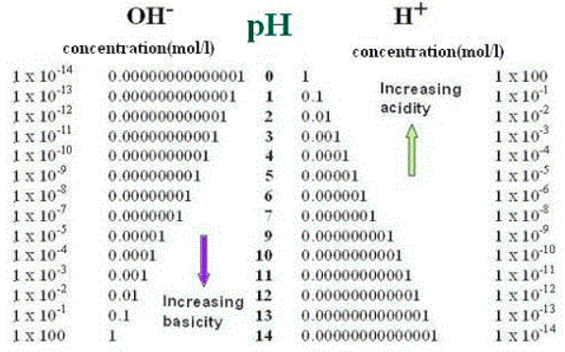
pH
pH measures [H⁺] on a logarithmic scale.
The pH scale works in powers of ten, so each jump in number is a multiple of 10 in concentration.
For example, a pH of 1 is 10 times more acidic than a pH of 2.
Notes:
30

Slide 31
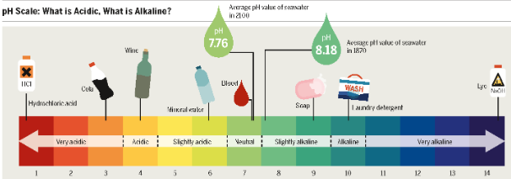
pH
pH measures [H⁺] on a logarithmic scale.
Corresponds to the variation of [H⁺] related to k_{w.}
[H⁺] ranges from 10⁻¹ to 10⁻¹⁴ M
Avoids the use of small fractions and negative exponents
Indicates “acid strength” in a solution
pH = -log₁₀[H⁺] or pH = -log₁₀[H₃O⁺]
Notes:
31

Slide 32
pH: “potential of Hydrogen”
Logarithmic scale.
When taking log to the base “10”, we remove the exponent:
log₁₀10⁻¹ = log₁₀10⁻¹ = -1
log₁₀10⁻¹⁴ = log₁₀10⁻¹⁴ = -14
log₁₀10⁷ = log₁₀10⁷ = 7
Common uses include earthquake strength (Richter scale), amplification of sound (decibel scale), light intensity (candela scale), and pH or pOH of solutions.
Notes:
32

Slide 33
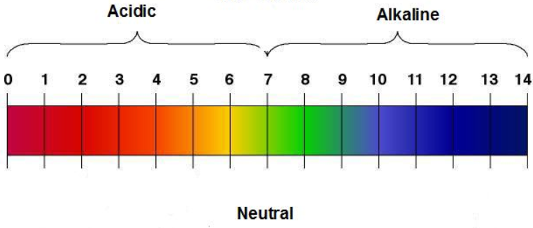
The pH Scale
Neutral
  Describe each solution (acidic, neutral, basic)
  pH ?
  [H⁺] & [(OH)⁻] ?
Notes:
Timing ≈ 0.5 min
Scientists use the pH scale to compare the acidity or alkalinity of substances.
[animate 1st bullet] Acidity is the degree to which a substance is acidic. The lower the pH of a substance, the more acidic it is--the greater is its acidity.
[animate 2nd bullet] Alkalinity is the degree to which a substance is basic, or alkaline. The higher the pH, the more basic the substance.
[teacher use diagram to give 2-3 examples of comparing acidity of substances--e.g., is vinegar more or less acidic than egg yolks]
SOURCE:
http://commons.wikimedia.org/wiki/File:PH_scale.png

Slide 34
The pH Scale
Neutral
10⁻³ M
10⁻⁷ M
  acidity:
  pH below 7
    [H⁺] > 1 × 10⁻⁷M [OH⁻] < 1 × 10⁻⁷M
    Lower pH indicates greater acidity
Notes:
Timing ≈ 0.5 min
Scientists use the pH scale to compare the acidity or alkalinity of substances.
[animate 1st bullet] Acidity is the degree to which a substance is acidic. The lower the pH of a substance, the more acidic it is--the greater is its acidity.
[animate 2nd bullet] Alkalinity is the degree to which a substance is basic, or alkaline. The higher the pH, the more basic the substance.
[teacher use diagram to give 2-3 examples of comparing acidity of substances--e.g., is vinegar more or less acidic than egg yolks]
SOURCE:
http://commons.wikimedia.org/wiki/File:PH_scale.png

Slide 35
The pH Scale
Neutral
10⁻⁷ M
10⁻¹¹ M
  alkalinity:
  pH above 7
    [OH⁻] > 1 × 10⁻⁷M [H⁺] < 1 × 10⁻⁷M
    Higher pH indicates greater alkalinity
Notes:
Timing ≈ 0.5 min
Scientists use the pH scale to compare the acidity or alkalinity of substances.
[animate 1st bullet] Acidity is the degree to which a substance is acidic. The lower the pH of a substance, the more acidic it is--the greater is its acidity.
[animate 2nd bullet] Alkalinity is the degree to which a substance is basic, or alkaline. The higher the pH, the more basic the substance.
[teacher use diagram to give 2-3 examples of comparing acidity of substances--e.g., is vinegar more or less acidic than egg yolks]
SOURCE:
http://commons.wikimedia.org/wiki/File:PH_scale.png

Slide 36
The pH Scale
Neutral
10⁻⁷ M
  Neutral:
  pH at 7
    [H⁺] = 10⁻⁷M [OH⁻] = 10⁻⁷M
    [H⁺] = [OH⁻]
Notes:
Timing ≈ 0.5 min
Scientists use the pH scale to compare the acidity or alkalinity of substances.
[animate 1st bullet] Acidity is the degree to which a substance is acidic. The lower the pH of a substance, the more acidic it is--the greater is its acidity.
[animate 2nd bullet] Alkalinity is the degree to which a substance is basic, or alkaline. The higher the pH, the more basic the substance.
[teacher use diagram to give 2-3 examples of comparing acidity of substances--e.g., is vinegar more or less acidic than egg yolks]
SOURCE:
http://commons.wikimedia.org/wiki/File:PH_scale.png

Slide 37
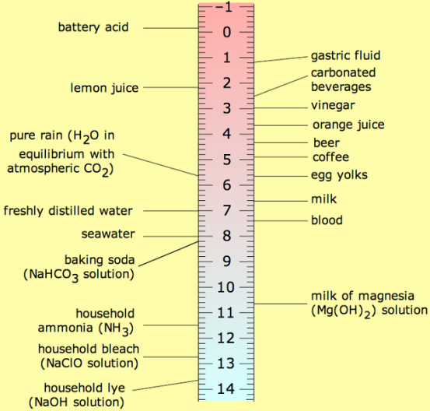
The pH Scale
  acidity: pH below 7
    [H⁺] > 1 × 10⁻⁷M
    Lower pH indicates greater acidity
  alkalinity: pH above 7
    [OH⁻] > 1 × 10⁻⁷M
    Higher pH indicates greater alkalinity
  Neutral: pH at 7
    [H⁺] = 10⁻⁷M [OH⁻] = 10⁻⁷M
    [H⁺] = [OH⁻]
Notes:
Timing ≈ 0.5 min
Scientists use the pH scale to compare the acidity or alkalinity of substances.
[animate 1st bullet] Acidity is the degree to which a substance is acidic. The lower the pH of a substance, the more acidic it is--the greater is its acidity.
[animate 2nd bullet] Alkalinity is the degree to which a substance is basic, or alkaline. The higher the pH, the more basic the substance.
[teacher use diagram to give 2-3 examples of comparing acidity of substances--e.g., is vinegar more or less acidic than egg yolks]
SOURCE:
http://commons.wikimedia.org/wiki/File:PH_scale.png

Slide 38
pOH … the “potential” of (OH)⁻ in solution
  pOH is a measure of the hydroxide ion concentration ([OH–]) in an aqueous solution
  pOH = –log₁₀[OH–]
  pH and pOH are inversely related
    As pH increases, pOH decreases
    Acids have low pH, high pOH
    Bases have high pH, low pOH
Notes:
Timing ≈ 1 min
If the concentrations of H+ and OH- are related, then it makes sense that there should be a value similar to pH that relates to the concentration of OH- ions instead of the concentration of H+ ions.
[animate 1st bullet] For pH of an aqueous solution, we look at the concentration of hydronium ions. But dissociation produces hydroxide ions as well. So we can also look at the pOH of a solution.
[animate 2nd bullet] As the diagram shows, pH and pOH are inversely related. [teacher use diagram to illustrate three sub-bullet points. Label diagram with some common substances and point out their pH and pOH values]
SOURCE:
http://commons.wikimedia.org/wiki/File:PHscalenolang.svg

Slide 39
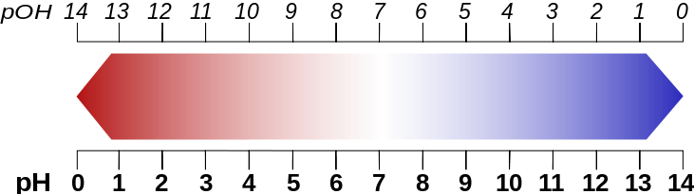
pH and pOH
  What is the relationship of pH to pOH by number?
Notes:
Timing ≈ 1 min
If the concentrations of H+ and OH- are related, then it makes sense that there should be a value similar to pH that relates to the concentration of OH- ions instead of the concentration of H+ ions.
[animate 1st bullet] For pH of an aqueous solution, we look at the concentration of hydronium ions. But dissociation produces hydroxide ions as well. So we can also look at the pOH of a solution.
[animate 2nd bullet] As the diagram shows, pH and pOH are inversely related. [teacher use diagram to illustrate three sub-bullet points. Label diagram with some common substances and point out their pH and pOH values]
SOURCE:
http://commons.wikimedia.org/wiki/File:PHscalenolang.svg

Slide 40
pH and pOH
  What is the relationship of pH to pOH by number?
  pH + pOH = 14
  pH = 5 = -log (10⁻⁵) … pOH = 9 = -log (10⁻⁹)
  pH = 5 = -log (10⁻⁵) … pOH = 9 = -log (10⁻⁹)
  5 + 9 = 14
Notes:
Timing ≈ 1 min
If the concentrations of H+ and OH- are related, then it makes sense that there should be a value similar to pH that relates to the concentration of OH- ions instead of the concentration of H+ ions.
[animate 1st bullet] For pH of an aqueous solution, we look at the concentration of hydronium ions. But dissociation produces hydroxide ions as well. So we can also look at the pOH of a solution.
[animate 2nd bullet] As the diagram shows, pH and pOH are inversely related. [teacher use diagram to illustrate three sub-bullet points. Label diagram with some common substances and point out their pH and pOH values]
SOURCE:
http://commons.wikimedia.org/wiki/File:PHscalenolang.svg

Slide 41
pH and pOH
  K_{w} = [H⁺][OH⁻] = 1.0 × 10⁻¹⁴
  pH + pOH = 14
Notes:
Timing ≈ 1 min
If the concentrations of H+ and OH- are related, then it makes sense that there should be a value similar to pH that relates to the concentration of OH- ions instead of the concentration of H+ ions.
[animate 1st bullet] For pH of an aqueous solution, we look at the concentration of hydronium ions. But dissociation produces hydroxide ions as well. So we can also look at the pOH of a solution.
[animate 2nd bullet] As the diagram shows, pH and pOH are inversely related. [teacher use diagram to illustrate three sub-bullet points. Label diagram with some common substances and point out their pH and pOH values]
SOURCE:
http://commons.wikimedia.org/wiki/File:PHscalenolang.svg

Slide 42

pH and pOH based on Molar Concentrations
[H⁺ ] | 10⁰ |  |  |  |  |  | 10⁻¹⁰
[OH⁻] |  | 10⁻¹² |  |  |  | 10⁻⁶ |  | 10⁻²
pH |  |  | 4 |  | 7 |  |  |  | 14
pOH |  |  |  | 8
  Complete the table above, filling in the missing items.
  In the boxes below the chart, indicate acidic, neutral, and basic solutions.
Notes:
Timing ≈ 1 min
If the concentrations of H+ and OH- are related, then it makes sense that there should be a value similar to pH that relates to the concentration of OH- ions instead of the concentration of H+ ions.
[animate 1st bullet] For pH of an aqueous solution, we look at the concentration of hydronium ions. But dissociation produces hydroxide ions as well. So we can also look at the pOH of a solution.
[animate 2nd bullet] As the diagram shows, pH and pOH are inversely related. [teacher use diagram to illustrate three sub-bullet points. Label diagram with some common substances and point out their pH and pOH values]
SOURCE:
http://commons.wikimedia.org/wiki/File:PHscalenolang.svg

Slide 43
pH and pOH based on Molar Concentrations
[H⁺ ] | 10⁰ | 10⁻² | 10⁻⁴ | 10⁻⁶ | 10⁻⁷ | 10⁻⁸ | 10⁻¹⁰ | 10⁻¹² | 10⁻¹⁴
[OH⁻] | 10⁻¹⁴ | 10⁻¹² | 10⁻¹⁰ | 10⁻⁸ | 10⁻⁷ | 10⁻⁶ | 10⁻⁴ | 10⁻² | 10⁻⁰
pH | 0 | 2 | 4 | 6 | 7 | 8 | 10 | 12 | 14
pOH | 14 | 12 | 10 | 8 | 7 | 6 | 4 | 2 | 0
acidic
neutral
basic
Molar concentrations are described by:
k_{w} = [H⁺][OH⁻] = 10⁻¹⁴
pH + pOH = 14
Notes:
Timing ≈ 1 min
If the concentrations of H+ and OH- are related, then it makes sense that there should be a value similar to pH that relates to the concentration of OH- ions instead of the concentration of H+ ions.
[animate 1st bullet] For pH of an aqueous solution, we look at the concentration of hydronium ions. But dissociation produces hydroxide ions as well. So we can also look at the pOH of a solution.
[animate 2nd bullet] As the diagram shows, pH and pOH are inversely related. [teacher use diagram to illustrate three sub-bullet points. Label diagram with some common substances and point out their pH and pOH values]
SOURCE:
http://commons.wikimedia.org/wiki/File:PHscalenolang.svg

Slide 44
pH = -log₁₀[H₃O⁺]
Strategies when using Logarithms (log)
Log to the base 10 of a power of 10 equals the superscript
Log₁₀10⁻⁸ = -8 Log₁₀10⁶ = 6
Place molar concentrations in Scientific Notation:
Example 1:
Log (1 x 10⁻⁶) = log₁₀1* + log₁₀10⁻⁶ = 0 + (-6) = -6
Example 2:
Log (3.7 x 10⁻⁹) = log₁₀3.7* + log₁₀10⁻⁹ = 0.57 + (-9) = -8.4
*Type in the number and hit the “log” button on calculator or
Hit “log” and type in the number (depending on calculator)
Notes:
44

Slide 45
pH = -log₁₀[H₃O⁺]
Calculate the pH of pure water or a neutral solution.
  Calculate the pH of a 0.0010M solution. Is this acidic, basic?
Notes:
45

Slide 46
pH = -log₁₀[H₃O⁺]
Calculate the pH of pure water or a neutral solution.
[H⁺] = 1 x 10⁻⁷ M
pH = −log₁₀[H⁺]
pH = −log₁₀(1 × 10⁻⁷)
= −log₁₀1 + (−log₁₀10⁻⁷)
pH = 0.0 + 7.0 = 7.0
  Calculate the pH of a 0.0010M solution. Is this acidic, basic?
[H⁺] = 1 x 10⁻³ M pH = −log₁₀[H⁺]
pH = −log₁₀(1 × 10⁻³)
= −log₁₀1 + (−log₁₀10⁻³)
pH = 0.0 + 3.0 = 3.0
This is an acidic solution (pH is below 7).
Notes:
46

Slide 47
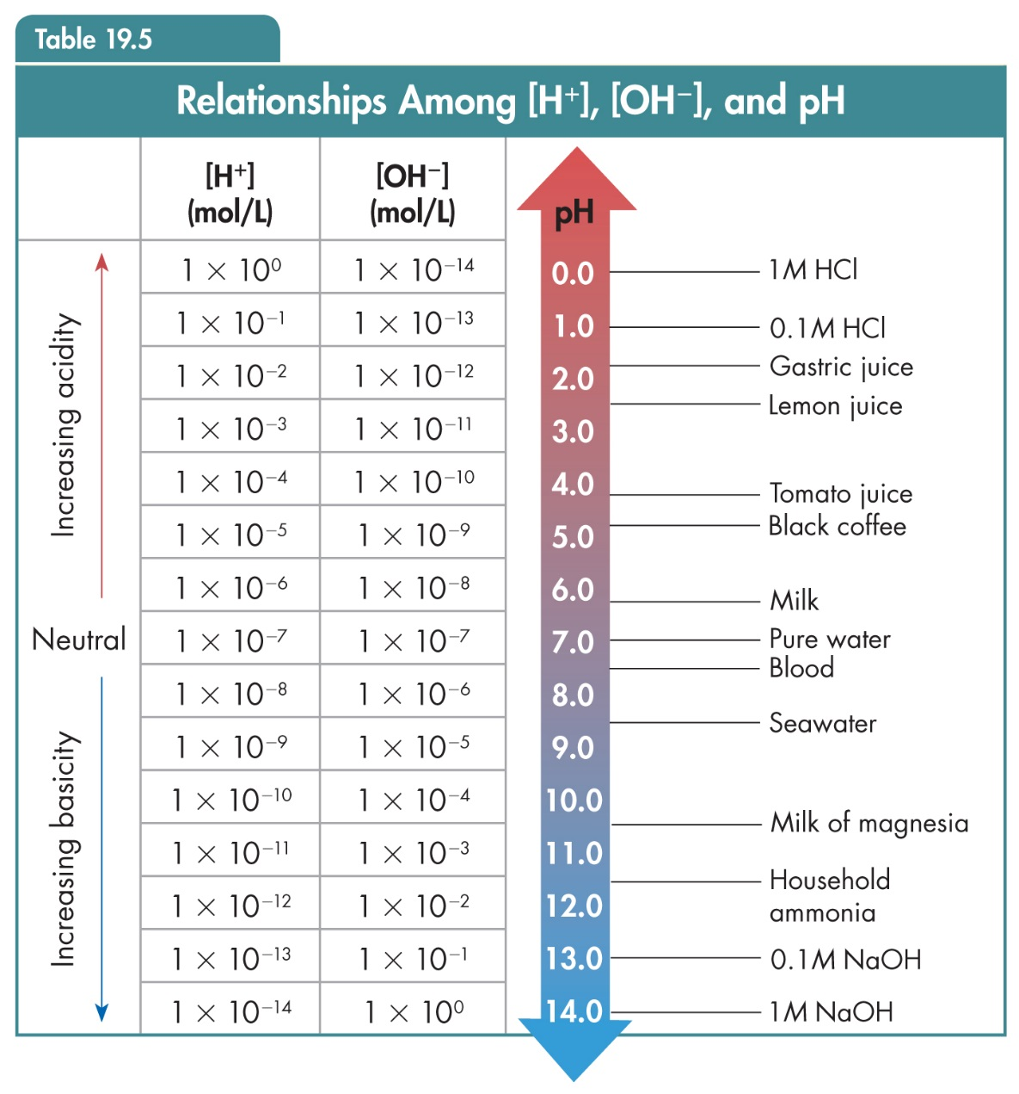
Hydrogen Ions and pH
When [H⁺] = 1 × 10^{–n},
pH = |n|
[OH⁻][H⁺] = 10⁻¹⁴
Notes:
47

Slide 48
  What is the pH of a solution if [OH⁻] = 4.0 × 10⁻¹¹M?
Notes:
48

Slide 49
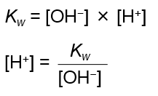
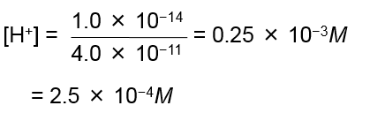
  What is the pH of a solution if [OH⁻] = 4.0 × 10⁻¹¹M?
  Find [H⁺], divide K_{w} by the known [OH⁻].
Find pH.
Substitute the value for [H⁺].
pH = −log₁₀[H⁺]
= −log₁₀(2.5 × 10⁻⁴)
= −log₁₀2.5* + (−log₁₀10⁻⁴ ) = -0.40 + 4.0
pH = 3.6
*Type in the number and hit the “log” button on calculator or
Hit “log” and type in the number (depending on calculator)
Notes:
49

Slide 50
  What is the pH of a solution if [OH⁻] = 4.0 × 10⁻¹¹M?
  Find pOH.
Substitute the value for [H⁺].
pOH = −log₁₀[OH⁻]
= −log₁₀(4.0 × 10⁻¹¹)
= −log₁₀4.0* + (−log₁₀10⁻¹¹ ) = -0.60 + 11.0
pOH = 10.4
pH + pOH = 14 … pH = 14 - pOH
pH = 3.6
*Type in the number and hit the “log” button on calculator or
Hit “log” and type in the number (depending on calculator)
Notes:
50

Slide 51
Calculating ion concentration from pH
Honors
  The pH of an unknown solution is 9.56. What is the hydrogen-ion concentration of the solution? Is this acidic or basic?
  pH = −log₁₀[H⁺]
  Rearrange to −log₁₀[H⁺] = pH
  Divide both sides by − : log₁₀[H⁺] = −pH
  [H⁺] = antilog₁₀(−9.56)*
* On some calculators: type in the number, hit the “+/-” key, then hit the “shift” and then the “10^{x}” keys on the calculator.
  [H⁺] = 2.75 x 10⁻¹⁰ M … basic solution
This will NOT be assessed on the tests (except for bonus).
Notes:
51

Slide 52
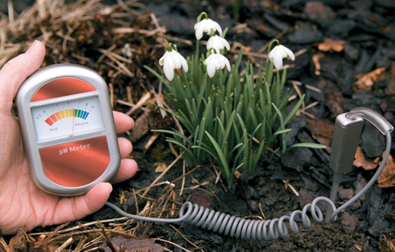
Measuring pH
pH Meters
A pH meter can be easier to use than liquid indicators or indicator strips.
The pH reading is visible in a display window on the meter.
The color and cloudiness of the solution do not affect the accuracy of the pH value
obtained.
Notes:
52

Slide 53
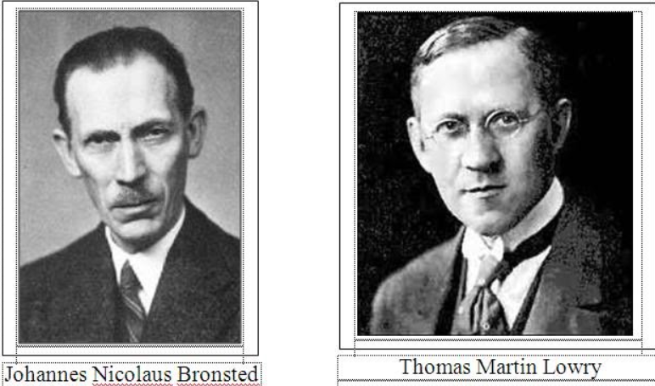
Brønsted-Lowry Acids and Bases
Brønsted is from Denmark; Lowry from England, 1923
A more general (and inclusive) definition of acids and bases
Extends the Arrhenius theory
Includes other solvents beside water
Notes:
53

Slide 54
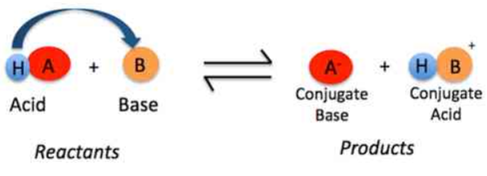
Brønsted-Lowry Acids and Bases
  An acid-base reaction in which there is a proton (H+) transfer from one species to another.
Notes:
54

Slide 55
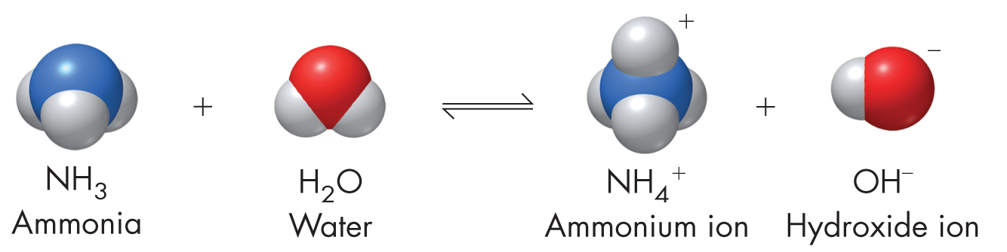
Brønsted-Lowry Acids and Bases
The species which donates the proton is a B-L acid.
The species which accepts the proton is a B-L base.
Notes:
55

Slide 56
Brønsted-Lowry Acids and Bases
  For the forward reaction:
Water donates the H+ … B-L acid
Ammonia accepts H+ … B-L base
Notes:
56

Slide 57
Brønsted-Lowry Acids and Bases
  For the forward reaction:
water donates the H+ … B-L acid
Ammonia accepts H+ … B-L base
Bronsted-Lowry proposed that the reverse reaction of an acid/base reaction is also an acid/base reaction.
  For the reverse reaction:
  Ammonium donates the H+ … B-L acid
  Hydroxide accepts H+ … B-L base
Notes:
57

Slide 58
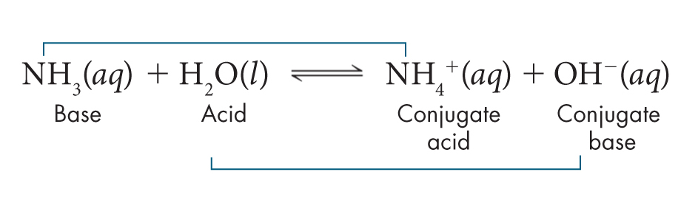
Brønsted-Lowry Conjugate Acid-Base Pairs
According to the Brønsted-Lowry concept, in every reaction, an acid reacts with a base to form another acid and another base which are conjugates of the original acid and base.
Conjugate means that the acid-base pairs have the same derivation and are distinguished by the presence or absence of a proton (H⁺).
  What are the conjugate pairs?
Notes:
58

Slide 59
Brønsted-Lowry Conjugate Acid-Base Pairs
According to the Brønsted-Lowry concept, in every reaction, an acid reacts with a base to form another acid and another base which are conjugates of the original acid and base.
Conjugate means that the acid-base pairs have the same derivation and are distinguished by the presence or absence of a proton (H⁺).
  NH₄⁺ is the conjugate acid of the base NH₃.
  OH– is the conjugate base of the acid H₂O.
Notes:
59

Slide 60
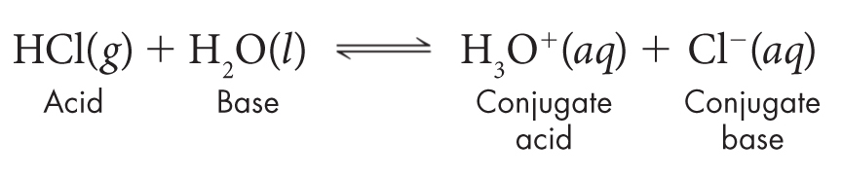
Brønsted-Lowry Conjugate Acid-Base Pairs
Determine & explain the B-L acids and bases in this reaction. Identify the conjugate pairs.
Notes:
60

Slide 61
Brønsted-Lowry Conjugate Acid-Base Pairs
Determine & explain the B-L acids and bases in this reaction. Identify the conjugate pairs.
Hydrogen chloride is the hydrogen-ion donor (B-L acid)
Water is the hydrogen-ion acceptor (B-L base)
  H₃O⁺ is the conjugate acid of the base H₂O.
  Cl– is the conjugate base of the acid HCl.
  NOTE THAT WATER IS A BASE HERE, BUT IT
  WAS AN ACID IN THE PREVIOUS REACTION. ???
Notes:
61

Slide 62
Amphoteric Substances
A substance that can act as either an acid or a base is said to be amphoteric.
Water is amphoteric. In the reaction with hydrochloric acid, water accepts a proton and is therefore a base.
In the reaction with ammonia, water donates a proton and is therefore an acid.
Notes:
62

Slide 63
Amphoteric Substances
HCO₃⁻ _{(aq)} + OH⁻ _{(aq)} → H₂O _{(aq)} + CO₃⁻² _{(aq)}
ACID base acid base
HF _{(aq)} + HCO₃⁻ _{(aq)} → H₂CO₃ _{(aq)} + F⁻ _{(aq)}
acid BASE acid base
Notice that bicarbonate can act as an acid (donate an H+) or a base (accept the H+).
The bicarbonate – carbonic acid relationship acts as a buffer in our bloodstream, maintaining pH and CO₂ levels of the blood .
Notes:
63

Slide 64
Amphoteric Substances
Common amphoteric substances include:
H₂O, HSO₄⁻, H₂PO₄⁻, HS⁻ [Reference Table L]
H₃O⁺ … H₂O … OH⁻
H₂SO₄ … HSO₄⁻ … SO₄⁻²
H₃PO₄ … H₂PO₄⁻ … HPO₄⁻²
H₂S … HS⁻ … S⁻²
Notes:
64

Slide 65
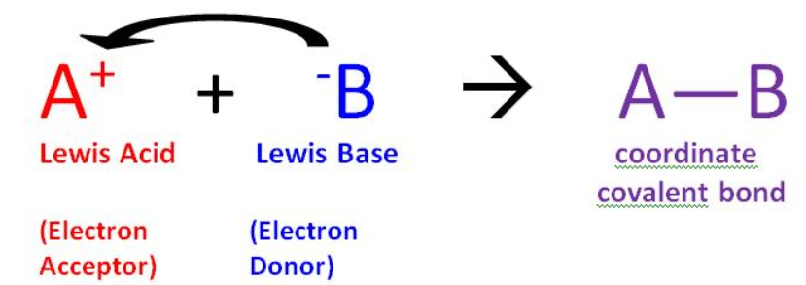
Lewis Acids and Bases
Honors
The Arrhenius theory is the most restricted “acid-base” explanation since an acid must possess an H⁺ ion and a base must possess an OH⁻ ion.
The Bronsted-Lowry concept extended the acid-base understanding, but can only be applied to reactions involving a proton transfer [an ionizable Hydrogen atom]
Notes:
65

Slide 66
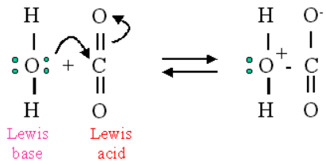
Lewis Acids and Bases
Honors
A Lewis acid is a substance that can accept a pair of electrons to form a covalent bond.
A Lewis base is a substance that can donate a pair of electrons to form a covalent bond.
Note that acids now “accept” rather than “donate” since electrons are opposite protons (H+).
Notes:
66

Slide 67
Lewis Acids and Bases
Honors
This table compares the definitions of acids and bases.
Acid-Base Definitions
Type | Acid | Base
Arrhenius | H⁺ producer | OH– producer
Brønsted-Lowry | H⁺ donor | H⁺ acceptor
Lewis | electron-pair acceptor | electron-pair donor
The Lewis definition is the broadest, least restrictive.
It extends to compounds that the Brønsted-Lowry theory does not classify as acids and bases.
Notes:
67

Slide 68

Lewis Acids and Bases
Honors
Coordinate Covalent Bonds
Any reaction that leads to the formation of a coordinate covalent bond (both e- in the bond are furnished by the same species) is an acid-base reaction.
Lewis Bases
a. All Brønsted-Lowry bases are included, plus a few more.
b. All the bases must possess an unshared pair of electrons which can be donated to an acid.
Notes:
68

Slide 69
Lewis Acids and Bases
Honors
Coordinate Covalent Bonds
Nitrogen donates both electrons … NH₄⁺
Oxygen donates both electrons … H₃O⁺
Fluorine donates both electrons … HF
NH₄⁺
H₃O⁺
H⁺
HF
H⁺
H⁺
Notes:
69

Slide 70
Lewis Acids and Bases
Honors
Identify the Lewis acid and the Lewis base in this reaction between ammonia and boron tri-fluoride.
NH₃ + BF₃ → NH₃BF₃
Notes:
70

Slide 71
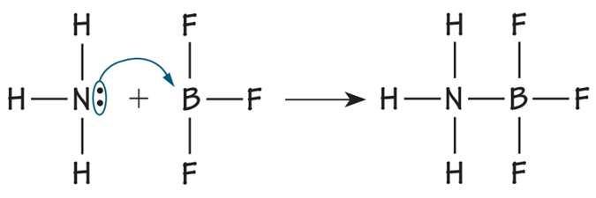
Lewis Acids and Bases
Honors
Identify the Lewis acid and the Lewis base in this reaction between ammonia and boron tri-fluoride.
NH₃ + BF₃ → NH₃BF₃
When a Lewis acid reacts with a Lewis base, the base donates a pair of electrons and the acid accepts the donated pair.
Ammonia has an unshared pair of electrons to donate (base).
The boron atom can accept the donated electrons (acid).
Notes:
71

Slide 72
Summary: Acid – Base Theories
  Arrhenius
  Acid → H⁺ ions
  Base → (OH)⁻ ions
  Bronsted-Lowry
  Acid → donates H⁺ ions
  Base → accepts H⁺ ions
  Lewis
  Acid → accepts electrons
  Base → donates electrons
pH scale
Conjugate acid-base pairs
Most inclusive definition
Notes:
Timing ≈ 0.5 min
Acids increase the concentration of hydrogen ions whereas bases decrease it.
Acids and bases have characteristic properties.

Slide 73
REVIEW:
Properties of Acids and Bases
  An Arrhenius acid is a substance that increases the concentration of H⁺ ions in an aqueous solution.
  An Arrhenius base is a substance than decreases the concentration of H⁺ ions in an aqueous solution.
  Acids have a sour taste, turn blue litmus red, and react with metals, carbonates, and bases.
  Bases have a bitter taste, feel slippery, turn red litmus blue, and react with metal salts, carbon dioxide, and acids.
  A Brønsted-Lowry Acid donates H⁺ while a Base accepts H⁺
  pH = −log₁₀[H⁺] … When [H⁺] = 1 × 10^{–n}, pH = |n|
pH + pOH = 14
Notes:
Timing ≈ 0.5 min
Acids increase the concentration of hydrogen ions whereas bases decrease it.
Acids and bases have characteristic properties.

Slide 74
Calculate pH, pOH, [H⁺], and [OH–]
What is the pH of a solution of H₂SO₄ that has [H₃O⁺] = 5.45 × 10^{–5} M?
Typical household bleach has a pH of 13. What is the H₃O⁺ concentration in household bleach?
What is the pH and pOH of HNO₃ (aq) that has [OH–] = 9.50 × 10^{–9} M?
Notes:
Timing ≈ 1 min
Entry audio: Now that you have seen how to use the pH and pOH equations, try some calculations on your own.
Hint1 audio: Remember to multiply the logarithm by –1.
Hint2 audio: Remember that pOH is calculated from [OH–] in the same way that pH is calculated from [H⁺].
Hint3 audio: Make sure to use the correct number of significant figures in your answer.
Hint4 audio: Don’t forget that pH is negative in the equation relating [H₃O⁺] and pH.
Hint5 audio: pOH and [OH–] are related in the same way as pH and [H⁺].
Hint6 audio: Remember to check your work. If the pH is acidic, then the concentration of H⁺ ions should be greater than 10^{–7} M.
Exit audio: Next, you learn about the mathematical relationship between pH and pOH.

Slide 75
Calculate pH, pOH, [H⁺], and [OH–]
What is the pH of a solution of H₂SO₄ that has [H₃O⁺] = 5.45 × 10^{–5} M?
pH = −log₁₀[H⁺]
pH = −log₁₀(5.45 × 10⁻⁵)
pH = −log₁₀(5.45) + (−log₁₀10⁻⁵)
pH = -0.74 + 5.00 = 4.26
Typical household bleach has a pH of 13. What is the H₃O⁺ concentration in household bleach?
When [H⁺] = 1 × 10^{–n} … pH = |n|
[H⁺] = 1.0 × 10⁻¹³ M
What is the pH and pOH of HNO₃ (aq) that has [OH–] = 9.50 × 10^{–9} M?
Kw = [OH-][H+] → [H+] = Kw/[OH-]
[H+] = 1 x 10^{–14} M / 9.50 × 10^{–9} M
pH = −log₁₀[H⁺]
pH = −log₁₀(1.05 × 10⁻⁶)
pH = −log₁₀(1.05) + (−log₁₀10⁻⁶)
pH = -0.021 + 6.00 = 5.98
pOH + pH = 14.00 … pOH = 14.00 – 5.98
pOH = 8.02 alternative method:
pOH = −log₁₀[OH⁻] = −log₁₀[9.50 × 10^{–9} ]
pOH = −log₁₀(9.50) + (−log₁₀10^{–9})
pOH = -0.98 + 8 = 8.02
Notes:
Timing ≈ 1 min
Entry audio: Now that you have seen how to use the pH and pOH equations, try some calculations on your own.
Hint1 audio: Remember to multiply the logarithm by –1.
Hint2 audio: Remember that pOH is calculated from [OH–] in the same way that pH is calculated from [H⁺].
Hint3 audio: Make sure to use the correct number of significant figures in your answer.
Hint4 audio: Don’t forget that pH is negative in the equation relating [H₃O⁺] and pH.
Hint5 audio: pOH and [OH–] are related in the same way as pH and [H⁺].
Hint6 audio: Remember to check your work. If the pH is acidic, then the concentration of H⁺ ions should be greater than 10^{–7} M.
Exit audio: Next, you learn about the mathematical relationship between pH and pOH.

Slide 76
Practice pH, pOH, [H+], [OH-]
What is the pH of a solution of KOH that has [H⁺] = 1.75 × 10^{–3} M?
What is [OH–] for the solution?
What is the pOH of the solution?
What is the H⁺ concentration in a solution with a pH of 5.00?
Calculate the pH of a solution with a pOH of 3.45.
Calculate the pOH of a solution with a pH of 5.3.
Notes:
Timing ≈ 1 min
Entry audio: You can convert between hydrogen ion concentration and hydronium ion concentration.
Hint1 audio: Make sure to use the correct number of significant figures.
Hint2 audio: You are looking for the equation that solves for [OH–].
Hint3 audio: Be careful of negative exponents when you do your calculation.
Hint4 audio: If the pH is less than 7, would pOH need to be greater than, less than, or equal to 7 to get their sum to be 14?
Hint5 audio: Remember to multiply by –1.
Exit audio: To convert between pH and pOH directly, you do not need to use molarity.

Slide 77
Practice pH, pOH, [H+], [OH-]
What is the pH of a solution of KOH that has [H⁺] = 1.75 × 10^{–3} M?
pH = −log₁₀[H⁺]
pH = −log₁₀(1.75 × 10^{–3})
pH = −log₁₀(1.75) + (−log₁₀10⁻³)
pH = -0.24 + 3.00 = 2.76
What is [OH–] for the solution?
Kw = [OH-][H+] → [OH-] = Kw/[H+]
[OH-] = 1 x 10^{–14} M / 1.75 × 10^{–3} M
[OH-] = 5.71 × 10⁻¹² M
What is the pOH of the solution?
pOH + pH = 14.0 … pOH = 14.0 – 2.76
pOH = 11.2
What is the H⁺ concentration in a solution with a pH of 5.00?
When [H⁺] = 1 × 10^{–n} … pH = |n|
[H⁺] = 1.0 × 10⁻⁵ M
Calculate the pH of a solution with a pOH of 3.45.
pOH + pH = 14.0 … pH = 14.0 – 3.45
pH = 10.55
Calculate the pOH of a solution with a pH of 5.3.
pOH + pH = 14.0 … pOH = 14.0 – 5.3
pOH = 8.7
Notes:
Timing ≈ 1 min
Entry audio: You can convert between hydrogen ion concentration and hydronium ion concentration.
Hint1 audio: Make sure to use the correct number of significant figures.
Hint2 audio: You are looking for the equation that solves for [OH–].
Hint3 audio: Be careful of negative exponents when you do your calculation.
Hint4 audio: If the pH is less than 7, would pOH need to be greater than, less than, or equal to 7 to get their sum to be 14?
Hint5 audio: Remember to multiply by –1.
Exit audio: To convert between pH and pOH directly, you do not need to use molarity.

