Slide 1
Click on “Slide Show”
Click “Play from Beginning”

Slide 2
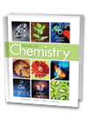
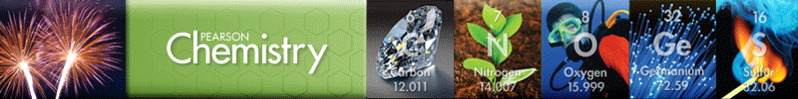
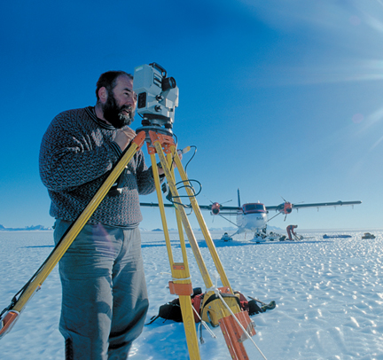
Chapter 3
Scientific Measurement
Using & Expressing Measurements
Units of Measurement
Solving Conversion Problems

Slide 3
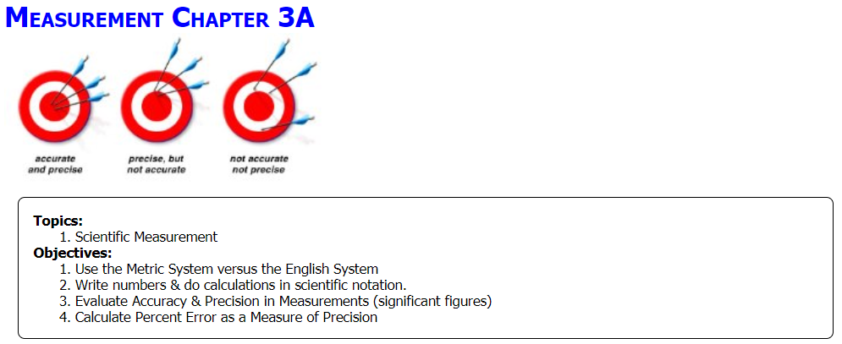

Slide 4
Measurement Intro
Click on the link for an overview of the chapter: (2:55)
https://screencast-o-matic.com/watch/cFQbqeqM8v

Slide 5
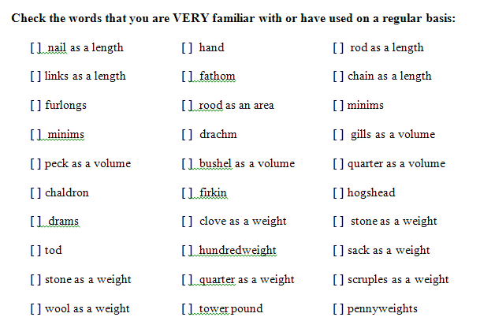
Count

Slide 6
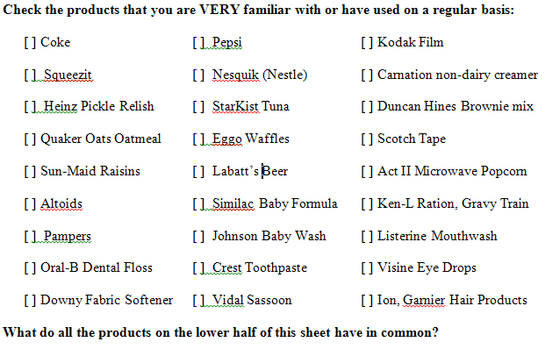
Count

Slide 7
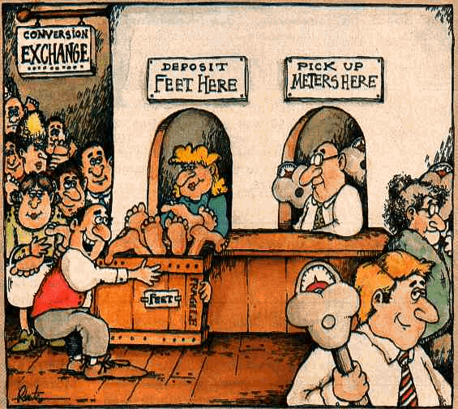
The Metric System
Click on:
http://prezi.com/zc-alvezwvy9/metric-versus-english-measurement/

Slide 8
The Metric System
Metric System Versus the English System
Simplicity
    The metric system uses ONE unit for each category of measurement
        Gram (mass), liter (volume), meter (distance)
    The English system utilizes many different names for each major measurement (units of mass, volume, distance)
        DISTANCE: Rod, furlong, hand, foot, yard, mile, nautical mile
        VOLUME: Pinch, gill, teaspoon, tablespoon, ounce, cup, pint, quart, gallon, peck, bushel
        MASS/WEIGHT: Penny, grain, ounce, pound, short ton, standard ton
https://screencast-o-matic.com/watch/cF6hIaYo00 (2:44) Meters, Liters & Grams Song

Slide 9
The Metric System
Metric System Versus the English System
Consistency
    All metric units are multiples of 10 or utilize decimal placement.
    The English system has no consistency between units.
        DISTANCE: Rod, furlong, hand, foot, yard, mile, nautical mile
        VOLUME: Pinch, gill, teaspoon, tablespoon, ounce, cup, pint, quart,
        gallon, peck, bushel
        MASS/WEIGHT: Penny, grain, ounce, pound, short ton, standard ton

Slide 10
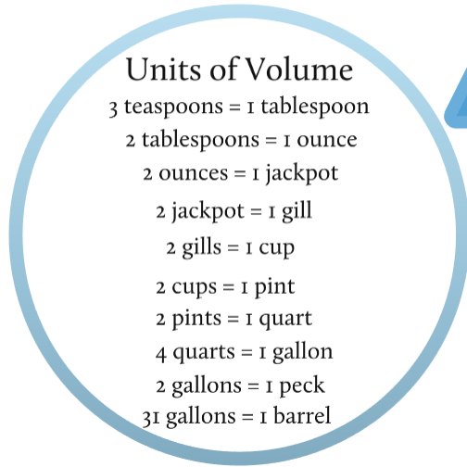
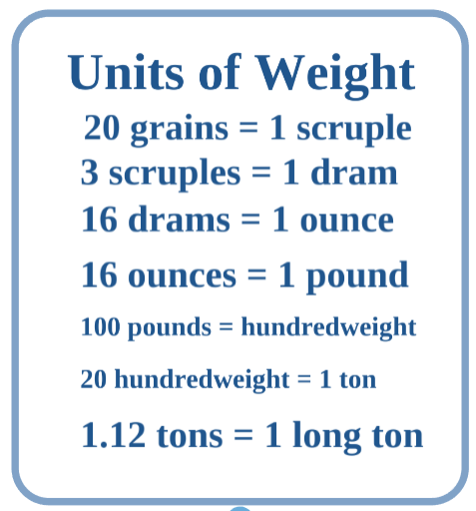
Inconsistency

Slide 11
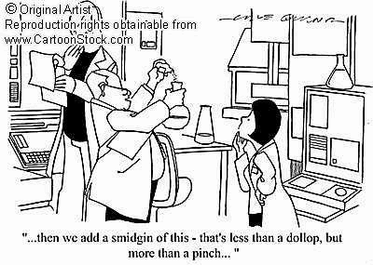
The Metric System

Slide 12
Metric & English Common Units
Vehicle Odometer:
1.6 km = 1 mile or 1 km = 0.625 miles
Temperature:
ºF = 9/5 ºC + 32 or ºC = 5/9 (ºF - 32)
Distance:
1 inch = 2.54 cm or 0.39 inches = 1 cm

Slide 13
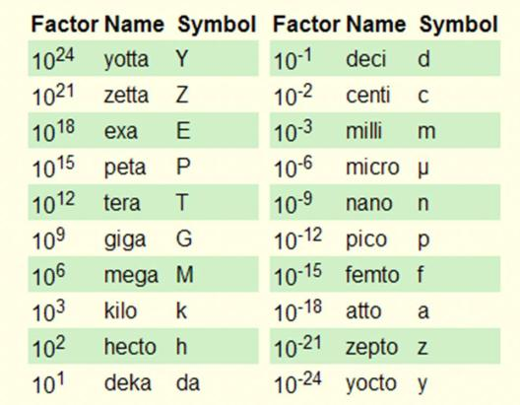
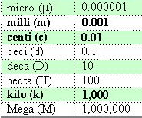
Metric Prefixes
Prefix Meaning
hecto
Metric prefixes mean the same thing regardless of the quantity being measured; i.e., mass, volume, distance, time.

Slide 14
Manipulating Units in the Metric System
You do need to memorize the metric progression at least from kilo- to milli- (and vice versa).
Video [Metric Progression Song] (1:19)
https://screencast-o-matic.com/watch/cFjtqBquew

Slide 15

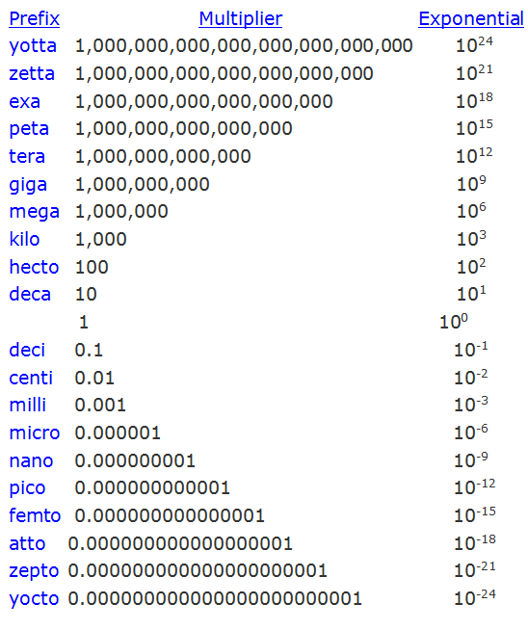

Slide 16
Using SI Units
The table below lists the prefixes in common use.
Commonly Used Metric Prefixes
Prefix | Symbol | Meaning | Factor
mega | M | 1 million times larger than the unit it precedes | 10⁶
kilo | k | 1000 times larger than the unit it precedes | 10³
deci | d | 10 times smaller than the unit it precedes | 10⁻¹
centi | c | 100 times smaller than the unit it precedes | 10⁻²
milli | m | 1000 times smaller than the unit it precedes | 10⁻³
micro | μ | 1 million times smaller than the unit it precedes | 10⁻⁶
nano | n | 1 billion times smaller than the unit it precedes | 10⁻⁹
pico | p | 1 trillion times smaller than the unit it precedes | 10⁻¹²
The prefixes “work” for any metric unit of measurement – meters, liters, grams, etc.

Slide 17
Manipulating Units in the Metric System
You do need to know how to convert between various metric prefixes.
Video
[Metric Progression & Factor labeling Basics] (4:13)
https://screencast-o-matic.com/watch/cFQj2vqCMt

Slide 18
Manipulating Units in the Metric System
Videos
[Factor labeling "Thumbs Up / Thumbs Down" Rule] (4:10)
https://screencast-o-matic.com/watch/cFQjoQqCL8
[Factor labeling (example with negative exponents] (3:34)
https://screencast-o-matic.com/watch/cFQ6lpqEa2

Slide 19
So You Know …
The Metric System vs the English System
(Don’t “slug” “Gram”-ma, and don’t “pound” “Newton”)
Physical Quantity | Base Metric Unit | Base English Unit
Mass | gram*(g) | slug (sl)
Distance | meter (m) | foot (ft)
Volume | liter (l) | gallon (g)
Time | second (s) | second (s)
Weight | Newton (N) | pound (lb)
Energy | joule (J) calorie (cal) | British Thermal Unit (BTU)

Slide 20
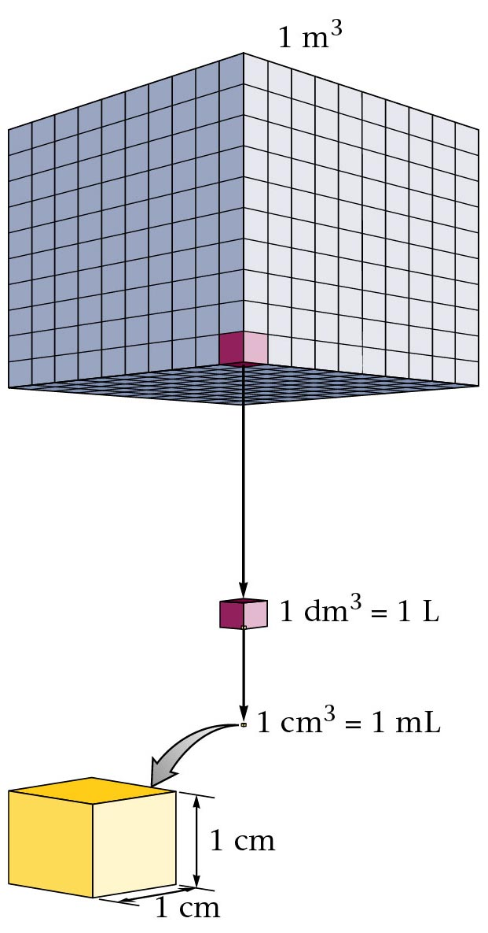
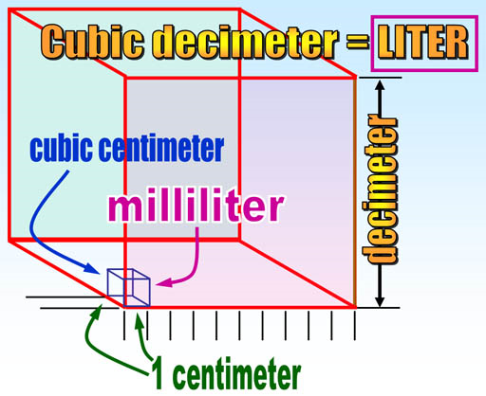
Metric Equalities
1 cubic centimeter, 1 cc = 1 milliliter, 1 ml
1,000 milliliters = 1 liter
1 cubic decimeter = 1 liter

Slide 21
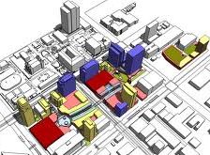
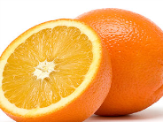
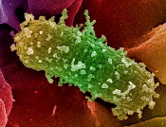


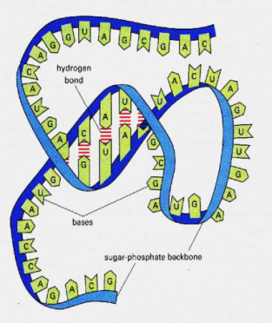
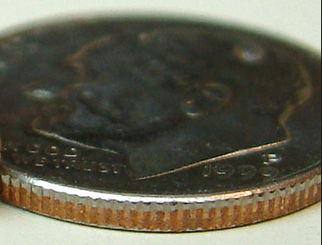
“Sizing up” Metric
Kilometer = 10³ meters
Length of about 5 city blocks
Meter = Distance from
  door knob to floor
Decimeter = 10⁻¹ m
Size of a large orange
Centimeter = 10⁻² m
Width of a shirt button
Millimeter = 10⁻³ m Thickness of a dime
Micrometer = 10⁻⁶ m
Diameter of bacterial cell
Nanometer = 10⁻⁹ m
Thickness of an RNA molecule

Slide 22
Mathematics in Science
A. Scientific Notation or
Exponential Notation
    B. Uncertainty in Measurement
    Significant Figures

Slide 23
Scientific Notation
The system of scientific notation was invented to express very large or very small numbers in a very compact and easy-to-calculate way.
It is also sometimes referred to as "powers of ten" or “exponential notation”, because it takes advantage of the decimal nature of our number system.
Scientific notation always involves raising 10 to some exponential power (“powers of 10”).

Slide 24
Scientific Notation
There is a lot to know about using numbers and measurements in Chemistry. I have three detailed videos to help out. Here’s the first:
Video
[Scientific Notation Overview] (3:31)
https://screencast-o-matic.com/watch/cFQjbKqCWJ

Slide 25

Scientific Notation
    Notation Conventions
    use a number from 1 to 9
    exponent (power) of ten
    e.g. 3,600,000,000,000
      assume the decimal follows the last zero & the exponent is 10⁰ … 3,600,000,000,000. x 10⁰
        … You need a number between 1 & 9 … so move the decimal to the left 12 places
      3.6 x 10¹² … Since the number decreased, you must increase the exponent the same amount of places

Slide 26

Scientific Notation
    Notation Conventions
    use a number from 1 to 9
    exponent (power) of ten
    e.g. 0.0000000000436
      assume the decimal follows the last zero & the exponent is 10⁰ … 0.0000000000436 x 10⁰
        … You need a number between 1 & 9 … so move the decimal to the right 11 places
      4.36 x 10⁻¹¹ … Since the number increased, you must decrease the exponent the same amount of places

Slide 27
Scientific Notation
Notice the number
decreases and the
exponent increases
Decimal Number | "Broken down" into tens | Powers of ten form
10 | 10 | 1 x 10¹
100 | 10 x 10 | 1 x 10²
1000 | 10 x 10 x 10 | 1 x 10³
10,000 | 10 x 10 x 10 x 10 | 1 x 10⁴
100,000 | 10 x 10 x 10 x 10 x 10 | 1 x 10⁵
1,000,000 | 10 x 10 x 10 x 10 x 10 x 10 | 1 x 10⁶
1,000,000,000 | 10 x 10 x 10 x 10 x 10 x 10 X 10 x 10 x 10 | 1 x 10⁹

Slide 28
Scientific Notation
Notice the number
increases and the
exponent decreases
Decimal Number
"Broken down" into tens
Powers of ten form
1
1
1 x 10⁰
0.1
1 / 10
1 x 10⁻¹
0.01
1 / 10 / 10
1 x 10⁻²
0.001
1 / 10 / 10 / 10
1 x 10⁻³
0.0001
1 / 10 / 10 / 10 / 10
1 x 10⁻⁴
0.00001
1 / 10 / 10 / 10 / 10 / 10
1 x 10⁻⁵
0.000001
1 / 10 / 10 / 10 / 10 / 10 / 10
1 x 10⁻⁶

Slide 29
Scientific Notation
    Inter-converting exponents to decimals
    scientific notation to standard notation
    e.g. 6.7 x 10⁴ = 67,000
    You must decrease the exponent, and therefore, increase the number,
    10⁴ decreases to 10⁰
    6.7 increases to 67,000

Slide 30
Scientific Notation
    Inter-converting exponents to decimals
    scientific notation to standard notation
    e.g. 3.82 x 10⁻³ = 0.00382
    You must increase the exponent, and therefore, decrease the number
    10⁻³ increases to 10⁰
    3.82 decreases to 0.00382

Slide 31
Scientific Notation
    Notice that if the number increases, the exponent decreases and vice versa
    This is an inversely proportional, indirectly proportional relationship
    (many scientific laws demonstrate this)
“Thumb Up / Thumb Down” RULE

Slide 32
Scientific Notation
Mathematical Operations
When adding, subtracting, multiplying or dividing, one must deal with units, numbers and exponents SEPARATELY … this means you cannot add a number to an exponent and vice versa.
2.3 x 10³ + 4.5 x 10³
    2.3 + 4.5 = 6.8
    Exponents are the same … 10³
    6.8 x 10³

Slide 33
Scientific Notation
Mathematical Operations
When adding, subtracting, multiplying or dividing, one must deal with numbers and exponents separately … this means you cannot add a number to an exponent and vice versa.
2.3 x 10³ + 4.5 x 10³
    2.3 + 4.5 = 6.8
    Exponents are the same … 10³
    6.8 x 10³

Slide 34
Scientific Notation
Mathematical Operations
Addition
65 x 10⁻¹ + 8.3 x 10¹
Convert numbers to a common exponent (choose the larger exponent)
The superscripts of the exponents must be the same to add or subtract numbers
    0.65 x 10¹ + 8.3 x 10¹
Add numbers to numbers
… add 0.65 + 8.3 = 8.95
  8.95 x 10¹

Slide 35
Scientific Notation
Mathematical Operations
Subtraction
47 x 10⁻¹ - 7.1 x 10¹
Convert numbers to a common exponent (choose the larger exponent)
The superscripts of the exponents must be the same to add or subtract numbers
    0.47 x 10¹ - 7.1 x 10¹
Subtract numbers from numbers
… subtract 0.47 - 7.1 = -6.63
  -6.63 x 10¹

Slide 36
Scientific Notation
Mathematical Operations
Multiplication
12 x 10⁻² x 3 x 10⁴
Multiply numbers by numbers
    12 x 3 = 36
ADD the superscripts of the exponents
    10⁻² x 10⁴ … add (-2) + 4 = 2 … = 10²
  36 x 10²
  3.6 x 10³

Slide 37
Scientific Notation
Mathematical Operations
Division
9 x 10⁴ / 3 x 10⁻²
Divide numbers by numbers
    9 / 3 = 3
SUBTRACT the superscripts of the exponents
    10⁴ x 10⁻² … subtract … 4 - (-2) = 6 … = 10⁶
3 x 10⁶

Slide 38
Scientific Notation: Adding & Subtracting (1:22)
https://screencast-o-matic.com/watch/cFQjFhq5cA
Scientific Notation: Multiplying & Dividing (0:58)
https://screencast-o-matic.com/watch/cFQjFoq5V2

Slide 39
Uncertainty in Measurement
Uncertainty in measurement depends on the skill and carefulness of the person and the limitations of the instruments.
We certainly want our dentists, doctors, mechanics, pharmacists, nurses, chefs, and other service providers to be accurate and precise in their care.

Slide 40
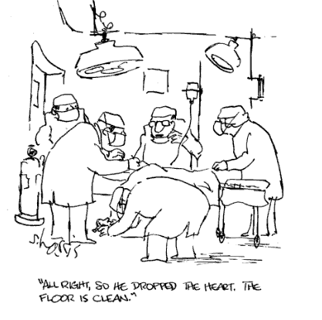
Uncertainty in Measurement
Why be precise?

Slide 41
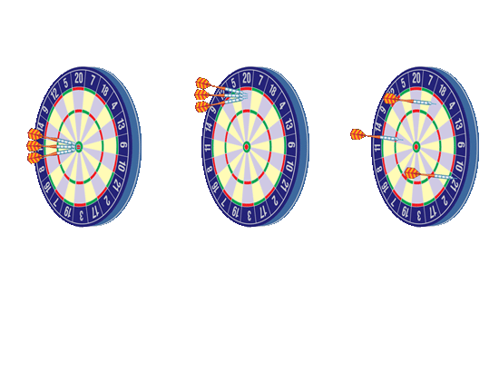
Accuracy, Precision, and Error
Accuracy and Precision
Darts on a dartboard illustrate the difference between accuracy and precision.
Good Accuracy, Good Precision
Poor Accuracy, Good Precision
Poor Accuracy, Poor Precision
The closeness of a dart to the bull’s-eye corresponds to the degree of accuracy. The closeness of several darts to one another corresponds to the degree of precision.

Slide 42
Accuracy, Precision, and Error
Accuracy and Precision
Example: TroubleShooting and Q & A’s
Troubleshooting is the identification or diagnosis of "trouble" in a system based on a lack of accuracy and/or precision.
Precision: deals with ‘common’ errors or failures (experienced repeatedly); “trends”.
E.g. Students forgot to put units on their measurements, lowering the average grade on the test.
Accuracy: deals with “mistakes” in the system.
E.g. A student misread the question and got it incorrect.

Slide 43
Uncertainty in Measurement
Precision
    Usually refers to instrumentation
    Indicates the reliability, reproducibility or consistency of a measurement
    Example
        The following measurements on a thermometer [91 C, 91.0 C].
        Notice that 91.0 C is more precise than 91 C because of the decimal.
43

Slide 44
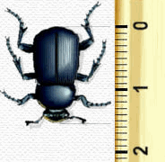
Uncertainty in Measurement
Precision
    Usually refers to instrumentation
Measure the bug to the left using the most precise unit on the centimeter ruler
The bug is more than 1 cm, but less than 2 cm
There are millimeters calibrations as well (more than 5 but less than 6 mm)
We can ESTIMATE once between the 5th and 6th mm …
The bug is 1.54 cm long

Slide 45
Uncertainty in Measurement
Accuracy
    Usually refers to people and inaccurate measuring OR to an instrument that may be measuring precisely, but is not accurate (see example below)
    Indicates how close a measurement is to the accepted value
    Example
        The values of temperature [91.9 C, 92.0 C, 92.0 C, 91.9 C] for the boiling point of water are inaccurate … the accepted value at sea level is 100.0 C (student probably used an “immersion thermometer” rather than non-immersion thermometer)

Slide 46
Uncertainty in Measurement
How do we designate precision and accuracy in measurements?
We use significant figures … also called significant digits … which are numbers that are significant in the measurement.

Slide 47
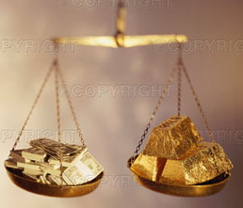
Uncertainty in Measurement
Significant Figures
A scientist uses significant figures for several reasons
        to decrease the amount of numbers used
        to indicate the accuracy of measurements obtained
        to indicate the precision of the measuring tool used

Slide 48
Uncertainty in Measurement
Significant Figures
The bottom line …
        significant figures are used to show that MEASUREMENTS are both accurate and precise.
        accurate based on the person measuring and the instrument is close to accepted standards.
        precise based on the measuring tool used.

Slide 49
Video Tutorials
Significant Figures / Precision PART 1 (3:28)
https://screencast-o-matic.com/watch/cFQjrRq5Xy
Significant Figures / Precision PART 2 (6:24)
https://screencast-o-matic.com/watch/cFQj0cq5IM

Slide 50
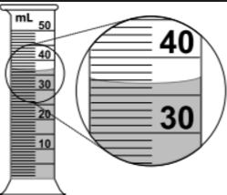
Uncertainty in Measurement
Significant Figures
When MEASURING …
How many degrees (assume C) are shown on the thermometer?
The mercury is above the 36 ml line
You are allowed ONE estimate … therefore, how many tenths of the way is the mercury between 36 & 37 milliliters?
A precise measurement could be 36.6 ml
All 3 digits are significant as part of the measurement.

Slide 51
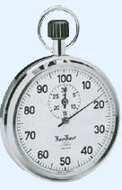
Uncertainty in Measurement
Significant Figures
When MEASURING …
        How many seconds are shown on the stop watch?
        The second hand is on the 17 second line
        You are allowed ONE estimate … therefore, how many tenths of the way is the second hand from 18 seconds?
        In this case, it is directly on the 17 second line, so the estimate would be “0”
        17.0 seconds is the most precise time. The “0” is significant as part of the measurement.

Slide 52
Uncertainty in Measurement
Significant Figures
Rules for Accuracy and Precision in Measurement
        The LAST significant figure or digit in a measurement can be an ESTIMATE.
        Unless instructed otherwise, one should use all the precision possible on a measuring device PLUS ONE ESTIMATE (one decimal place).
        All of measurement numbers are considered significant (including the ONE estimate).

Slide 53

Uncertainty in Measurement
Significant Figures
What is the greatest precision on the ruler?
        There are centimeter lines shown clearly
        The smaller lines in between the centimeter lines are tenths of a centimeter or millimeters
        There is a space between the millimeter lines … therefore, one can make a tenth of a millimeter estimate
        The ruler precisely measures millimeters
        One can estimate 0.1 millimeters

Slide 54
Uncertainty in Measurement
Significant Figures
What is the length of the arrow?
        The arrow is beyond the 7 centimeter line
        The arrow is slightly beyond the 6th millimeter line between 7 & 8 cm
        A reasonable estimate for the space between the millimeter lines is 0.2
        A precise measurement could be 7.60 cm
        Millimeters is the most precise unit shown and 0.1 mm place is the estimate
        All three digits are significant as part of the measurement.

Slide 55
Uncertainty in Measurement
RULES for determining which numbers in a
measurement are significant
All digits (INTEGERS) except zero are ALWAYS considered to be significant in a measurement.
      433 → 3 sig figs .1746 → 4 sig figs
Zeros are significant if they:
  exist BETWEEN two integers
      502 → 3 sig figs .12304 → 5 sig figs
  FOLLOW a number containing a decimal
      20. → 2 sig figs .7000 → 4 sig figs

Slide 56
Uncertainty in Measurement
RULES
Zeros are NOT significant if they [they are placeholders], meaning they are NOT part of the measurement.
  Precede a number
0.00001 → 1 sig fig .012 → 2 sig figs
  follow a number WITHOUT a decimal
90,000,000 → 1 sig fig 0.00000000084 → 2 sig figs

Slide 57
Significant Figures
Mathematical Operations
Addition & Subtraction
Use the number of significant figures in the LEAST precise measurement for the total.
1520 + 0.1 - 0.001 = 1520.099
Which of our values is least precise? 1520, which has its last significant digit in the tens place. Thus, our answer must be rounded to the tens place: 1520.

Slide 58
Significant Figures
Mathematical Operations
Multiplication & Division
When multiplying or dividing two or more numbers, count the significant figures in each of the original numbers.
Take the smallest of the numbers of significant figures.
The product or quotient will have that minimum number of significant figures.
0.048 m × 32.97 m = 1.58256 m²
Round to two significant figures because 0.048 has two: 1.6 m² .
14570 kg ÷ 5.81 L = 0.19719 kg/L
Round to three significant figures because 5.81 has three.
0.197 kg/L

Slide 59
Uncertainty in Measurement
How do we assess precision and accuracy in measurements?
We use percent error

Slide 60
Uncertainty in Measurement
Percent Error
Percent error is a mathematical way of showing accuracy and precision
% Error = accepted value - observed value x 100%
accepted value
Accepted or Theoretical Value of the boiling point of water = 100 C
Observed or Experimental Value = 98 C
(98 C - 100 C) / 100 C x 100% = 2 % error

Slide 61
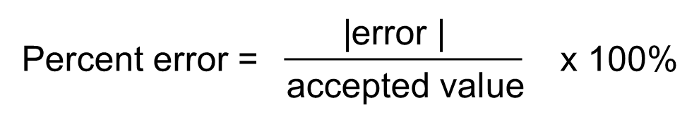
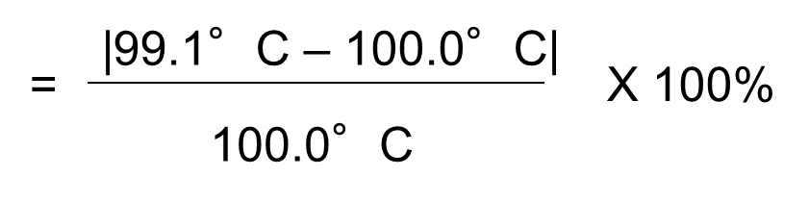
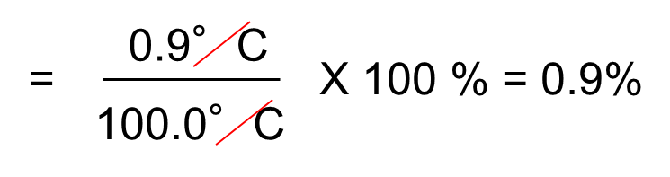
Calculating Percent Error
The boiling point of pure water is measured to be 99.1°C. Calculate the percent error.
Using the absolute value of the error means that percent error will always be a positive value.

Slide 62
PRACTICE

Slide 63

Using Scientific Notation
Solve each problem and express the answer in scientific notation.
a. (8.0 x 10^{–2}) x (7.0 x 10^{–5})
b. (7.1 x 10^{–2}) + (5 x 10^{–3})

Slide 64
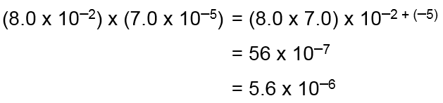
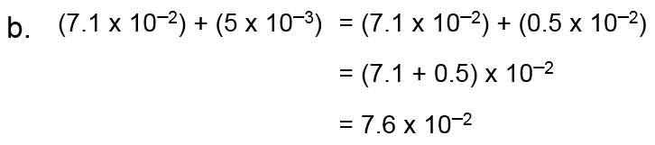
Multiply the coefficients and add the exponents.
a.

Slide 65
The mass of one molecule of water written in scientific notation is 2.99 x 10^{–23} g. What is the mass in standard notation?

Slide 66
The mass of one molecule of water written in scientific notation is 2.99 x 10^{–23} g. What is the mass in standard notation?
The mass of one molecule of water in standard notation is 0.000 000 000 000 000 000 000 0299 gram.

Slide 67
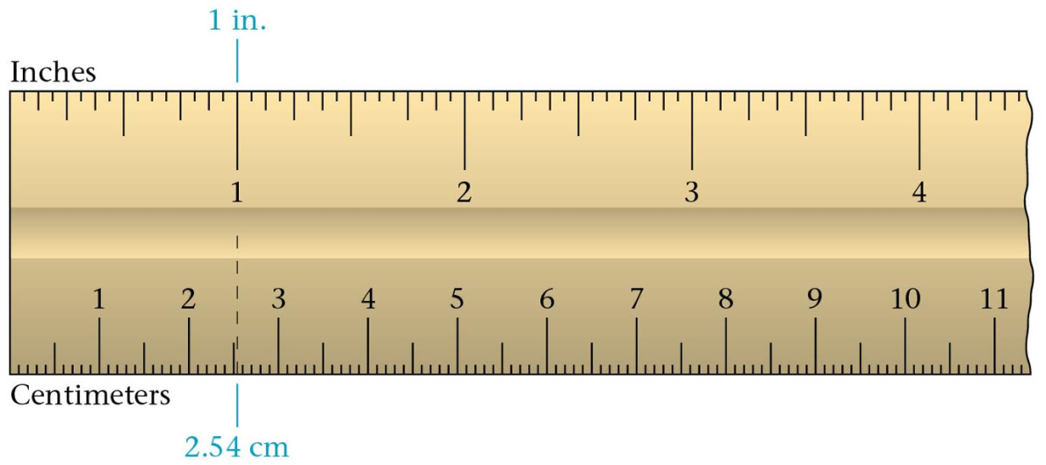
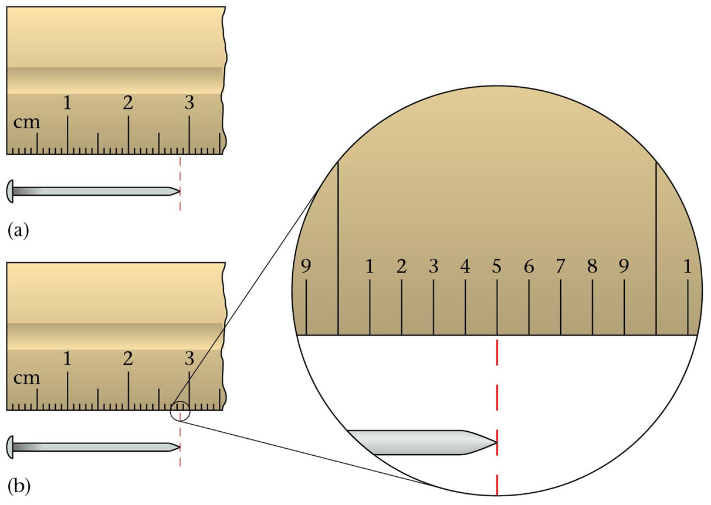
Estimating between markings

Slide 68
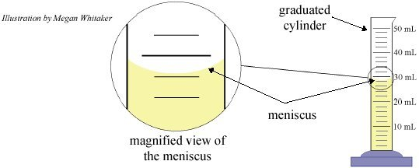
Making Measurements
Measuring volume:
Read bottom of meniscus.
Estimate between lines, to get one more decimal place in your answer.
So, this volume estimate would be about: 28.2 or 28.3 ml.
Estimated ml line:

Slide 69
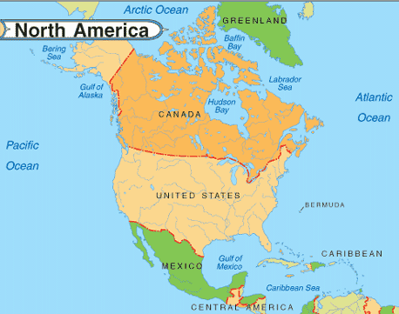
The Atlantic-Pacific rule for determining significant figures
Pacific
If a decimal is present, start counting at the left side of the number, and, beginning with the first non-zero number, count all the numbers.
Atlantic
If a decimal is absent, start counting at the right side of the number and, beginning with the first non-zero number, count all the numbers.

Slide 70

If zeros at the end of a whole number are known measured values, then they are significant. One must then write the value in scientific notation to make it clear that these zeros are significant.
i.e., 300 meters = 3.00 x 10² meters
Exact numbers: A number that is counted is exact. It has an unlimited number of significant figures.
Conversion factors which are definitions are exact.
i.e., 1 L = 1000 mL

Slide 71
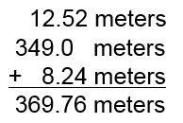
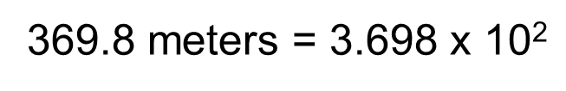
Significant Figures
Significant Figures in Calculations
  In general, a calculated answer cannot be more precise than the least precise measurement from which it was calculated.
  The calculated value must be rounded to make it consistent with the measurements from which it was calculated.
  Addition and Subtraction
  The answer to an addition or subtraction calculation should be rounded to the same place (units, tens, etc.) as the least precise measurement.

Slide 72
Significant Figures
Significant Figures in Calculations
Multiplication and Division
  In calculations involving multiplication and division, you need to round the answer to the same number of significant figures as the measurement with the least number of significant figures.
  The position of the decimal point has nothing to do with the rounding process when multiplying and dividing measurements.
e.g. 7.55 meters x 0.34 meter = 2.567 meters²
= 2.6 meters²

Slide 73
23487.25 cl = ? Dl
1 L = 10² cL
1 DL = 10¹ L
23487.25 cl X 1 L/10² cl X 1 Dm/10¹ L
2.3 x 10¹ Dl

