Slide 1
Go to the “Slide Show” shade above
Click on “Play from Beginning”

Slide 2
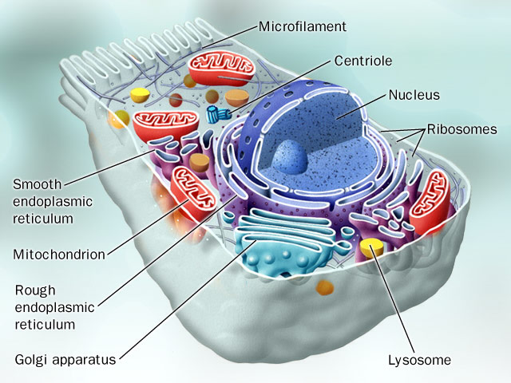
Chapter 4: Introduction to the Cell and Cell Membrane

Slide 3

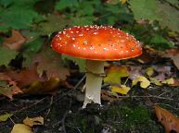
Review & Assess What You Know
Every living organism:
Choose the statements below that are true. Check all that apply.
[ ] Cells are the smallest unit of life.
[ ] Cells are important to the structure and function of living things.
[ ] All organisms are made of multiple cells.
[ ] Cells come in different shapes and sizes.
Notes:
#frame
Timing ~ 1 minute.
Entry Audio: After reviewing the five characteristics of life, use these criteria to identify the objects that are living.
Hint Audio: Determine whether each item is missing one of the characteristics. If it is, then don’t check it — it’s not living.
SOURCES:
Flower. “Flowers,” Domenico Salvagnin. 2005 as CC, Digital Image. http://www.flickr.com/photos/dominiqs/137546658/ (accessed April 9, 2012).
Rock. “Diorite.jpg,” Siim Sepp. 2005 as CC-SA/GNU, Digital Image. http://commons.wikimedia.org/wiki/File:Diorite.jpg (accessed April 20, 2011).
Lightning. “Lightning,” Tim . 2008 as CC, Digital Image. http://www.flickr.com/photos/seabamirum/2726998568/ (accessed April 20, 2011).
Mushroom. “IMG_3008.JPG,” Badeendjuh. 2009 as Free Photo, Digital Image. http://www.morguefile.com/archive/display/629267 (accessed April 20, 2011).

Slide 4
Review & Assess What You Know
Every living organism:
  has cells with DNA
  uses energy
  reproduces
  Maintains homeostasis
  responds to the environment
  grows and develops
Choose the statements below that are true. Check all that apply.
[X] Cells are the smallest unit of life.
[X] Cells are important to the structure and function of living things.
[ ] All organisms are made of multiple cells.
[X] Cells come in different shapes and sizes.
Notes:
#frame
Timing ~ 1 minute.
Entry Audio: After reviewing the five characteristics of life, use these criteria to identify the objects that are living.
Hint Audio: Determine whether each item is missing one of the characteristics. If it is, then don’t check it — it’s not living.
SOURCES:
Flower. “Flowers,” Domenico Salvagnin. 2005 as CC, Digital Image. http://www.flickr.com/photos/dominiqs/137546658/ (accessed April 9, 2012).
Rock. “Diorite.jpg,” Siim Sepp. 2005 as CC-SA/GNU, Digital Image. http://commons.wikimedia.org/wiki/File:Diorite.jpg (accessed April 20, 2011).
Lightning. “Lightning,” Tim . 2008 as CC, Digital Image. http://www.flickr.com/photos/seabamirum/2726998568/ (accessed April 20, 2011).
Mushroom. “IMG_3008.JPG,” Badeendjuh. 2009 as Free Photo, Digital Image. http://www.morguefile.com/archive/display/629267 (accessed April 20, 2011).

Slide 5
Lesson Objectives
  By the end of this lesson, you should be able to:
  Describe basic structures in all cells and state the cell theory.
  Compare and contrast prokaryotic and eukaryotic cells.
  Describe the anatomy and function of the cell membrane.
  Differentiate between diffusion, osmosis, passive transport, and active transport.
  Science Practice: Osmosis in an Egg
Notes:
#frame
instructional video
Timing ≈ 0.5 minutes
Intro
Transition: In the warm-up, you observed two different types of cells and thought about the differences in their internal structure. In fact, that is what the first objective [read it] is really about.
Preview the other objectives:
Preview the 2nd objective as being part of the first.
Preview the third one that was created because of our understanding of the first two objectives.
Finally, mention that along the way, they’ll Evaluate past research from investigations similar in design and purpose.

Slide 6
Identify Cell Structures
Which cell structures are seen in all types of cells? Check all that apply.
[ ] membrane bound organelles
[ ] DNA
[ ] cytoplasm
[ ] nucleus
[ ] ribosomes
[ ] cell membrane
Organisms that contain more than one cell with internal membrane-bound structures are known as (Prokaryotes / Eukaryotes).
Organisms that contain only one cell and do not contain a nucleus or internal membrane-bound structures are known as (Prokaryotes / Eukaryotes).
Notes:
#frame
Timing~ 1 minute
Entry audio: Answer the questions provided on the screen.
Hint1 audio: One of the structures listed is not seen in prokaryotes.
Hint2 audio: Recall the definitions of prokaryotes and eukaryotes.
Exit audio: The structures of prokaryotes and eukaryotes are different.

Slide 7
Identify Cell Structures
Which cell structures are seen in all types of cells? Check all that apply.
[ ] membrane bound organelles
[x] DNA
[x] cytoplasm
[ ] nucleus
[x] ribosomes
[x] cell membrane
Organisms that contain more than one cell with internal membrane-bound structures are known as Eukaryotes.
Organisms that contain only one cell and do not contain a nucleus or internal membrane-bound structures are known as Prokaryotes.
Notes:
#frame
Timing~ 1 minute
Entry audio: Answer the questions provided on the screen.
Hint1 audio: One of the structures listed is not seen in prokaryotes.
Hint2 audio: Recall the definitions of prokaryotes and eukaryotes.
Exit audio: The structures of prokaryotes and eukaryotes are different.

Slide 8
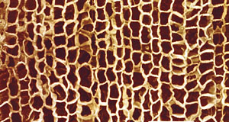
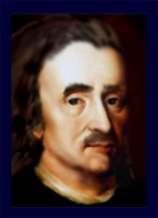
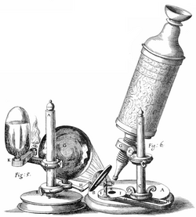
First to View Cells
In 1665, Robert Hooke used a microscope to
examine a thin slice of cork (dead plant cell walls).
What he saw what looked like the small rooms monks used to live in → Cells.

Slide 9
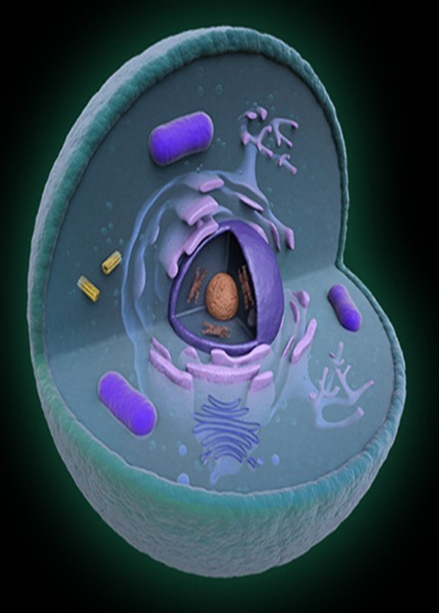
CELL THEORY
All living things are made of CELLS.
Cells are the basic units of structure and function for all Life.
All Cells are produced from other living cells.

Slide 10
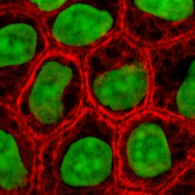
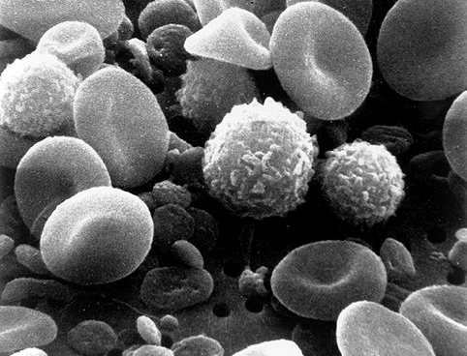
Cells: The Basic Unit of Life
A cell is the basic unit of structure and function of all organisms.
Human skin cells
Human blood cells
Notes:
Timing ≈ 0.5 min
Cells are the basic unit of structure and function of all living things.
In other words, every structure within an organism’s body and every function an organism can perform is a result of cells.
You would not have a heart, bones, skin, etc. if you did not have cells.
Cells perform a variety of functions. For example, [animate] skin cells work only to perform functions for the skin such as repair and growth. [animate] Blood cells transport gases, waste, nutrients, etc. through your body.
SOURCE:
Epithelial cells. “Epithelial-cells.jpg,” John Schmidt. 2005 as CC-SA/GNU, Digital Image. http://commons.wikimedia.org/wiki/File:Epithelial-cells.jpg (accessed April 27, 2011).
Blood cells. “SEM blood cells.jpg,” Harry Schaefer. 2006 as PD, Digital Image. http://commons.wikimedia.org/wiki/File:SEM_blood_cells.jpg (accessed April 27, 2011).

Slide 11
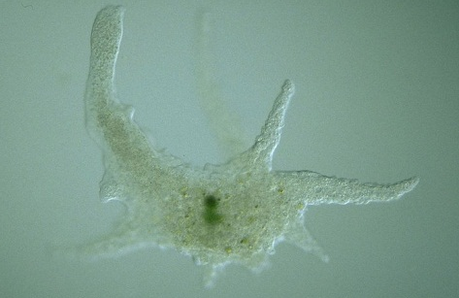

Cells: The Basic Unit of Life
All organisms are made of cells.
Unicellular:
Composed of one cell
Multicellular:
Composed of many cells
Notes:
Timing ≈ 0.5 min
Cells are the basic unit of structure and function of all living things.
In other words, every structure within an organism’s body and every function an organism can perform is a result of cells.
You would not have a heart, bones, skin, etc. if you did not have cells.
Cells perform a variety of functions. For example, [animate] skin cells work only to perform functions for the skin such as repair and growth. [animate] Blood cells transport gases, waste, nutrients, etc. through your body.
SOURCE:
Epithelial cells. “Epithelial-cells.jpg,” John Schmidt. 2005 as CC-SA/GNU, Digital Image. http://commons.wikimedia.org/wiki/File:Epithelial-cells.jpg (accessed April 27, 2011).
Blood cells. “SEM blood cells.jpg,” Harry Schaefer. 2006 as PD, Digital Image. http://commons.wikimedia.org/wiki/File:SEM_blood_cells.jpg (accessed April 27, 2011).

Slide 12
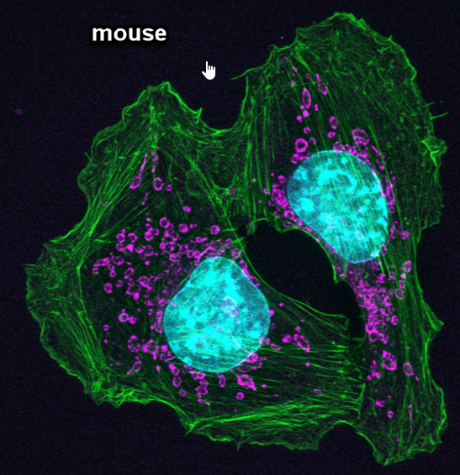
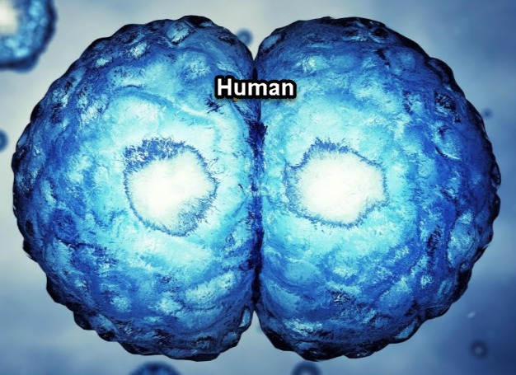
Cells: The Basic Unit of Life
All cells come from preexisting cells.
One of the major flaws of evolution is that ultimately life comes from non-life.
Notes:
Timing ≈ 0.5 min
Cells are the basic unit of structure and function of all living things.
In other words, every structure within an organism’s body and every function an organism can perform is a result of cells.
You would not have a heart, bones, skin, etc. if you did not have cells.
Cells perform a variety of functions. For example, [animate] skin cells work only to perform functions for the skin such as repair and growth. [animate] Blood cells transport gases, waste, nutrients, etc. through your body.
SOURCE:
Epithelial cells. “Epithelial-cells.jpg,” John Schmidt. 2005 as CC-SA/GNU, Digital Image. http://commons.wikimedia.org/wiki/File:Epithelial-cells.jpg (accessed April 27, 2011).
Blood cells. “SEM blood cells.jpg,” Harry Schaefer. 2006 as PD, Digital Image. http://commons.wikimedia.org/wiki/File:SEM_blood_cells.jpg (accessed April 27, 2011).

Slide 13
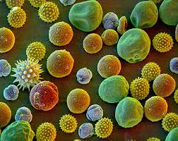
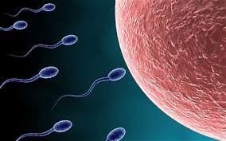
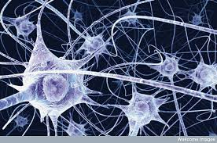
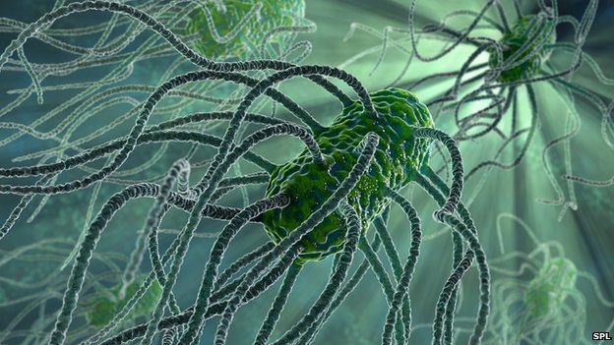
Cells are diverse in shape, size, and function:

Slide 14
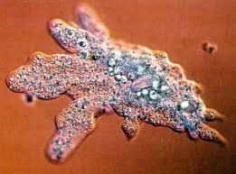

Number of Cells
Organisms may be:
Unicellular – composed of one cell.
Multicellular- composed of many cells that may organize into tissues, organs, etc.

Slide 15

Common Features of All Cells
Cell Membrane: Barrier around the cell that protects it from the outside world.
Organelles: Separate units inside of cells which perform certain functions.
Contain DNA

Slide 16
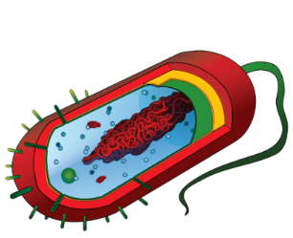
Common Features of All Cells
Cell membrane
An organelle that provides a protective layer around the cell and controls what enters and leaves the cell.
DNA
A nucleic acid that contains the genetic information for heredity in most organisms.
Ribosomes
Organelles that produce proteins for the cell.
Cytoplasm
A jelly-like substance that supports and protects organelles in the cell.

Slide 17
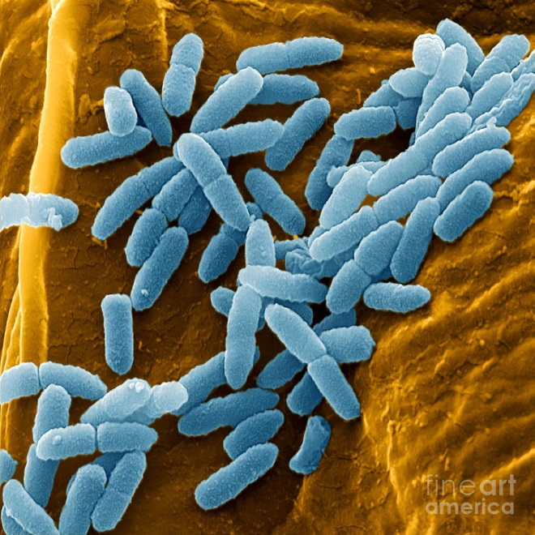
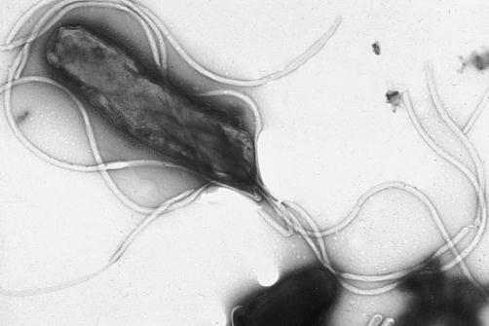
Prokaryotic Cells
Cells that lack a nucleus and membrane-bound organelles.
Includes Eubacteria and Archaebacteria.
Simplest type of cell.
Single, circular chromosome.

Slide 18
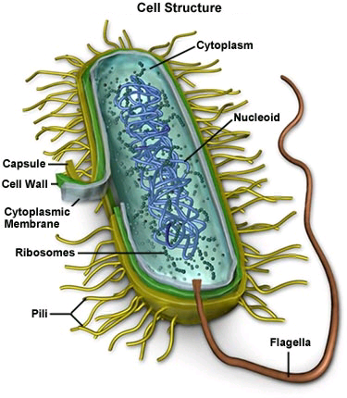
Prokaryotic Cells
Nucleoid Region (center) contains the DNA in the cytoplasm.
Surrounded by Cell Membrane and Cell Wall.
No membrane-bound organelles.
Contain Ribosomes in their Cytoplasm to make proteins.

Slide 19
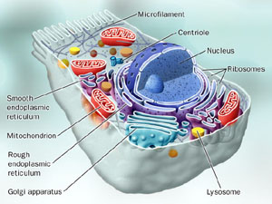
Eukaryotic Cells
Cells that HAVE a nucleus and membrane-bound + non-membrane bound organelles.
Includes protists, fungi, plants, & animals.
More complex type of cells.

Slide 20
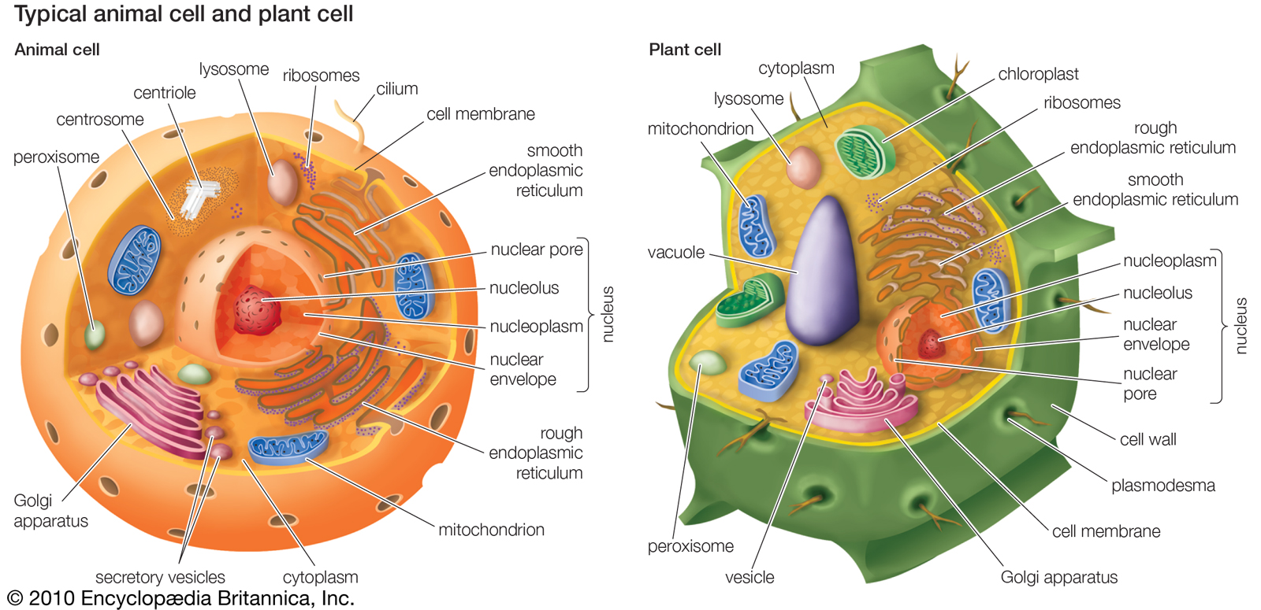
Two Main Types of Eukaryotic Cells
Animal Cell (No Cell Walls)
Plant Cell

Slide 21
Summary of the Difference Between Eukaryotic and Prokaryotic Cells
Feature | Prokaryote | Eukaryote
Cell (Plasma) Membrane | ? | ?
Nucleus | ? | ?
Nuclear Material | ? | ?
Organelles (with or without membranes) | ? | ?
Cell Wall | ? | Animals – ? Plants - ?
Cytoplasm | ? | ?
Figure 4.7.2

Slide 22
Summary of the Difference Between Eukaryotic and Prokaryotic Cells
Feature | Prokaryote | Eukaryote
Cell (Plasma) Membrane | Yes; All | Yes; All
Nucleus | No | Yes; All
Nuclear Material | Not a true nucleus; DNA free-floating in Nucleoid Area of the cytoplasm | Inside membrane-bound Nucleus; In the form of Chromosomes
Organelles | No membrane-bound organelles Only non-membrane bound (e.g. Ribosomes) | Complex organelles with and without membranes
Cell Wall | Yes, some | Animals – No Plants - Yes
Cytoplasm | Yes | Yes
Figure 4.7.2

Slide 23
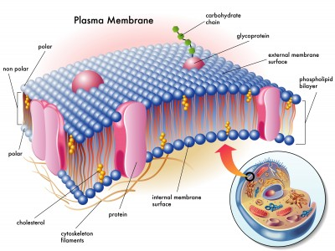
Cell Membrane
Made up mostly of lipids and proteins.
Outer boundary of the cell.
Regulates which molecules can get in and out of the cell (selectively permeable).
Helps with Cell to Cell recognition.

Slide 24
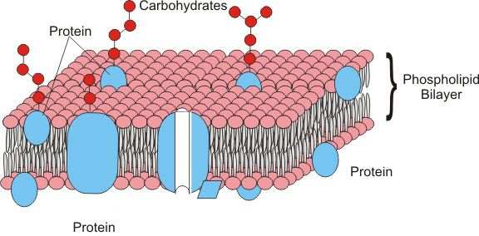
Cell Membrane
Main Components:
  Double Layer of Phospholipids
  Proteins
  Carbohydrates
  Cholesterol
Polar end
nonpolar end

Slide 25
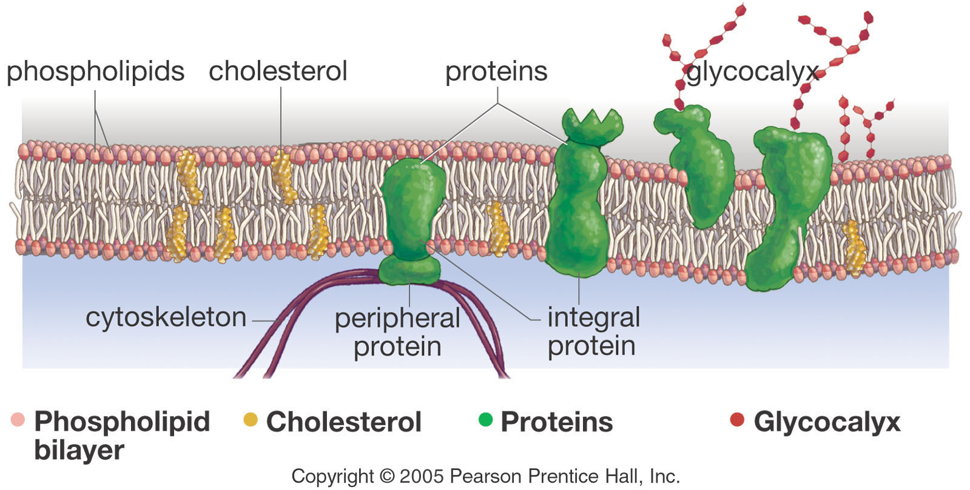
Membrane Components
carbohydrates
carbohydrates

Slide 26
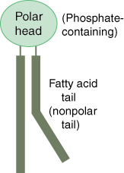
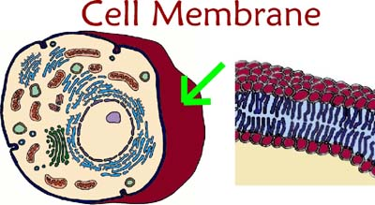
Phospholipids
Heads contain glycerol and phosphate and are hydrophilic (attract water).
Tails are made of fatty acids and are hydrophobic (repel water).
Make up a bilayer where tails point inward toward each other.
This makes the membrane “Selective” in what crosses it.

Slide 27
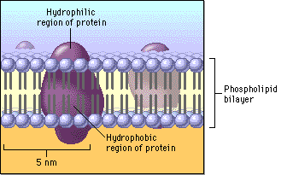
Fluid Mosaic Model
FLUID because individual phospholipids and proteins can move side-to-side within the layer, like a liquid.
MOSAIC because of the pattern produced by the scattered protein molecules when the membrane is viewed from above.

Slide 28
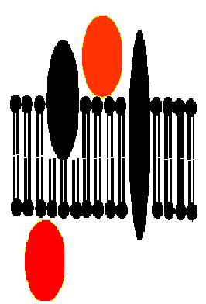
Cell Membrane Proteins
Proteins help move large molecules in and out of the cell or aid in cell recognition.
Peripheral proteins are attached on the surface (inner or outer).
Integral proteins are embedded completely through the membrane.
  Function as channel to regulate movement of substances in and out of the cell.

Slide 29
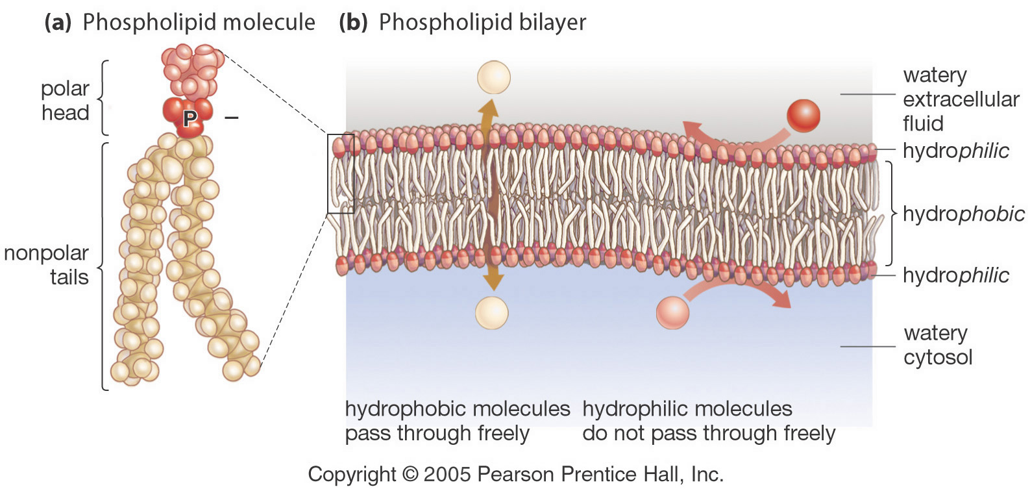
Semipermeable Membrane
In general, small, non-charged, hydrophobic molecules that are soluble in lipids can pass through the cell membrane easily.
E.g. O₂, CO_{2,} Alcohol

Slide 30
Semipermeable Membrane
Ions, hydrophilic, and polar molecules such as glucose and proteins (amino acids) do not move through the membrane on their own.

Slide 31
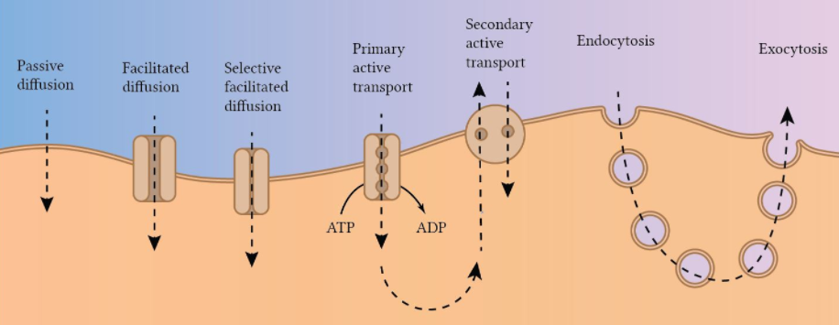
Types of Transport Across Cell Membranes

Slide 32
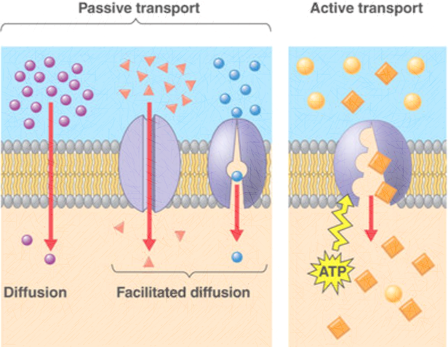

Slide 34
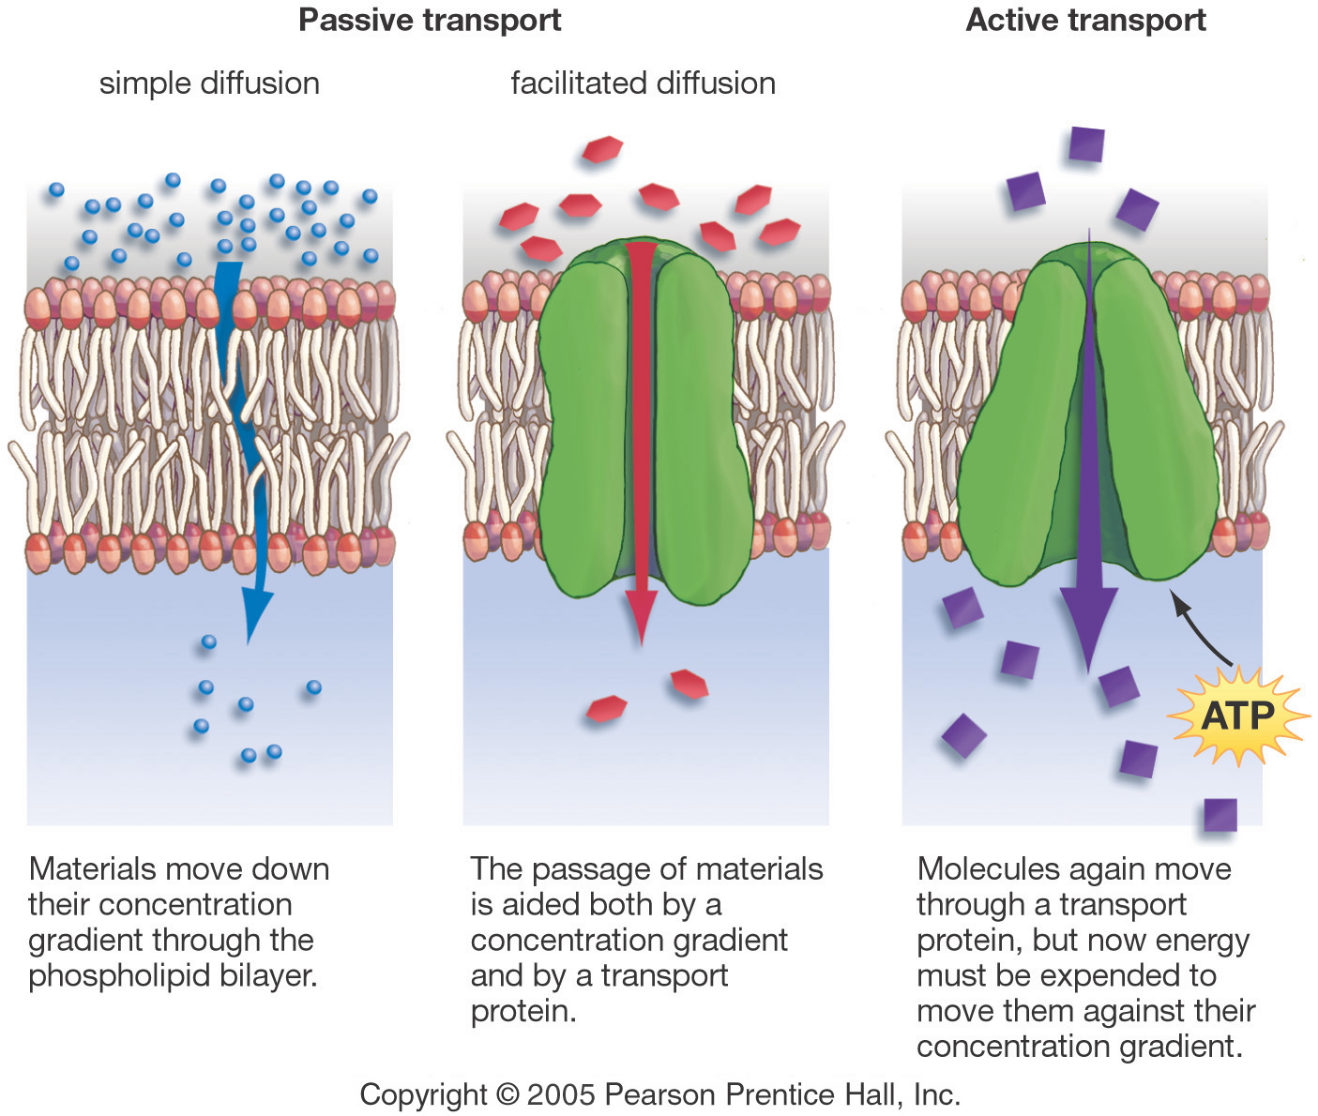
Passive Transport: Simple Diffusion
Does not require energy.
Moves from high to low concentration.
  “Down” a concentration gradient
Example: Oxygen diffusing into a cell.

Slide 35
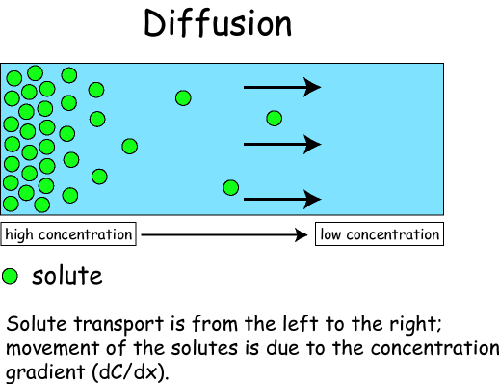
Diffusion through a Membrane
Cell Membrane
Solute moves DOWN the concentration gradient from HIGH to LOW.
E.g.: Oxygen
How Diffusion Works (1:29)
http://somup.com/c3eir7Tv0j

Slide 36
Passive Transport: Facilitated Diffusion
Does not require energy.
Uses transport proteins to move high to low concentration.
E.g.: Glucose moving from blood into a cell.
How facilitated diffusion works
http://somup.com/c3eir8Tv0z (1:17)

Slide 37
Passive Transport: Osmosis
Diffusion of WATER across a semipermeable membrane.
Membrane permeable only to water.
Flows from HIGH water potential or concentration (LOW solute concentration) to LOW water potential or concentration (HIGH solute concentration).
Passive Transport (No energy required).
TONICITY → the relative concentration of SOLUTE (particles) OUTSIDE the cell compared with the inside of the cell.

Slide 38
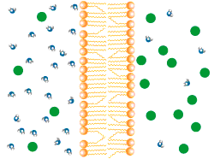
Diffusion of H₂O Across A Membrane
High H₂O potential or concentration
Low Solute concentration
Low H₂O potential or concentration
High Solute concentration
= solute

Slide 39
Animal Cell in Isotonic Solution
10% NaCl
90% H₂O
ENVIRONMENT
CELL
10% NaCl
90% H₂O
What is the direction of water movement?

Slide 40
Animal Cell in Isotonic Solution
10% NaCl
90% H₂O
ENVIRONMENT
CELL
NO NET MOVEMENT
10% NaCl
90% H₂O
What is the direction of water movement?
The Cell is at equilibrium (“iso-”)

Slide 41
Animal Cell in Hypotonic Solution
10% NaCl
90% H₂O
CELL
20% NaCl
80% H₂O
What is the direction of water movement?

Slide 42
Animal Cell in Hypotonic Solution
10% NaCl
90% H₂O
CELL
Water flows INTO cell
20% NaCl
80% H₂O
What is the direction of water movement?
“hypo-” means LOWER solute OUTSIDE the cell; more water inside the cell.

Slide 43
Animal Cell in Hypertonic Solution
15% NaCl
85% H₂O
ENVIRONMENT
CELL
5% NaCl
95% H₂O
What is the direction of water movement?

Slide 44
Animal Cell in Hypertonic Solution
15% NaCl
85% H₂O
ENVIRONMENT
CELL
Water flows OUT of cell
5% NaCl
95% H₂O
What is the direction of water movement?
“hyper-” means HIGHER solute OUTSIDE the cell; lower water inside the cell.

Slide 45
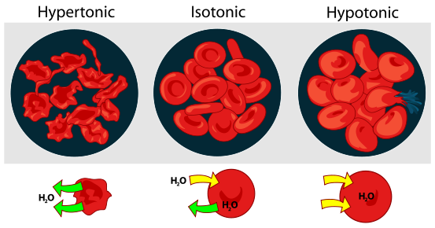
Describe the diffusion of H₂O across the Membrane
Give the tonicity of each situation
? H₂O potential or concentration ? Solute concentration
? H₂O potential or concentration ? Solute concentration
? H₂O potential or concentration ? Solute concentration

Slide 46
Describe the diffusion of H₂O across the Membrane
LOW H₂O potential or concentration HIGH Solute concentration OUTSIDE cell
EQUAL H₂O potential or concentration EQUAL Solute concentration OUTSIDE cell
HIGH H₂O potential or concentration LOW Solute concentration OUTSIDE cell

Slide 47
Active Transport
Requires energy or ATP.
Requires a Protein Carrier.
Moves materials from LOW to HIGH concentration.
Flows AGAINST the concentration gradient.

Slide 48
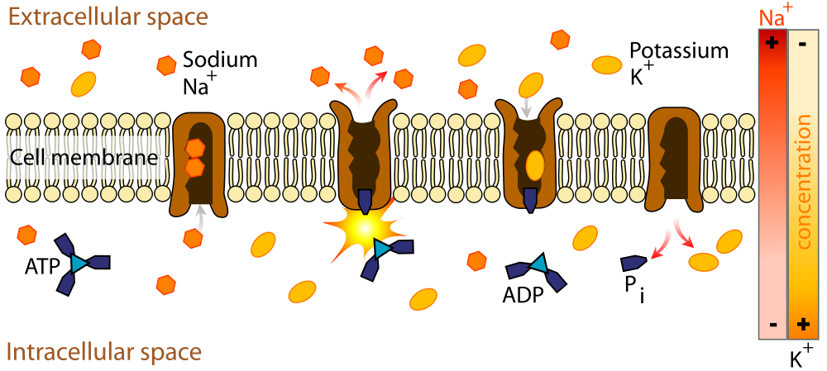
Active Transport
Cytoplasm (inside cell)
In cells, the use of energy (ATP) by the cell to move particles AGAINST the concentration gradient from an area of LOW concentration to an area HIGH concentration.

Slide 49
Three Forms of Transport Across the Membrane
Give the type of transport in each cell?
Give the type of diffusion
Give the type of diffusion
Materials move down their concentration gradient aided by a transport _______.
Materials move down their concentration gradient through the _________ _______.
Molecules move through a transport protein ______ the concentration gradient, requiring ________.

Slide 50
Three Forms of Transport Across the Membrane
Materials move down their concentration gradient aided by a transport protein.
Materials move down their concentration gradient through the phospholipid bilayer.
Molecules move through a transport protein AGAINST the concentration gradient, requiring ENERGY.

Slide 51
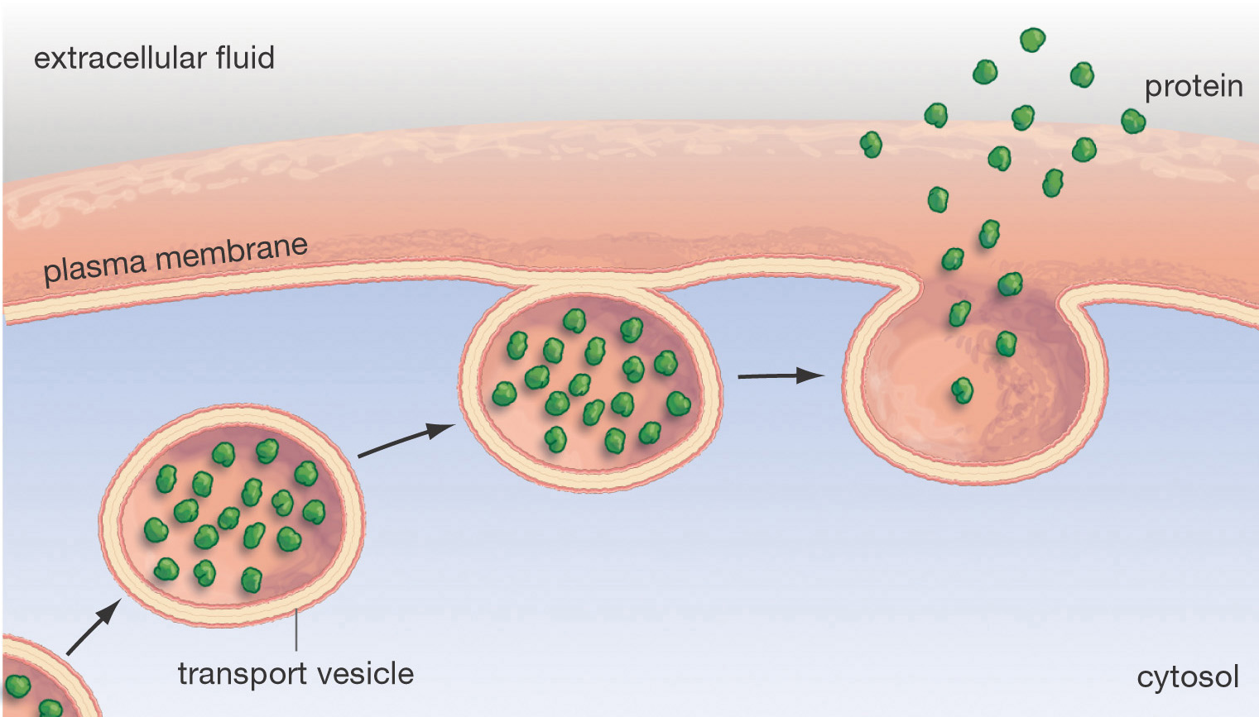
EXOCYTOSIS
Moving the “Big Stuff”
Moving things out of the cell
Inside the cell
Molecules are moved out of the cell by vesicles that fuse with the plasma membrane.
This is how many hormones are secreted and how nerve cells communicate with one another through neurotransmitters.

Slide 52
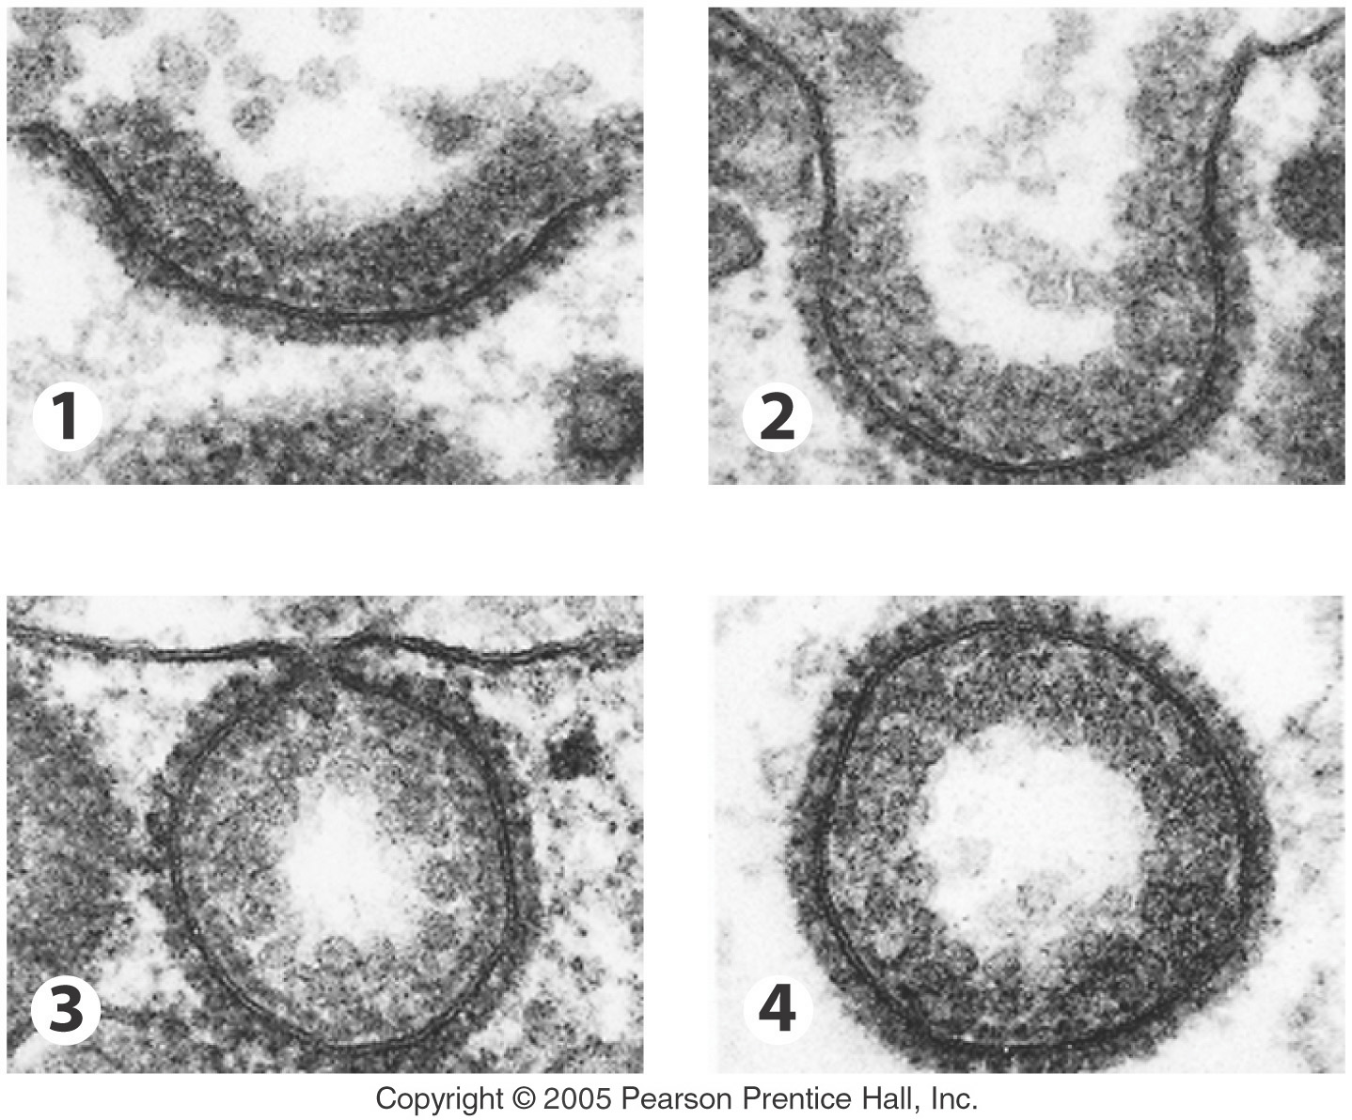
Moving the “Big Stuff”
Molecules move INTO the cell by ENDOCYTOSIS.

Slide 53
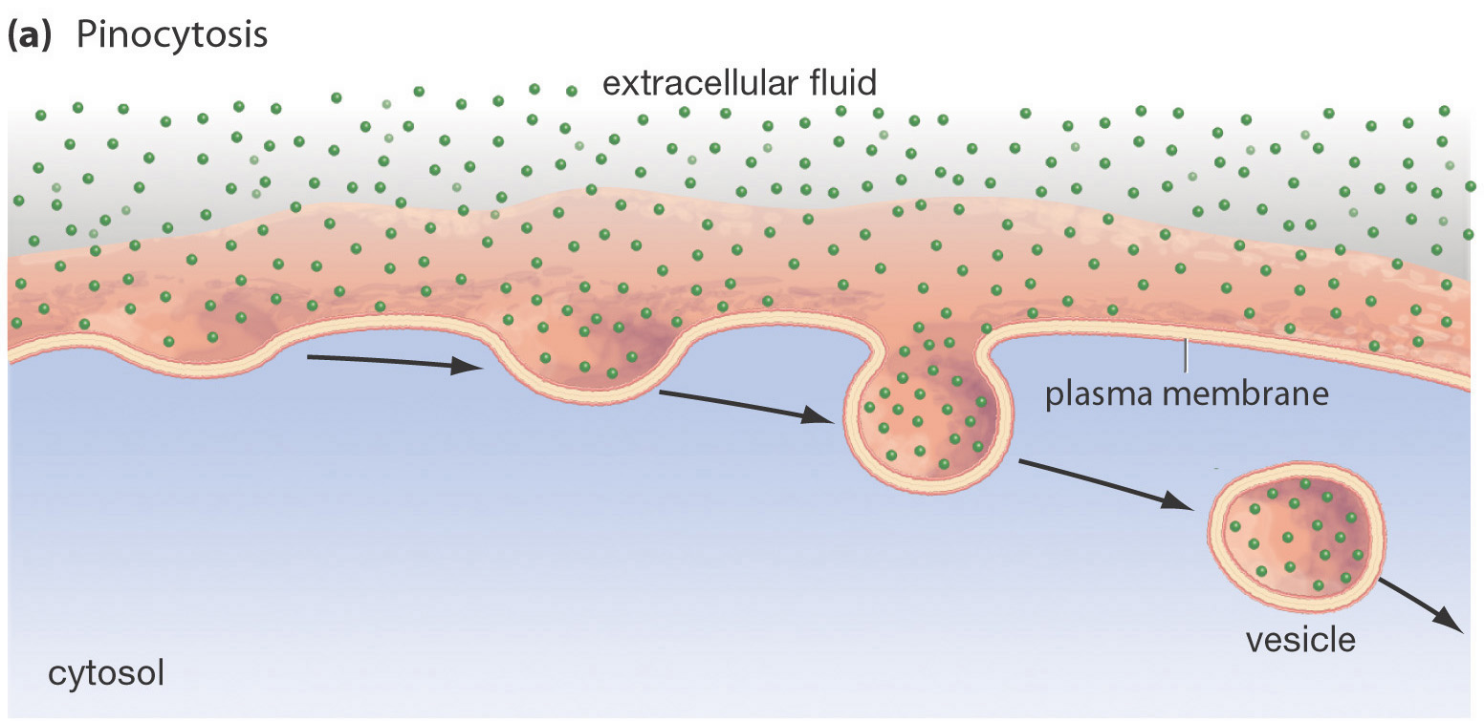
Endocytosis: Pinocytosis
Inside the cell
Cell moves large quantities of fluid (or SMALLER particles) INTO the cell.

Slide 54
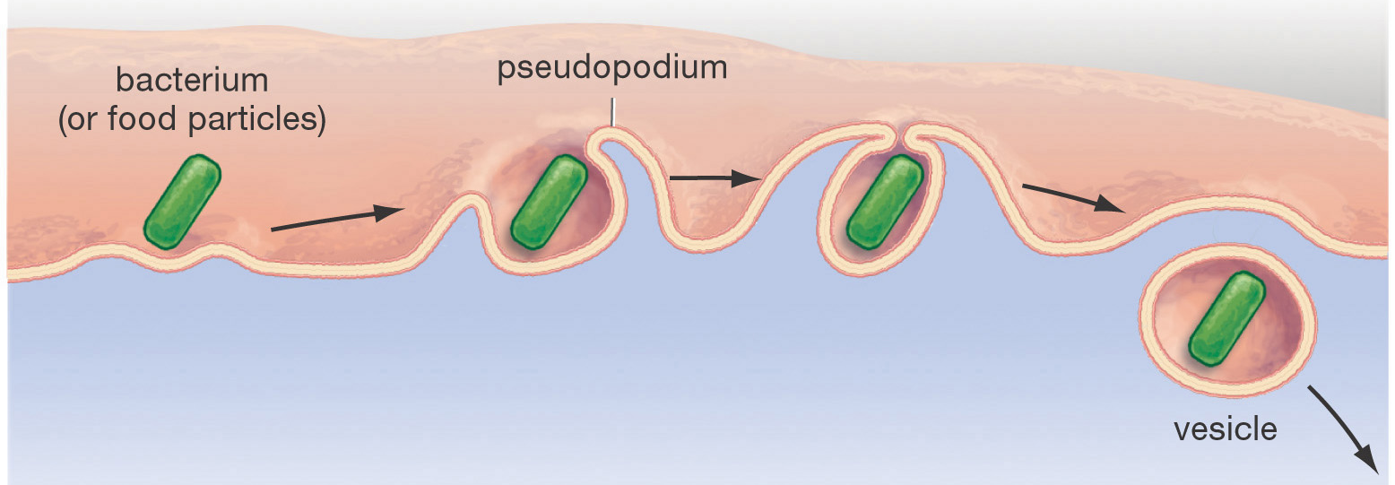
Endocytosis – Phagocytosis
Inside the cell
Used to engulf large particles such as food, bacteria, etc. into vesicles and bring into cell.

Slide 55
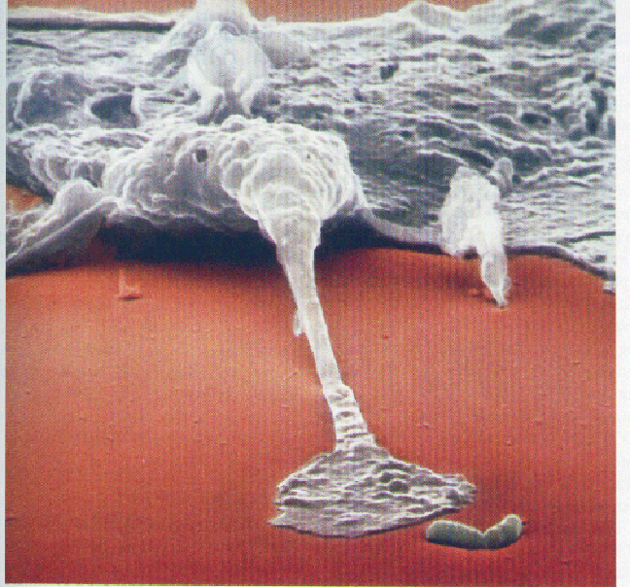
Phagocytosis About to Occur
Endocytosis & Exocytosis (1:40)
http://somup.com/c3ei3cTv08

Slide 56
Summary of Transport Mechanisms
General Mode of Transport | Examples | Energy Required | Movement
? | D_______ F_________ Diffusion O________ | ? | Down Concentration __________
? | Membrane Pumps | ? | __________ Concentration Gradient
Cytosis | Leave cell ? Small/fluid ? Large ? | ? | Down or Against Concentration Gradient

Slide 57
Summary of Transport Mechanisms
General Mode of Transport | Examples | Energy Required | Movement
Passive | Diffusion Facilitated Diffusion Osmosis | No | Down Concentration Gradient
Active | Membrane Pumps | Yes | Against Concentration Gradient
Cytosis | Exocytosis Pinocytosis Phagocytosis | Yes | Down or Against Concentration Gradient

