Slide 1
Go to the “Slide Show” shade above
Click on “Play from Beginning”

Slide 2
Basics of Electricity and
Electrical Transmission
electrons
Generation
Transmission

Slide 3
What is Electricity?
Electricity is the movement of electrons
e
e
e
e
e
e
e
e
e
e
e
e
Notice that electrons in materials do not move as much as they transfer their energy to the next electron

Slide 4
What kinds of electricity are there?
Static electricity occurs when charges build up and get transferred to the ground

Slide 5
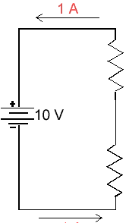
Electricity is often contained in “circuits” or closed loops of electrons flowing
A series circuit has only ONE loop of flowing electrons
The same current flows throughout the circuit

Slide 6
Some types of Christmas lights use a series circuit
What is a major disadvantage of using devices with series circuits?

Slide 7
A flashlight is another example of an electrical device that uses a series circuit

Slide 8
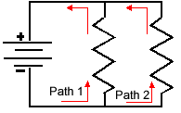
Another kind of “circuit” or closed loop of flowing electrons is called parallel
A parallel circuit has more than one loop of flowing electrons

Slide 9
The same voltage flows throughout the parallel circuit
This means that any loop of the same parallel circuit
can do the same amount of electrical work.

Slide 10
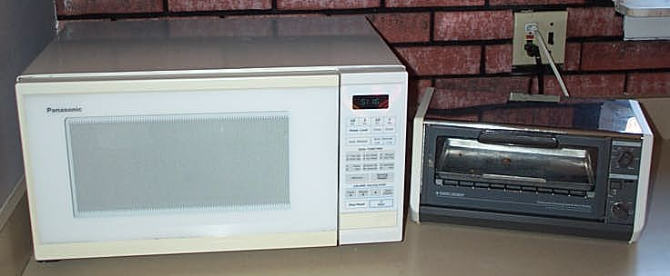
Most appliances and electrical devices used in industry and at home utilize parallel circuits

Slide 11
Combination circuits containing both series and parallel circuits are common in our homes and in industry

Slide 12
Combination Circuits are very important for electrical safety in our homes, schools and industry …

Slide 13
Fuses and Circuit Breakers are connected in “series” to parallel circuits. Why?

Slide 14
If the fuse blows or the breaker trips, the entire circuit is “opened”
Fuse or Breaker
Electric Appliances

Slide 15
Current
The amount of electrons moving within a circuit is called Current.
Current is measured in “amps” … named after the scientist who worked with current (Ampere)
Current or amps are designated by an “I” in the electrical equation (V = I R)

Slide 16
Components of Electricity

Slide 17
Basic Components of Electricity
Conductors, Insulators
and
Resistors

Slide 18
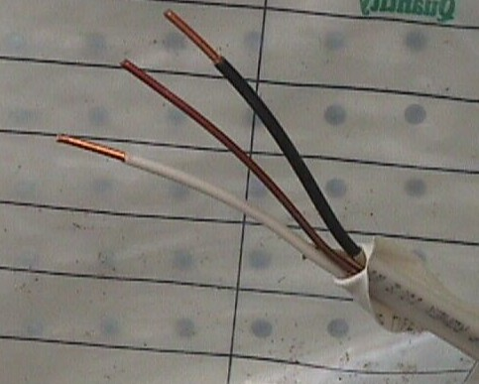
Electrons Can Move Through Materials
Conductors
If electrons move very easily in a material, that material is a “conductor”
Copper wire
Transmission wires are made of conductors like copper or aluminum

Slide 19
Insulators
stop
If the electrons do not move easily in a material, that material is an “insulator”
Glass, wood, air and plastic are good insulators
Insulators keep the current from touching other materials (or people)

Slide 20
Many Conductors are Covered with Insulators
Wires are often coated with insulating material like plastic
Plastic insulation on the white and black wires
Plastic insulation around all three wires

Slide 21
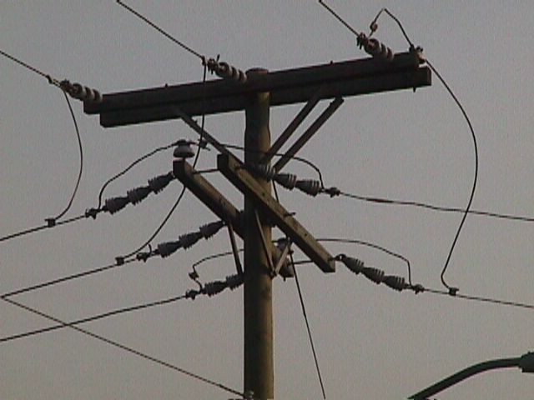
Insulating Transmission Wires
High voltage transmission wires are coated to prevent corrosion but this doesn’t provide sufficient insulation
They are suspended in the air by glass insulators
Glass and air are good insulators
Glass insulator

Slide 22
Resistance
Some materials allow the electrons to move, but not easily. Such materials are called “resistors”
Resistance is measured in ohms (named after George Ohm)
Ohms are designated by an “R” in the electrical equation (V = I R)

Slide 23
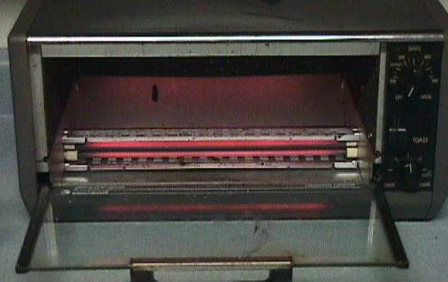
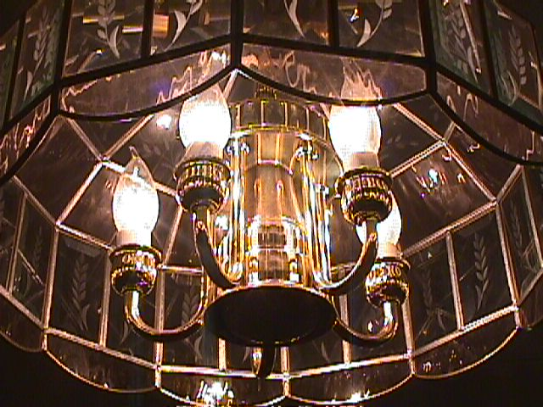
Resistance Turns Electricity Into Heat and Light
Wires allow electrons to move through them but they resist the movement
These wires produce useful heat and light

Slide 24
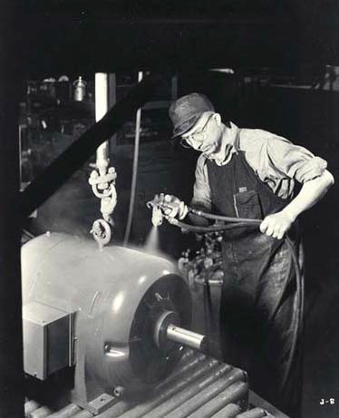
A common means to produce electricity for useful work is:
Magnetic Induction

Slide 25

Magnetic Fields
When current moves through a wire, a magnetic field is created around the wire
The direction of the magnetic field is determined by the “right hand” rule

Slide 26
Magnetic Fields Can Do Work
When a magnetic field moves across a conductor (like a wire), electrical current is produced in that conductor
This is called “Induction”
  Induction causes motors to turn
Induction is used to modify electrical potential and current in transformers

Slide 27
Summary
Conductors allow current to flow easily
Insulators do not
Resistors will resist the current flow and get hot … this heat becomes useful for …
  Heating elements
  Lighting
Magnetic fields can “induce” a current in wires
  Motors
  Transformers

Slide 28
Generating Electricity

Slide 29
Power plants (Utility Companies) force electrons to move through magnetic induction.
There are several phases of electricity production, involving particular equipment and processes.

Slide 30
Boilers
Heat runs a reactor
Boiling water expands 1000 times and rapidly escapes the boiler

Slide 31
Turbines
Expanding & escaping steam from the boiler turns a turbine shaft
Heat energy of the steam is converted to mechanical energy to generate electricity

Slide 32
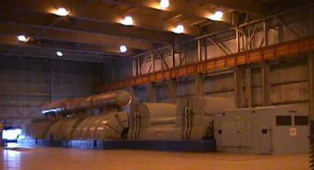
A Turbine in a Power Plant
Turbine

Slide 33
Generators
Coil of wire
A Shaft from a turbine is attached to an electromagnet
Rotating the magnet produces electric current in nearby wires
e
N
S
e
e

Slide 34
Generators
Coil of wire
The Magnet rotates 60 times each second as the north pole and south pole pass by the coils of wire
Alternating Current is produced at 60 hertz
N
S

Slide 35
Generators
Generator
Use Magnetic Induction
Produce Alternating Current
In our homes, this generation of 60 hertz alternating current yields a voltage of 120

Slide 36
Since this type of electrical generation uses heat, a cooling system is also required to restore normal temperatures
This cooling system is called a condenser
The condenser restores the temperature of the water from the hot steam

Slide 37
Boiling Water Reactors
Electric Power
Steam
Turbine
e
e
Boiler
e
Generator
Heat
Transformer
Condenser

Slide 38
Transmitting Electricity

Slide 39
Transmission of Electricity
Now that we have generated electricity in a power plant, how do we get it to our fingertips?

Slide 40
We pay the power company to move the electrons back and forth to and from our homes when we flip on a switch
Power plants are connected to our homes through a network of transmission wires

Slide 41


The electricity transmitted does work for us through electrical devices and appliances

Slide 42
Electricity’s potential to do work is measured in volts.
Examples of “voltage”:
  Batteries (1.5 volts, 6 volts, 12 volts)
  Outlets (120 volts, 220 volts)
  Voltage indicates how much work an electrical device can do. The higher the voltage, the more work per unit of charge that device can perform.

Slide 43
A power plant may produce 200,000 volts of electricity or more each second
This is enough to do work in thousands of homes and in industry

Slide 44
How can we transport this huge amount of electrical potential to our homes without getting hurt and without huge electricity bills?

Slide 45
Safe & Cheaper Transmission
Transmitting electricity using lower current is safer and utilizes smaller wires, saving weight and money
Since the current is lower, the voltage (potential) can be very high
Higher Potential is more dangerous so the high voltage wires are placed high in the air and suspended from the towers by glass insulators
Glass insulator

Slide 46
Electrical companies use Transformers to change the amount of voltage and current being transmitted
A transformer keeps the electrical power the same while changing the voltage (potential) and current to make transmission safer and less costly
Transformers use magnetic induction … producing alternating current
This is one reason power plants produce “Alternating Current” rather than “Direct Current”

Slide 47
Transformers
Use Magnetic Induction
An alternating current in one coil of wire will induce a potential and current in a coil next to it
High
Iron core
Low

Slide 48
Transformers
The ratio of coils in each loop determines the potential (voltage) in each loop
High
Iron core
Low

Slide 49
Example of Using A Transformer
High
Low
If the Utlility Company generates 100 volts of electricity with 20 amps of current, 2000 watts of electric power are produced.
V x I = P
(100 Volts) x (20 amps) = 2000 W
A transformer changes the electricity to 2000 volts with 1 amp of current. This still represents 2000 watts of electrical power.
(2000 Volts) x (1 amp) = 2000 W

Slide 50
High
Low
“Step up” transformers
increase the potential while decreasing the current
“Step down” transformers
decrease the potential while increasing the current

Slide 51
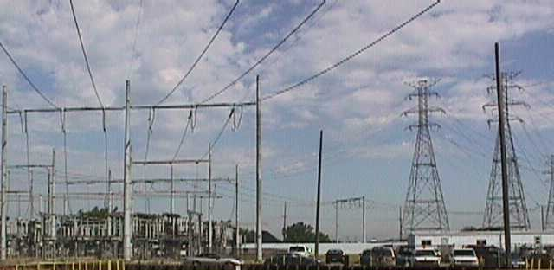
“Step Up” Transformers
Low current / high potential (voltage) electricity
Transformers reduce current (and increase potential)

Slide 52
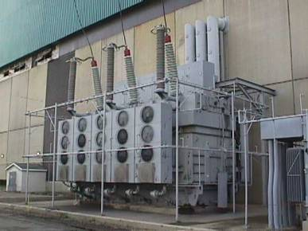
“Step Up” Transformers
From the generator
To the consumer

Slide 53
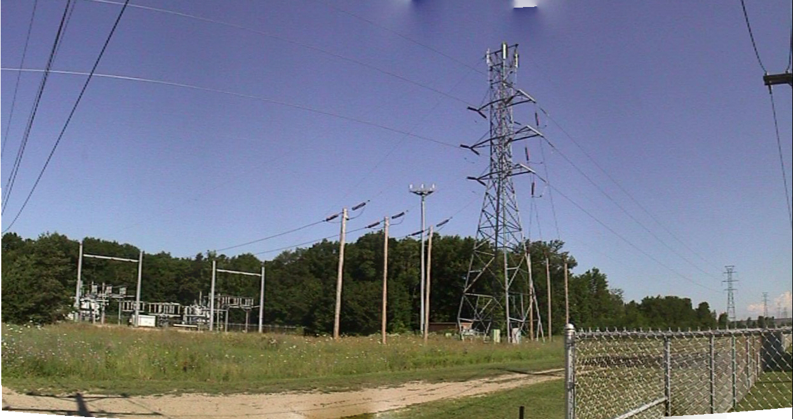
“Step Down” Transformers
exist near our homes and increase the current (reducing the potential)
Transformers

Slide 54
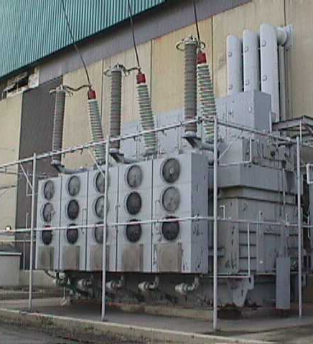
Reducing Amperage or Current
Transformers are used at the power plant to decrease the current (therefore increasing the potential)
Current from generator
This reduces transmission losses
Higher voltage current
Insulators

Slide 55
One Last Thing
Current is created when electricity is connecting to the earth. This is called the “ground”
Wires are used to connect to the earth. These are called “ground wires”
If part of an appliance is connected to the earth through the ground wire it is “grounded”

