Slide 1
Go to the “Slide Show” shade above
Click on “Play from Beginning”

Slide 2
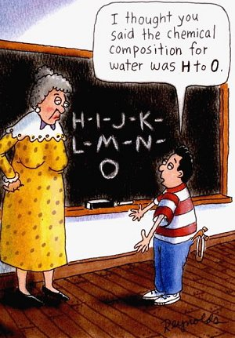
Chapter 2: THE COMPOSITION AND CHEMISTRY OF LIFE

Slide 3
Lesson Objectives
  By the end of this lesson, you should be able to:
Understand matter and how matter is affected (physical versus chemical changes).
Describe atoms and molecules (subatomic particles, atomic number, atomic mass, isotopes).
Explore types of bonds between atoms and molecules (covalent, ionic, hydrogen).
Identify and explain hydrogen bonding and its relationship to the properties of water.
Define solutions especially when water is the solvent.
Describe acidic and basic solutions in terms of pH, ion concentration and examples.
Explain buffers and their relevance to life.
  Science Practice: Chemistry Overview Lab
Notes:
#frame
instructional video
Timing ≈ 0.5 min
Transition: In the warm up, you thought about why plants might be important to living organisms and what Earth might be like without plants. During this lesson, you will learn about the process of photosynthesis, which is one way that plants are important to all living organisms.
[Preview the other objectives:]
You will also learn the chemical equation that summarizes the process of photosynthesis.
You will then explore the importance of photosynthesis to Earth’s organisms.
You will also briefly review the history of the discovery of photosynthesis and see how, with each new discovery, newer and more complex hypotheses led to new experimental methods, so that our understanding of photosynthesis increased over the years.

Slide 4
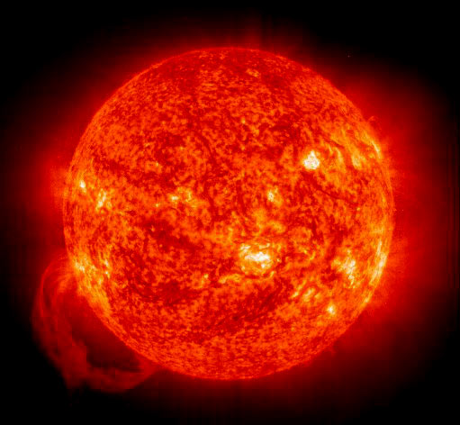
MATTER
Living organisms are composed of Matter.
Matter - anything that occupies space or has mass (weight).
Matter is composed of chemical Elements.

Slide 5

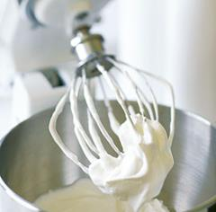
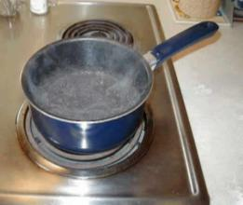
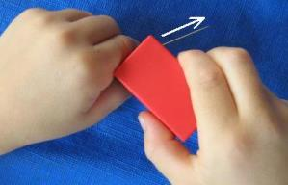
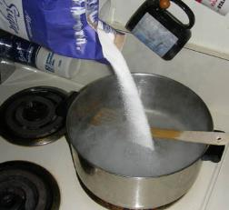
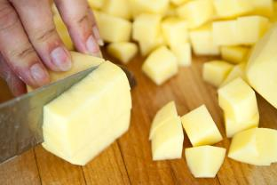

Physical changes affect the state or structure, but do NOT change the chemical make-up of a substance.

Slide 6
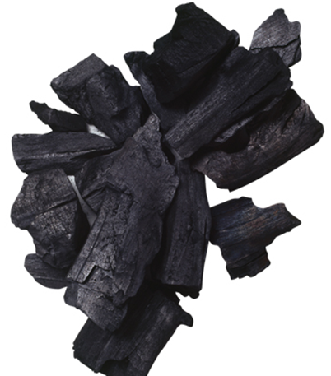

Matter
Chemical Changes
alter the chemical composition of a substance.
produce NEW substances with physical & chemical properties DIFFERENT from the constituents.
e.g. Sodium (Na) explodes in air, Chlorine gas (Cl₂) is lethal
But table salt (NaCl) tastes great!

Slide 7
Elements
Substances that cannot be broken down chemically into simpler kinds of matter.
Composed of only one type of ATOM.
More than 110 elements (92 naturally- occurring)
Essential elements in living organisms include
  Carbon
  Hydrogen
  Oxygen
  Nitrogen
CHON

Slide 8
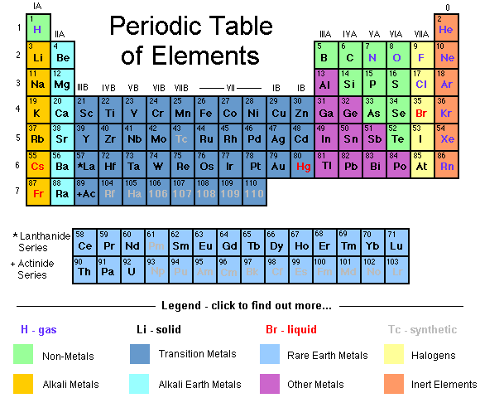

Slide 9
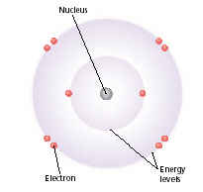
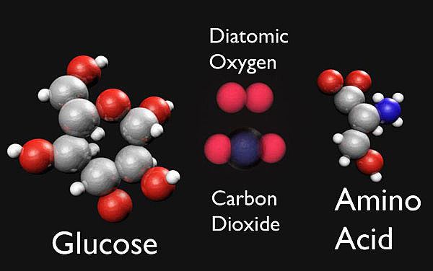
Atoms and Molecules
ATOMS are the simplest particle of an element that retains all the properties of that element.
  Smallest building blocks of Matter
Properties of atoms determine the structure and properties of the matter they compose.
MOLECULES are groups of atoms connected together.

Slide 10
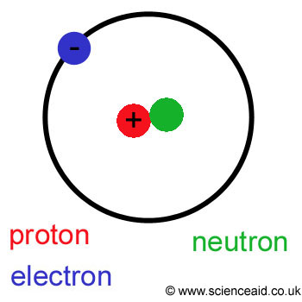
SUBATOMIC PARTICLES
Atoms of each element are composed of even smaller parts called Subatomic Particles:
Neutrons, which have no electrical charge (in nucleus).
Protons, which are positively charged (in nucleus).
Electrons, which are negatively charged (around the nucleus in a “cloud”).

Slide 11
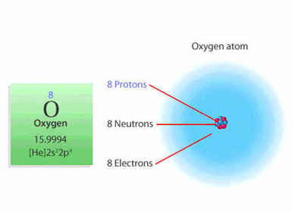
Atomic Number and Mass
Number of protons of an atom of a particular element is called the Atomic Number.
The number of protons + neutrons = Atomic Mass.
Number of protons is normally balanced by an equal number of negatively charged electrons.

Slide 12
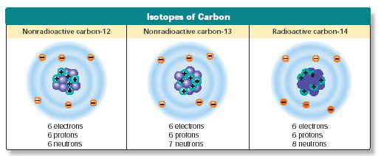
Isotopes
Different forms of the same element.
Have the same number of protons, but different number of neutrons.
May be radioactive, spontaneously giving off particles and energy.
May be used to date fossils or as medical tracers.

Slide 13
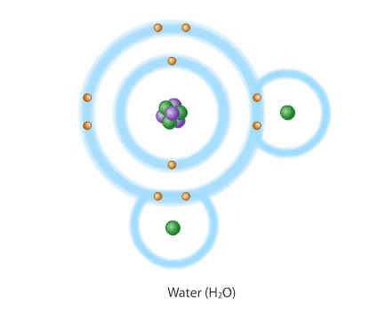
Chemical Bonds: Covalent
Formed when two atoms share one or more pairs of electrons.
Often the Strongest type of chemical bond.
Types:
  Non-Polar
  Polar

Slide 14
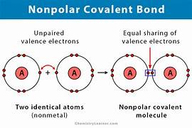
Non-Polar Covalent Bonds
In non-polar covalent bonds, sharing of electrons is equal, i.e. the electrons are not attracted to either atom to a greater degree.

Slide 15
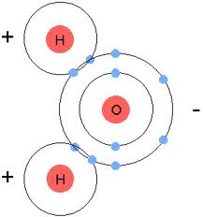
Polar Covalent Bonds
With polar covalent bonds, the sharing of electrons is unequal i.e. electrons involved in the bond are slightly more attracted to one atom of the bond than to the other.
Example:
  Water (H₂O) is a polar molecule.
  Electrons spend more time with Oxygen than Hydrogens.
  Hydrogens become slightly positive, Oxygen slightly negative.

Slide 16
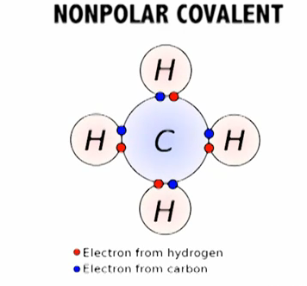
Polar & NonPolar
Covalent Molecules
Polar Molecule

Slide 17
Chemical Bonds: Ionic
Ion: Atom that has a negative or positive charge.
Some atoms become stable by losing or gaining electrons.
Atoms that lose electrons are called positive ions.
Atoms that gain electrons are called negative ions.
Because positive and negative electrical charges attract each other, ionic bonds form.
Ionic bonds are often weaker than covalent bonds.

Slide 18
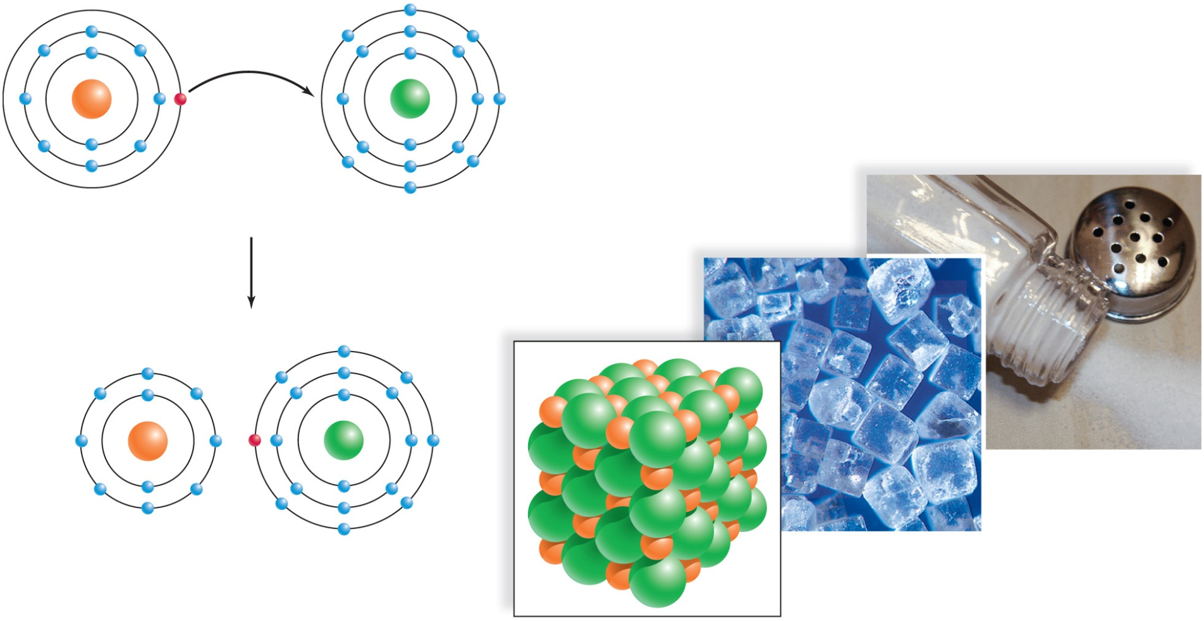
Formation of Sodium Chloride (NaCl)
Copyright © The McGraw-Hill Companies, Inc. Permission required for reproduction or display.
Na
Cl
sodium atom (Na)
chlorine atom (Cl)
+
–
Na⁺
Cl⁻
Na
Cl
sodium ion (Na⁺)
chloride ion (Cl⁻)
sodium chloride (NaCl)
a.
b.
(Crystals): © Charles M. Falco/Photo Researchers, Inc.; (Salt shaker): © Erica S. Leeds

Slide 19
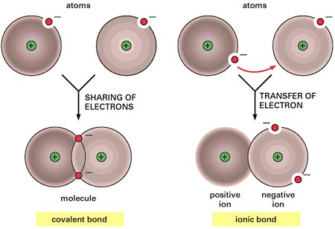
Summary of Ionic and Covalent Bonds

Slide 20

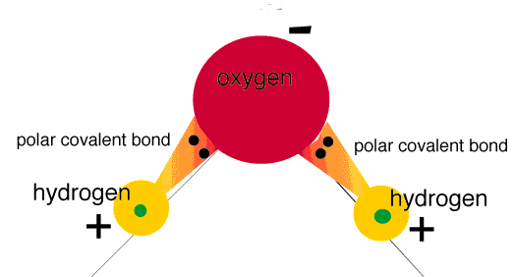
Polarity of Water
Can’t have life without it!
  Water (H₂O) is a POLAR molecule.
    Polar Covalent Bonds WITHIN each molecule.
  Shared Electrons spend more time with Oxygen than with Hydrogens.
  Hydrogens become slightly positive, Oxygen slightly negative.

Slide 21
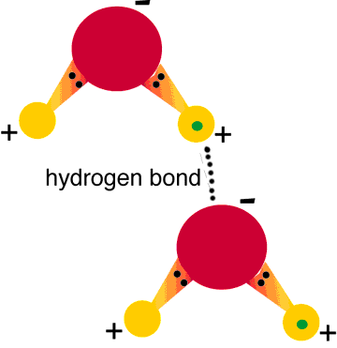
Hydrogen Bonds Exist Between Water Molecules
The positive Hydrogens of water molecules are attracted to the negative Oxygens of other water molecules and form a HYDROGEN BOND.
One hydrogen bond is weak, but many hydrogen bonds are strong.

Slide 22
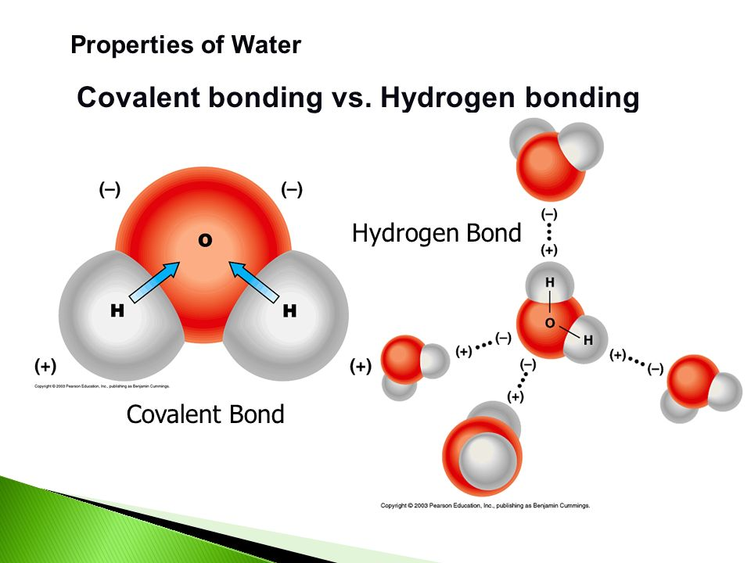

Slide 23
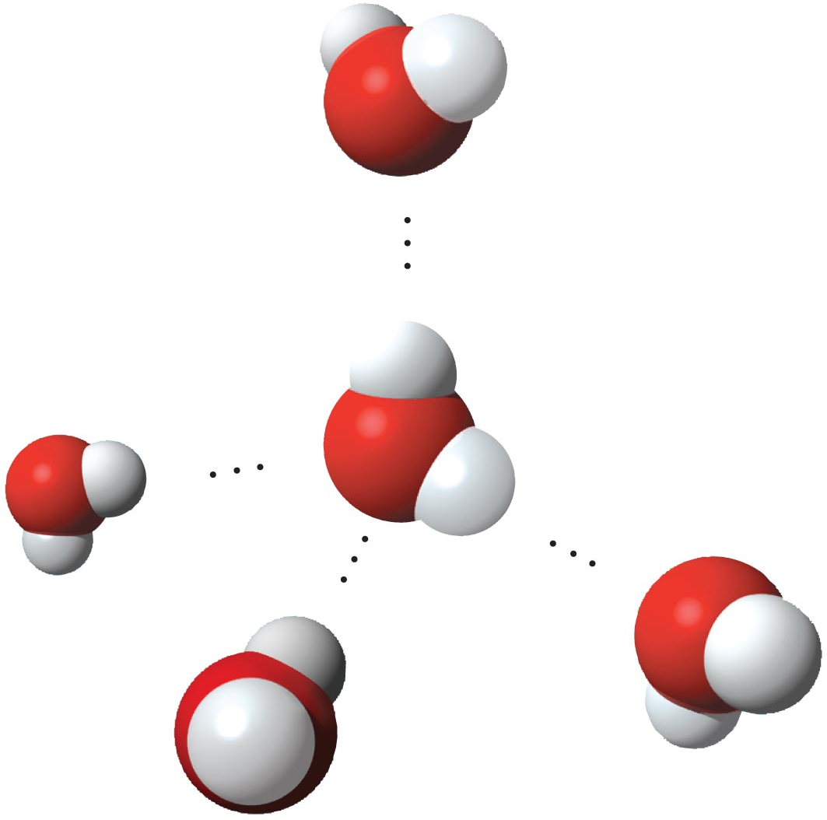
Hydrogen Bonding
<----- Water molecule
The opposite charges of the molecules attract one another.
<------ Hydrogen Bond
The oxygen
of one water molecule and the hydrogen of a different water molecule
forms a hydrogen bond.
The force of attraction forms hydrogen bonds.
A single water molecule can form up to 4 hydrogen bonds with other water molecules at the same time. This is responsible for many of the unusual properties found in water.

Slide 24
PROPERTIES OF WATER
Hydrogen Bonds give Water many unique properties, which makes it critical to the functioning of all life forms
Cohesion
Adhesion
Temperature Moderation
Less Dense as a Solid than as a Liquid
Solvent of Life
Notes:
1

Slide 25
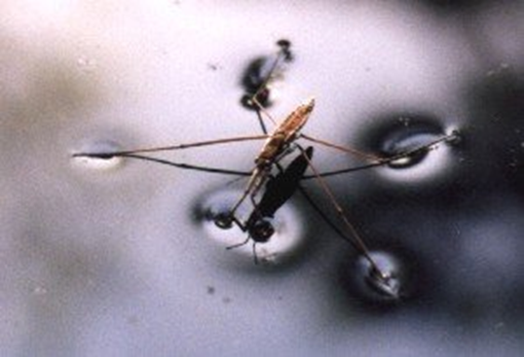
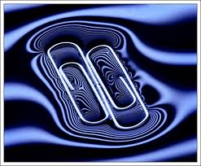
1) Cohesion
Attraction between water molecules.
Results in Surface Tension (a measure of how difficult it is to break the surface of a liquid).
Produces a surface film.
Notes:
1

Slide 26
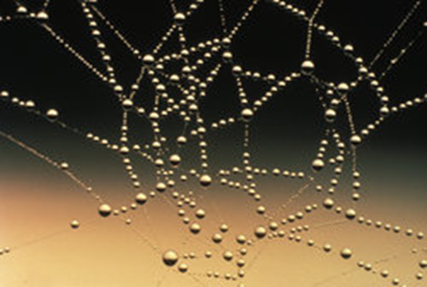
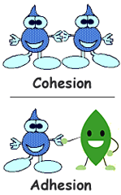
2) Adhesion
Attraction between water and another substance.
Water will make hydrogen bonds with other surfaces such as glass, soil, plant tissues, and cotton.
Notes:
1

Slide 27
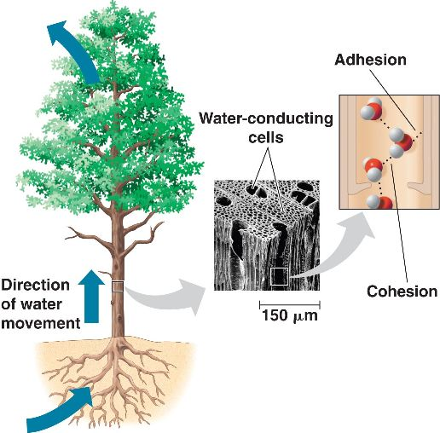
Cohesion and Adhesion
Most plants depend upon cohesion and adhesion to help transport water and nutrients from their roots to their leaves.
Notes:
1

Slide 28
3) Temperature Moderation
Heat → energy in transfer from a warmer to a cooler substance.
Temperature measures the amount of heat energy — that is, the average speed of molecules in a substance.
  The higher the heat energy the higher the temperature.
Notes:
1

Slide 29
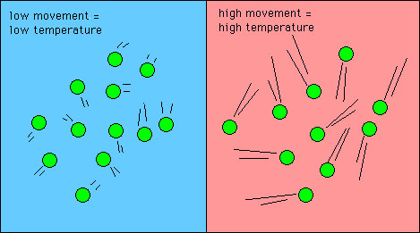
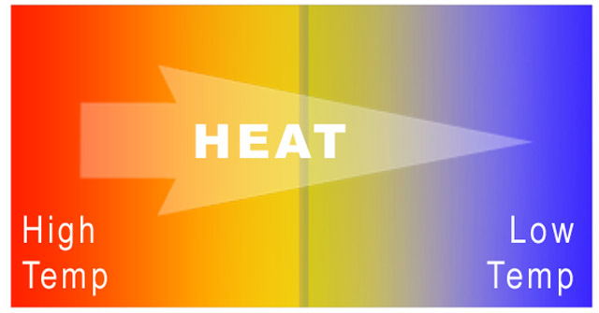
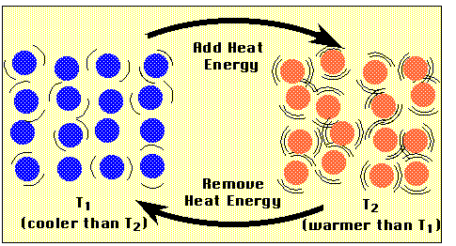
3) Temperature Moderation
Notes:
1

Slide 30
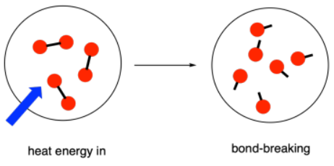
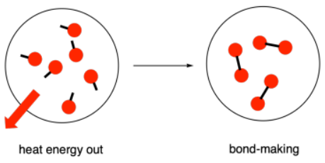
3) Temperature Moderation
Heat must be absorbed to break hydrogen bonds.
Heat is released when hydrogen bonds form.
To raise the temperature of water, hydrogen bonds between water molecules must be broken before the molecules can move faster.
Notes:
1

Slide 31
Specific Heat of Water
The specific heat capacity, or simply the specific heat (C) of a substance, is the amount of heat it takes to raise the temperature of 1 g of the substance 1⁰ C.
Water has the second highest specific heat of all liquids.
Metals generally have low specific heats.
Specific Heats of Some Common Substances
Substance | Specific heat (c_{p})
 | J/(g·⁰C) | cal/(g·⁰C)
Liquid water | 4.18 | 1.00
Ethanol | 2.4 | 0.58
Ice | 2.1 | 0.50
Steam | 1.9 | 0.45
Chloroform | 0.96 | 0.23
Aluminum | 0.90 | 0.21
Iron | 0.46 | 0.11
Silver | 0.24 | 0.057

Slide 32
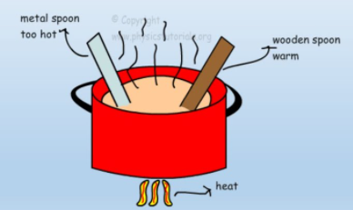
3) Temperature Moderation
Water has a high specific heat
  when warming up, water absorbs a large amount of heat.
  when water cools, water molecules slow down, more hydrogen bonds form, and a considerable amount of heat is released.
Notes:
1

Slide 33

Specific Heat (C)
Some things heat up or cool down faster than others.
Land heats up and cools down faster than water
e.g. Michigan stays warmer in the winter due to the heat from the lakes (e.g. hot vegetables stay hot a long time because of their high water content)

Slide 34
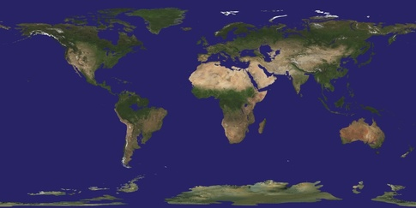
3) Temperature Moderation
Earth’s giant water supply, with its high resistance to temperature change, moderates temperatures, helping to keep temperatures within limits that permit life.
Water’s resistance to temperature change also stabilizes ocean temperatures, creating a favorable environment for marine life.
Notes:
1

Slide 35

4) Water is Less Dense as a Solid
Ice floats because is less dense than liquid water.
This accounts for lakes and other bodies of water freezing on the top first (insulating the water and organisms below from harsh temperature changes).
Notes:
1

Slide 36
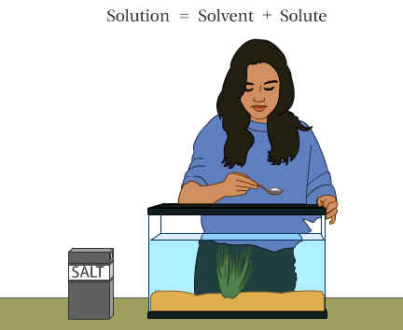
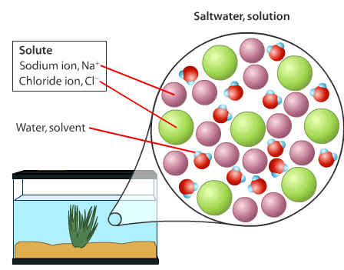
5) Water is the Solvent of Life
A SOLUTION is a liquid consisting of a uniform mixture of two or more substances.
Solute is the substance that is dissolved (lower quantity).
Solvent is the dissolving agent (higher quantity).
Aqueous solution → Water is the solvent.
All metabolic processes of life occur in aqueous solution environments.

Slide 37
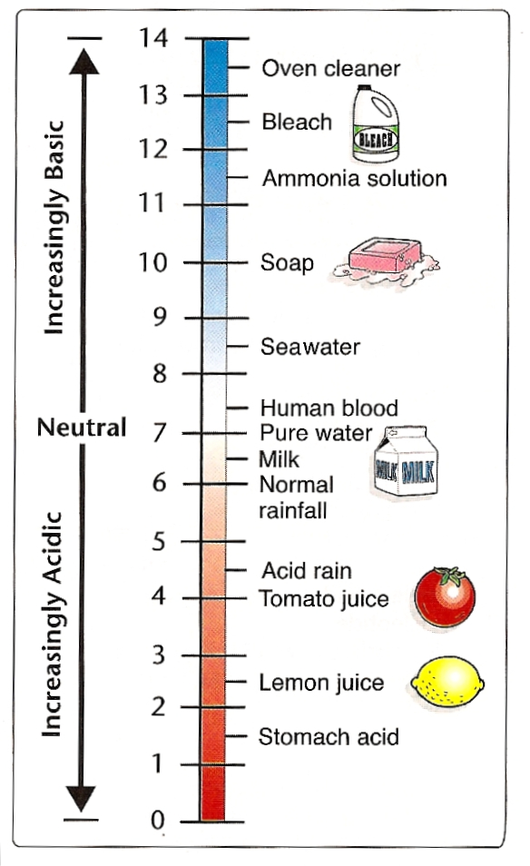
Acids, Bases and pH
The pH scale describes how acidic or basic a solution is.
The pH scales ranges from _________.
0 to 14
Each pH unit represents a 10-fold change in the concentration of H+ in a solution
A pH of 7 is a _________ solution. This is neither acidic nor basic. Pure water has a pH of 7.
neutral
Solutions with a pH below 7 are considered ______.
acidic
Solutions with a pH above 7 are considered _______.
The pH Scale
basic

Slide 38
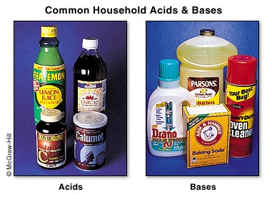
Acid, Bases and pH
The chemistry of life is sensitive to acidic and basic conditions.
ACID → substance that donates Hydrogen ions (H+) to solutions.
BASE → substance that reduces the Hydrogen ions (H+) concentration of a solution.
Notes:
1

Slide 39
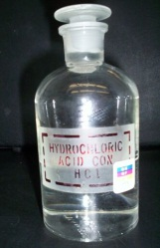
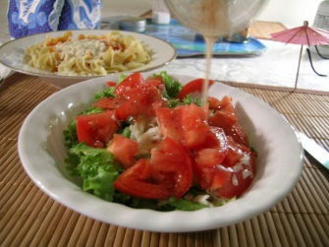
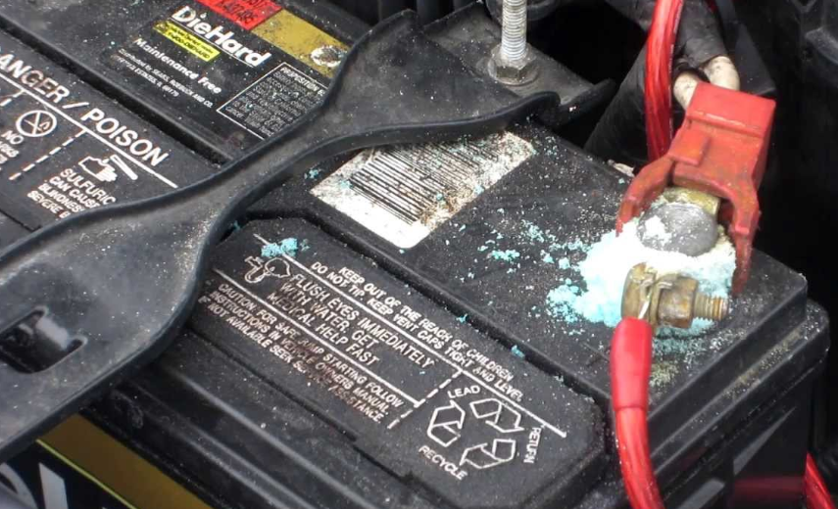
Acidic Solutions
  A substance that increases the concentration of H⁺ (H₃O⁺) ions in solution.
    H⁺: hydrogen ion … H₃O⁺: hydronium ion
  In acidic solutions, the hydrogen-ion concentration is greater than the hydroxide-ion concentration.
  [H⁺] > [(OH)⁻]
Notes:
39

Slide 40
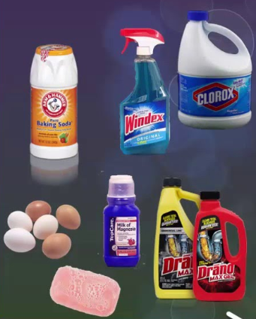
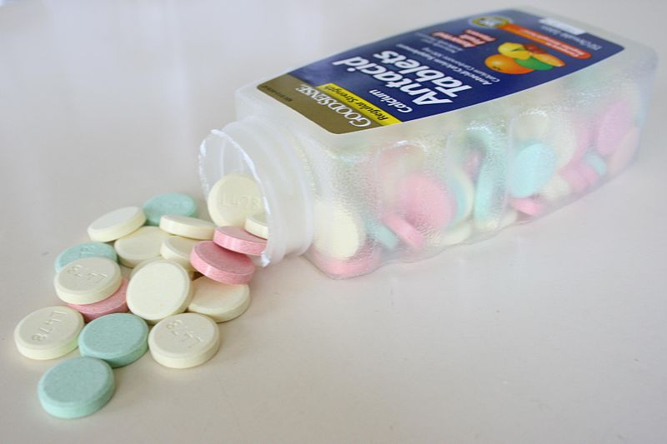
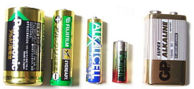
Basic Solutions
  A substance that increases the concentration of (OH)⁻ ions in solution.
  In basic solutions, the hydroxide-ion concentration is greater than the hydrogen-ion concentration.
  [(OH)⁻] > [H⁺]
  Basic solutions are also known as alkaline solutions.
Notes:
40

Slide 41
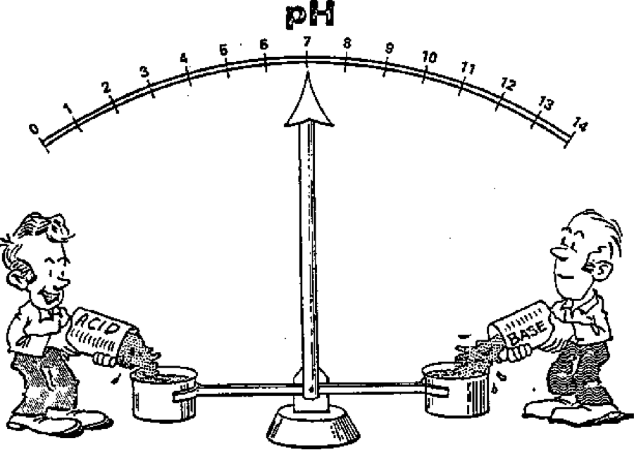
Buffers
Example of where they work:
The pH of most human cells should generally be between 7 and 7.5.
If the pH gets too high or too low, it affects the chemical reactions that take place within cells.
Cells must be able to control their pH.
Buffers are substances produced by cells that prevent sharp, sudden changes in pH.

Slide 42
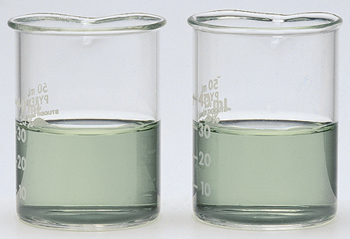
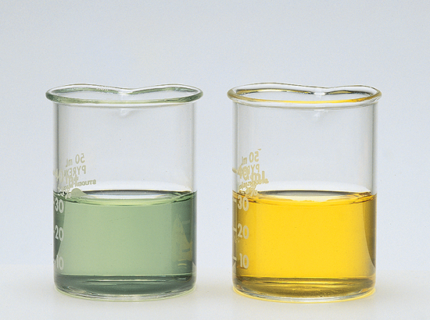
Buffers
Observe what happens when 1.0 mL of 0.10M HCl solution is added to buffered and unbuffered solutions.
HCl is added to each solution.
buffered
unbuffered
buffered
unbuffered
acidic
PRIOR to adding acid, the indicator shows that both solutions are basic (pH of about 8).
The indicator shows no visible pH change in the buffered solution.
The color change in the unbuffered solution indicates a change in pH from 8 to about 3.
Notes:
42

Slide 43
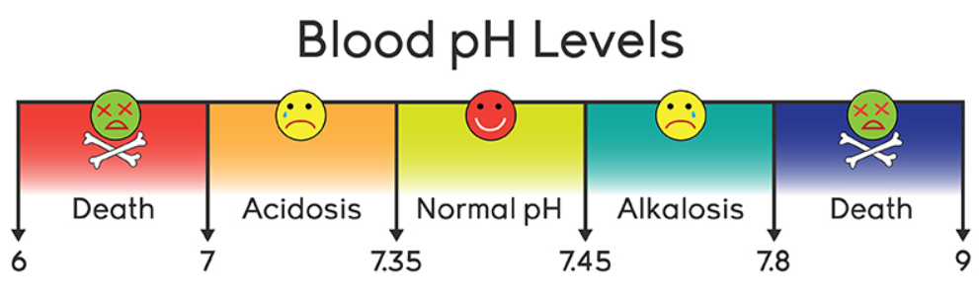
Buffers
Buffers cause neutralization reactions that will not have much effect on the overall pH of the buffer solution.
When hydrogen ions are added to a buffer, they will be neutralized by the base in the buffer.
Hydroxide ions will be neutralized by the acid.
Notes:
43

