Slide 1
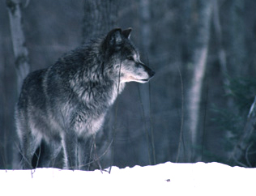
Michigan Wolves:
Past, Present, and Future
Dorothy F. McLeer
Timber Wolf Alliance

Slide 2
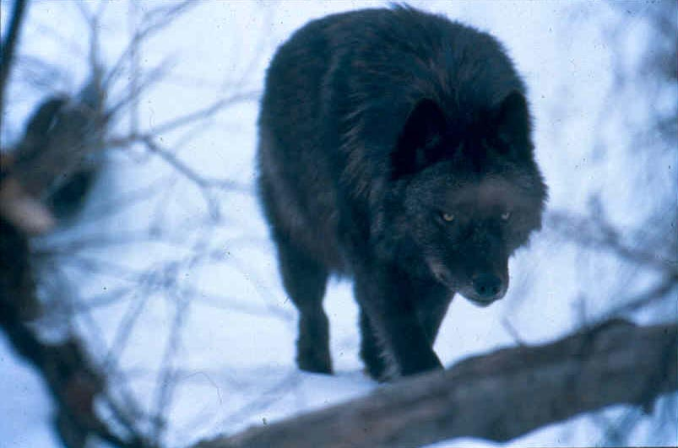

Slide 3
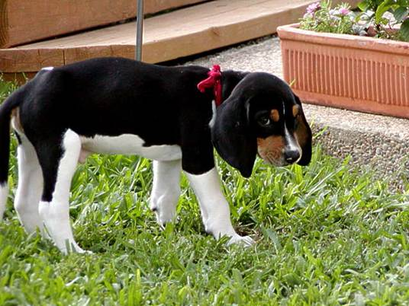

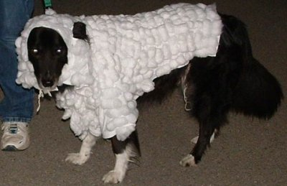

Slide 4
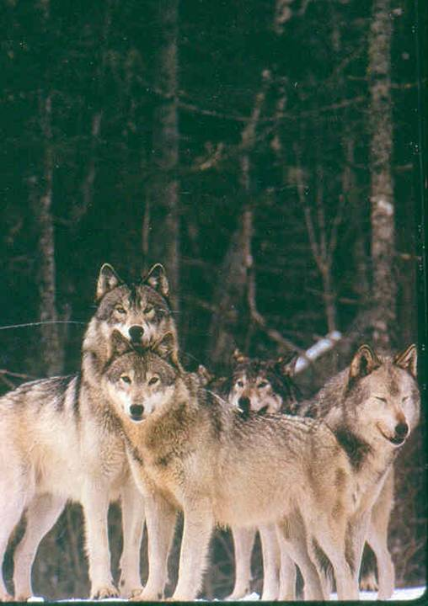

Slide 5
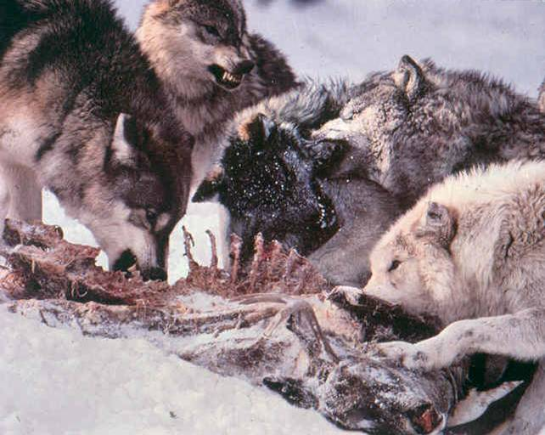

Slide 6
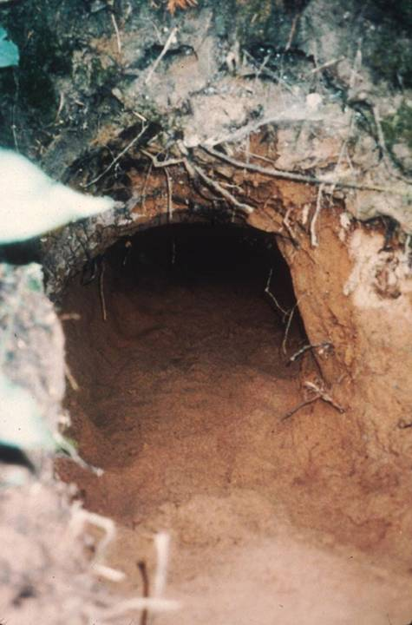

Slide 7
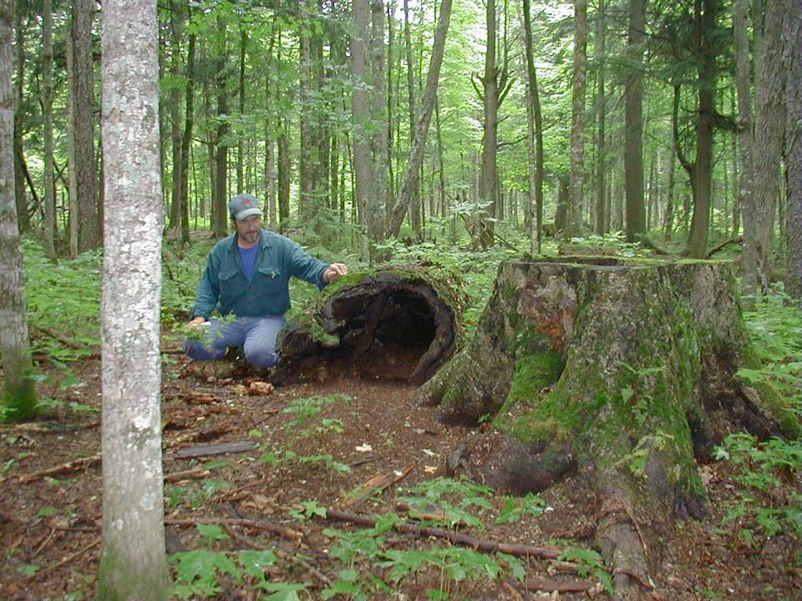

Slide 8
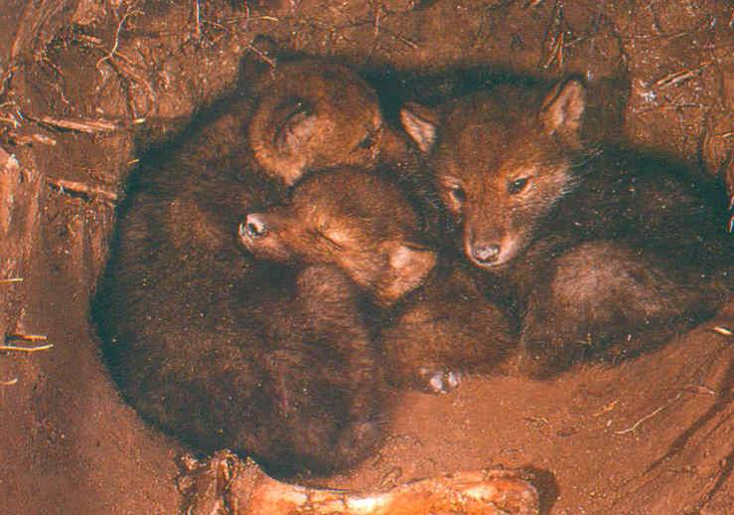

Slide 9
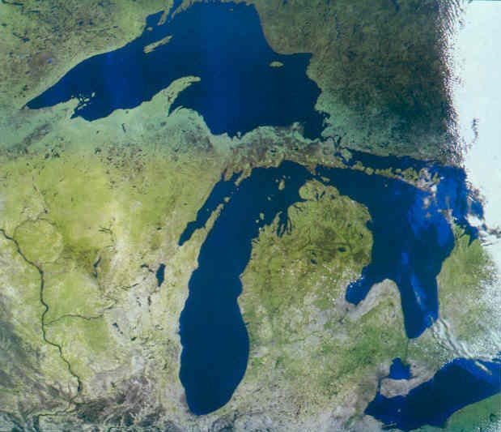

Slide 10

Ma’iingan,
Brother Wolf

Slide 11
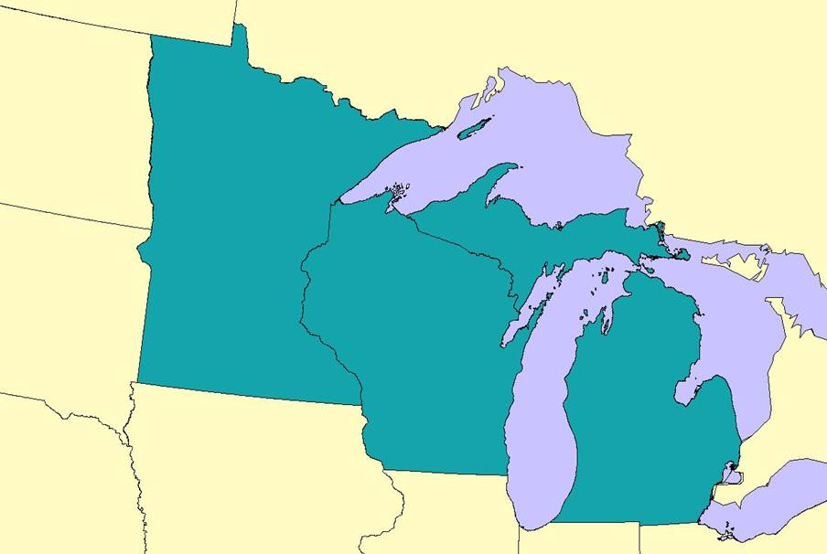
Pre-settlement Wolf Distribution in the Upper Great Lakes States

Slide 12
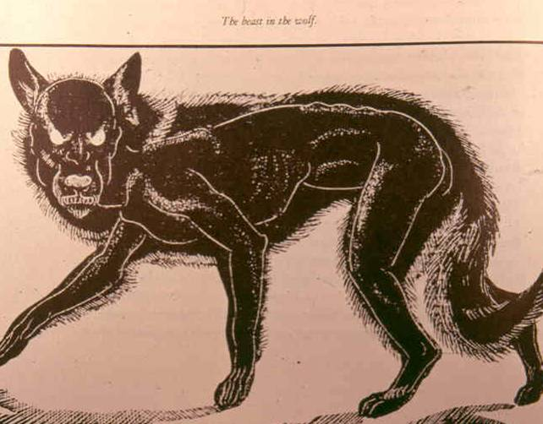

Slide 13
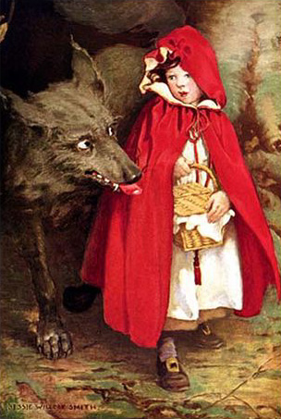

Slide 14
Wolf Bounty Programs
Bounties are $$$$ paid as incentive for capture and/or killing
Bounties are designed not to reduce but to eliminate a species
Sixth century B.C., Greece: first wolf bounty
1510: last wolves in England killed
1630, Plymouth, MA: bounty instituted by English colonists
1700: wolves extirpated from New England landscape

Slide 15
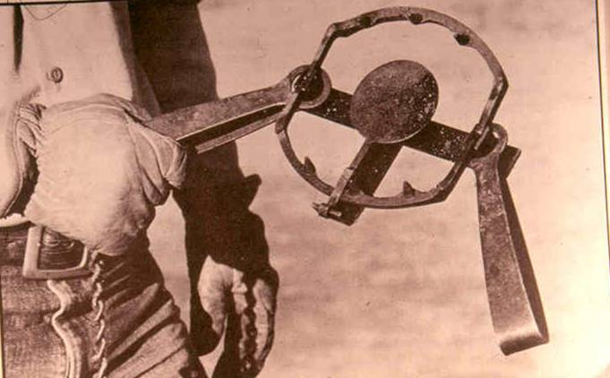

Slide 16
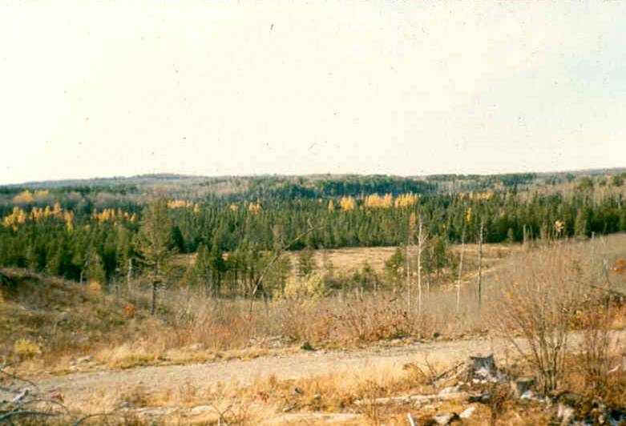

Slide 17
Early MI Wolf Management
(post-European settlement)
1817: Congress passes wolf bounty in Northwest Territories (MI)
1838: One year after statehood, MI wolf bounty instituted (9th law)
1922-1935: State trapper system
1935: Bounty reinstated
1960: Bounty repealed
1965: MI wolves granted full state protection

Slide 18
Michigan Wolf Populations
(post-European settlement)
1837: Wolves south of mid-Michigan exterminated
1900: All wolves below the Straights of Mackinac gone
1954: Last documented pup production known at Pictured Rocks National Lakeshore
1960: Gray wolves in Michigan (except Isle Royale) all but gone
1973: Possibly six left in MI, around Pictured Rocks

Slide 19
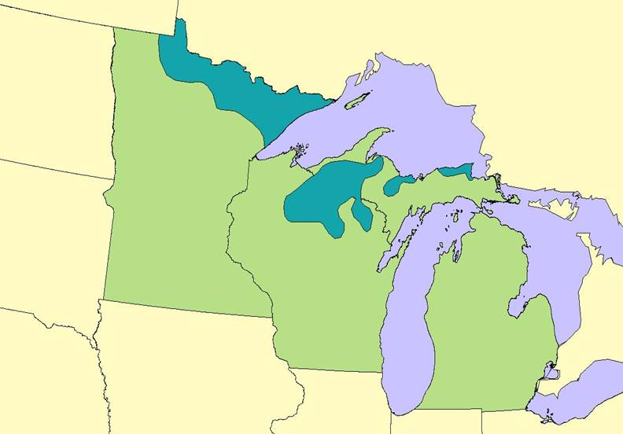
Wolf Distribution in the
Upper Great Lakes States, 1950

Slide 20
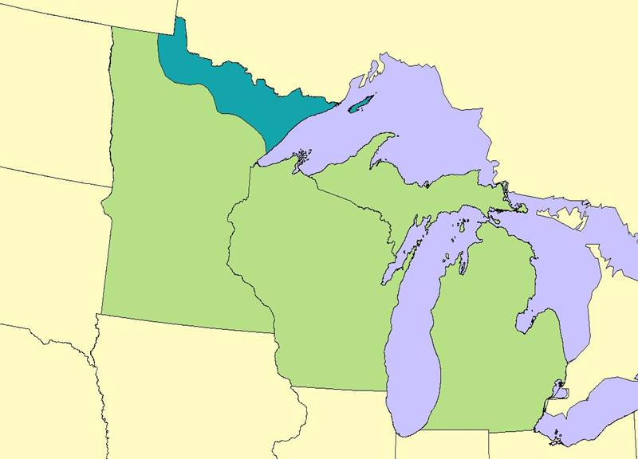
Wolf Distribution in the
Upper Great Lakes States, 1960-1970

Slide 21
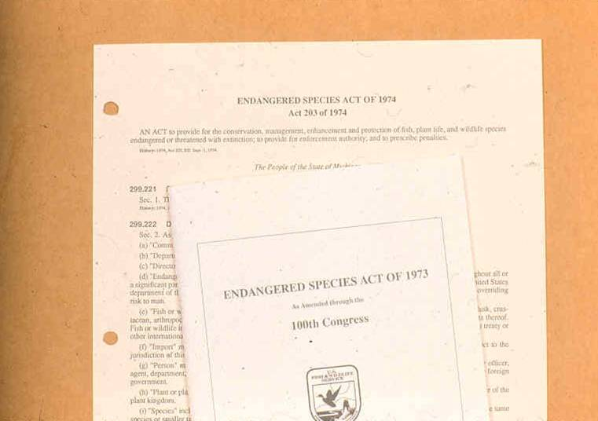

Slide 22
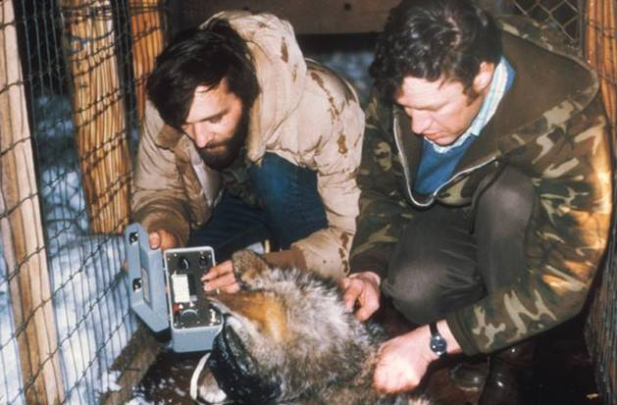

Slide 23
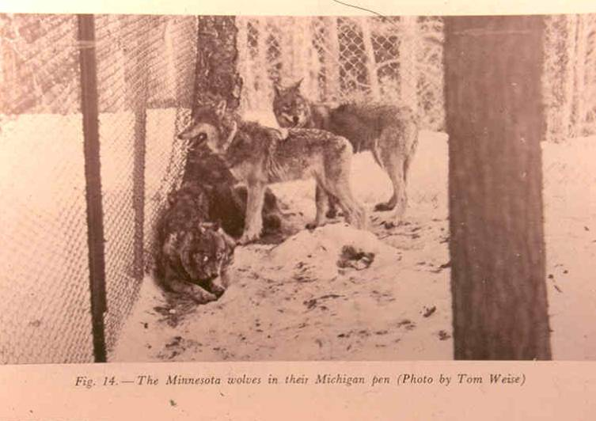

Slide 24
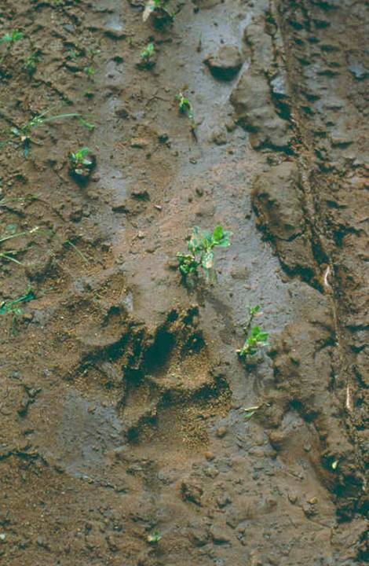
…where did they come from…?

Slide 25
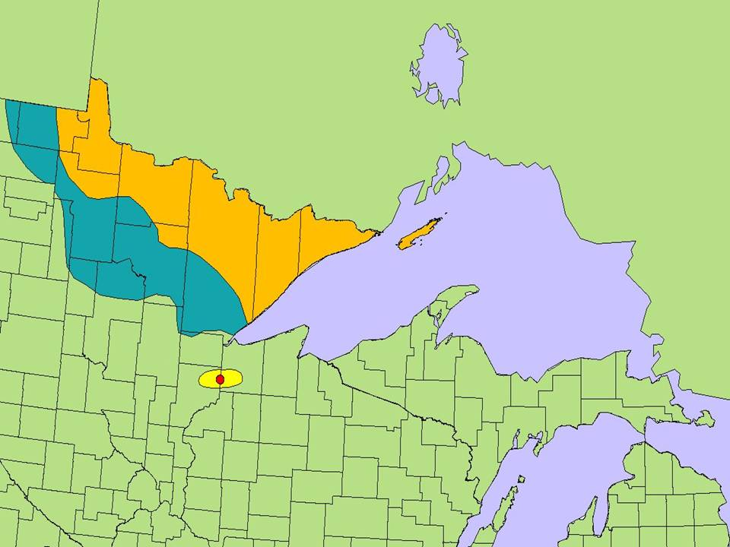
Range Expansion
1960
Early
1970’s
1980s
1974-75
1980s

Slide 26
Hunter Outreach Program
A partnership between volunteer wolf advocates and wildlife agency personnel
A way to distribute factual information about wolves
About 100,000 firearm deer hunters hunt in the UP
Historically, many wolves have been illegally killed during firearm deer season (Nov. 15-30)

Slide 27
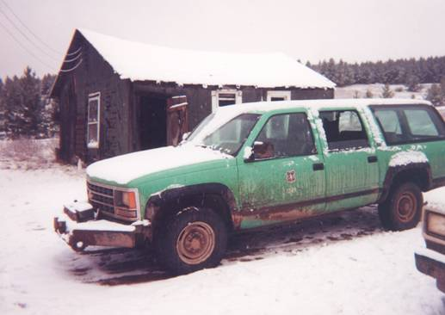
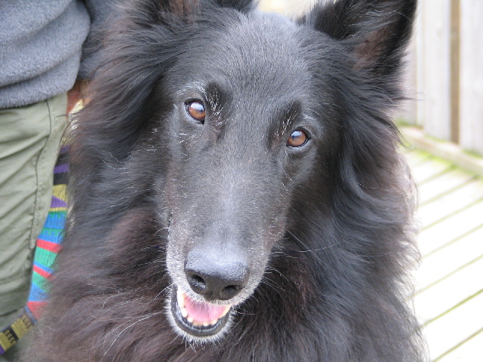
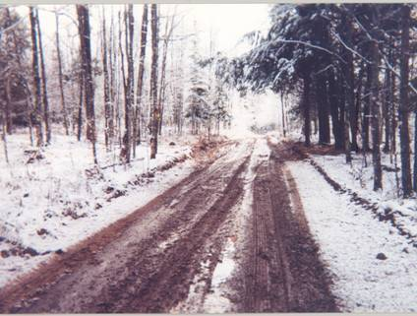

Slide 28
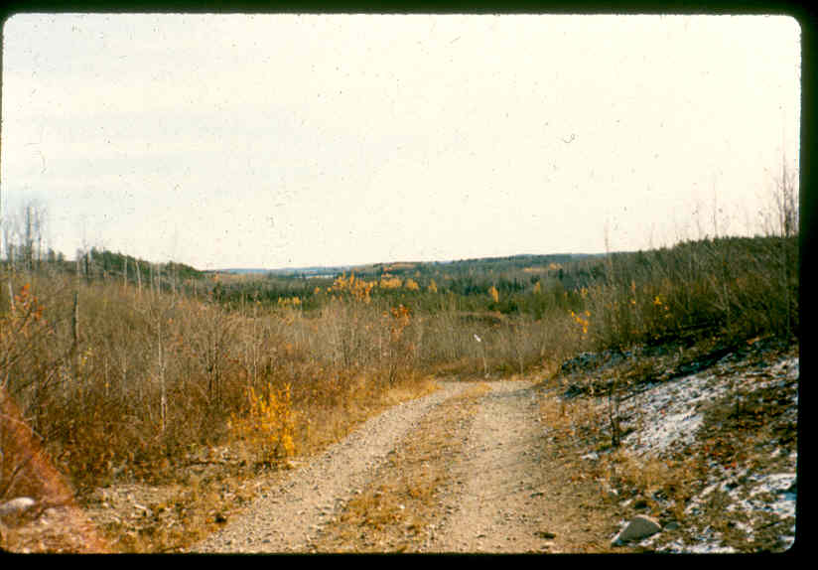
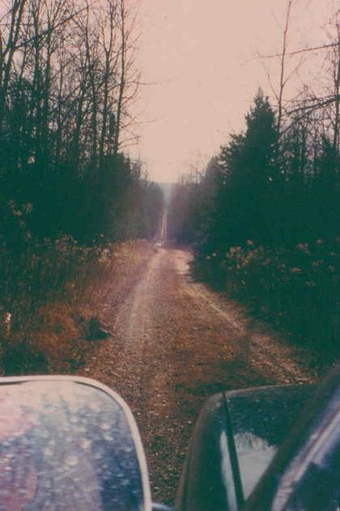
Yooper
Super-Highways

Slide 29
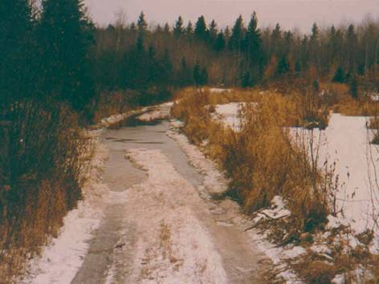
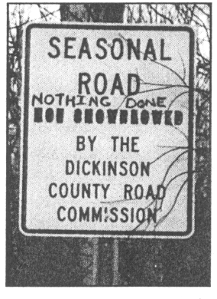
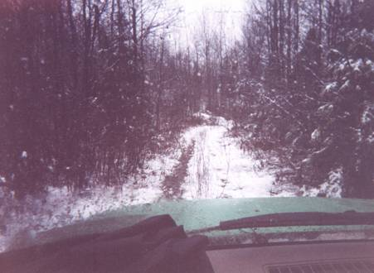

Slide 30
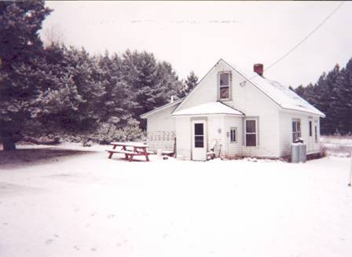
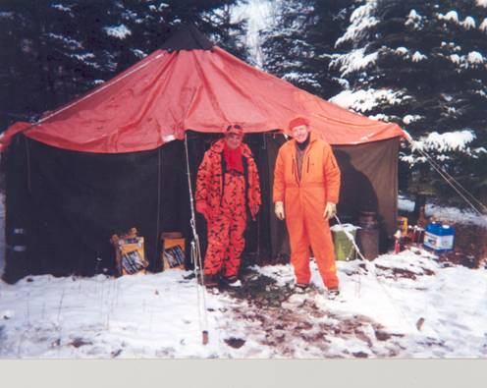
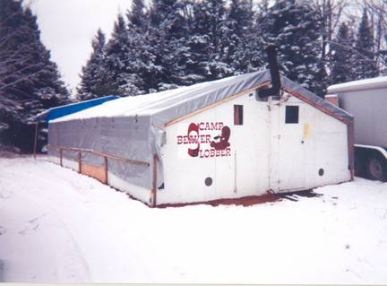

Slide 31
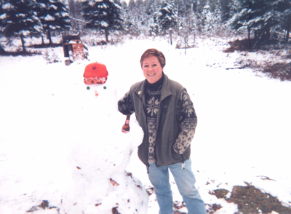
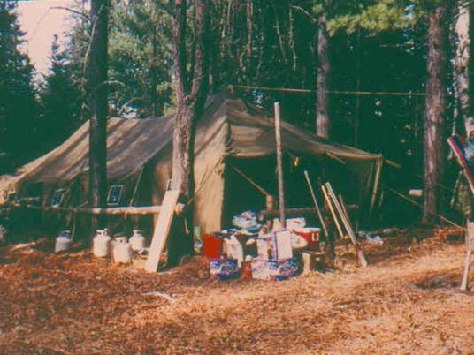

Slide 32
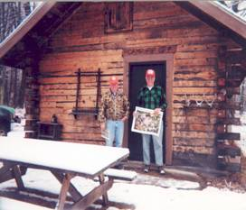
In Michigan, About 1,000
Hunters Receive:
DNR F.A.Q. wolf information sheet
DNR Wolf Recovery & Mgmt. Plan summary page
Press release on livestock depredation compensation
“Sharing the Land with Wolves”
Bookmarks with wolf and coyote track measurements
DNR Wolf Observation Report
Timber Wolf Alliance information
Wolf Awareness Week posters

Slide 33
APPROXIMATE NUMBERS OF U.P. DEER DYING ANNUALLY TO VARIOUS CAUSES
human harvest
wounding loss
low estimate
road kill
high estimate
mild winter
typical winter
severe winter
Human causes kill
~61,000 deer/yr.
Winter stress kills between 35,000 and 105,000 deer/yr, depending on winter severity.
Wolves likely kill between 12,000-20,000 deer/yr.
In a typical year, there are ~350,000 deer in the U.P.
**NOTE—other predators and disease are not included**

Slide 34
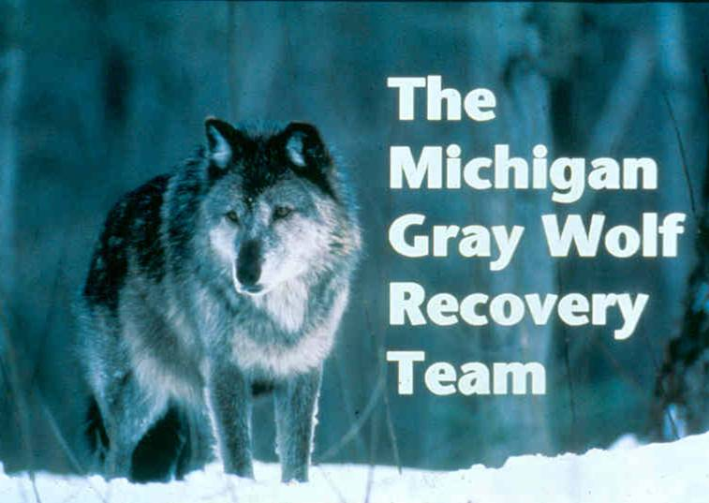

Slide 35
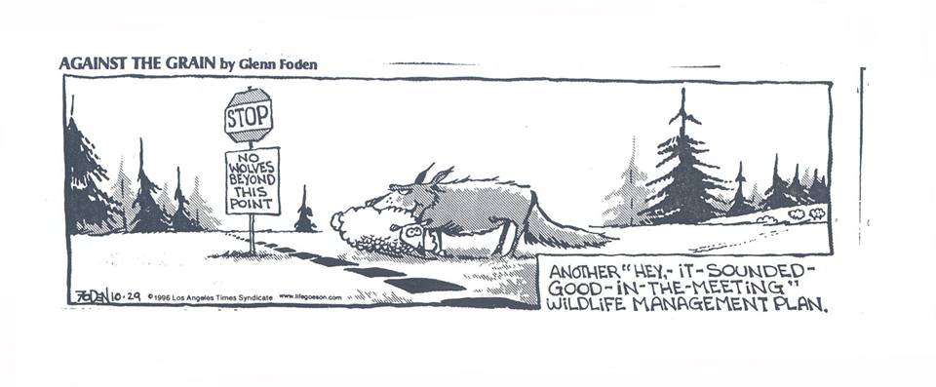

Slide 36
Recovery and Management Strategy
Public support is vital for the long-term survival of wolves in Michigan.
Information and education efforts…are essential…and a high priority.
Wolf protection will be achieved…law enforcement, cooperation with tribal leaders, landowners, hunters, trappers, and livestock farmers.
Wolf population monitoring needed…measure progress, …limiting factors, …and direct management at all population levels.

Slide 38
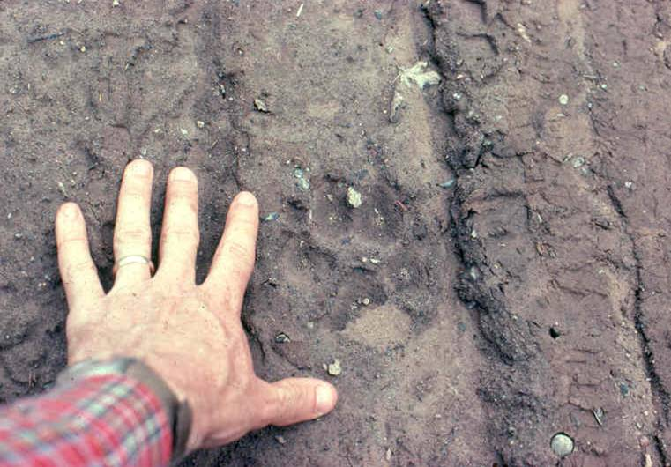

Slide 39
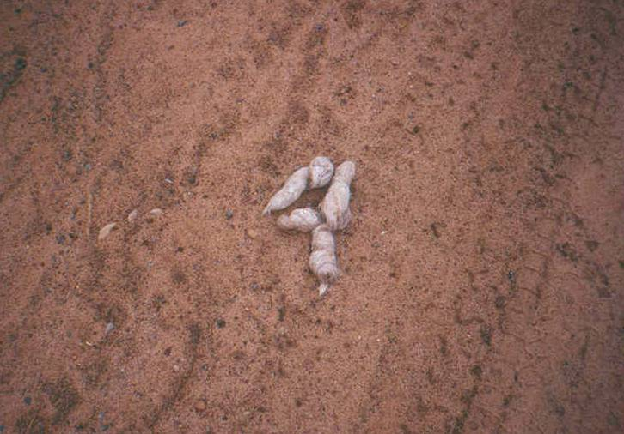

Slide 40
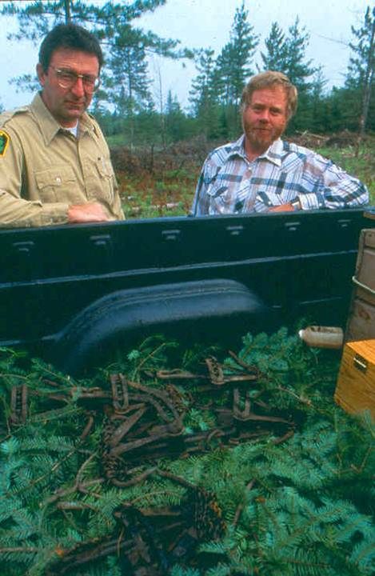

Slide 41
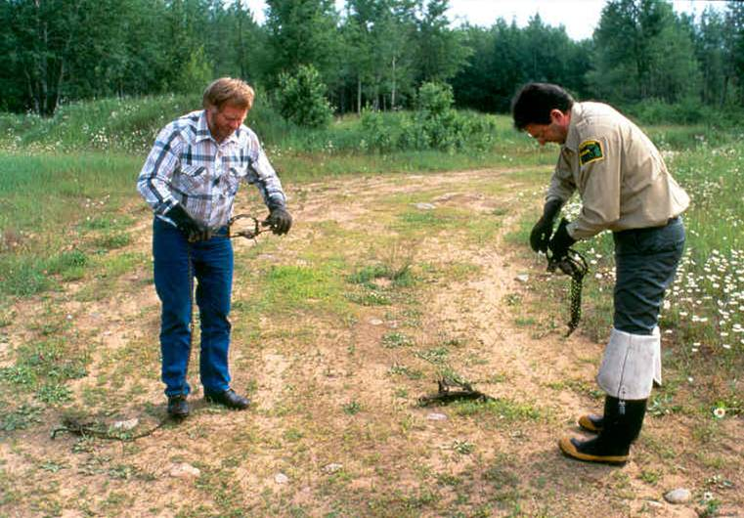
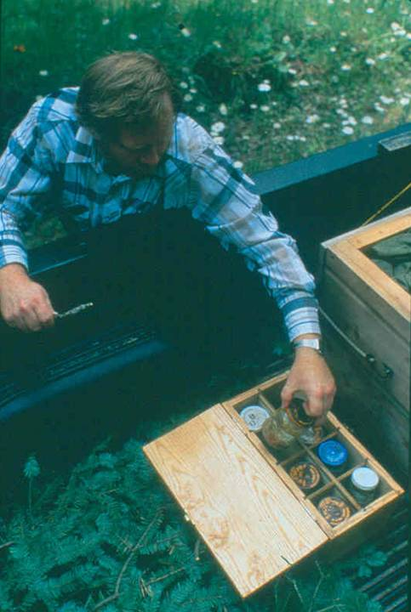

Slide 42
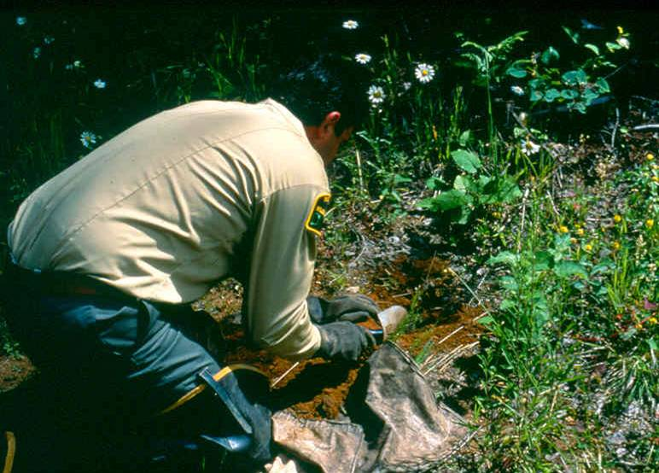

Slide 43
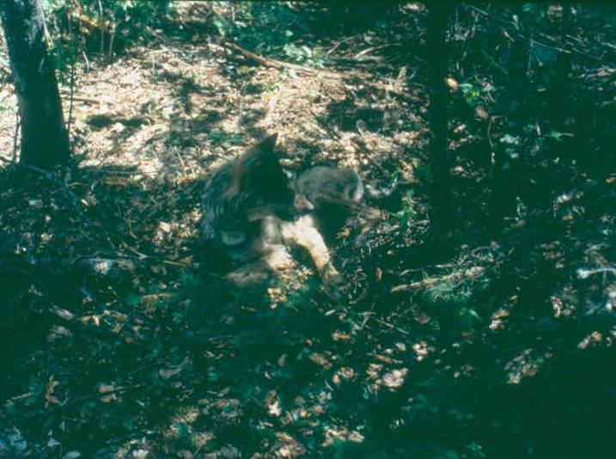

Slide 44
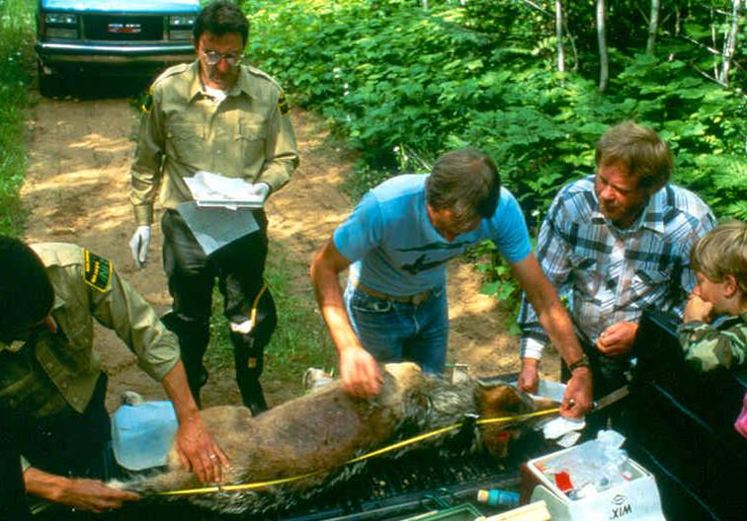

Slide 45
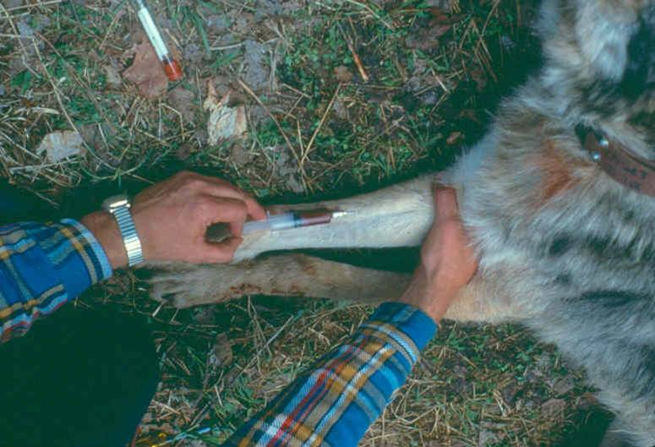

Slide 46
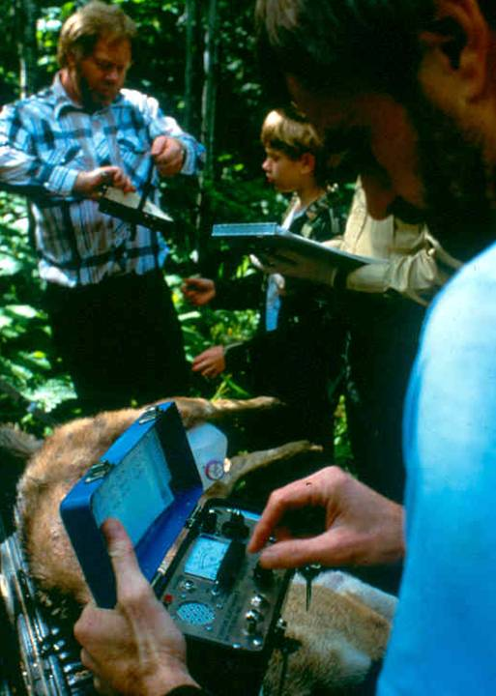

Slide 47
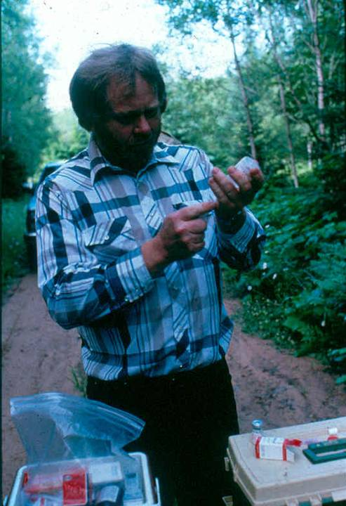

Slide 48
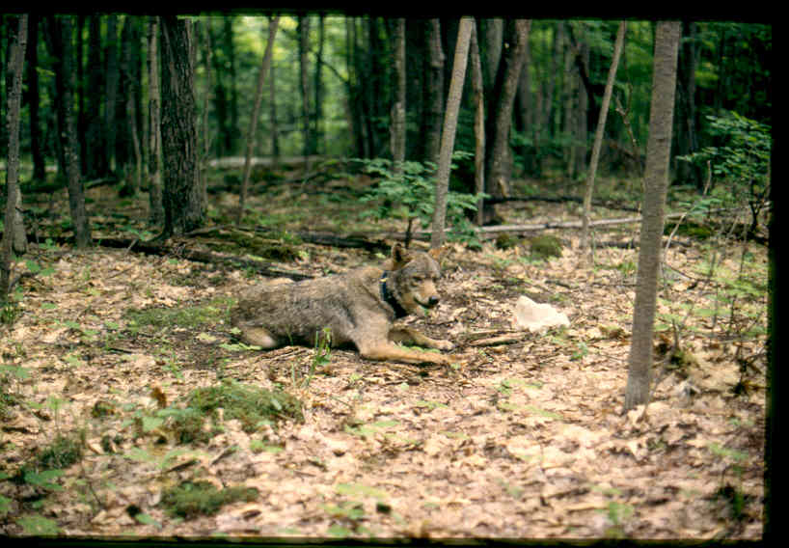

Slide 49


Slide 50


Slide 51


Slide 52


Slide 53


Slide 54


Slide 55
Wolf Radio: All Wolves, All the Time!
Presently, ~50 active collars in the UP
237 Individual Wolves Have Been Captured 269 times
MDNR Has Collected
19,224 Telemetry
Locations

Slide 56


Slide 57

Gray Wolf Distribution in the
Upper Peninsula of Michigan, 1992

Slide 58

Gray Wolf Distribution in the
Upper Peninsula of Michigan, 1993

Slide 59

Gray Wolf Distribution in the
Upper Peninsula of Michigan, 1995

Slide 60


Slide 61

Citizen Observations of Wolves 1999-2000

Slide 62

2006 Packs and Loners Found During the
Minimum Winter Population Estimates

Slide 63

2007 Wolf Pack Movements

Slide 64

2007 NLP Survey
No evidence of wolves in 2007
Winter 2006
Fall 2004
Spring 2005

Slide 65

Minimum Winter Population Estimates

Slide 66

Long Distance Movement Of
Wolves Between Other States

Slide 67

Minnesota, Wisconsin and Michigan as well as parts of North Dakota, South Dakota, Iowa, Illinois, Indiana and Ohio.
The DPS includes all the areas currently occupied by wolf packs in Minnesota, Michigan, and Wisconsin, as well as areas in these states in which wolf packs may become established in the future.
The DPS also includes surrounding areas into which wolves may disperse but are not likely to establish packs.
Notes:
67

Slide 68
The Wolf Score Card
April 1, 2003: USFWS upgraded to “Threatened” from “Endangered”
Jan., 2005: Federal district court in Oregon withdraws decision; wolves “Endangered” once again
Spring, 2005: Special permits granted by USFWS to euthanize depredating wolves (20 MI, 34 WI)
Sept., 2005: Humane Society of US and 18 other groups file suit against USFWS; DNR applies for permits for ltd. lethal methods

Slide 69
The Wolf Score Card
May, 2006: Permit issued allowing DNR and USDA Wildlife Services use ltd. lethal control- max. 40 (MI) and 43 (WI) permits for confirmed wolf depredation
August 9, 2006: Federal judge revoked Wisconsin permits as a result of lawsuit; based on this ruling, USFWS revoked Michigan’s permits a week later. Wolves are, once again, a federally endangered species.
January 29, 2007: USFWS announces proposal to remove western Great Lakes wolf population from endangered and threatened list. Official after 30-day public comment period.

Slide 70

Signed July 2008!

Slide 71

Minimum Winter
Wolf Track Survey,
2007-’08

Slide 72
Wolf Population Survey Summary
Parameters | 2000 | 2001 | 2002 | 2003 | 2004 | 2005 | 2006 | 2007 | 2008
Pop. Estimate | 216 | 249 | 278 | 321 | 360 | 405 | 434 | 509 | 520
No. Packs | 63 | 70 | 63 | 68 | 77 | 87 | 91 | 94 | 115
No. Pairs | 27 | 33 | 17 | 18 | 24 | 24 | 22 | 21 | 27
No. Loners | 14 | 5 | 8 | 11 | 6 | 6 | 11 | 5 | 11
x Pack Size | 3.2 | 3.5 | 4.3 | 4.6 | 4.6 | 4.6 | 4.6 | 4.9 | 4.4
Mi. Surveyed | 6,314 | 6,205 | 7,326 | 8,092 | 8,298 | 8,458 | 8,622 | 6,562 | 5,956
Hours | 2,550 | 2,120 | 2,447 | 2,385 | 2,005 | 2,609 | 2,122 | 1,801 | 1,413

Slide 73
What Do the Numbers Mean?
Federal recovery plan requires a sustained population of 100 wolves between Michigan and Wisconsin for a period of 5 years.
Michigan’s plan requires 200 wolves as the minimum population for a self sustaining population to delist wolves from Michigan's Endangered Species list.
The third population level has not been determined. It will be established based both on a biological and social (people) carrying capacity.

Slide 74

What is the Future for Michigan Wolves?
Confirmed minimum wolf pop.: 520 Confirmed number of packs: 115
Pack size between 4-5 wolves (4.4)
Population growth continues, but has slowed in the past five years
Habitat remains favorable
Diseases such as parvo, mange, and rabies do not seem to be a problem
Non-lethal control methods in practice

Slide 75
Current News
575 min count
5.3 pack size; increase
5 possible poachings
12 depredation events (8 cows, 3 sheeps, 1 pet dog)
300,000-350,00 white-tails UP

Slide 76
However…
“Shoot, shovel, and shut up” Illegal wolf poaching an issue
UP deer mgmt. to reduce deer herd, so hunter harvest lower
“Bold” or habituated wolves are a concern
Verified wolf depredation on livestock and pets
*July 2, 2008, Great Lakes DPS relisted as “endangered”

Slide 77
Letters to the Editor, Ironwood, MI
“What needs to happen is for the DNR to get off their duff and control these animals, or let the ones who know how to handle the problems do it, meaning, the farmers who have been doing their job for hundreds of years.”
Jon Brown
Anvil Location
“If the people down state want wolves, they can have ours, we don't want them.”
Darrin Jarvenpaa
Ironwood

Slide 78

There’s a place for wolves…
A hole in the ground with the fishers and the pine martens!!

Slide 79


The truth lies between the extremes…

Slide 80

Let’s work together to find the answers!

