Slide 1
Go to the “Slide Show” shade above
Click on “Play from Beginning”

Slide 2
Chapter 6
Metabolism Overview and Enzymes

Slide 3
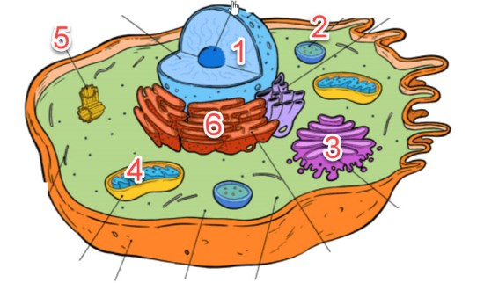
Label the Organelles (Animal or Plant?)
8
7
9
11
12
10
13
Notes:
#frame
Timing ~ 1 minute.
Entry Audio: After reviewing the five characteristics of life, use these criteria to identify the objects that are living.
Hint Audio: Determine whether each item is missing one of the characteristics. If it is, then don’t check it — it’s not living.
SOURCES:
Flower. “Flowers,” Domenico Salvagnin. 2005 as CC, Digital Image. http://www.flickr.com/photos/dominiqs/137546658/ (accessed April 9, 2012).
Rock. “Diorite.jpg,” Siim Sepp. 2005 as CC-SA/GNU, Digital Image. http://commons.wikimedia.org/wiki/File:Diorite.jpg (accessed April 20, 2011).
Lightning. “Lightning,” Tim . 2008 as CC, Digital Image. http://www.flickr.com/photos/seabamirum/2726998568/ (accessed April 20, 2011).
Mushroom. “IMG_3008.JPG,” Badeendjuh. 2009 as Free Photo, Digital Image. http://www.morguefile.com/archive/display/629267 (accessed April 20, 2011).

Slide 4
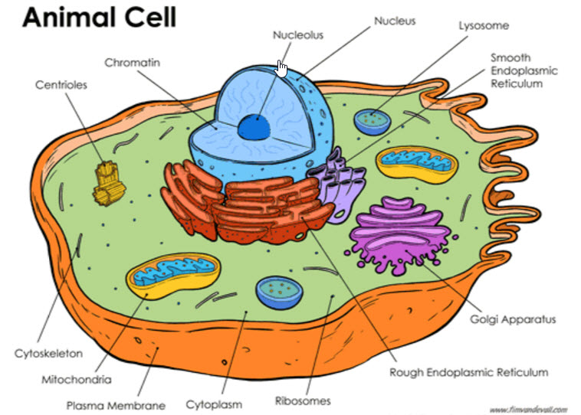
Label the Organelles
Notes:
#frame
Timing ~ 1 minute.
Entry Audio: After reviewing the five characteristics of life, use these criteria to identify the objects that are living.
Hint Audio: Determine whether each item is missing one of the characteristics. If it is, then don’t check it — it’s not living.
SOURCES:
Flower. “Flowers,” Domenico Salvagnin. 2005 as CC, Digital Image. http://www.flickr.com/photos/dominiqs/137546658/ (accessed April 9, 2012).
Rock. “Diorite.jpg,” Siim Sepp. 2005 as CC-SA/GNU, Digital Image. http://commons.wikimedia.org/wiki/File:Diorite.jpg (accessed April 20, 2011).
Lightning. “Lightning,” Tim . 2008 as CC, Digital Image. http://www.flickr.com/photos/seabamirum/2726998568/ (accessed April 20, 2011).
Mushroom. “IMG_3008.JPG,” Badeendjuh. 2009 as Free Photo, Digital Image. http://www.morguefile.com/archive/display/629267 (accessed April 20, 2011).

Slide 5
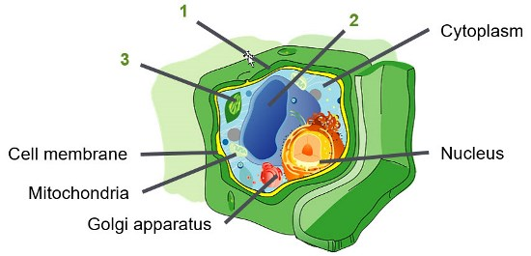
Label the Organelles & Name Differences between Plant and Animal Cells
8
4
7
5
6
Notes:
#frame
Timing ~ 1 minute.
Entry Audio: After reviewing the five characteristics of life, use these criteria to identify the objects that are living.
Hint Audio: Determine whether each item is missing one of the characteristics. If it is, then don’t check it — it’s not living.
SOURCES:
Flower. “Flowers,” Domenico Salvagnin. 2005 as CC, Digital Image. http://www.flickr.com/photos/dominiqs/137546658/ (accessed April 9, 2012).
Rock. “Diorite.jpg,” Siim Sepp. 2005 as CC-SA/GNU, Digital Image. http://commons.wikimedia.org/wiki/File:Diorite.jpg (accessed April 20, 2011).
Lightning. “Lightning,” Tim . 2008 as CC, Digital Image. http://www.flickr.com/photos/seabamirum/2726998568/ (accessed April 20, 2011).
Mushroom. “IMG_3008.JPG,” Badeendjuh. 2009 as Free Photo, Digital Image. http://www.morguefile.com/archive/display/629267 (accessed April 20, 2011).

Slide 6
Organelles
Differences
1 Cell wall
2 Large Central Vacuole
3 Chloroplast
Flagella (if present)
Notes:
#frame
Timing ~ 1 minute.
Entry Audio: After reviewing the five characteristics of life, use these criteria to identify the objects that are living.
Hint Audio: Determine whether each item is missing one of the characteristics. If it is, then don’t check it — it’s not living.
SOURCES:
Flower. “Flowers,” Domenico Salvagnin. 2005 as CC, Digital Image. http://www.flickr.com/photos/dominiqs/137546658/ (accessed April 9, 2012).
Rock. “Diorite.jpg,” Siim Sepp. 2005 as CC-SA/GNU, Digital Image. http://commons.wikimedia.org/wiki/File:Diorite.jpg (accessed April 20, 2011).
Lightning. “Lightning,” Tim . 2008 as CC, Digital Image. http://www.flickr.com/photos/seabamirum/2726998568/ (accessed April 20, 2011).
Mushroom. “IMG_3008.JPG,” Badeendjuh. 2009 as Free Photo, Digital Image. http://www.morguefile.com/archive/display/629267 (accessed April 20, 2011).

Slide 7
Lesson Objectives
  By the end of this lesson, you should be able to:
Define types of Metabolism.
Investigate the structure and function of ATP.
Investigate the properties and actions of Enzymes in living systems.
Science Practice: Enzymes in Pineapple
Metabolism & Enzymes
Notes:
#frame
instructional video
Timing ≈ 0.5 minutes
Intro
Transition: In the warm-up, you observed two different types of cells and thought about the differences in their internal structure. In fact, that is what the first objective [read it] is really about.
Preview the other objectives:
Preview the 2nd objective as being part of the first.
Preview the third one that was created because of our understanding of the first two objectives.
Finally, mention that along the way, they’ll Evaluate past research from investigations similar in design and purpose.

Slide 8
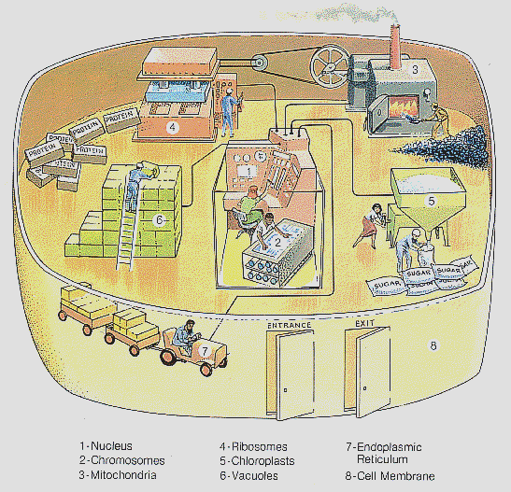
Cells Transform Energy As They Perform Work
Picture a cell with its organelles as a manufacturing plant.
What organelles would take on the functions shown in the diagram?

Slide 9
Cells Transform Energy As They Perform Work
Cells are miniature chemical factories, housing thousands of chemical reactions.
Some of these chemical reactions release energy, and others require energy.

Slide 10
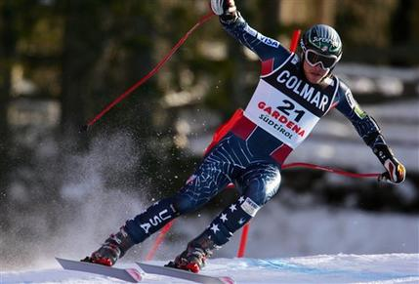
Energy
Ability to do Work or to cause Change.
Two General Types of Energy that exist in all forms of energy:
1. Kinetic energy is the energy of motion
  2. Potential energy is stored energy that matter possesses as a result of its location or structure.
  Energy can be converted from one form to another.

Slide 11
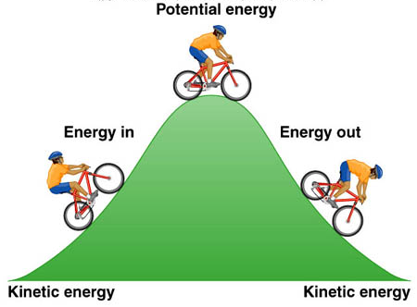
Potential & Kinetic Energy
Describe the energy at each point.
?
?
?
?
?

Slide 12
Potential & Kinetic Energy
Maximum PE
No KE
Both PE & KE
Both PE & KE
No PE
KE supplied by rider
No PE
Maximum KE

Slide 13
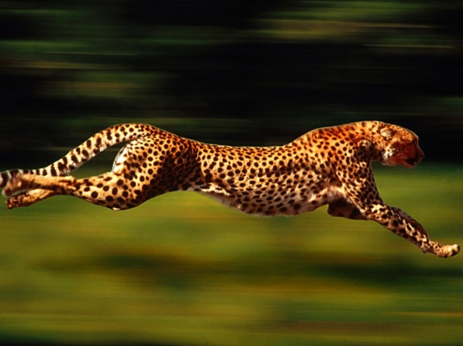
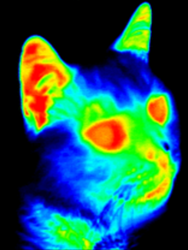
Kinetic Energy
Energy of Motion or Active Energy.
Work being done.
Thermal Energy
  Type of kinetic energy associated with Heat.
  Deals with the amount of matter and the random movement of atoms or molecules.
  Heat flows (transfers thermal energy) from warmer to cooler (thus, KE).

Slide 14
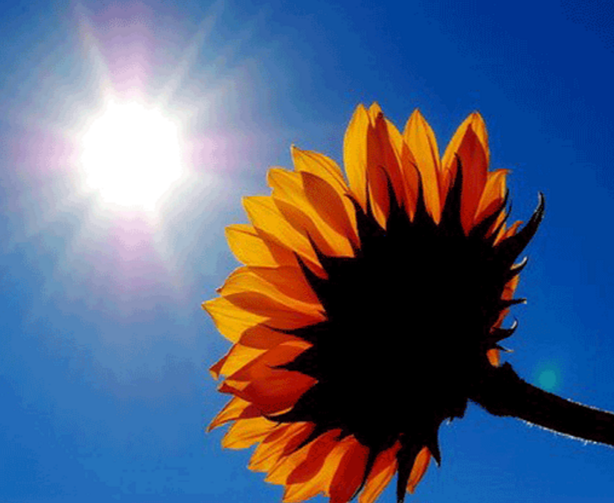
Kinetic Energy
  Radiant (Light) Energy
  The kinetic energy of photons or waves of light.
  Light energy is absorbed to power photosynthesis.
  Converted into other forms of energy.
  Stored in chemical bonds (PE).

Slide 15
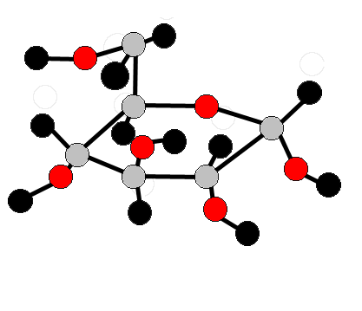
Potential Energy
Stored Energy
  In chemical bonds
  In concentration gradients
  In electric potential (cell membrane)
Chemical Energy
  Form of potential energy available for release in all chemical reactions .
  The most important type of energy for living organisms to power the work of the cell.

Slide 16
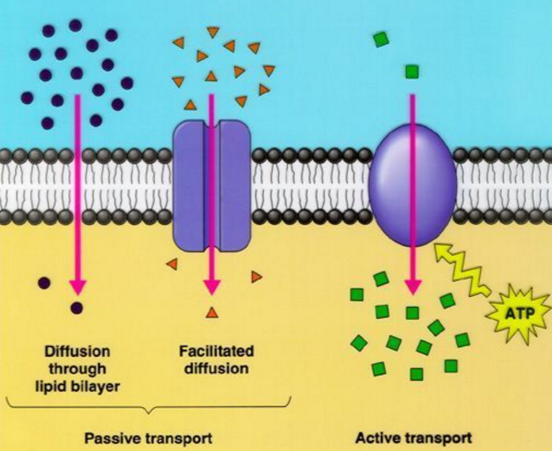
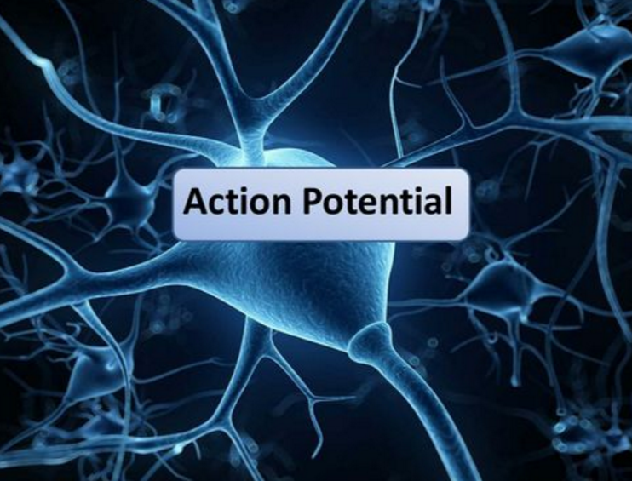
Potential Energy
  In concentration gradients
  In electric potential (cell membrane)

Slide 17
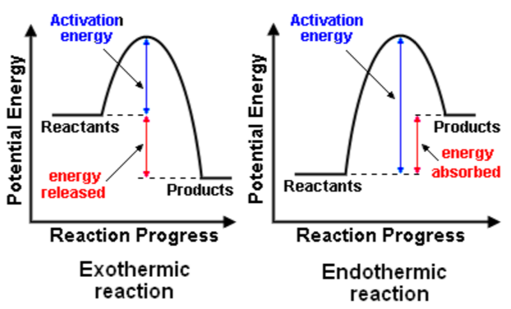
Potential Energy
  In chemical bonds

Slide 18
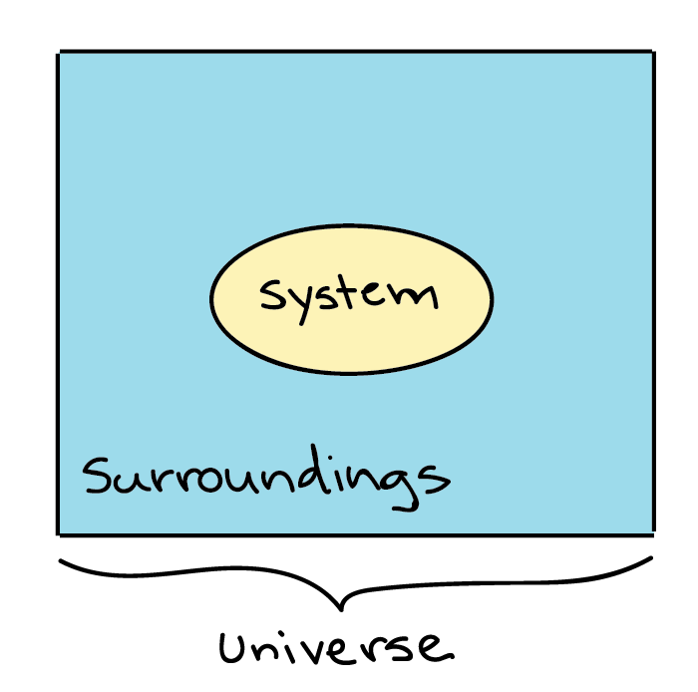
Cells Transform Energy As They Perform Work
Thermodynamics
The study of energy transformations that occur in and between living organisms.
  The word system is used for the matter under study.
  The word surroundings is used for everything outside the system; the rest of the universe.

Slide 19
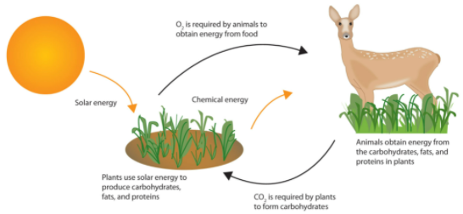
The LAWS OF THERMODYNAMICS govern energy transformations in organisms.

Slide 20
The LAWS OF THERMODYNAMICS govern energy transformations in organisms.

Slide 21
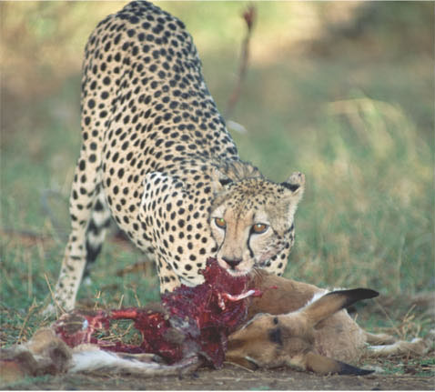
First Law of Thermodynamics
Law of Energy Conservation.
Energy can be transferred and transformed.
Energy cannot be created or destroyed.
Chemical
energy
  Food (PE) will be converted to KE in the Cheetah’s movement.
(a)
First law of thermodynamics: Energy
can be transferred or transformed but
Neither created nor destroyed. For
example, the chemical (potential) energy
in food will be converted to the kinetic
energy of the cheetah’s movement in (b).

Slide 22
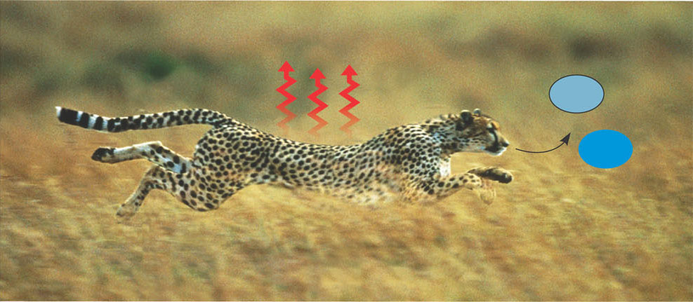
Second Law of Thermodynamics
Energy conversions increase the disorder of the universe.
ENTROPY: measure of disorder
Heat
co₂
+
H₂O
  The larger molecules in the Cheetah’s cells are broken down by cellular respiration (metabolism) and released into the atmosphere as smaller molecules (this increases disorder).
(b)
Second law of thermodynamics: Every energy transfer or transformation increases
the disorder (entropy) of the universe. For example, disorder is added to the cheetah’s
surroundings in the form of heat and the small molecules that are the by-products
of metabolism.

Slide 23
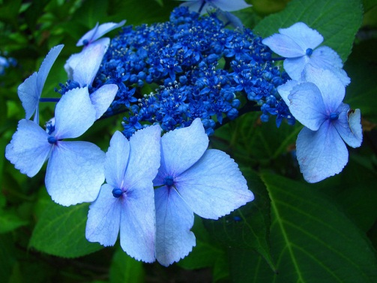
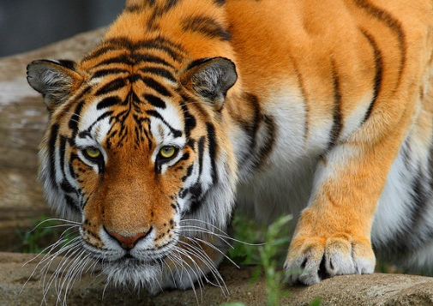
Endergonic & Exergonic Reactions
Endergonic
Exergonic
Photosynthesis is carried out by plants, algae, and some bacteria.
Cellular respiration is carried out by ALL living organisms.
Photos by Walter Simmons and Shane Gorski
Notes:
Timing ≈ 1min
What organisms use these processes?
[animate] Photosynthesis is carried out by plants, algae, and some bacteria.
[animate] Cellular respiration is carried out by all living organisms: animals (as shown here, plants, fungus, etc.)
SOURCES:
Blue fower. “Flower..,” Walter Simmons. 2008 as CC-SA, Digital Image. http://www.flickr.com/photos/28176756@N04/2684107481/in/photostream/ (accessed April 25, 2011).
Tiger. “Altaic Warrior,” Shane Gorski. 2008 as CC-ND, Digital Image. http://www.flickr.com/photos/shanegorski/2515009456/ (accessed April 25, 2011).

Slide 24
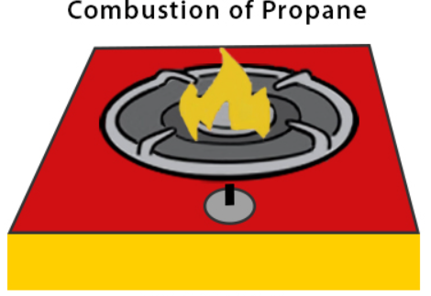
1) Exergonic Reactions
Types of Chemical Reactions:
RELEASE ENERGY in the form of heat to the surroundings (exothermic).
Releases the energy stored in the covalent bonds of the reactants.
Burning wood releases the energy in glucose as heat & light.
Cellular Respiration

Slide 25
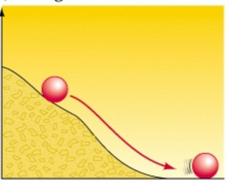
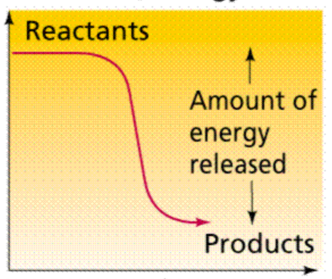
1) Exergonic Reactions
Types of Chemical Reactions:
“DownHill” Reaction
Energy of the reactants is greater than the energy of the products.

Slide 26
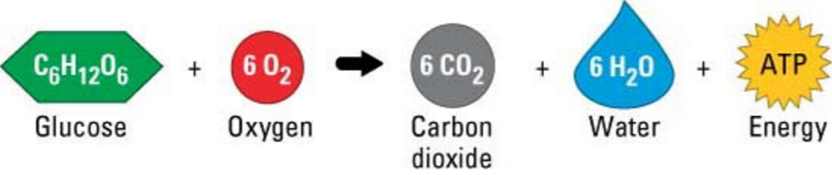
1) Exergonic Reactions
Types of Chemical Reactions:
Cellular Respiration
  involves many steps.
  releases energy slowly.
  uses some of the released energy to produce ATP.

Slide 27
1) Exergonic Reactions
Types of Chemical Reactions:
Cellular Respiration
  Occurs in both plants and animal cells (and all living organisms).

Slide 28
Exergonic Reaction: Cellular Respiration
Cellular respiration
Reactants
Products
C₆H₁₂O₆ + 6O₂
6CO₂ + 6H₂O + 36 ATP
Glucose
Oxygen
Carbon dioxide
Water
Energy
Notes:
Timing ≈ 0.5min
Now, we will take a closer look at aerobic respiration.
[animate]
Reactants: glucose and oxygen
Products: carbon dioxide and water
Let’s relate this in terms that may be more familiar. We eat food that is broken down into glucose, and we breath in oxygen—those are the reactants.
{Go through the equation }
C₆H₁₂O₆ + 6O₂ → 6CO₂ + 6H₂O + Energy (ATP)
Sugar + Oxygen → Carbon dioxide + Water +Energy(ATP)
As a result, we are able to do all the things that we do in out lives, we exhale CO2 and H2O (breathe on a pane of glass and you will see the water).

Slide 29
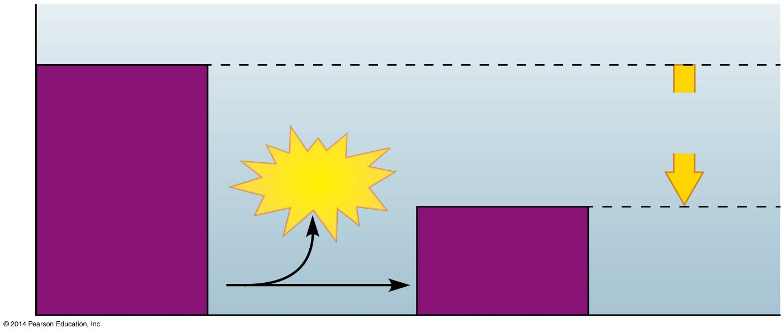
1) Exergonic Reactions: Cellular Respiration
“DOWNHILL Reactions”
Reactants
Amount of
energy released
Energy
Products
Potential energy
Notes:
Figure 5.11a Exergonic reaction, energy released

Slide 30
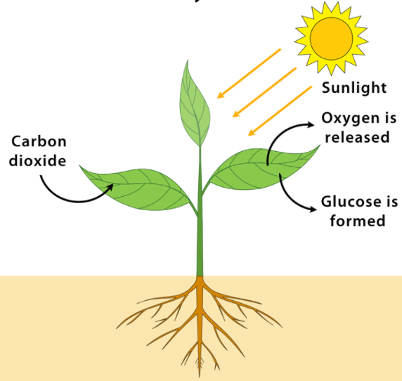
2) Endergonic Reactions
Types of Chemical Reactions:
Absorb ENERGY from the surroundings (endothermic).
Yield products rich in potential energy.
Start with reactant molecules that contain relatively little potential energy.
End with products that contain more chemical energy.

Slide 31
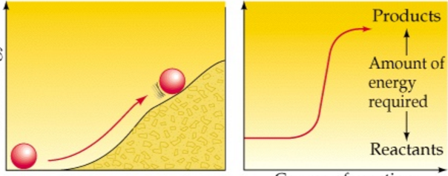
2) Endergonic Reactions
Types of Chemical Reactions:
“UPHill” Reaction
Energy of the products is greater than the energy of the reactants.

Slide 32
Types of Chemical Reactions: 2) Endergonic Reactions
Photosynthesis
Uses energy-poor reactants (carbon dioxide & water).
Energy is absorbed from sunlight.
Energy-rich sugar molecules are produced.
6CO₂ + 6H₂O → C₆H₁₂O₆ + 6O₂
Light
Energy
SUN
(Glucose)

Slide 33
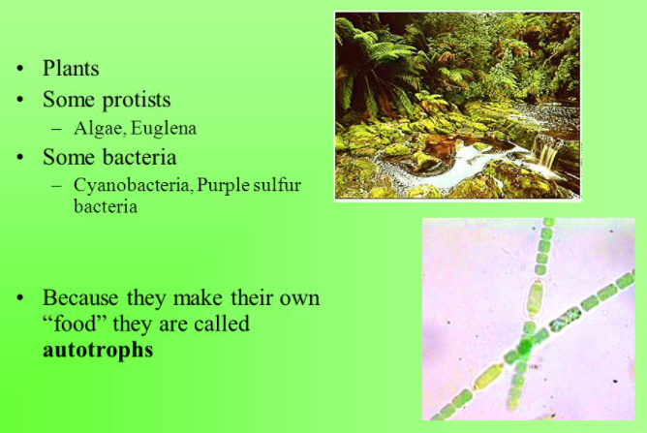
Types of Chemical Reactions: 2) Endergonic Reactions
Photosynthesis

Slide 34
Types of Chemical Reactions: 2) Endergonic Reactions
Photosynthesis

Slide 35
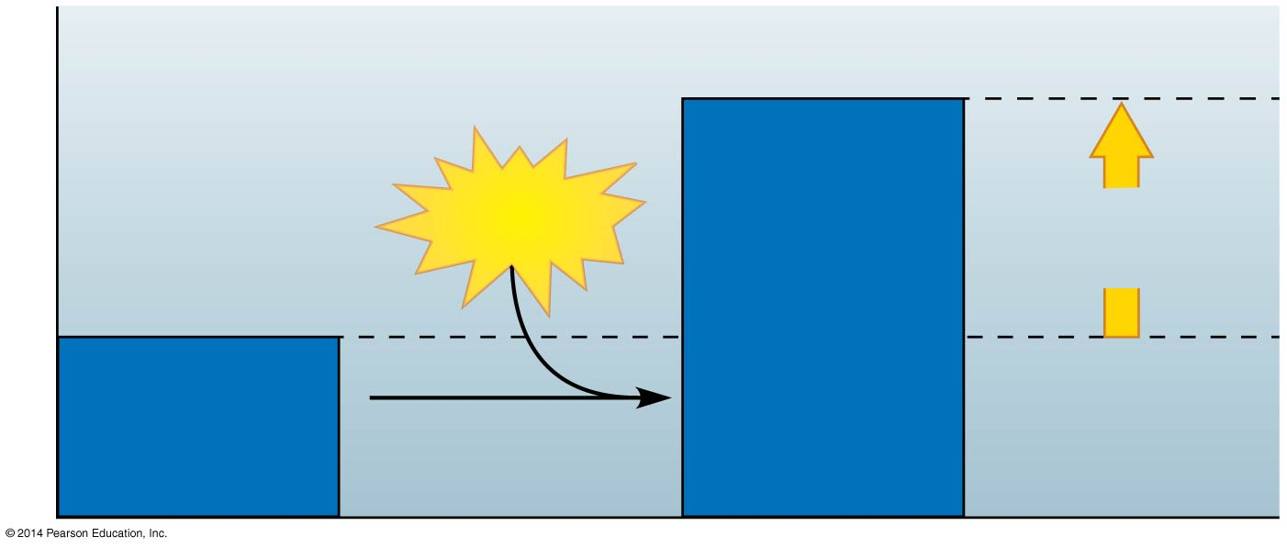
2) Endergonic Reactions: Photosynthesis
Products
Energy
Amount of
energy required
Reactants
Potential energy
“UPHILL Reactions”
Notes:
Figure 5.11b Endergonic reaction, energy required

Slide 36
Chemical Reactions:
A living organism carries out thousands of endergonic and exergonic chemical reactions.
The total of an organism’s chemical reactions is called METABOLISM.
A metabolic pathway is a series of chemical reactions that either …
  builds a complex molecule or
  breaks down a complex molecule into simpler compounds.

Slide 37

Energy Is Cyclic
  Photosynthesis
    Uses sunlight as the energy source.
    Chloroplast uses carbon dioxide and water.
    Produces sugar and oxygen.
CO₂
Sunlight energy
H₂O
Chloroplasts in plant cells
C₆H₁₂O₆
O₂
Notes:
Timing ≈ 1.5min
Both processes are energy based
Energy in photosynthesis and cellular respiration: cyclic, reactants of photosynthesis, are products of cellular respiration, and vice versa
[animate]
Photosynthesis
Uses solar energy to convert carbon dioxide and water to sugars and other organic molecules
[animate]
Reactants
CO₂+H₂O+Light energy
[animate]
Products
C₆H₁₂O₆+O₂
[animate]
Cellular respiration
Uses energy from sugars and other organic molecules
[animate]
Reactants
C₆H₁₂O₆+O₂
[animate]
Products
CO₂+H₂O+energy (ATP)
SOURCES:
Images by e2020

Slide 38
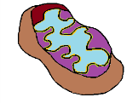
Energy Is Cyclic
  Cellular respiration
    Mitochondrion uses energy from sugars and other organic molecules.
    Produces carbon dioxide and water.
    Releases energy.
CO₂
H₂O
Mitochondria in plant & animal cells
ATP for work
C₆H₁₂O₆
HEAT
O₂
Notes:
Timing ≈ 1.5min
Both processes are energy based
Energy in photosynthesis and cellular respiration: cyclic, reactants of photosynthesis, are products of cellular respiration, and vice versa
[animate]
Photosynthesis
Uses solar energy to convert carbon dioxide and water to sugars and other organic molecules
[animate]
Reactants
CO₂+H₂O+Light energy
[animate]
Products
C₆H₁₂O₆+O₂
[animate]
Cellular respiration
Uses energy from sugars and other organic molecules
[animate]
Reactants
C₆H₁₂O₆+O₂
[animate]
Products
CO₂+H₂O+energy (ATP)
SOURCES:
Images by e2020

Slide 39
Energy Is Cyclic
  Photosynthesis
    Uses sunlight as the energy source.
  Cellular respiration
    Uses energy from sugars and other organic molecules.
CO₂
CO₂
Sunlight energy
Mitochondria in plant & animal cells
H₂O
H₂O
ATP for work
C ₆H₁₂O₆
Chloroplasts in plant cells
C ₆H₁₂O₆
HEAT
O₂
O₂
Notes:
Timing ≈ 1.5min
Both processes are energy based
Energy in photosynthesis and cellular respiration: cyclic, reactants of photosynthesis, are products of cellular respiration, and vice versa
[animate]
Photosynthesis
Uses solar energy to convert carbon dioxide and water to sugars and other organic molecules
[animate]
Reactants
CO₂+H₂O+Light energy
[animate]
Products
C₆H₁₂O₆+O₂
[animate]
Cellular respiration
Uses energy from sugars and other organic molecules
[animate]
Reactants
C₆H₁₂O₆+O₂
[animate]
Products
CO₂+H₂O+energy (ATP)
SOURCES:
Images by e2020

Slide 40
Energy Is Cyclic
  Photosynthesis
    Uses sunlight as the energy source.
  Cellular respiration
    Uses energy from sugars and other organic molecules.
CO₂
CO₂
Sunlight energy
Mitochondria in plant & animal cells
H₂O
H₂O
ATP for work
C ₆H₁₂O₆
Chloroplasts in plant cells
C ₆H₁₂O₆
HEAT
O₂
O₂
Notes:
Timing ≈ 1.5min
Both processes are energy based
Energy in photosynthesis and cellular respiration: cyclic, reactants of photosynthesis, are products of cellular respiration, and vice versa
[animate]
Photosynthesis
Uses solar energy to convert carbon dioxide and water to sugars and other organic molecules
[animate]
Reactants
CO₂+H₂O+Light energy
[animate]
Products
C₆H₁₂O₆+O₂
[animate]
Cellular respiration
Uses energy from sugars and other organic molecules
[animate]
Reactants
C₆H₁₂O₆+O₂
[animate]
Products
CO₂+H₂O+energy (ATP)
SOURCES:
Images by e2020

Slide 41
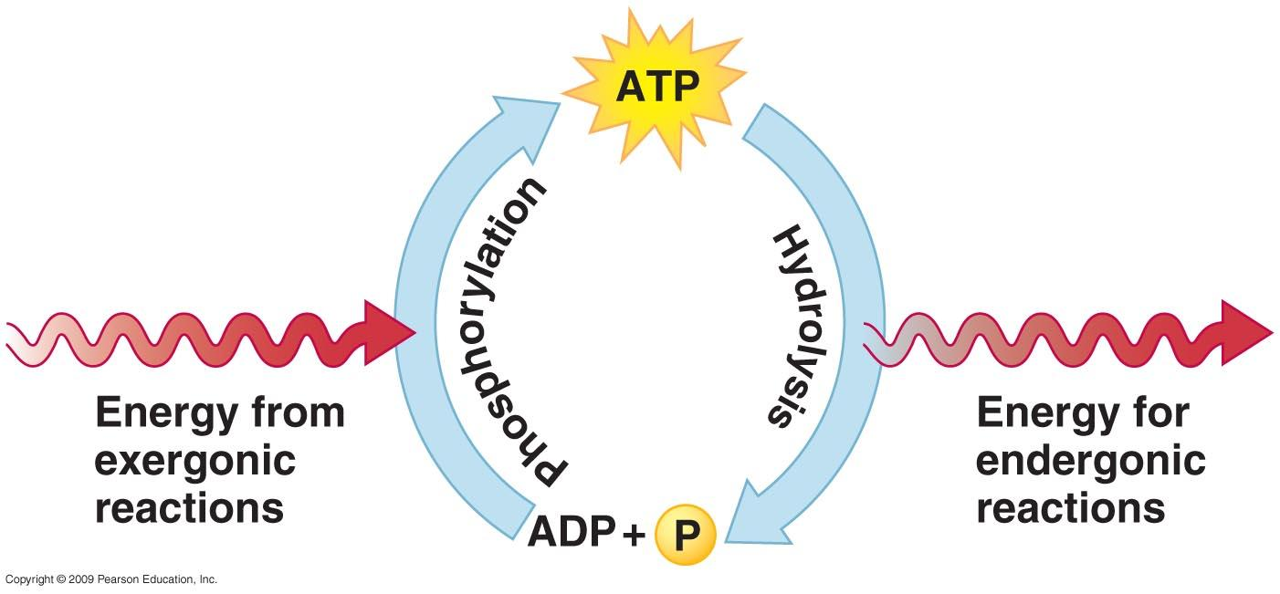
Energy Coupling
uses the energy released from exergonic reactions to drive endergonic reactions, typically using the energy stored in ATP molecules.

Slide 42
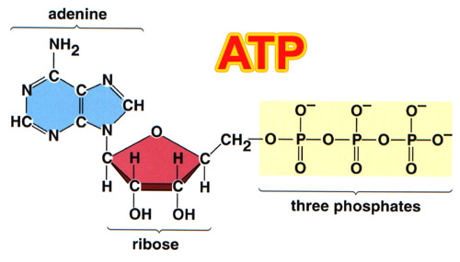
ATP drives Cellular Work by Coupling Exergonic & Endergonic Reactions
ATP, Adenosine TriPhosphate, powers nearly all forms of cellular work.

Slide 43
Structure of ATP
ATP is composed of three parts:
  A base, adenine
  A sugar, ribose
  Tri-phosphate tail
  “adenosine triphosphate”
Adenosine triphosphate (ATP)
P
P
P
Notes:
Timing = 0.5 min
[animate intro stem and image] ATP is a nucleotide (base + sugar + phosphate group) with 2 “extra” phosphate groups. [Teacher points or circles parts of ATP molecule as they are described. The blue is the base, purple is the sugar, orange are the phosphates.]
[animate first bullet] The base is adenine.
[animate second bullet] The sugar is ribose.
[animate third bullet] And there are a total of three phosphate groups.
[animate last sentence] So, now you can see why it’s called adenosine triphosphate.

Slide 44
ATP drives Cellular Work by Coupling Exergonic & Endergonic Reactions
Hydrolysis of ATP releases energy by transferring its third phosphate from ATP to some other molecule in a process called Phosphorylation.
Most cellular work depends on ATP energizing molecules by phosphorylating them.

Slide 45
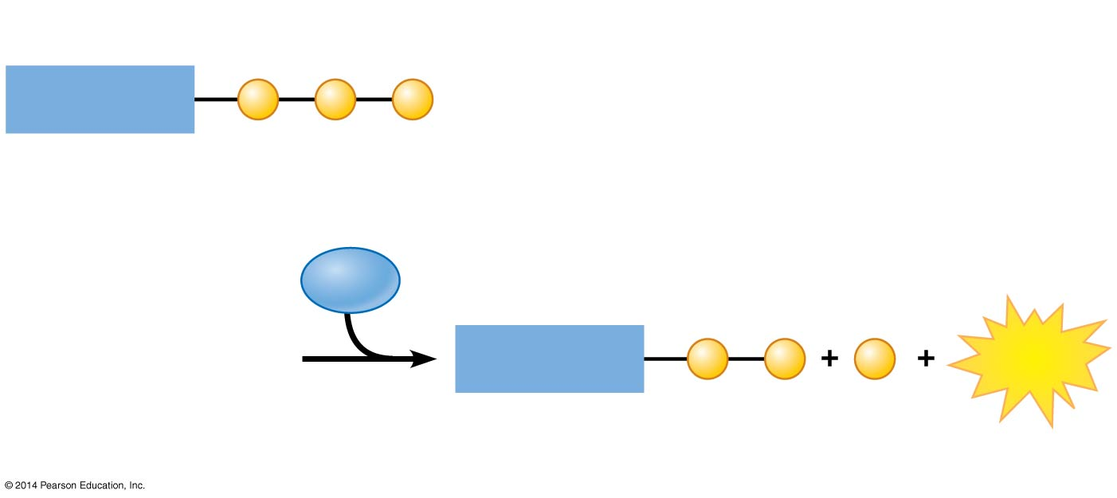
Hydrolysis of ATP
Triphosphate
Adenosine
P
P
P
ATP
H₂O
Diphosphate
Adenosine
P
P
P
Energy
ADP
Phosphate
Notes:
Figure 5.12a-2 The hydrolysis of ATP yielding ADP, a phosphate group, and energy (step 2)

Slide 46
Hydrolysis of ATP
Triphosphate
Adenosine
P
P
P
ATP
H₂O
Diphosphate
Adenosine
P
P
P
Energy
ADP
Phosphate
Notes:
Figure 5.12a-2 The hydrolysis of ATP yielding ADP, a phosphate group, and energy (step 2)

Slide 47
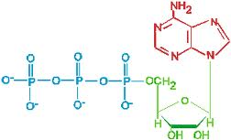
ATP has enough stored energy to power a variety of cellular activities such as...
Photosynthesis
Protein synthesis
Muscle contraction
Active transport across the cell membrane
Growth & repair
Reproduction

Slide 48
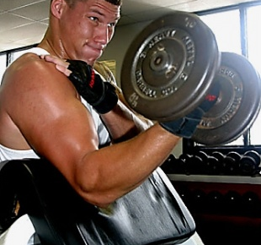

How do cells receive the energy they need to function?
The ATP molecule is the basic energy source of all living cells.
In a cell, ATP is used continuously and must be regenerated continuously. In a working muscle cell, 10 million ATP are consumed & regenerated per sec!!

Slide 49
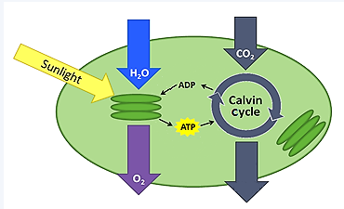
ATP drives Cellular Work by Coupling Exergonic and Endergonic Reactions
A cell uses & regenerates ATP continuously.
In the ATP Cycle, energy released in an exergonic reaction, such as the breakdown of glucose during cellular respiration, is used in an endergonic reaction to generate ATP from ADP.
Sugar

Slide 50
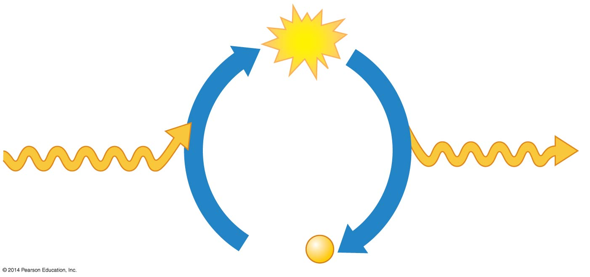
ATP drives Cellular Work by Coupling Exergonic and Endergonic Reactions
ATP synthesis
is endergonic
ATP
ATP hydrolysis
is exergonic
Energy from
cellular respiration
(exergonic)
Energy for
cellular work
(endergonic)
ADP +
P
Notes:
Figure 5.12c The ATP cycle

Slide 51
ADP and ATP Recycling
ATP ADP + P + energy
ADP + P + energy ATP
Notes:
Timing = 1 min
[animate blue box] [Teacher explains the top equation as breaking ATP down into ADP, a phosphate, and energy.] ATP and its “worn-down” form, ADP (adenosine diphosphate), are part of a cycle.
The energy in ATP is stored in its chemical bonds. So, with three phosphate groups bonded to the rest of the molecule, ATP has more stored energy than ADP, which has two phosphate groups bonded to the molecule.
[animate green box] [Teacher explains the bottom equation as combining ADP, a phosphate group, using energy, back into ATP.] To complete the cycle, the same amount of energy released by breaking ATP into ADP and P is required to make ATP again by combining ADP and P.

Slide 52
Review of Energy & ATP
Which pathway shows the hydrolysis of ATP ?
[ ] ATP + P + energy → ADP
[ ] ATP → ADP + P + energy
[ ] ADP → ATP + P + energy
[ ] ADP + P + energy → ADP
Label each item exergonic or endergonic.
Cellular Respiration
Phosphorylation of ATP
Photosynthesis
Hydrolysis of ATP
Label each item Potential Energy (PE) or Kinetic Energy (KE).
Chemical Bonds
Radiant Energy shining
Heat flowing
Concentration gradients
Notes:
#frame
Timing =1 min
Entry Audio: Take a look at the pathways, or chemical reactions, shown here. Choose the pathway that correctly shows the relationships between ATP, ADP, chemical bonds, and energy.
Hint Audio: If the word “energy” appears to the left of the arrow, it means that energy is required to add a bond. If the word “energy” appears to the right of the arrow, it means that energy is released as a bond is broken.
Exit Audio: You should have selected the pathway showing only ATP on the left and ADP, P, and energy on the right. This shows ATP being broken down to ADP, a process that releases energy.

Slide 53
Review of Energy & ATP
Which pathway shows the hydrolysis of ATP ?
[ ] ATP + P + energy → ADP
[X] ATP → ADP + P + energy
[ ] ADP → ATP + P + energy
[ ] ADP + P + energy → ADP
Label each item exergonic or endergonic.
Cellular Respiration …exergonic
Phosphorylation of ATP…endergonic
Photosynthesis …endergonic
Hydrolysis of ATP … exergonic
Label each item Potential Energy (PE) or Kinetic Energy (KE).
Chemical Bonds PE
Radiant Energy shining KE
Heat flowing KE
Concentration gradients PE
Notes:
#frame
Timing =1 min
Entry Audio: Take a look at the pathways, or chemical reactions, shown here. Choose the pathway that correctly shows the relationships between ATP, ADP, chemical bonds, and energy.
Hint Audio: If the word “energy” appears to the left of the arrow, it means that energy is required to add a bond. If the word “energy” appears to the right of the arrow, it means that energy is released as a bond is broken.
Exit Audio: You should have selected the pathway showing only ATP on the left and ADP, P, and energy on the right. This shows ATP being broken down to ADP, a process that releases energy.

Slide 54
The Importance of Enzymes
And How They Function
Chemical reaction
Reactants
Products
Chemical Reactions are influenced by Enzymes.
Notes:
54

Slide 55
Enzymes Speed Up the Cell’s Chemical Reactions by Lowering Energy Barriers
Although biological molecules possess much potential energy, it is not released spontaneously.
  An energy barrier must be overcome before a chemical reaction can begin.
  This energy is called the Activation Energy (because it activates the reactants).
Activation energy
Reactants
Energy
Products
Time
Notes:
55

Slide 56
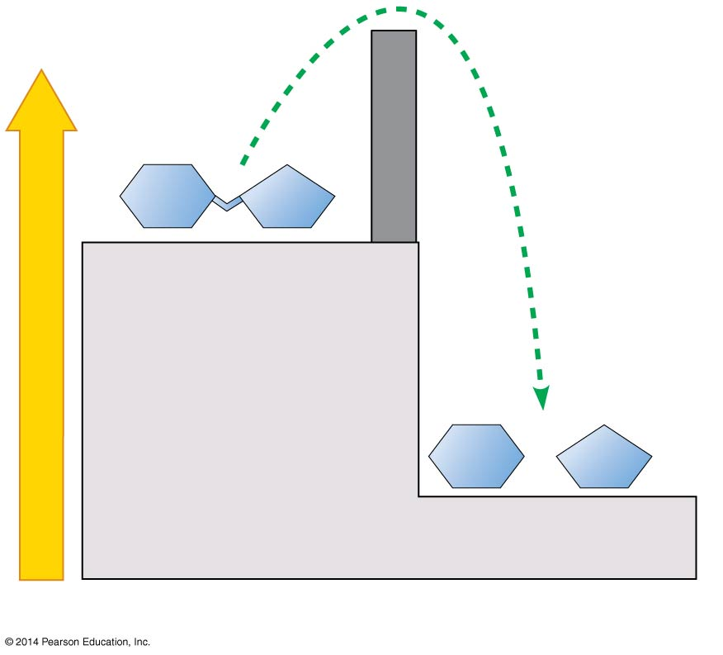
Enzymes Speed Up the Cell’s Chemical Reactions by Lowering Energy Barriers
Activation
energy
barrier
Without enzyme
Reactant
Energy
Products
Notes:
Figure 5.13-2 The effect of an enzyme in lowering the activation energy (part 2)

Slide 57
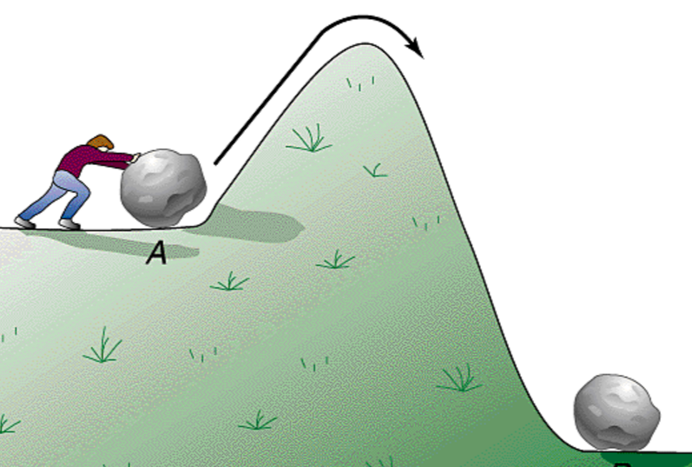
Enzymes Speed Up the Cell’s Chemical Reactions by Lowering Energy Barriers
Activation energy
The energy needed for a reactant molecule to move “uphill” to a higher-energy (although an unstable state) so that the “downhill” part of the reaction can begin.
e.g. use a ski lift to get to the top of the hill.
One way to speed up a reaction is to add heat, which agitates atoms so that bonds break more easily and reactions can proceed, but too much heat will kill a cell.
Notes:
57

Slide 58
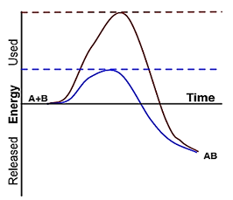
Enzymes Speed Up the Cell’s Chemical Reactions by Lowering Energy Barriers
ENZYMES
  function as biological catalysts.
  speeds up a reaction without being consumed by the reaction.
  are usually proteins.
Without catalyst
With catalyst
reactants
products
Enzymes speed up a reaction by lowering the activation energy needed for a reaction to begin.
Notes:
58

Slide 59
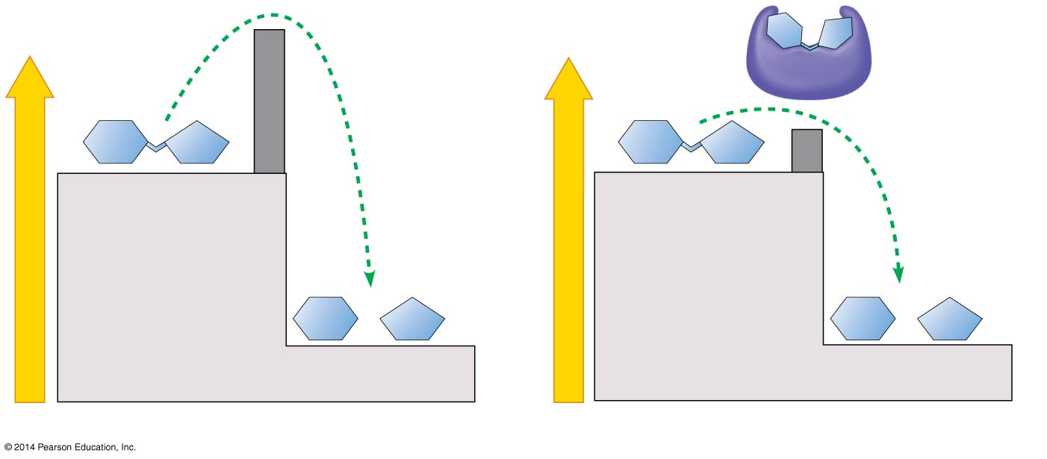
Enzymes Speed Up the Cell’s Chemical Reactions by Lowering Energy Barriers
Activation
energy
barrier
Enzyme
Activation
energy
barrier
reduced by
enzyme
Reactant
Reactant
Energy
Energy
Products
Products
Without enzyme
With enzyme
Notes:
Figure 5.13-1 The effect of an enzyme in lowering the activation energy (part 1)

Slide 60

A Specific Enzyme Catalyzes Each Cellular Reaction
An Enzyme
  is very selective in the reaction it catalyzes.
  has a shape that determines the enzyme’s specificity.
The specific reactant that an enzyme acts on is called the enzyme’s substrate.
A substrate fits into a region of the enzyme called the active site.
Enzymes are specific because only specific substrate molecules fit into their active site.
Notes:
60
Student Misconceptions and Concerns
• The specific interactions of enzymes and substrates can be illustrated with simple physical models. Many students new to these concepts will benefit from several forms of explanation, including diagrams such as those in the textbook, physical models, and the opportunity to manipulate or create their own examples. Just like pitching a tent, new concepts are best constructed with many lines of support.
Teaching Tips
• The information in DNA is used to direct the production of RNA, which in turn directs the production of proteins. However, in Chapter 3, four different types of biological molecules were noted as significant components of life. Students who think this through might wonder, and you could point out, that DNA does not directly control the production of carbohydrates and lipids. So how does DNA exert its influence over the synthesis of these two chemical groups? The answer is largely by way of enzymes, proteins with the ability to promote the production of carbohydrates and lipids.
• The text notes that the relationship between an enzyme and its substrate is like a handshake, with each hand generally conforming to the shape of the other. This induced fit is also like the change in shape of a glove when a hand is inserted. The glove’s general shape matches the hand, but the final “fit” requires some additional adjustments.
Active Lecture Tips
• See the Activity Students, Design Your Own Enzyme-Catalyzed Reaction on the Instructor Exchange. Visit the Instructor Exchange in the MasteringBiology instructor resource area for a description of this activity.

Slide 61
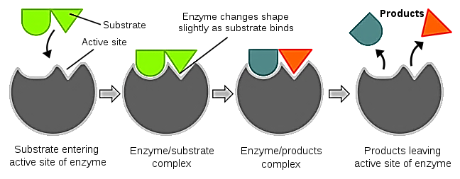
Enzymes at Work
  Substrate: is a reactant that is catalyzed by an enzyme
  One enzyme and one substrate fit together like a lock and key.
Enzyme
Enzyme
Enzyme
Enzyme
Notes:
#frame
instructional video
Timing ≈ 1.5min
[animate] A substrate is a reactant that is catalyzed by an enzyme.
[animate with image] Enzymes and substrates have complimentary shapes. One enzyme and one substrate fit together like a lock and a key.
This is a model of what a substrate and enzyme look like. Real substrates and enzymes are actually much more complex because they are huge molecules with thousands of repeated parts. Circle or point out the parts of the diagram as you discuss the following information.
The active site is the place on the enzyme where the substrate fits. Once they come together they are bound by attractive forces and form the enzyme-substrate complex. They will remain together until the reaction is complete.
While the enzyme and substrate are bound together, the chemical reaction occurs. As chemical bonds break or form a reaction takes place and new substances result. Point out these changes on the diagram, maybe put a star where the reaction takes place. These new substances are the products of the reaction.
When these products are released, the enzyme is then free to bond with another substrate.
SOURCES
Diagram. “Induced fit diagram.svg,”Tim Vickers. 2006 as PD, Digital Image. http://commons.wikimedia.org/wiki/File:Induced_fit_diagram.svg (accessed January 3, 2011).

Slide 62
Enzymes at Work
  Substrate: is a reactant that is catalyzed by an enzyme
  One enzyme and one substrate fit together like a lock and key.
Induced Fit Model → the enzyme/substrate changes shape
Enzyme
Enzyme
Enzyme
Enzyme
Notes:
#frame
instructional video
Timing ≈ 1.5min
[animate] A substrate is a reactant that is catalyzed by an enzyme.
[animate with image] Enzymes and substrates have complimentary shapes. One enzyme and one substrate fit together like a lock and a key.
This is a model of what a substrate and enzyme look like. Real substrates and enzymes are actually much more complex because they are huge molecules with thousands of repeated parts. Circle or point out the parts of the diagram as you discuss the following information.
The active site is the place on the enzyme where the substrate fits. Once they come together they are bound by attractive forces and form the enzyme-substrate complex. They will remain together until the reaction is complete.
While the enzyme and substrate are bound together, the chemical reaction occurs. As chemical bonds break or form a reaction takes place and new substances result. Point out these changes on the diagram, maybe put a star where the reaction takes place. These new substances are the products of the reaction.
When these products are released, the enzyme is then free to bond with another substrate.
SOURCES
Diagram. “Induced fit diagram.svg,”Tim Vickers. 2006 as PD, Digital Image. http://commons.wikimedia.org/wiki/File:Induced_fit_diagram.svg (accessed January 3, 2011).

Slide 63
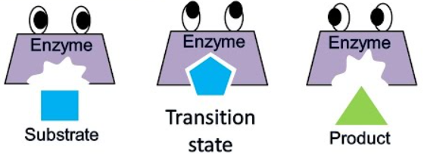
Induced Fit Model of Enzyme Action
  The enzyme/substrate intermediate induces a changed shape.
square pentagon triangle
Notes:
#frame
instructional video
Timing ≈ 1.5min
[animate] A substrate is a reactant that is catalyzed by an enzyme.
[animate with image] Enzymes and substrates have complimentary shapes. One enzyme and one substrate fit together like a lock and a key.
This is a model of what a substrate and enzyme look like. Real substrates and enzymes are actually much more complex because they are huge molecules with thousands of repeated parts. Circle or point out the parts of the diagram as you discuss the following information.
The active site is the place on the enzyme where the substrate fits. Once they come together they are bound by attractive forces and form the enzyme-substrate complex. They will remain together until the reaction is complete.
While the enzyme and substrate are bound together, the chemical reaction occurs. As chemical bonds break or form a reaction takes place and new substances result. Point out these changes on the diagram, maybe put a star where the reaction takes place. These new substances are the products of the reaction.
When these products are released, the enzyme is then free to bond with another substrate.
SOURCES
Diagram. “Induced fit diagram.svg,”Tim Vickers. 2006 as PD, Digital Image. http://commons.wikimedia.org/wiki/File:Induced_fit_diagram.svg (accessed January 3, 2011).

Slide 64
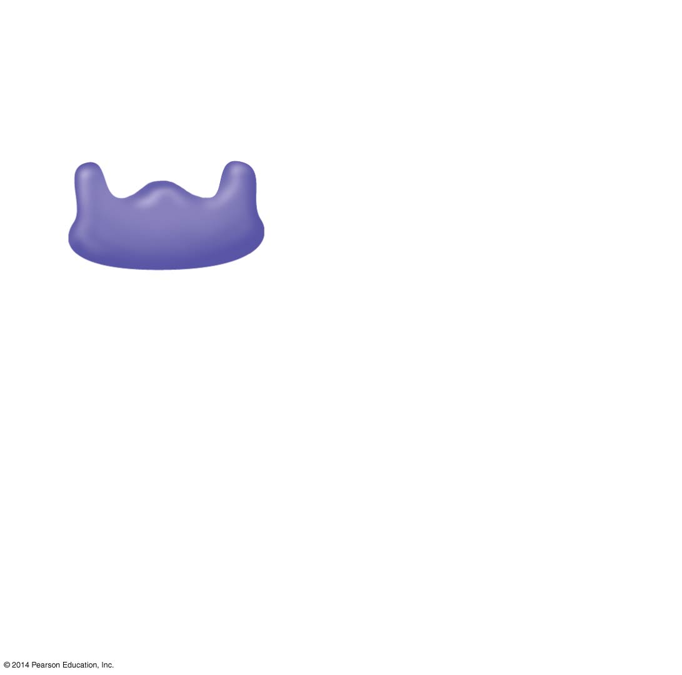
1
The enzyme available
with an empty active site
Active site
Enzyme
(sucrase)
Notes:
Figure 5.14-1 The catalytic cycle of an enzyme (step 1)

Slide 65
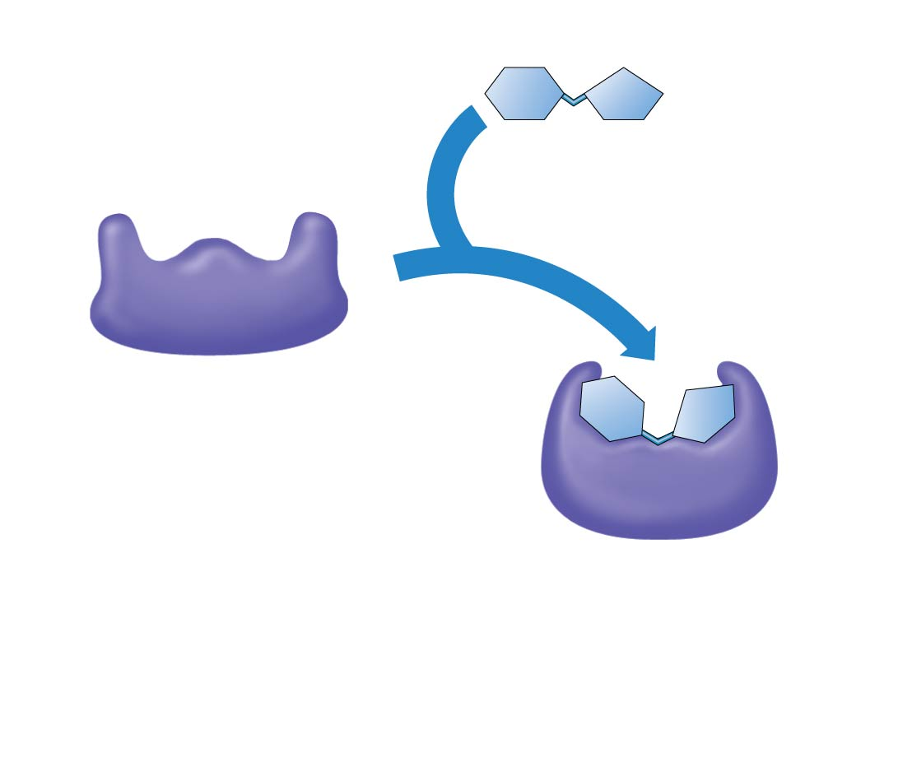
1
The enzyme available
with an empty active site
Active site
Substrate
(sucrose)
2
Substrate
binds to
enzyme with
induced fit.
Enzyme
(sucrase)
Notes:
Figure 5.14-2 The catalytic cycle of an enzyme (step 2)

Slide 66
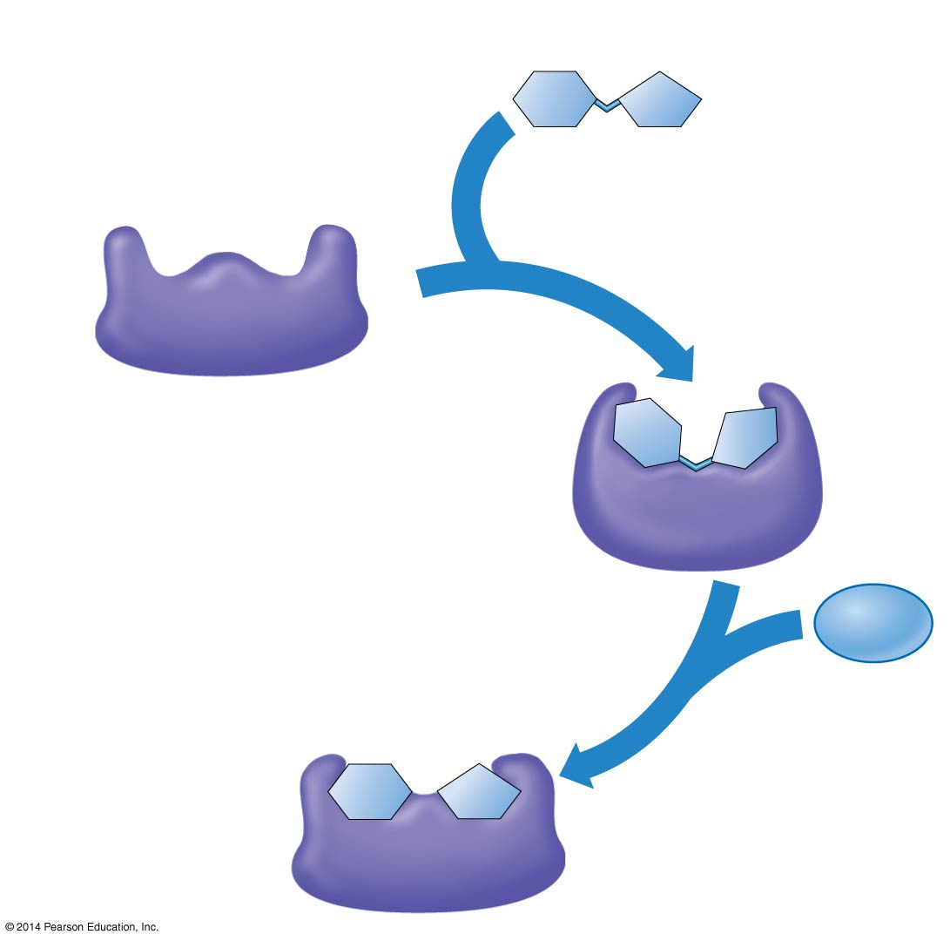
1
The enzyme available
with an empty active site
Active site
Substrate
(sucrose)
2
Substrate
binds to
enzyme with
induced fit.
Enzyme
(sucrase)
H₂O
3
The substrate
is converted
to products
Notes:
Figure 5.14-3 The catalytic cycle of an enzyme (step 3)

Slide 67
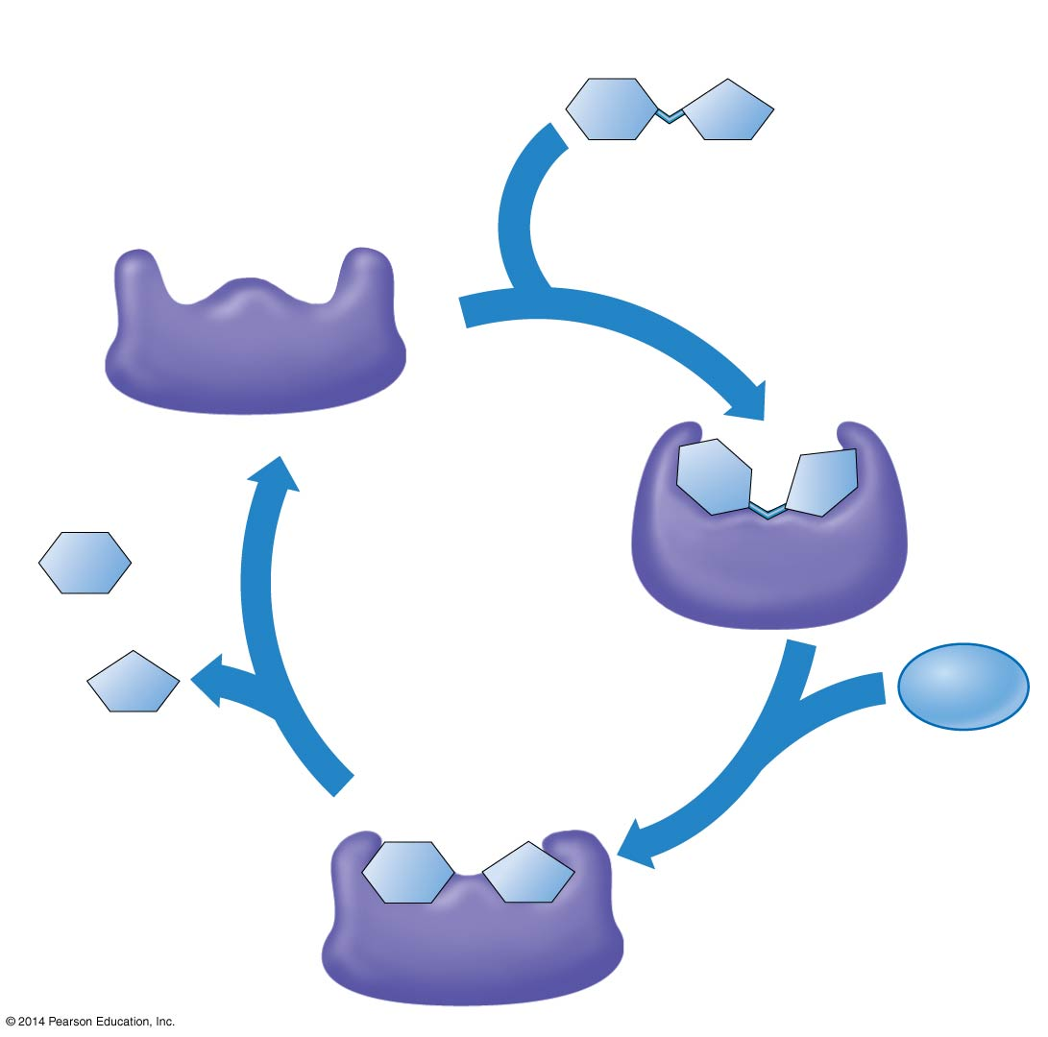
1
The enzyme available
with an empty active site
Active site
Substrate
(sucrose)
2
Substrate
binds to
enzyme with
induced fit.
Enzyme
(sucrase)
Glucose
Fructose
H₂O
4
The products
are released
3
The substrate
is converted
to products
Watch Animation
Notes:
Figure 5.14-4 The catalytic cycle of an enzyme (step 4)

Slide 68
A Specific Enzyme Catalyzes Each Cellular Reaction
For every enzyme, there are optimal conditions under which it is most effective.
Temperature affects molecular motion.
  An enzyme’s optimal temperature produces the highest rate of contact between the reactants and the enzyme’s active site.
  Most human enzymes work best at 35–40°C.
The optimal pH for most enzymes is near neutrality (about 7).
Notes:
68

Slide 69
Some Enzyme “Helpers”:
Coenzymes and Cofactors
Necessary for some enzymes to function properly.
Cofactors: inorganic (Mg⁺², Cu⁺², Zn⁺², Fe^{+2,} Ca⁺²) or organic
Coenzymes: organic; most Vitamins; NAD, FAD

Slide 70
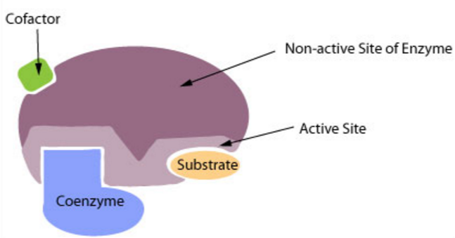
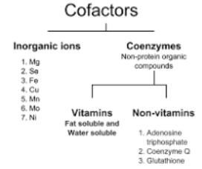
Coenzymes are Cofactors

Slide 71
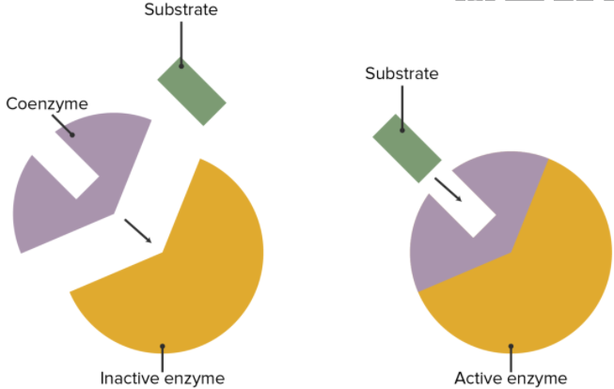

Slide 72
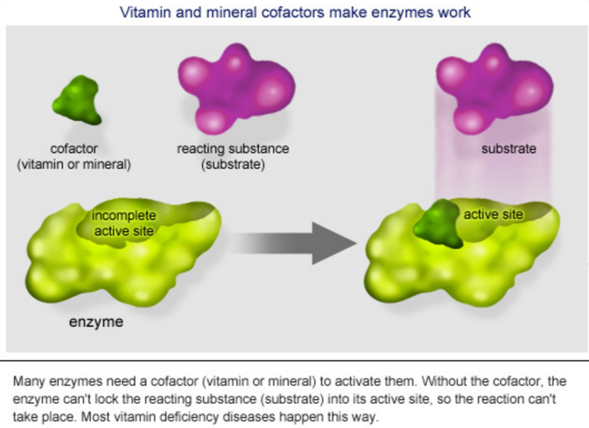


Slide 73

Enzymes
Put the steps of enzyme activity in order from first (1) to last (4).
[ ] The chemical reaction occurs.
[ ] A substrate enters the active site of enzyme.
[ ] New substances called “products” are formed.
[ ] The enzyme and the substrate bind to form the enzyme-substrate complex.
?
Label the diagram
?
?
heat
?
Notes:
#frame
Timing ~ 1 min
Entry audio: Use what you remember about the interaction between enzymes and substrates to put the steps of enzyme activity in order from first to last.
Hint audio: For a catalyzed reaction to begin, the substrate must enter the active site of the enzyme.
Exit audio: Enzyme activity begins when a substrate enters the active site on the enzyme. The two bind to form the enzyme-substrate complex. Then, the chemical reaction occurs, forming new substances, called products.

Slide 74
Enzymes
Put the steps of enzyme activity in order from first (1) to last (4).
[ 3 ] The chemical reaction occurs.
[ 1 ] A substrate enters the active site of enzyme.
[ 4 ] New substances called “products” are formed.
[ 2 ] The enzyme and the substrate bind to form the enzyme-substrate complex.
Label the diagram
heat
Notes:
#frame
Timing ~ 1 min
Entry audio: Use what you remember about the interaction between enzymes and substrates to put the steps of enzyme activity in order from first to last.
Hint audio: For a catalyzed reaction to begin, the substrate must enter the active site of the enzyme.
Exit audio: Enzyme activity begins when a substrate enters the active site on the enzyme. The two bind to form the enzyme-substrate complex. Then, the chemical reaction occurs, forming new substances, called products.

