Slide 1
Go to the “Slide Show” shade above
Click on “Play from Beginning”

Slide 2
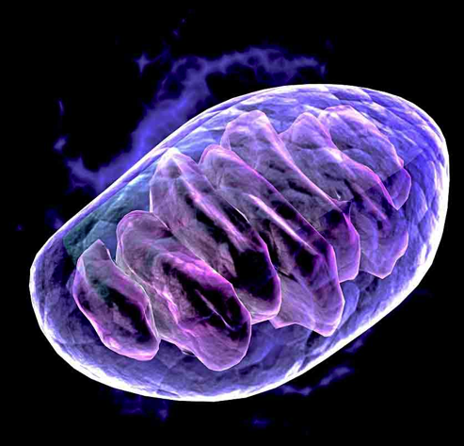
Chapter 8B: Cellular Respiration
-----
Krebs Cycle

Slide 3
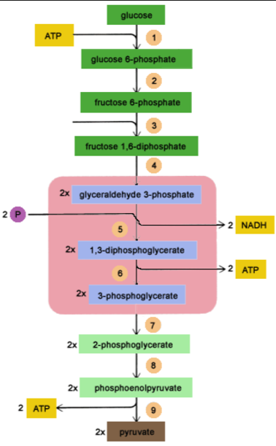
Review
?
?
What process is shown in the image?
Define the term (above).
Label the diagram to the right.
How is NADH formed (what chemical process)?
How many carbons are in glucose and pyruvate?
What is the net energy production?
?
?
?
Notes:
#frame
Timing ≈ .5min
Entry Audio: The energy from the Sun eventually allows all living things to have energy. Categorize the activities as low, moderate, or high energy.
Exit Audio: Over the course of one day the amount of energy a person uses can vary.
SOURCES:

Slide 4
Review
2 ATP
What process is shown in the image? glycolysis
Define the term (above).
“Sugar Splitting”
Label the diagram to the right.
How is NADPH formed (what chemical process)? NAD+ is reduced (gains e- and H+ ion)
How many carbons are in glucose (6) and pyruvate (3)?
What is the net energy production?
2 ATP added → 4 ATP produced = 2 ATP (net)
Notes:
#frame
Timing ≈ .5min
Entry Audio: The energy from the Sun eventually allows all living things to have energy. Categorize the activities as low, moderate, or high energy.
Exit Audio: Over the course of one day the amount of energy a person uses can vary.
SOURCES:

Slide 5
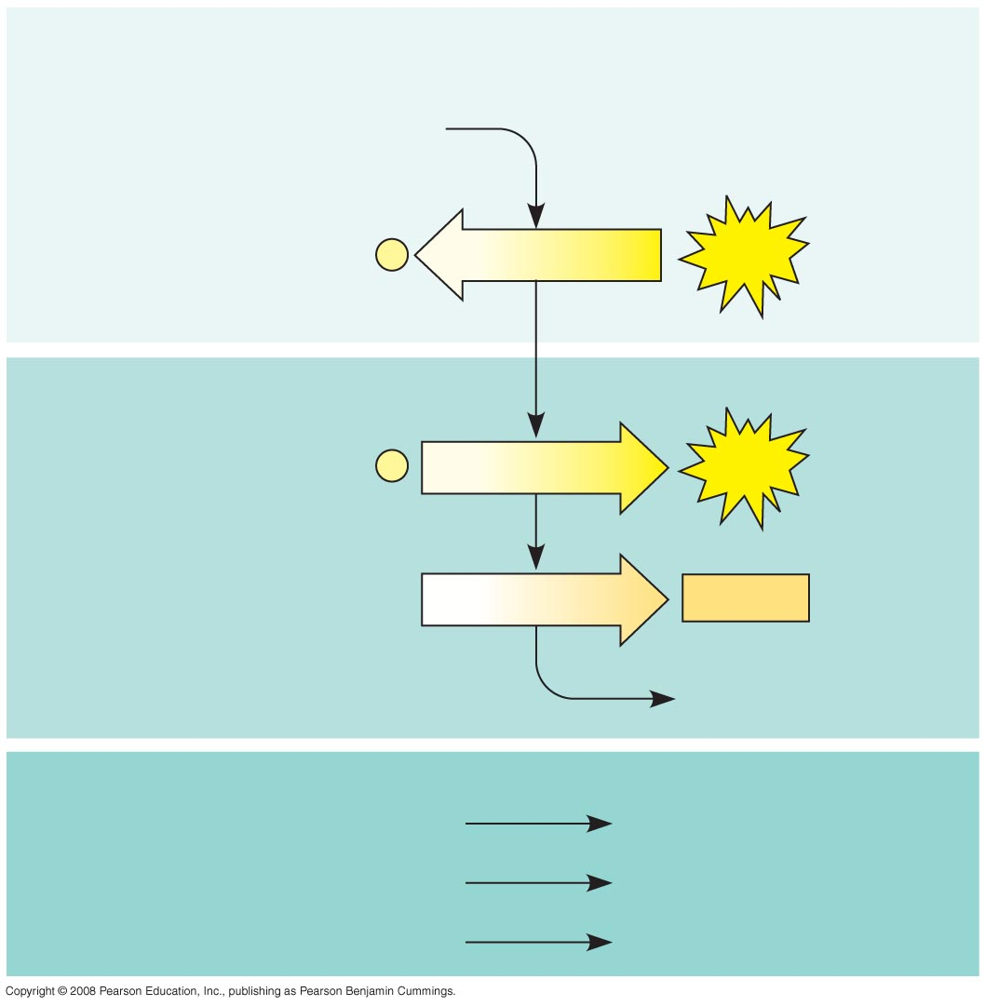
Process? - Energy investment phase
molecule?
?
?
Energy used
Energy payoff phase
?
?
formed
Electron carrier?
?
?
?
Net
? organic molecule
?
energy formed – ? used
?
Electron carrier?
?

Slide 6
Glycolysis - Energy investment phase
Glucose
2 ADP + 2
P
2 ATP
used
Energy payoff phase
4 ADP + 4
P
4 ATP
formed
2 NAD⁺ + 4 e– + 4 H⁺
2 NADH
+ 2 H⁺
2 Pyruvate + 2 H₂O
Net
Glucose
2 Pyruvate + 2 H₂O
4 ATP formed – 2 ATP used
2 ATP
2 NAD⁺ + 4 e– + 4 H⁺
2 NADH + 2 H⁺

Slide 7
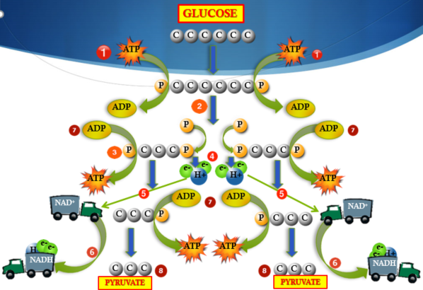
1. Glycolysis Summary
Takes place in the _________.
____________ (no oxygen).
Glucose “splits” into two 3-carbon molecules of _______.
NAD+ is ________ by gaining electrons & produces _______.
“_____________” of 4 ATP.
Requires an ______ of 2 ATP.
Net ATP production = _____.

Slide 8
1. Glycolysis Summary
Takes place in the Cytoplasm.
Anaerobic (no oxygen).
Glucose “splits” into two 3-carbon molecules of Pyruvate.
NAD+ is reduced by gaining electrons & produces 2 NADH.
Phosphorylation to make 4 ATP.
Requires an input of 2 ATP.
Net ATP production = 2 ATP.

Slide 9
Lesson Objectives
  By the end of this lesson, you should be able to:
  Understand how energy is acquired by organisms.
  Investigate the biological processes of Cell Respiration
  Analyze the steps of Cellular Respiration: Glycolysis, Transition Reaction, the Krebs Cycle, and the Electron Transport Chain.
  Distinguish aerobic from anaerobic respiration.
  Science Practice: Simulation Cell Respiration
Notes:
#frame
instructional video
Timing ≈ 0.5 minutes
Living organisms need energy to accomplish the wide variety of tasks they attempt each day.
You will begin learning about how energy is captured from the Sun and stored in organic molecules.
[read objectives]

Slide 10
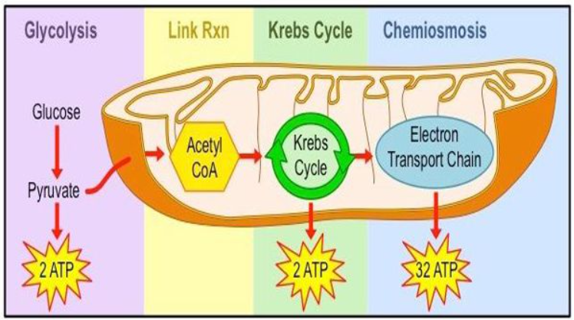
Cellular Respiration Overview (4 Stages)
Notes:
#frame
instructional video
Timing ≈ 1min
Respiration takes two routes: aerobic and anaerobic respiration.
Aerobic respiration: A cellular respiration reaction that requires the presence of oxygen.
Anaerobic respiration: A cellular respiration reaction that does not require the presence of oxygen.
Glucose is necessary to start each process. Both begin with glycolysis, which produces two ATP. Glycolysis is the first stage of the metabolic pathway of cellular respiration that results in the production of ATP. They all start with the step glycolysis: The metabolic pathway of cellular respiration that results in the production of ATP. Glycolysis is followed by the citric acid cycle (produces two ATP) and then the electron transport chain (produces 32 ATP). Electron transport chain: A series of chemical reactions where electrons carried by electron carriers (NAPH and FADH) pass from one molecule to another until they reach an oxygen molecule to produce water.
Anaerobic respiration starts with glycolysis and then lactic acid fermentation (no additional ATP is produced apart from the one in glycolysis).
Fermentation: A metabolic process that release energy from sugar or other organic compound, in the absence of oxygen

Slide 11
Cellular Respiration Overview (3 Major Stages)
Glucose
Aerobic respiration
Anaerobic respiration
(Oxygen present)
(No oxygen present)
Glycolysis: 2 ATP
Glycolysis: 2 ATP
Citric acid cycle: 2 ATP
Fermentation: 0 ATP
Electron transport chain ETC
Total = 2 ATP
(up to 32 ATP)
Total = 36 ATP
Notes:
#frame
instructional video
Timing ≈ 1min
Respiration takes two routes: aerobic and anaerobic respiration.
Aerobic respiration: A cellular respiration reaction that requires the presence of oxygen.
Anaerobic respiration: A cellular respiration reaction that does not require the presence of oxygen.
Glucose is necessary to start each process. Both begin with glycolysis, which produces two ATP. Glycolysis is the first stage of the metabolic pathway of cellular respiration that results in the production of ATP. They all start with the step glycolysis: The metabolic pathway of cellular respiration that results in the production of ATP. Glycolysis is followed by the citric acid cycle (produces two ATP) and then the electron transport chain (produces 32 ATP). Electron transport chain: A series of chemical reactions where electrons carried by electron carriers (NAPH and FADH) pass from one molecule to another until they reach an oxygen molecule to produce water.
Anaerobic respiration starts with glycolysis and then lactic acid fermentation (no additional ATP is produced apart from the one in glycolysis).
Fermentation: A metabolic process that release energy from sugar or other organic compound, in the absence of oxygen

Slide 12
Molecular Accounting of Glycolysis
Glycolysis:
One 6-carbon glucose molecule
Two 3-Carbon Pyruvate molecules
2 ATP (4 are produced but 2 are used)
2 NADH
12
Notes:
So, now a total of 4 ATP molecules and 4 NADH molecules are formed from glycolysis and the transition reaction.

Slide 13
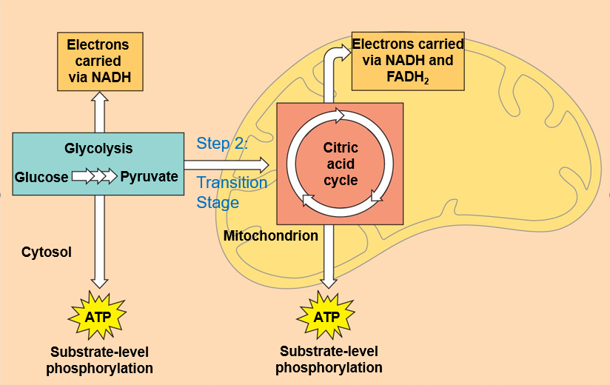
Transition (link) Reaction
2 Pyruvates enter the Mitochondria per glucose molecule
It occurs in the Matrix of the mitochondria
When pyruvate enters the mitochondria, it undergoes a Transition Reaction.
13
Notes:
Pyruvic acid oxidation. The Pyruvates are converted to two carbon molecule called an acetyl group. In this process two hydrogen atoms are removed along with their electrons which is an oxidation reaction. The electrons are moved by the NADH (electron carrier) the the ETC so their energy can be used to make ATP. The Acetyl group is attached to a coenzyme and is now called acetyl coA which carries it to the Krebs cycle.

Slide 14
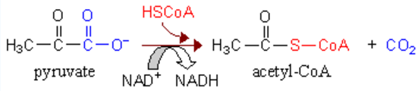
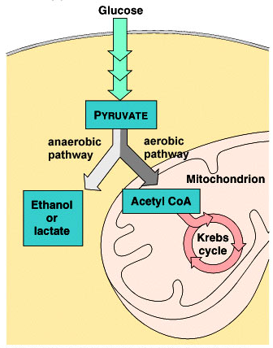
Transition
Reaction
14
Notes:
Pyruvic acid oxidation. The Pyruvates are converted to two carbon molecule called an acetyl group. In this process two hydrogen atoms are removed along with their electrons which is an oxidation reaction. The electrons are moved by the NADH (electron carrier) the the ETC so their energy can be used to make ATP. The Acetyl group is attached to a coenzyme and is now called acetyl coA which carries it to the Krebs cycle.

Slide 15
Transition (Link) Reaction
2 Pyruvic Acid molecules (pyruvate) are converted into 2 acetyl-CoA (from glycolysis).
Acetyl Co-A (2 carbon molecule) connects glycolysis to the Citric Acid cycle (Stage 2 of cellular respiration).
NAD+ is REDUCED to NADH by gaining H+ and electrons, entering the Electron Transport Chain (ETC). (Stage 3 of cellular respiration).
Pyruvic acid
Pyruvic acid
C
C
C
C
C
C
NAD⁺
CoA
NAD⁺
CoA
NADH
NADH
+ H⁺
CO₂
+ H⁺
CO₂
C
C
Acetyl-CoA
Acetyl-CoA
C
C
C
C
Cell Respiration
15
Notes:
Timing ≈ 0.5min
[animate] In preparation for aerobic respiration, after glycolysis but before the next stage the two pyruvic acid molecules are converted into a molecule known as acetyl-CoA. It occurs in the presence of oxygen, and the pyruvic acid produced in glycolysis reacts with a molecule called coenzyme A to form acetyl Co-A. Each of the two pyruvic acid produces one molecule of acetyl-CoA; hence, each glucose molecule produces two acetyl-CoA molecules.
[animate] This reaction connects glycolysis to the citric acid, or Krebs, cycle and is an intermediate step.
This is also where the CO2 that we exhale is produced.

Slide 16





Transition Reaction Summary
From Glycolysis
Mitochondria
Pyruvate
Each pyruvate enters Matrix of the mitochondria from glycolysis.
Pyruvate releases one CO₂ molecule.
CO₂
C
C
C
C
Matrix of Mitochondria
Coenzyme A
C
C
e-
e-
e-
H+
NAD⁺
e-
NADH
H+
Acetyl Co-A
Coenzyme A
C
C
To Krebs Cycle
16
Notes:
In eukarotic cells. Remember 2 pyruvate molecules enter the transition reaction per glucose molecule.

Slide 17
Transition Reaction Summary
From Glycolysis
Mitochondria
Pyruvate
The remaining portion of the molecule is attached to Coenzyme-A (2 carbon molecule).
This releases H+ & two electrons.
NAD+ is reduced by gaining H+ and electrons which creates NADH.
CO₂
C
C
C
C
Matrix of Mitochondria
Coenzyme A
C
C
e-
e-
e-
H+
NAD⁺
e-
NADH
H+
Acetyl Co-A
Coenzyme A
C
C
To Krebs Cycle
17
Notes:
In eukarotic cells. Remember 2 pyruvate molecules enter the transition reaction per glucose molecule.

Slide 18

Transition Reaction Summary
From Glycolysis
Mitochondria
Pyruvate
Coenzyme-A joins with Acetic Acid to form Acetyl Co-A.
CO₂
C
C
C
C
Matrix of Mitochondria
Coenzyme A
C
C
e-
e-
e-
H+
NAD⁺
e-
NADH
H+
Acetyl Co-A
Coenzyme A
C
C
To Krebs Cycle
18
Notes:
In eukarotic cells. Remember 2 pyruvate molecules enter the transition reaction per glucose molecule.

Slide 19
Transition Reaction Summary
From Glycolysis
Mitochondria
Pyruvate
Each pyruvate enters Matrix of the mitochondria from glycolysis.
Pyruvate releases one CO₂ molecule.
The remaining portion of the molecule is attached to Coenzyme-A (2 carbon molecule).
This releases H+ & two electrons
NAD+ is reduced by gaining H+ and electrons which creates NADH.
Coenzyme-A joins with Acetic Acid to form Acetyl Co-A.
CO₂
C
C
C
C
Matrix of Mitochondria
Coenzyme A
C
C
e-
e-
e-
H+
NAD⁺
e-
NADH
H+
Acetyl Co-A
Coenzyme A
C
C
To Krebs Cycle
19
Notes:
In eukarotic cells. Remember 2 pyruvate molecules enter the transition reaction per glucose molecule.

Slide 20
Molecular Accounting in Transition Reaction
From Glycolysis
Mitochondria
Pyruvate
Transition Reaction:
2 Acetyl Co-A molecules
2 Carbon Dioxide molecules
2 NADH
[one of each per Pyruvate molecule]
CO₂
C
C
C
C
Matrix of Mitochondria
Coenzyme A
C
C
e-
e-
e-
H+
NAD⁺
e-
NADH
H+
Acetyl Co-A
Coenzyme A
C
C
To Krebs Cycle
20
Notes:
Remember that glycolysis broke down a 6 carbon glucose molecule providing
2 3-Carbon pyruvate molecules
2 ATPs
2 NADH

Slide 21
Transition Stage
Where does it occur?
What is used?
What molecule is produced?
What are the electron carriers produced? Process?

Slide 22
Transition Stage
Where does it occur?
  Starts in cytoplasm
  Ends in mitochondria
What is used?
  Pyruvate
What molecule is produced?
  2 CO₂
What are the electron carriers produced? Process?
  2 NADH, 2 Acetyl CoA … reduction

Slide 23
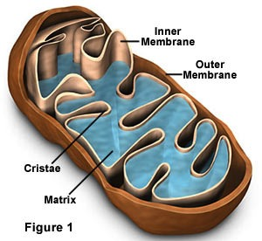

Stage 2: Krebs Cycle
Citric Acid Cycle
Takes place in matrix of mitochondria.
Acetyl Co-A enters the Krebs Cycle.
Requires Oxygen (Aerobic).
Acetyl-CoA
NAD⁺
NADH
C
C
FADH₂
CoA
FAD
CoA
4-carbon
compound
Citric Acid
C
C
C
C
C
C
C
C
C
C
ADP
CO₂
C
ATP
5-carbon
compound
NAD⁺
NADH
NADH
NAD⁺
C
C
C
C
C
C
CO₂
23
Notes:
The remaining carbon molecules from glucose are catabolized. When these bonds are broken energy is released. Enzymes capture the released energy and make ATP
FAD- Flavin adenine dinucleotide. FADH₂ is the hydrogenated form of FAD and is the form of FAD that is actively carrying activated electrons.

Slide 24




2. Krebs Cycle
Acetyl CoA enters the mitochondria from the Transition Reaction.
From Transition Reaction
Acetyl Co-A
Coenzyme A
C
C
C
C
C
C
C
C
C
C
CO₂
NAD⁺
NAD⁺
FAD
NAD⁺
C
C
C
C
C
e-
e-
e-
e-
H+
e-
e-
H+
H+
C
C
C
C
C
e-
H+
e-
H+
H+
C
C
C
C
NADH
FADH₂
C
C
C
C
C
CO₂
NAD⁺
C
C
C
C
NAD⁺
e-
C
C
C
C
ADP
e-
e-
H+
e-
H+
NADH
ATP
24
Notes:
4 carbon molecule oxaloacetic acid merges with acetyl Co-A to make a 6 carbon molecule

Slide 25

2. Krebs Cycle
Acetyl Co-A (a two carbon molecule) joins with a 4 Carbon molecule forming a 6 Carbon molecule.
From Transition Reaction
Acetyl Co-A
Coenzyme A
Coenzyme A
C
C
C
C
C
C
C
C
C
C
C
C
C
e-
e-
e-
e-
H+
e-
e-
H+
H+
C
C
C
C
C
e-
H+
e-
H+
H+
C
C
C
C
NADH
FADH₂
C
C
C
C
C
CO₂
NAD⁺
C
C
C
C
NAD⁺
e-
C
C
C
C
ADP
e-
e-
H+
e-
H+
NADH
ATP
25
Notes:
4 carbon molecule oxaloacetic acid merges with acetyl Co-A to make a 6 carbon molecule

Slide 26
2. Krebs Cycle
Two carbons break off this molecule releasing 2 Carbon Dioxide molecules.
From Transition Reaction
Acetyl Co-A
Coenzyme A
Coenzyme A
C
C
C
C
C
C
C
C
CO₂
C
C
C
C
C
e-
e-
e-
H+
H+
C
C
C
C
C
e-
H+
H+
C
C
C
C
FADH₂
C
C
C
C
C
CO₂
NAD⁺
C
C
C
C
NAD⁺
e-
e-
H+
e-
e-
H+
NADH
26
Notes:
4 carbon molecule oxaloacetic acid merges with acetyl Co-A to make a 6 carbon molecule

Slide 27
2. Krebs Cycle
The Hydrogen and Electrons released by each reaction form 2 NADH (reduction).
From Transition Reaction
NAD⁺
NAD⁺
e-
e-
Acetyl Co-A
H+
e-
Coenzyme A
e-
H+
Coenzyme A
C
C
NADH
C
C
C
C
C
C
CO₂
NAD⁺
NAD⁺
C
C
C
C
C
e-
e-
e-
e-
H+
e-
e-
H+
H+
C
C
C
C
C
e-
H+
e-
H+
H+
C
C
C
C
NADH
FADH₂
C
C
C
C
C
CO₂
NAD⁺
C
C
C
C
NAD⁺
e-
e-
H+
e-
e-
H+
NADH
27
Notes:
4 carbon molecule oxaloacetic acid merges with acetyl Co-A to make a 6 carbon molecule

Slide 28
2. Krebs Cycle
This 4 carbon molecule reacts with ADP forming ATP.
From Transition Reaction
NAD⁺
NAD⁺
e-
e-
Acetyl Co-A
H+
e-
Coenzyme A
e-
H+
Coenzyme A
C
C
NADH
C
C
C
C
C
C
CO₂
NAD⁺
NAD⁺
C
C
C
C
C
e-
e-
H+
e-
C
C
C
C
C
e-
H+
NADH
C
C
C
C
C
CO₂
C
C
C
C
ADP
ATP
28
Notes:
4 carbon molecule oxaloacetic acid merges with acetyl Co-A to make a 6 carbon molecule

Slide 29
2. Krebs Cycle
Then the 4 carbon molecule releases H+ and 2 Electrons to form another NADH.
From Transition Reaction
NAD⁺
NAD⁺
e-
e-
Acetyl Co-A
H+
e-
Coenzyme A
e-
H+
Coenzyme A
C
C
NADH
C
C
C
C
C
C
CO₂
NAD⁺
NAD⁺
C
C
C
C
C
e-
e-
H+
e-
C
C
C
C
C
e-
H+
NADH
C
C
C
C
C
CO₂
NAD⁺
C
C
C
C
NAD⁺
e-
C
C
C
C
e-
e-
e-
H+
H+
NADH
ADP
ATP
29
Notes:
4 carbon molecule oxaloacetic acid merges with acetyl Co-A to make a 6 carbon molecule

Slide 30
2. Krebs Cycle
Then it releases 2 H+ and 2 electrons to form FADH₂
From Transition Reaction
NAD⁺
NAD⁺
e-
e-
Acetyl Co-A
H+
e-
Coenzyme A
e-
H+
Coenzyme A
C
C
NADH
C
C
C
C
C
C
CO₂
NAD⁺
FAD
NAD⁺
NAD⁺
C
C
C
C
C
e-
e-
e-
e-
H+
e-
e-
H+
H+
C
C
C
C
C
e-
H+
e-
H+
H+
C
C
C
C
NADH
FADH₂
C
C
C
C
C
CO₂
NAD⁺
C
C
C
C
NAD⁺
e-
C
C
C
C
e-
e-
H+
e-
H+
NADH
ADP
ATP
30
Notes:
4 carbon molecule oxaloacetic acid merges with acetyl Co-A to make a 6 carbon molecule

Slide 31
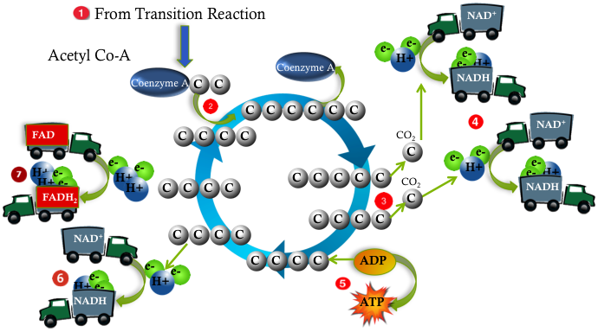
Molecular Accounting in the Krebs Cycle
The Krebs Cycle turns twice per glucose molecule.
Per Glucose molecule it produces:
  4 CO₂ (2 per turn)
  2 ATP (1 per turn)
  6 NADH (3 per turn)
  2 FADH₂ (1 per turn)
31
Cell Respiration
Notes:
Acetyl-CoA enters the mitochondria after glycolysis. A total of 6 CO2 molecules are released during this process. 2 during the transition reaction (reducing the Pyruvate from a 3 carbon molecule to a 2 carbon molecule) then 4 are released as each of the Acetyl CoA molecules release 2 of their carbon molecules each. The ATP produced either stays in the mitochondria or is released into the cytoplasm

Slide 32
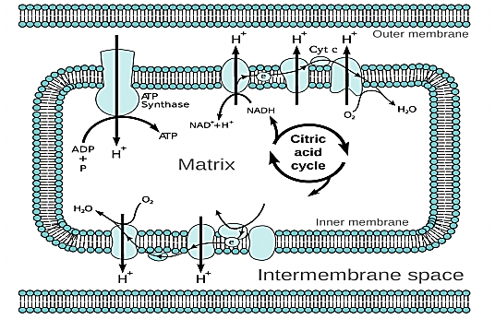
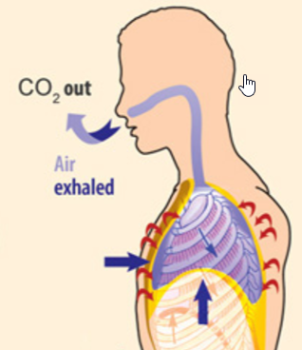
Krebs Cycle Follow Up
ATP is used directly by the cell for ENERGY.
NADH and FADH₂ are coenzymes used to transport activated electrons to the Electron Transport Chain (ETC).
Carbon Dioxide is released by exhaling.
Cell Respiration
32

Slide 33
Aerobic Respiration
How many molecules of CO₂ total are produced during the aerobic metabolism of glucose?
Six:
  2 in the Transition Reaction
  4 in the Krebs Cycle
C₆H₁₂O₆ + 6O₂ 6H₂O + 6CO₂ + Energy (ATP)
Glucose
Oxygen
Water
Carbon dioxide
33

Slide 34
Krebs Cycle
Where does it occur?
What is used?
What energy molecule is produced? What do organisms get rid of?
What are the products entering the ETC?

Slide 35
Krebs Cycle
Where does it occur?
  Matrix in mitochondria
What is used?
  2 Acetyl CoA
What energy molecule is produced? What do organisms get rid of?
  4 CO₂, 2 ATP
What are the products that will enter the ETC?
  6 NADH, 2 FADH₂ via reduction.

Slide 36
Transition and Krebs Cycle
What role does the transition reaction play in cellular respiration?
How do glycolysis & the Krebs cycle differ in terms of oxygen?
Name the energy molecules produced in the Citric Acid Cycle.
Notes:
#frame
Timing~ 1 minute
Entry audio: Read the statement below. Check off those statements that are true for Aerobic cellular respiration only.
[Side note to teacher: This is also the Skill objective: Organize data using specific grouping methods.]

Slide 37
Transition and Krebs Cycle
What role does the transition reaction play in cellular respiration?
Pyruvate (from glycolysis) enters the “matrix” (of the mitochondria) and forms into Acetyl-CoA (a 2 carbon compound).
Acetyl-CoA goes into the Krebs cycle; NADH enters ETC.
Carbon Dioxide is released and will be exhaled from the lungs.
How do glycolysis & the Kreb’s cycle differ in terms of oxygen?
Glycolysis is anaerobic (does not require oxygen).
The Krebs cycle is aerobic (utilizes oxygen).
Name the energy molecules produced in the Citric Acid Cycle.
1. ATP 2. NADH 3. FADH₂
Notes:
#frame
Timing~ 1 minute
Entry audio: Read the statement below. Check off those statements that are true for Aerobic cellular respiration only.
[Side note to teacher: This is also the Skill objective: Organize data using specific grouping methods.]

Slide 38
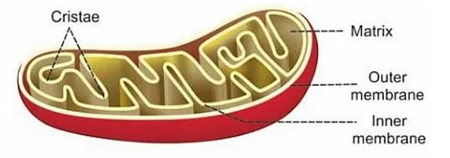
Stage 3: Electron Transport Chain (ETC) (Oxidative Phosphorylation)
Location
  Inner Mitochondrial Membrane (CRISTAE) (eukaryotes)
  Plasma Membrane (prokaryotes)
Notes:
The purpose of the Krebs cycle is to generate molecules of NADH and FADH2 to be used in the electron transport chain where the majority of ATP is made during cellular respiration.

Slide 39
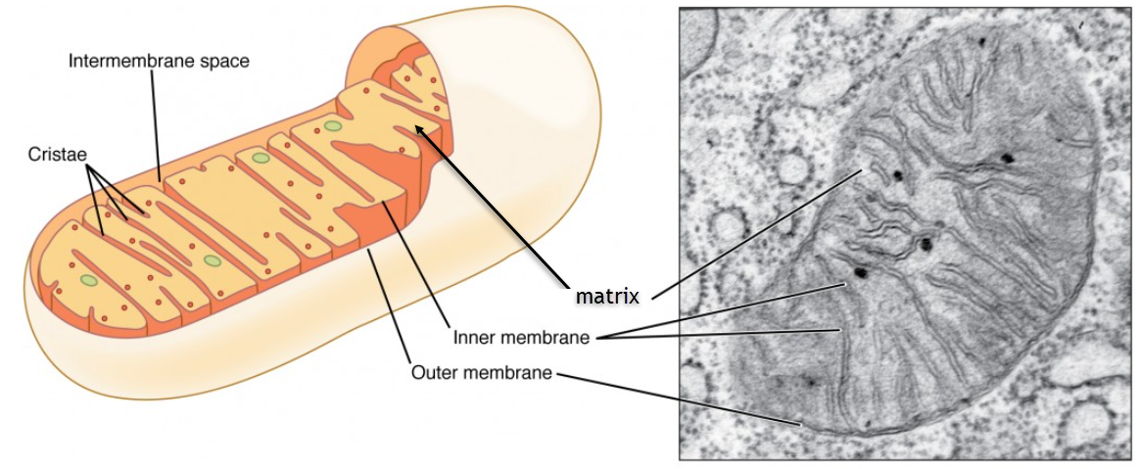
Stage 3: Electron Transport Chain (ETC) (Oxidative Phosphorylation)
Efficiency
  Generates up to 32 ATP
Notes:
The purpose of the Krebs cycle is to generate molecules of NADH and FADH2 to be used in the electron transport chain where the majority of ATP is made during cellular respiration.

Slide 40
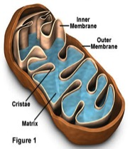
Stage 3: Electron Transport Chain (ETC) (Oxidative Phosphorylation)
Uses the ETC and ATP Synthase to make ATP through Oxidative Phosphorylation.
All NADH and FADH₂ is converted to ATP during this stage of cellular respiration.
Majority of ATP is made in this stage.
The final electron acceptor is OXYGEN (oxidation).
When electrons combine with oxygen, WATER is formed.
Notes:
The purpose of the Krebs cycle is to generate molecules of NADH and FADH2 to be used in the electron transport chain where the majority of ATP is made during cellular respiration.

Slide 41
3. Electron Transport Chain (ETC) (Oxidative Phosphorylation)
e-
e-
H+
e-
H+
e-
H+
NADH
FADH₂
10 NADH and 2 FADH₂ deliver electrons to electron transport chain (OXIDATION).
Electron transport sets up H⁺ ion gradients.
The energy released by the downhill fall of electrons from NADH and FADH₂ to Oxygen is used to phosphorylate ADP → ATP.
(completes Oxidative Phosphorylation)
Flow of H⁺ down gradients through ATP Synthase powers ATP formation (Chemiosmosis).

Slide 42
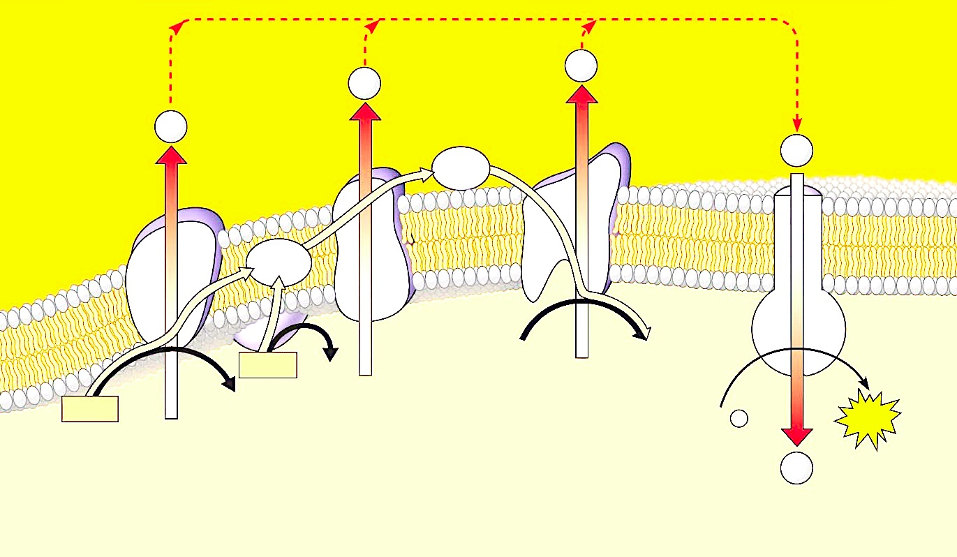
Steps of the Electron Transport Chain
Outer Compartment
e⁻
e⁻
e⁻
e⁻
e⁻
e⁻
Inner membrane
(cristae)
e⁻
FADH₂
FAD
NADH
NAD⁺
Inner Compartment (Matrix)
The high-energy electrons from NADH and FADH₂ are passed along the electron transport chain, from one protein to the next, forming NAD+ and FAD (oxidation).

Slide 43

Steps of the Electron Transport Chain
Outer Compartment
e⁻
e⁻
e⁻
e⁻
e⁻
e⁻
ETC
Inner membrane
(cristae)
e⁻
FADH₂
O₂
H₂O
FAD
NADH
NAD⁺
Inner Compartment (Matrix)
At the end of the electron transport chain, the electrons & Hydrogen ions will be combined with oxygen to form water. [“oxidative”]

Slide 44

Steps of the Electron Transport Chain
Outer Compartment
e⁻
e⁻
e⁻
e⁻
e⁻
e⁻
ETC
Inner membrane
(cristae)
e⁻
FADH₂
O₂
H₂O
FAD
NADH
NAD⁺
Inner Compartment (Matrix)
Oxygen is the final electron acceptor. Oxygen is essential for getting rid of low energy electrons and hydrogen ions.

Slide 45
Steps of the Electron Transport Chain
High concentration of H⁺
H⁺
Outer Compartment
e⁻
e⁻
e⁻
H⁺
e⁻
e⁻
e⁻
ETC
Inner membrane
(cristae)
e⁻
FADH₂
FAD
O₂
H₂O
H⁺
H⁺
NADH
NAD⁺
H⁺
Inner Compartment (Matrix)
Matrix: Low concentration of H⁺
As these electrons move down the electron transport chain, they release energy, which is used to pump hydrogen ions across the membrane from the matrix to the Outer Compartment.
The hydrogen ions are pumped against the concentration gradient from an area of low concentration to an area of high concentration in the outer compartment (in the matrix).

Slide 46
Steps of the Electron Transport Chain
High concentration of H⁺
High concentration of H+
H⁺
H⁺
H⁺
Outer Compartment
e⁻
H⁺
e⁻
e⁻
H⁺
e⁻
e⁻
e⁻
ETC
Inner membrane
(cristae)
e⁻
FADH₂
FAD
O₂
H₂O
NADH
NAD⁺
Inner Compartment (Matrix)
Matrix: Low concentration of H⁺
A concentration gradient has now been established.
There is a high concentration of hydrogen in the outer compartment.
and a low concentration in the matrix.

Slide 47

Steps of the Electron Transport Chain
High concentration of H⁺
H⁺
H⁺
H⁺
Outer Compartment
e⁻
H⁺
e⁻
e⁻
H⁺
e⁻
e⁻
e⁻
ETC
ATP synthase
Inner membrane
(cristae)
e⁻
FADH₂
FAD
O₂
H₂O
NADH
NAD⁺
Inner Compartment (Matrix)
H⁺
Matrix: Low concentration of H⁺
Also embedded in the mitochondrial membranes are enzymes called ATP synthases.
Hydrogen ions flow through ATP synthase back the area of low concentration in the matrix .

Slide 48
Steps of the Electron Transport Chain
High concentration of H⁺
H⁺
H⁺
H⁺
Outer Compartment
e⁻
H⁺
e⁻
e⁻
H⁺
e⁻
e⁻
e⁻
ETC
ATP synthase
Inner membrane
(cristae)
e⁻
FADH₂
2
FAD
O₂
H₂O
NADH
10
NAD⁺
ATP
ADP + P
Inner Compartment (Matrix)
H⁺
Matrix: Low concentration of H⁺
As the hydrogen flows through ATP synthase, it spins like a rotor.
Each time it rotates, a phosphate is attached to ADP to form ATP. (“phosphorylation”)

Slide 49
Steps of the Electron Transport Chain
Outer Compartment
Inner membrane
(cristae)
Inner Compartment (Matrix)
Can You Explain each step in the Diagram?
(If not, go back & review)

Slide 50
Electron Transport Chain (ETC)
Where does it occur?
What molecules are used?
What molecule & energy molecule is produced?
What are the oxidized products?

Slide 51
Electron Transport Chain (ETC)
Where does it occur?
  Cristae (membranes) in mitochondria
What molecules are used?
  H+ from NADH and FADH₂, O₂
What molecule and energy molecule is produced?
  34 ATP and H₂O molecules
What are the oxidized products?
  NAD ⁺, FAD⁺²

Slide 52
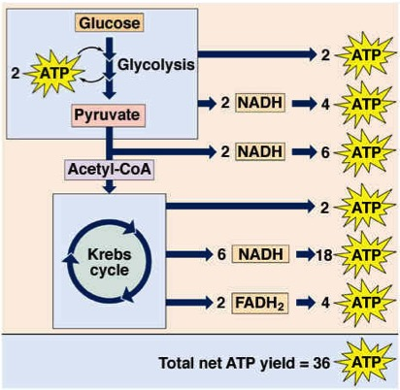
Summary of Energy Harvest
(per molecule of Glucose)
  Output:
  NADH from Glycolysis:
    2 ATP from each at ETC
    Some energy is used initially to import these NADH from the cytoplasm into the mitochondria
  NADH from Transition Reaction + Krebs Cycle:
    3 ATP from each at ETC
  FADH₂ from Krebs Cycle:
    2 ATP from each at ETC
52

Slide 53
Summary of Energy Harvest
(per molecule of Glucose)
Glycolysis
  2 ATP
  2 NADH
Transition Reaction
  2 NADH
Kreb’s Cycle
  2 ATP
  6 NADH
  2 FADH₂
Electron Transport Chain
4 ATP
6 ATP
18 ATP
4 ATP
Total in Aerobic Respiration
36 ATP
32 ATP
53

Slide 54
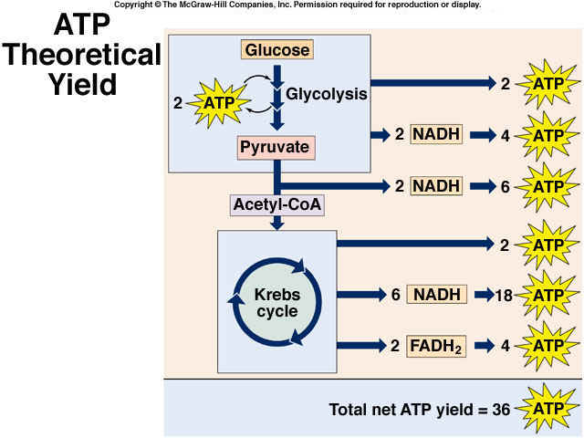
54
Cell Respiration

Slide 55
Summary
32 ATP
36 ATP
55

Slide 56
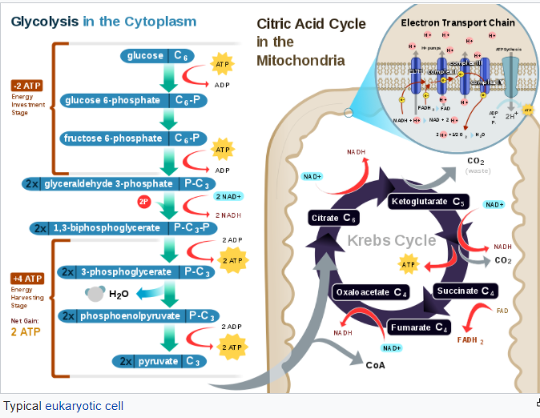
HONORS
56

Slide 57
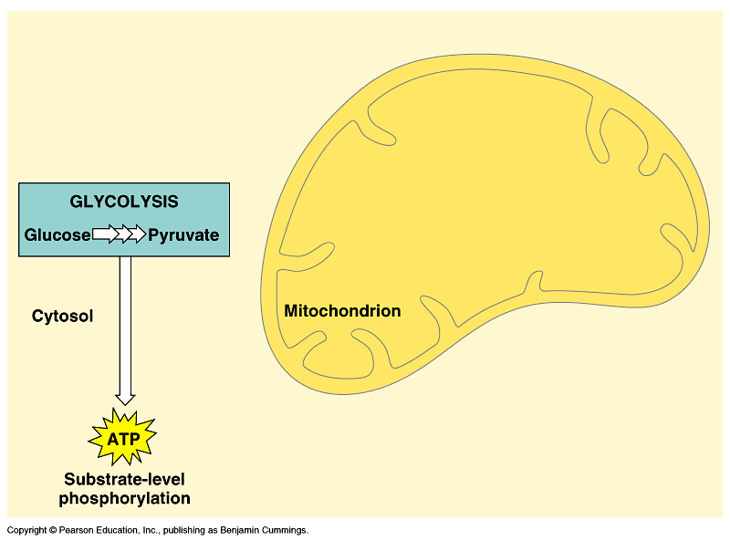
Cellular Respiration Review
36

Slide 58
Transition Reaction
Acetyl-CoA
matrix
36

Slide 59
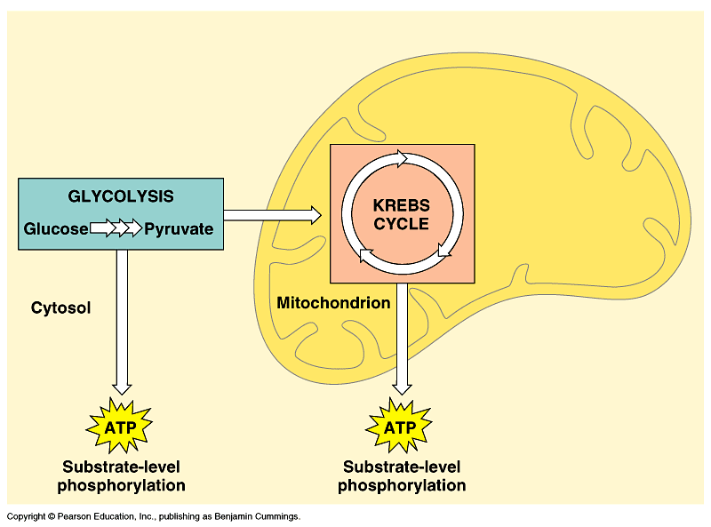
An overview of cellular respiration (Layer 2)
Cellular Respiration Review
59

Slide 60
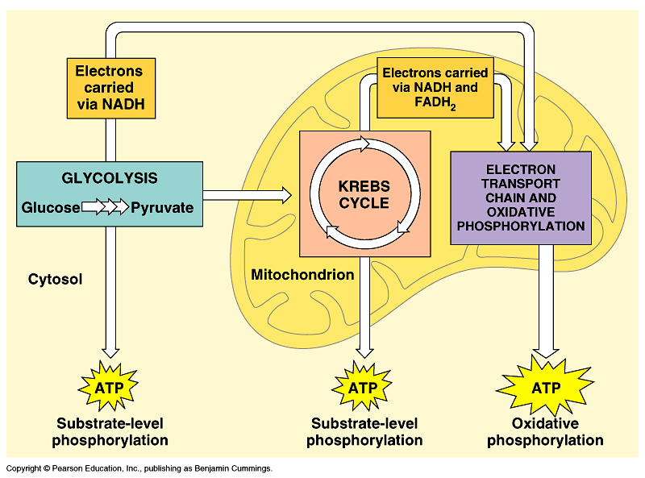
An overview of cellular respiration (Layer 3)
Cellular Respiration Review
60

Slide 61
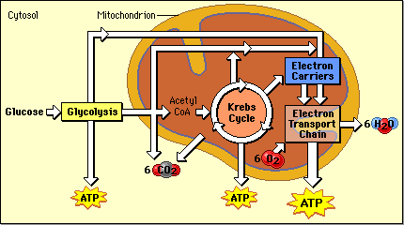
Diagram of Cellular Respiration
Occurs across Cristae
Occurs in Cytoplasm
Occurs in Matrix
61

Slide 62
Summary of the 3 Major Stages of Cellular Respiration:
Pathway | Eukaryote | Prokaryote

Slide 63
Summary of the 3 Major Stages of Cellular Respiration:
Pathway | Eukaryote | Prokaryote
Glycolysis | Cytoplasm | Cytoplasm
Krebs cycle | Mitochondrial matrix | Cytoplasm
ETC (Electron Transport Chain) | Mitochondrial inner membrane | Plasma membrane

Slide 64
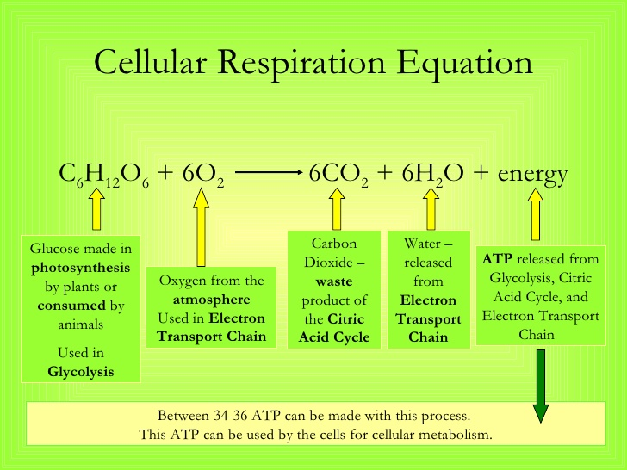
Name each molecule. Tell where it comes from, and name the stage it appears?
Amount & Purpose of ATP?
64

Slide 65
65

Slide 66
Identifying the Stages of Cellular Respiration
Identify the stage of cellular respiration for each of the following:
Produces 32 ATP molecules …
Creates four ATP molecules, but gains only two overall …
Gives off carbon dioxide …
Gives off water …
Produces two ATP molecules total …
Converts pyruvate to Acetyl-CoA …
Takes place in the matrix of the mitochondria …
Produces NADH from NAD+ …
Takes place in the cytoplasm in eukaryotes …
Produces FADH₂ for the ETC …
66
Notes:
#frame
Timing≈ 1 minute
Entry Audio: Identify the stage of cellular respiration in which each product is generated.
Exit Audio: Overall, 36 molecules of ATP are produced through these three stages of cellular respiration.

Slide 67
Identifying the Stages of Cellular Respiration
Identify the stage of cellular respiration for each of the following:
Produces 32 ATP molecules … electron transport chain
Creates four ATP molecules, but gains only two overall … glycolysis
Gives off carbon dioxide … citric acid cycle (Krebs cycle)
Gives off water … electron transport chain
Produces two ATP molecules total … citric acid cycle
Converts pyruvate to Acetyl-CoA … transition reaction
Takes place in the matrix of the mitochondria … transition reaction & Krebs
Produces NADH from NAD+ … glycolysis, transition reaction, Krebs cycle
Takes place in the cytoplasm in eukaryotes … glycolysis & fermentation
Produces FADH₂ for the ETC … Krebs cycle
67
Notes:
#frame
Timing≈ 1 minute
Entry Audio: Identify the stage of cellular respiration in which each product is generated.
Exit Audio: Overall, 36 molecules of ATP are produced through these three stages of cellular respiration.

Slide 68
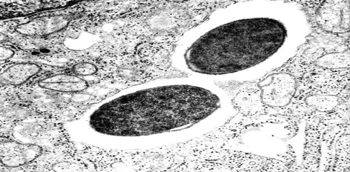
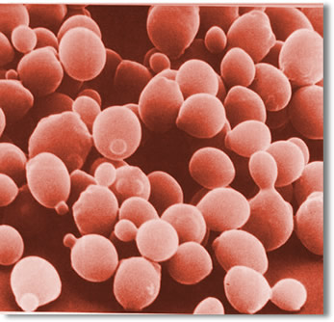
Anaerobic Processes
FERMENTATION
No Oxygen is required
Glycolysis is the first step
Some bacteria and yeast are examples of “anaerobes”
Net gain = 2 ATP
per glucose molecule
68
Notes:
Images: http://www.biol.vt.edu/research/images/C._perfringens_in_mac._jpg.jpg
and http://www.utoronto.ca/greenblattlab/images/a/yeast%201.jpg

Slide 69
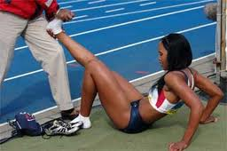
Fermentation
Pyruvate can be metabolized by:
  Alcoholic Fermentation (AF)
    produces ethyl alcohol and CO₂
    In bacteria and yeast cells
  Lactic Acid Fermentation (LAF)
    LAF produces lactic acid. It can build up in muscles during strenuous exercise and cause burning and soreness.
    In bacteria and muscles
Glycolysis is first part of Fermentation

Slide 70
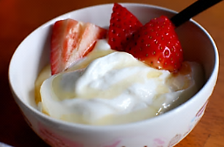
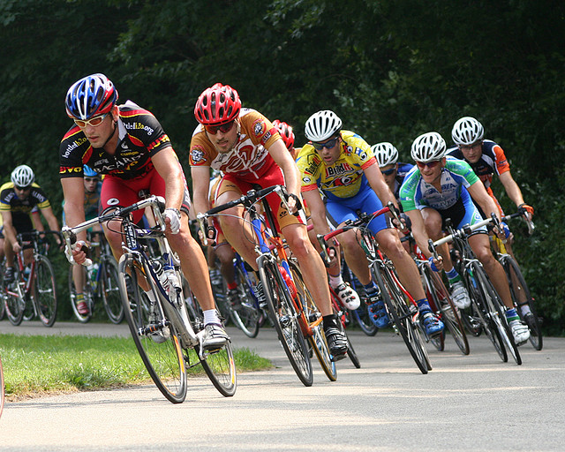
Lactic Acid Fermentation
  Cheese & Yogurt
  Accumulation of lactic acid after rigorous exercise causes fatigue and sore muscles.
  Lactic acid will eventually be converted back to pyruvate in the liver once oxygen is available.
Notes:
Timing ≈ 1min
Alcohol fermentation and lactic acid fermentation have commercial applications that you may benefit from.
[animate] Alcohol fermentation by yeast is used commercially in
Baking
Brewing
Winemaking
For baking and brewing, yeast is a helpful organism. Yeast is a live single-celled organism. Yeast cells reproduce rapidly no matter where they are. During this growth, yeast produces enzymes, so when yeast is added to bread dough, an enzyme goes to work on the flour, changing the starch in it into sugar. Another enzyme changes the sugar into alcohol and carbon dioxide. This gas spreads through the dough in the form of bubbles, causing it to rise. Yeast is also used in winemaking to produce carbon dioxide; the gas builds up in champagne and causes the bubbly froth that overflows when it is uncorked. It also causes the froth in beer.
[animate] Lactic acid fermentation is also used commercially in
preparation of cheese.
preparation of yogurt.
The lactic acid is what gives yogurt its sour taste. All these are made possible through cellular respiration.
SOURCES:
Yogurt. “Breakfast,” Janine. 2010 as CC, Digital Image. http://www.flickr.com/photos/geishabot/4579250516/ (accessed April 11, 2011).
Bread. “Bread 12.JPG,” Naomi. 2007 as Free Photo, Digital Image. http://www.morguefile.com/archive/display/708746 (accessed April 11, 2011).

Slide 71
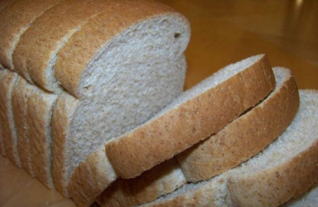
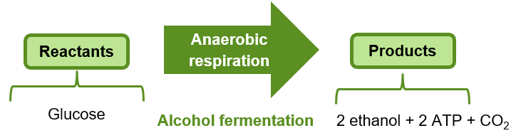
Alcohol Fermentation
  Baking
  Brewing
  Winemaking
Notes:
Timing ≈ 1min
Alcohol fermentation and lactic acid fermentation have commercial applications that you may benefit from.
[animate] Alcohol fermentation by yeast is used commercially in
Baking
Brewing
Winemaking
For baking and brewing, yeast is a helpful organism. Yeast is a live single-celled organism. Yeast cells reproduce rapidly no matter where they are. During this growth, yeast produces enzymes, so when yeast is added to bread dough, an enzyme goes to work on the flour, changing the starch in it into sugar. Another enzyme changes the sugar into alcohol and carbon dioxide. This gas spreads through the dough in the form of bubbles, causing it to rise. Yeast is also used in winemaking to produce carbon dioxide; the gas builds up in champagne and causes the bubbly froth that overflows when it is uncorked. It also causes the froth in beer.
[animate] Lactic acid fermentation is also used commercially in
preparation of cheese.
preparation of yogurt.
The lactic acid is what gives yogurt its sour taste. All these are made possible through cellular respiration.
SOURCES:
Yogurt. “Breakfast,” Janine. 2010 as CC, Digital Image. http://www.flickr.com/photos/geishabot/4579250516/ (accessed April 11, 2011).
Bread. “Bread 12.JPG,” Naomi. 2007 as Free Photo, Digital Image. http://www.morguefile.com/archive/display/708746 (accessed April 11, 2011).

Slide 72
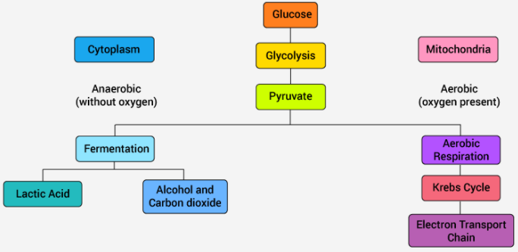
Anaerobic & Aerobic
Cell Respiration
Oxygen is present.
Same Questions …
No oxygen is present.
Which type of respiration is it?
Where does it take place?
What reactions are involved?
72

Slide 73
Anaerobic & Aerobic
Cell Respiration
73

Slide 74
Comparison of Cellular Respiration Processes
Respiration Process | Where Process Occurs | Net Gain of ATP Per Glucose
Anaerobic: Glycolysis & Fermentation
Aerobic: Krebs Cycle & ETC
74

Slide 75
Comparison of Cellular Respiration Processes
Respiration Process | Where Process Occurs | Net Gain of ATP Per Glucose
Anaerobic: Glycolysis & Fermentation | Cytoplasm | 2 ATP
Aerobic: Krebs Cycle & ETC | Mitochondria | 2 ATP + 32 ATP 34 ATP
75

Slide 76
ATP in Cellular Respiration
Glucose
Aerobic respiration
Anaerobic respiration
(Oxygen ?)
(oxygen ?)
Glycolysis: ___ ATP
Glycolysis: ___ ATP
___________cycle: ___ ATP
________ _________ _________ ETC
______________: __ ATP
(lactic acid or alcohol)
(up to ___ ATP)
Total = ___ ATP
Total = ___ ATP
76
Notes:
#frame
instructional video
Timing ≈ 1min
Respiration takes two routes: aerobic and anaerobic respiration.
Aerobic respiration: A cellular respiration reaction that requires the presence of oxygen.
Anaerobic respiration: A cellular respiration reaction that does not require the presence of oxygen.
Glucose is necessary to start each process. Both begin with glycolysis, which produces two ATP. Glycolysis is the first stage of the metabolic pathway of cellular respiration that results in the production of ATP. They all start with the step glycolysis: The metabolic pathway of cellular respiration that results in the production of ATP. Glycolysis is followed by the citric acid cycle (produces two ATP) and then the electron transport chain (produces 32 ATP). Electron transport chain: A series of chemical reactions where electrons carried by electron carriers (NAPH and FADH) pass from one molecule to another until they reach an oxygen molecule to produce water.
Anaerobic respiration starts with glycolysis and then lactic acid fermentation (no additional ATP is produced apart from the one in glycolysis).
Fermentation: A metabolic process that release energy from sugar or other organic compound, in the absence of oxygen

Slide 77
ATP in Cellular Respiration
Glucose
Aerobic respiration
Anaerobic respiration
(Oxygen present)
(No oxygen present)
Glycolysis: 2 ATP
Glycolysis: 2 ATP
Citric acid cycle: 2 ATP
Electron transport chain ETC
Fermentation: 0 ATP
(lactic acid or alcohol)
(up to 32 ATP)
Total = 36 ATP
Total = 2 ATP
77
Notes:
#frame
instructional video
Timing ≈ 1min
Respiration takes two routes: aerobic and anaerobic respiration.
Aerobic respiration: A cellular respiration reaction that requires the presence of oxygen.
Anaerobic respiration: A cellular respiration reaction that does not require the presence of oxygen.
Glucose is necessary to start each process. Both begin with glycolysis, which produces two ATP. Glycolysis is the first stage of the metabolic pathway of cellular respiration that results in the production of ATP. They all start with the step glycolysis: The metabolic pathway of cellular respiration that results in the production of ATP. Glycolysis is followed by the citric acid cycle (produces two ATP) and then the electron transport chain (produces 32 ATP). Electron transport chain: A series of chemical reactions where electrons carried by electron carriers (NAPH and FADH) pass from one molecule to another until they reach an oxygen molecule to produce water.
Anaerobic respiration starts with glycolysis and then lactic acid fermentation (no additional ATP is produced apart from the one in glycolysis).
Fermentation: A metabolic process that release energy from sugar or other organic compound, in the absence of oxygen

Slide 78
Complete the Venn Diagram:
Aerobic vs. Anaerobic Respiration
Aerobic
Anaerobic
Notes:
#frame
Timing~ 1 minute
Entry audio: Read the statement below. Check off those statements that are true for Aerobic cellular respiration only.
[Side note to teacher: This is also the Skill objective: Organize data using specific grouping methods.]

Slide 79
Complete the Venn Diagram:
Aerobic vs. Anaerobic Respiration
Aerobic
Anaerobic
Mainly in cytoplasm of cell
Does not require oxygen
Produces lactic acid or alcohol (fermentation)
Yields ATP molecules much faster (2 net) … needed in muscle and tissues
Mainly in mitochondria
Requires oxygen
Consists of three major stages
Yields more ATP molecules (36 net)
Use glucose
Occurs in all cells
Glycolysis
Yields ATP
Notes:
#frame
Timing~ 1 minute
Entry audio: Read the statement below. Check off those statements that are true for Aerobic cellular respiration only.
[Side note to teacher: This is also the Skill objective: Organize data using specific grouping methods.]

