Slide 1
Click “Slide Show”
Click “From Beginning”
Or
“From Current Slide”

Slide 2
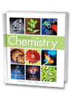

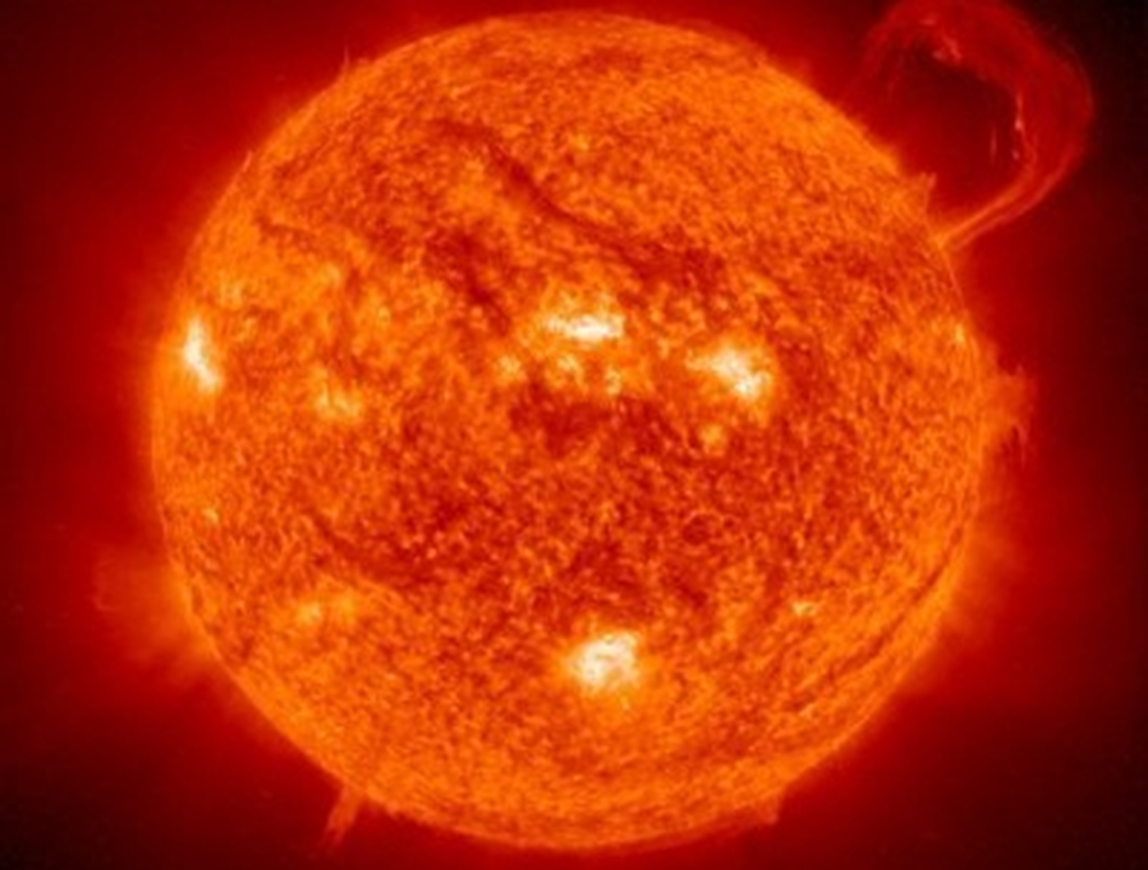
Chapter 17B
Thermochemistry
The Flow of Energy
Measuring and Expressing
Enthalpy Changes
Heat in Changes of State
Calculating Heats of Reaction

Slide 3
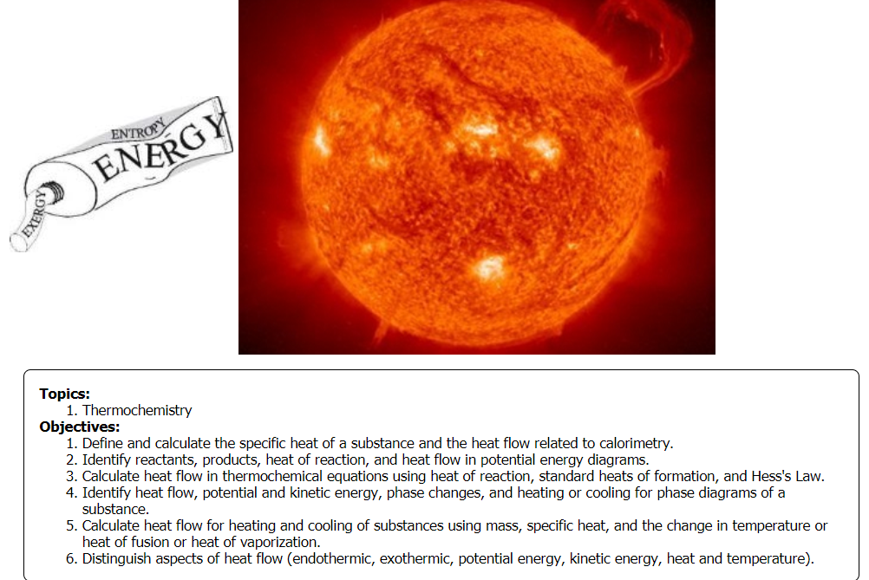

Slide 4
Heating and Cooling Curves
Inquiry Questions
  Why doesn’t the temperature change as ice melts? As water boils?
  What type of heat flow occurs as ice melts and then water boils?
  What type of heat flow occurs as water condenses and eventually freezes?
  What do we call the stages when ice melts and water boils? Opposite phase changes?
  Distinguish Heat from Temperature

Slide 5
Heating and Cooling Curves
  Why doesn’t the temperature change as ice melts? As water boils? (PE changes the phase; avg KE is constant )
  What type of heat flow occurs as ice melts and then boils? (Heat is added → endothermic)
  What type of heat flow occurs as water condenses and eventually freezes? (Heat is given off → exothermic)
  When ice melts (melting pt) and water boils (boiling pt) … opposite phase changes: (freezing pt), (condensation pt).
  Distinguish Heat from Temperature boils (Heat includes mass and temperature; temperature is the average KE of molecules)?

Slide 6
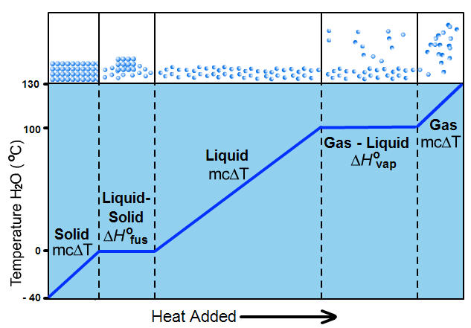

What kind of heat flow is shown?
Label PE, KE, Title, Equations, Fixed pts
Liquid → gas
Solid → Liquid

Slide 7

Phase Change Diagrams
Endothermic “Heating Curve”
q = +
BP
PE
KE
Liquid → gas
q = m∆Hv
KE
PE
BP
KE
Solid → Liquid
MP
q = m∆Hf
MP

Slide 8
What kind of heat flow is shown?
Label PE, KE, Title, Equations, Fixed pts
gas
KE
?
PE
∆H_{v}
Temperature
°C
liquid
KE
PE
?
∆H_{f}
KE
solid
Heat

Slide 9
Exothermic (Cooling) Curve
q=mc∆T
gas
q = -
KE
CP
PE
g → l
∆H_{v}
10O C for Water
q=m∆H_{v}
q=mc∆T
Temperature
°C
liquid
KE
q=m∆H_{f}
O C for Water
PE
FP
l → s
∆H_{f}
KE
solid
q=mc∆T
Heat

Slide 10
Quantitative Heat Measurements
How much heat flows when 42.3 g of ice at 0.00° C melts and is heated to 40.0° C? (Endo/Exothermic?)

Slide 11
Quantitative Heat Measurements
How much heat flows when 42.3 g of ice at 0.00° C melts and is heated to 40.0° C? (Endo/Exothermic?)
There is a phase change involved so you need 2 steps
Step 1 ice melting
q = m H_{fus} = 42.3 g (80.0 cal/g)
q_{ice} = +3384 cal = +3.38 kcal
Endothermic (heat is added or absorbed)
2
1

Slide 12
Quantitative Heat Measurements
How much heat flows when 42.3 g of ice at 0.00° C melts and is heated to 40.0° C? (Endo/Exothermic?)
There is a phase change involved so you need 2 steps
Step 1: ice melting → q = m H_{fus} = 42.3 g (80.0 cal/g)
q_{ice} = +3384 cal = +3.38 kcal
Step 2 heating water → q_{water} = m c ∆T
q_{water} = (42.3 g)(1.00 cal/g·°C)(40.0° C – 0.00°C)
q_{water} = +1692 cal = +1.69 kcal
The total heat flow is the sum of the heat in the 2 steps q_{ice} + q_{water} = total heat flow
+3.38 kcal + +1.69 kcal = +5.08 kcal
Endothermic (heat is added or absorbed)
2
1

Slide 13

Calculating the Specific Heat of a Substance
The temperature of a 95.4 g piece of copper increases from 25.0 ⁰C to 48.0 ⁰C when the copper absorbs 849 J of heat. What is the specific heat of copper?

Slide 14
Calculating the Specific Heat of a Substance
The temperature of a 95.4 g piece of copper increases from 25.0 ⁰C to 48.0 ⁰C when the copper absorbs 849 J of heat. What is the specific heat of copper?
q = mc∆T
Rearrange & solve for “c” → c = q/m∆T
c_{Cu} = (849 J)/(95.4 g)(48.0° C – 25.0° C)
c_{Cu} = 0.387 J/g°C

Slide 15
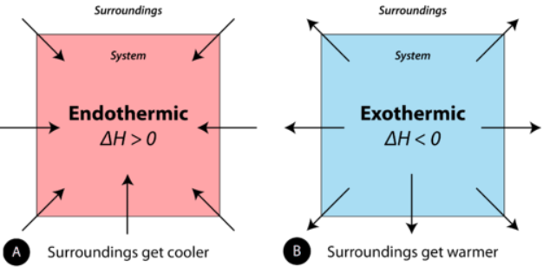

Thermochemical Equations
Thermochemical equations are balanced stoichiometric chemical equations that include the enthalpy change (heat of reaction ΔH).
ΔH_{rxn} = ΔH_{final} – ΔH_{initial}

Slide 16
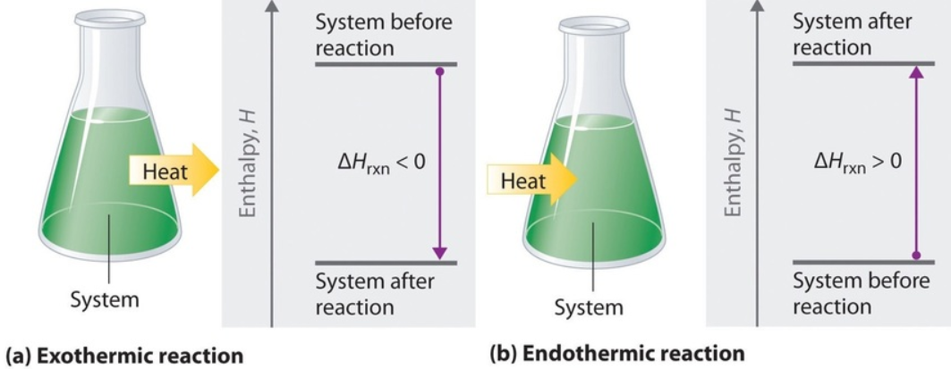
Thermochemical Equations
Compare heat of products to reactants.
Compare stability of Products reactants.
Is Enthalpy + or – (exo or endothermic)?

Slide 17
Thermochemical Equations
ΔH_{rxn} = ΔH_{final} < ΔH_{initial}
Products MORE stable than reactants
ΔH_{rxn} = -
ΔH_{rxn} = ΔH_{final} > ΔH_{initial}
Products LESS stable than reactants
ΔH_{rxn} = +

Slide 18
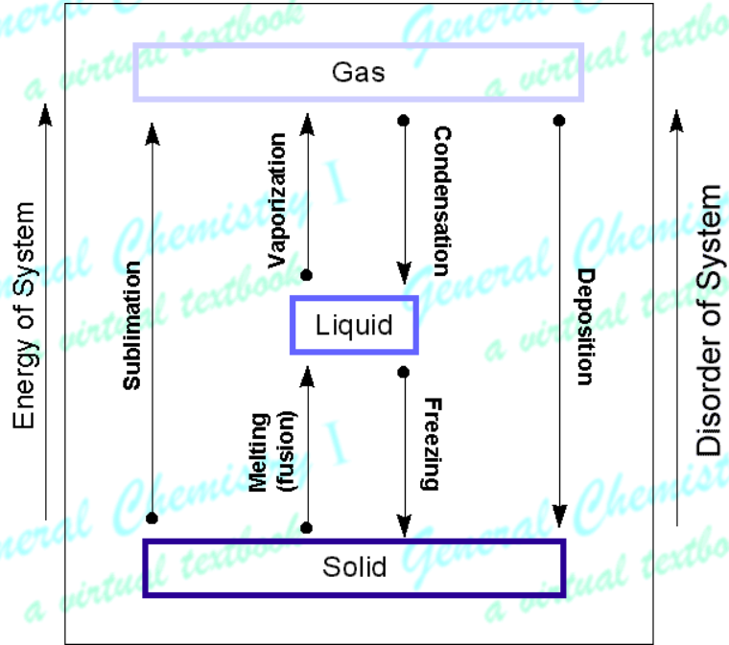
Thermochemical Equations
The physical states (s, l, g) of reactants and products must always be included in thermochemical equations, because the states of reactants and products influence the overall amount of energy exchanged.

Slide 19
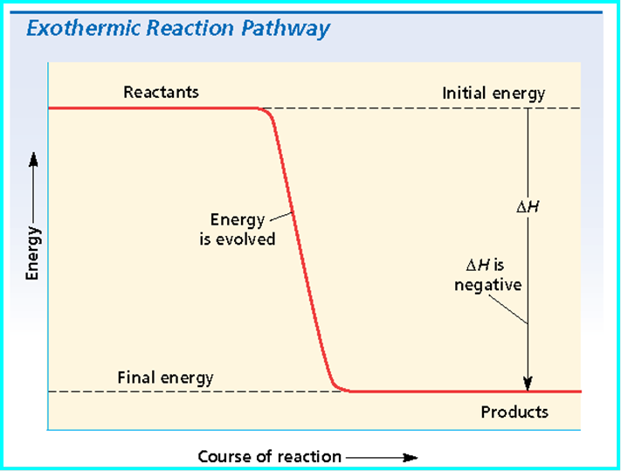
Thermochemical Equations
In any chemical equation, the heat of reaction (∆H) is based on the enthalpy difference of the products and reactants. It is written as either a reactant or a product, depending on whether the reaction is endothermic (+∆H) or exothermic (-∆H).
Which graph shows an endothermic heat of reaction? Exothermic?

Slide 20
Thermochemical Equations
In any chemical equation, the heat of reaction (∆H) is based on the enthalpy difference of the products and reactants. It is written as either a reactant or a product, depending on whether the reaction is endothermic (+∆H) or exothermic (-∆H).

Slide 21
Heats of Reaction -∆H
In exothermic processes, the chemical potential energy of the reactants is HIGHER than the chemical potential energy of the products. This is a “DOWNHILL” Reaction.
CaO(s) + H₂O(l) → Ca(OH)₂(s) ΔH = – 65.2 kJ
The reactants produce calcium hydroxide and release 65.2 kJ/mol of heat.
Is the enthalpy change considered a reactant or product?
Equation:

Slide 22
Heats of Reaction -∆H
In exothermic processes, the chemical potential energy of the reactants is HIGHER than the chemical potential energy of the products. This is a “DOWNHILL” Reaction.
CaO(s) + H₂O(l) → Ca(OH)₂(s) ΔH = – 65.2 kJ
The reactants produce calcium hydroxide and release 65.2 kJ/mol of heat.
∆H is -65.2 KJ because heat energy (enthalpy) is given off or released. Therefore, the enthalpy change can be considered a PRODUCT:
CaO(s) + H₂O(l) → Ca(OH)₂(s) + 65.2 kJ

Slide 23
Heats of Reaction +∆H
In endothermic processes, the chemical potential energy of the reactants is LOWER than the chemical potential energy of the products. This is an “UPHILL” Reaction.
2NaHCO₃(s) → Na₂CO₃(s) + H₂O(l) + CO₂(g) ΔH = +85 kJ
The reactants produce baking soda, water, and CO₂(g) but require 85 kJ/mol of heat.
Is the enthalpy change considered a reactant or product?
Equation:

Slide 24
Heats of Reaction +∆H
In endothermic processes, the chemical potential energy of the reactants is LOWER than the chemical potential energy of the products. This is an “UPHILL” Reaction.
2NaHCO₃(s) → Na₂CO₃(s) + H₂O(l) + CO₂(g) ΔH = +85 kJ
The reactants produce baking soda, water, and CO₂(g) but require 85 kJ/mol of heat.
∆H is +85 KJ because heat energy (enthalpy) is taken in or absorbed. Therefore, the enthalpy change can be considered a REACTANT:
2NaHCO₃(s) + 85 kJ/mol → Na₂CO₃(s) + H₂O(l) + CO₂(g)

Slide 25
What Heat flow is involved in the Reactions?
Label “reactants”, “products”, and “Heat of Reaction”.
  2H₂O + 572 kJ → 2H₂ + O₂
  O exothermic
  O endothermic
Notes:
Time ≈ 2 minutes
Entry Audio: Now apply your understanding of exothermic and endothermic processes to evaluate two chemical reactions carried out in a chemistry lab. In each case, a graph is shown that plots the change in potential energy as the reactants undergo reaction to form the products over the time needed for the reaction to occur.
Hint1 Audio: Remember that an exothermic reaction involves a transfer of heat to the surroundings from the reacting substances while an endothermic reaction involves a transfer of heat from the surroundings to the reacting substances.
Hint2 Audio: The change in potential energy as reactants go to form products will decrease if energy is released by the reacting system, and will increase if energy is absorbed by the reacting system.
Exit Audio: Remember that all chemical reactions begin with reactants, which are substances that react with one another, and become rearranged to form new substances called products. As reactants undergo rearrangement, they either release or absorb energy from the surroundings. As a result, every chemical reaction either releases energy and is exothermic, or absorbs energy and is endothermic.
Source of figures: created by writer
Source of thermochemical data: Zumdahl, S.S. and Zumdahl, S.A., Chemistry, sixth edition, Houghton Mifflin, New York (2003)

Slide 26
What Heat flow is involved in the Reactions?
Label “reactants”, “products”, and “Heat of Reaction”.
  2H₂O + 572 kJ → 2H₂ + O₂
  endothermic
products
∆H = +572 kJ / 2 mol
∆H = +286 kJ/mol
+∆H
reactant
Notes:
Time ≈ 2 minutes
Entry Audio: Now apply your understanding of exothermic and endothermic processes to evaluate two chemical reactions carried out in a chemistry lab. In each case, a graph is shown that plots the change in potential energy as the reactants undergo reaction to form the products over the time needed for the reaction to occur.
Hint1 Audio: Remember that an exothermic reaction involves a transfer of heat to the surroundings from the reacting substances while an endothermic reaction involves a transfer of heat from the surroundings to the reacting substances.
Hint2 Audio: The change in potential energy as reactants go to form products will decrease if energy is released by the reacting system, and will increase if energy is absorbed by the reacting system.
Exit Audio: Remember that all chemical reactions begin with reactants, which are substances that react with one another, and become rearranged to form new substances called products. As reactants undergo rearrangement, they either release or absorb energy from the surroundings. As a result, every chemical reaction either releases energy and is exothermic, or absorbs energy and is endothermic.
Source of figures: created by writer
Source of thermochemical data: Zumdahl, S.S. and Zumdahl, S.A., Chemistry, sixth edition, Houghton Mifflin, New York (2003)

Slide 27
What Heat flow is involved in the Reactions?
Label “reactants”, “products”, and “Heat of Reaction”.
  HCl + NaOH → NaCl + H₂O + 58 kJ
  O exothermic
  O endothermic
Notes:
Time ≈ 2 minutes
Entry Audio: Now apply your understanding of exothermic and endothermic processes to evaluate two chemical reactions carried out in a chemistry lab. In each case, a graph is shown that plots the change in potential energy as the reactants undergo reaction to form the products over the time needed for the reaction to occur.
Hint1 Audio: Remember that an exothermic reaction involves a transfer of heat to the surroundings from the reacting substances while an endothermic reaction involves a transfer of heat from the surroundings to the reacting substances.
Hint2 Audio: The change in potential energy as reactants go to form products will decrease if energy is released by the reacting system, and will increase if energy is absorbed by the reacting system.
Exit Audio: Remember that all chemical reactions begin with reactants, which are substances that react with one another, and become rearranged to form new substances called products. As reactants undergo rearrangement, they either release or absorb energy from the surroundings. As a result, every chemical reaction either releases energy and is exothermic, or absorbs energy and is endothermic.
Source of figures: created by writer
Source of thermochemical data: Zumdahl, S.S. and Zumdahl, S.A., Chemistry, sixth edition, Houghton Mifflin, New York (2003)

Slide 28
What Heat flow is involved in the Reactions?
Label “reactants”, “products”, and “Heat of Reaction”.
  HCl + NaOH → NaCl + H₂O + 58 kJ
  exothermic
reactants
∆H = -58 kJ/mol
-∆H
products
Notes:
Time ≈ 2 minutes
Entry Audio: Now apply your understanding of exothermic and endothermic processes to evaluate two chemical reactions carried out in a chemistry lab. In each case, a graph is shown that plots the change in potential energy as the reactants undergo reaction to form the products over the time needed for the reaction to occur.
Hint1 Audio: Remember that an exothermic reaction involves a transfer of heat to the surroundings from the reacting substances while an endothermic reaction involves a transfer of heat from the surroundings to the reacting substances.
Hint2 Audio: The change in potential energy as reactants go to form products will decrease if energy is released by the reacting system, and will increase if energy is absorbed by the reacting system.
Exit Audio: Remember that all chemical reactions begin with reactants, which are substances that react with one another, and become rearranged to form new substances called products. As reactants undergo rearrangement, they either release or absorb energy from the surroundings. As a result, every chemical reaction either releases energy and is exothermic, or absorbs energy and is endothermic.
Source of figures: created by writer
Source of thermochemical data: Zumdahl, S.S. and Zumdahl, S.A., Chemistry, sixth edition, Houghton Mifflin, New York (2003)

Slide 29
Previously, we used the decomposition reaction of bicarbonate and found that 85 KJ/mol of heat were needed.
2NaHCO₃(s) + 85 kJ/mol → Na₂CO₃(s) + H₂O(l) + CO₂(g)
Calculate the amount of heat (in kJ) required to decompose 4.24 mol NaHCO₃(s).

Slide 30
Previously, we used the decomposition reaction equation of bicarbonate and found that 85 KJ/mol of heat were needed.
2NaHCO₃(s) + 85 kJ/mol → Na₂CO₃(s) + H₂O(l) + CO₂(g)
Calculate the amount of heat (in kJ) required to decompose 4.24 mol NaHCO₃(s).
Since 85 KJ/mol are required to decompose 2 mol NaHCO₃(s)
Use mole ratios of “actual/theoretical” mol:
ΔH → 4.24 mol / 2 mol = ? / +85 kJ
ΔH = +180 KJ

Slide 31
Heat (Enthalpy) of Reaction
Heat of reaction refers to Enthalpy Change (∆H), which is the Enthalpy or heat content of a system.
For any reaction carried out directly at constant pressure, the heat flow (∆H = mc∆T) is exactly equal to the difference between the enthalpy of the products and the enthalpy of the reactants.
ΔH = ∑ΔH_{products} – ∑ΔH_{reactants}

Slide 32
Heat (Enthalpy) of Reaction
One can calculate the overall Heat of reaction by expanding the enthalpy equation:
∆H = ∑[(∆H_{products}) × (mol_{products})] – ∑[(ΔH_{reactants}) × (mol_{reactants})]
ΔH = ∑ΔH_{products} – ∑ΔH_{reactants}
coefficients
coefficients

Slide 33
Calculating Enthalpy of Reaction
  Iron(III) oxide (Fe₃O₄(s), ΔH_{f} = –1117.1 kJ/mol) can react with aluminum powder to form aluminum oxide (Al₂O₃(s), ΔH_{f} = –1669.8 kJ/mol) and iron according to the equation below:
  3Fe₃O₄(s) + 8Al(s) → 4Al₂O₃(s) + 9Fe(s)
What is ΔH_{rxn} for this reaction?

Slide 34
Calculating Enthalpy of Reaction
  Iron(III) oxide (Fe₃O₄(s), ΔH_{f} = –1117.1 kJ/mol) can react with aluminum powder to form aluminum oxide (Al₂O₃(s), ΔH_{f} = –1669.8 kJ/mol) and iron according to the equation below:
  3Fe₃O₄(s) + 8Al(s) → 4Al₂O₃(s) + 9Fe(s)
What is ΔH_{rxn} for this reaction?
∆H = ∑[(∆H_{products}) × (mol_{products})] – ∑[(ΔH_{reactants}) × (mol_{reactants})]
ΔH_{f} (prod) = [4 mol Al₂O₃(s) × ΔH_{f}⁰ Al₂O₃(s)] + [9 mol Fe(s) × ΔH_{f} ⁰ Fe(s)]
= (4 × –1669.8 kJ) + (9 x 0.00 KJ) = –6679.2 kJ
ΔH_{f} (react) = [3 mol Fe₃O₄(s) × ΔH_{f}⁰ Fe₃O₄ (s)] + [8 mol Al × ΔH_{f}⁰ Al(s)]
= (3 × –1117.1 kJ) + (8 x 0.00 kJ) = –3351.3 kJ
Notes:
Timing ~2 min
Let's look at an example of how to calculate enthalpy of reaction. Consider the thermite reaction. How can we calculate enthalpy of reaction for this reaction?
First, we have to calculate the total enthalpy of the reactants. (Al has 0 Hf because it's in its standard state (don't omit it from the equation, just enter it as zero), multiply by stoichiometric coefficients; answer = –3351.3 kJ)
The total enthalpy of the products. (0 Hf for iron and multiply by stoichiometric coefficient; answer = –6679.2 kJ)
calculate the enthalpy of reaction.

Slide 35
Calculating Enthalpy of Reaction
  Iron(III) oxide (Fe₃O₄(s), ΔH_{f} = –1117.1 kJ/mol) can react with aluminum powder to form aluminum oxide (Al₂O₃(s), ΔH_{f} = –1669.8 kJ/mol) and iron according to the equation below:
  3Fe₃O₄(s) + 8Al(s) → 4Al₂O₃(s) + 9Fe(s)
What is ΔH_{rxn} for this reaction? Is this reaction endothermic or exothermic?
ΔH_{f} (prod) = [4 mol Al₂O₃(s) × ΔH_{f}⁰ Al₂O₃(s)] + [9 mol Fe(s) × ΔH_{f} ⁰ Fe(s)]
= (4 × –1669.8 kJ) + 0.00 KJ = –6679.2 kJ
ΔH_{f} (react) = [3 mol Fe₃O₄(s) × ΔH_{f}⁰Fe₃O₄ (s)] + [8 mol Al × ΔH_{f}⁰Al(s)]
= (3 × –1117.1 kJ) + 0.00 kJ = –3351.3 kJ
ΔH° = ∑ΔH_{f} ⁰(products) – ∑ΔH_{f} ⁰(reactants)
ΔH° = –6679.2 kJ – (–3351.3 kJ)
ΔH° = –3327.9 kJ Exothermic
Notes:
Timing ~2 min
Let's look at an example of how to calculate enthalpy of reaction. Consider the thermite reaction. How can we calculate enthalpy of reaction for this reaction?
First, we have to calculate the total enthalpy of the reactants. (Al has 0 Hf because it's in its standard state (don't omit it from the equation, just enter it as zero), multiply by stoichiometric coefficients; answer = –3351.3 kJ)
The total enthalpy of the products. (0 Hf for iron and multiply by stoichiometric coefficient; answer = –6679.2 kJ)
calculate the enthalpy of reaction.

Slide 36
Standard Heat of Formation ΔH_{f}⁰
Where do the values for ΔH originate?
The standard heat of formation (ΔH _{f}⁰) of a compound is the change in enthalpy that accompanies the formation of one mole of a compound from its elements with all substances in their standard states, those being the stable forms of the substances at 25 ⁰C and 101.3 kPa.

Slide 37
Standard Heat of Formation ΔH_{f}⁰
Where do the values for ΔH originate?
The standard heat of formation (ΔH _{f}⁰) of a compound is the change in enthalpy that accompanies the formation of one mole of a compound from its elements with all substances in their standard states, those being the stable forms of the substances at 25 ⁰C and 101.3 kPa.
The ΔH_{f}⁰ of all free elements (including the “Professor HOFBrINCl” diatomic molecules is arbitrarily set at zero.
Thus, ΔH_{f}⁰ = 0 for all elements and the diatomic molecules:
H₂(g), O₂(g), F₂(g), Br₂(l), I₂(s), N₂(g), Cl₂(g)

Slide 38
Standard Heats of Formation
(Reference Table 1, chart G except in KJ/mol)
Standard Heats of Formation (ΔH_{f}°) at 25°C and 101.3 kPa
Substance | ΔH_{f}° (kJ/mol) | Substance | ΔH_{f}° (kJ/mol) | Substance | ΔH_{f}° (kJ/mol)
Al₂O₃(s) | –1676.0 | F₂(g) | 0.0 | NO(g) | 90.37
Br₂(g) | 30.91 | Fe(s) | 0.0 | NO₂(g) | 33.85
Br₂(l) | 0.0 | Fe₂O₃(s) | –822.1 | NaCl(s) | –411.2
C(s, diamond) | 1.9 | H₂(g) | 0.0 | O₂(g) | 0.0
C(s, graphite) | 0.0 | HCl(g) | –92.4 | O₃(g) | 142.0
CH₄(g) | –74.86 | H₂O(g) | –241.8 | P(s, white) | 0.0
CO(g) | –110.5 | H₂O(l) | –285.8 | P(s, red) | –18.4
CO₂(g) | –393.5 | H₂O₂(l) | –187.8 | S(s, rhombic) | 0.0
CaCO₃(s) | –1207.0 | I₂(g) | 62.4 | S(s, monoclinic) | 0.30
CaO(s) | –635.1 | I₂(s) | 0.0 | SO₂(g) | –296.8
Cl₂(g) | 0.0 | N₂(g) | 0.0 | SO₃(g) | –395.7
 |  | NH₃(g) | –46.19
38

Slide 39
Enthalpy of Formation
Compounds with a large negative enthalpy of formation are very stable.
Example:
The ΔH_{f}⁰ of CO₂ is –393.5 kJ/mol of gas produced.
    This indicates that carbon dioxide is more stable than the elements from which it was formed.
Compounds with positive values of enthalpies of formation are typically unstable.
Example:
Hydrogen iodide, HI, has a ΔH_{f}⁰ of +26.5 kJ/mol.
It decomposes at room temperature into violet iodine vapor, I₂, and hydrogen, H₂.

Slide 40
Standard Heats of Formation ΔH⁰
For a reaction that occurs at standard conditions (25 ⁰C, 101.3 kPa), you can calculate the heat of reaction by using standard heats of formation.
The standard heat of reaction is calculated by taking the difference between the standard heats of formation of the products and the reactants.
ΔH ° = ∑ΔH_{f}°_{products} – ∑ΔH_{f}°_{reactants}

Slide 41
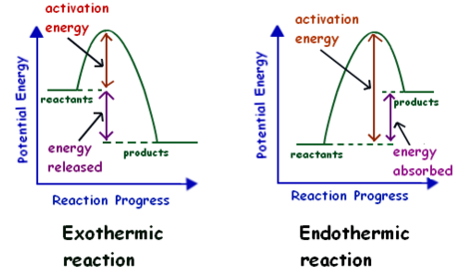
Heat of Reaction
Real Life
∆H = ∑[(∆H_{products}) × (mol_{products})] – ∑[(ΔH_{reactants}) × (mol_{reactants})]
ΔH = ∑ΔH_{products} – ∑ΔH_{reactants}
coefficients
coefficients
-∆H
+∆H

Slide 42
Heat of Reaction
For the reaction: 2 H_{2 (g)} + O_{2 (g)} ⇌ 2 H₂O _{(l)}
∆H _{rxn} = ∆H_{f} _{products} - ∆H_{f} _{reactants}
∆H_{rxn} = [∆H _{2 moles H2O (l)}] - [∆H _{2 moles of H2 (g)} + ∆H _{1 mole of O2 (g)}]
∆H_{f} _{H2O (l)} = -285.8 KJ/mol at 25 C, 1 atm
(Reference Table 1, chart G)
Is this endo/exothermic? Write equation:
Elements that exist in nature do not need ∆H

Slide 43
Heat of Reaction
For the reaction: 2 H_{2 (g)} + O_{2 (g)} ⇌ 2 H₂O _{(l)}
∆H _{rxn} = ∆H_{f} _{products} - ∆H_{f} _{reactants}
∆H_{rxn} = [∆H _{2 moles H2O (l)}] - [∆H _{2 moles of H2 (g)} + ∆H _{1 mole of O2 (g)}]
∆H _{rxn} = 2(-285.8 KJ/mol) - 0
(Reference Table 1, chart G)
∆H _{rxn} = -286 KJ/mol x 2 mol = -572 KJ
This is an EXOthermic reaction:
2 H_{2 (g)} + O_{2 (g)} ⇌ 2 H₂O _{(l)} + 2(286 KJ/mol)
2 H_{2 (g)} + O_{2 (g)} ⇌ 2 H₂O _{(l)} + 572 KJ

Slide 44
Heat of Reaction
For the reaction: 2 MgO _{(s)} ⇌ 2 Mg _{(l)} + O_{2 (g)}
∆H _{rxn} = ∆H_{f} _{products} - ∆H_{f} _{reactants}
∆H_{rxn} = [∆H _{2 moles of Mg (l)} + ∆H _{1 mole of O2 (g)}] - [∆H _{2 moles MgO(s)}]
∆H_{f} _{MgO (s)} = -143.8 kcal/mol at 25 C, 1 atm
(Reference Table 1, chart G)
Is this endo/exothermic? Write equation:
Elements that exist in nature do not need ∆H

Slide 45
Heat of Reaction
For the reaction: 2 MgO _{(s)} ⇌ 2 Mg _{(l)} + O_{2 (g)}
∆H _{rxn} = ∆H_{f} _{products} - ∆H_{f} _{reactants}
∆H_{rxn} = [∆H _{2 moles of Mg (l)} + ∆H _{1 mole of O2 (g)}] - [∆H _{2 moles MgO (s)}]
∆H _{rxn} = 0 - 2(-143.8 kcal/mol)
(Reference Table 1, chart G)
∆H_{rxn} = +287.6 kcal in 2 mol = +143.8 Kcal/mol
This is an ENDOthermic reaction:
2 MgO _{(s)} + 2(143.8 kcal/mol) ⇌ 2 Mg _{(l)} + O_{2 (g)}
2 MgO _{(s)} + 287.6 kcal ⇌ 2 Mg _{(l)} + O_{2 (g)}

Slide 46
Heat of Reaction
The physical state of the reactants and products is an important factor in enthalpy (heat of reaction). Compare the following two equations.
H₂O(l) → H₂(g) + ½ O₂(g) ΔH = +285.8 kJ
H₂O(g) → H₂(g) + ½ O₂(g) ΔH = +241.8 kJ
difference = + 44.0 kJ
The vaporization of 1 mol of liquid water to water vapor at 25 ⁰C requires 44.0 kJ of heat.
H₂O(l) → H₂O(g) ΔH = +44.0 kJ

Slide 47
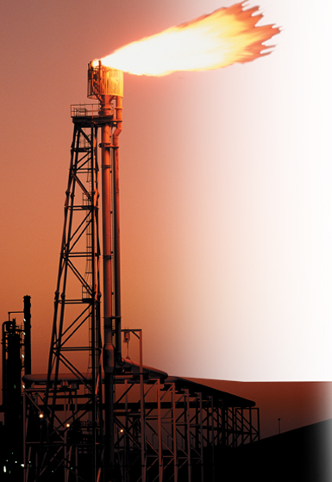
Heat of Combustion
A common ΔH, heat of reaction, is the heat of combustion, relating to the complete burning of one mole of a substance.
For instance, small amounts of natural gas within crude oil are burned off at oil refineries according to the following equation:
CH₄(g) + 2O₂(g) → CO₂(g) + 2H₂O(l) + 890 kJ
Burning methane, an exothermic reaction, releases 890 kJ of heat/mol.
The heat of combustion (ΔH) for this reaction is –890 kJ/mol of methane burned. So, if 2 mol of methane combust, 1780 KJ are released, etc..

Slide 48
Heat of Combustion
Heats of Combustion at 25°C
Substance | Formula | ΔH (kJ/mol)
Hydrogen | H₂(g) | –286
Carbon | C(s, graphite) | –394
Methane | CH₄(g) | –890
Acetylene | C₂H₂(g) | –1300
Ethanol | C₂H₆O(l) | –1368
Propane | C₃H₈(g) | –2220
Glucose | C₆H₁₂O₆(s) | –2808
Octane | C₈H₁₈(l) | –5471
Sucrose | C₁₂H₂₂O₁₁(s) | –5645
Like other heats of reaction, heats of combustion are reported as the enthalpy changes when the reactions are carried out at 101.3 kPa and 25 ⁰C.
All are EXOthermic.

Slide 49
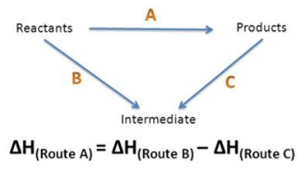
Hess’s Law
The heat of reaction for many chemical processes cannot be measured directly. (Theoretically, diamond can be made into graphite.)
The heat released or absorbed in a chemical process is the same whether the process takes place in one or in several steps.

Slide 50
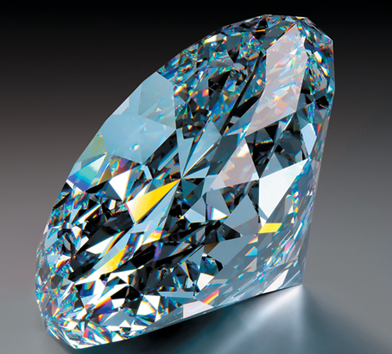
Hess’s Law
The heat of reaction for many chemical processes cannot be measured directly. (Theoretically, diamond can be made into graphite.)
The heat released or absorbed in a chemical process is the same whether the process takes place in one or in several steps.
Hess's law shows that energy changes are “state” functions, meaning that the amount of energy depends only on the states of the reactants and the state of the products, but not on the intermediate steps.
“States” here refer to solid, liquid, or gas.

Slide 51
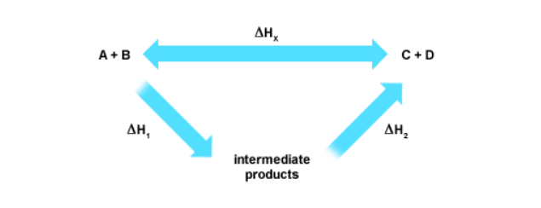
Hess’s Law
If a reaction can take place by more than one pathway and the initial and final conditions are the same, the total enthalpy change (∆H_{x}) is equal. Therefore, ADD the heats of reaction for the individual reactions (Intermediate pathway → ∆H₁ + ∆H₂).

Slide 52
Hess’s Law
The overall enthalpy change in a reaction is equal to the sum of enthalpy changes for the individual steps in the process.
e.g. SnCl_{4 (l)} is not produced directly in nature. Hess’s law allows you to determine the heat of reaction indirectly, by using the known heats of reaction of 2 or more thermochemical equations.
Example: Tin and Chlorine synthesize Stannic Chloride
Step 1: Sn _{(s)} + Cl_{2 (g)} ⇌ SnCl_{2 (s)} + 83.6 kcal
Step 2: SnCl_{2 (s)} + Cl_{2 (g)} ⇌ SnCl_{4 (l)} + 46.7 kcal
Determine the OVERALL Reaction

Slide 53
Hess’s Law
The overall enthalpy change in a reaction is equal to the sum of enthalpy changes for the individual steps in the process.
e.g. SnCl_{4 (l)} is not produced directly in nature. Hess’s law allows you to determine the heat of reaction indirectly, by using the known heats of reaction of two or more thermochemical equations.
Example: Tin and Chlorine synthesize Stannic Chloride
Step 1: Sn _{(s)} + Cl_{2 (g)} ⇌ SnCl_{2 (s)} + 83.6 kcal
Step 2: SnCl_{2 (s)} + Cl_{2 (g)} ⇌ SnCl_{4 (l)} + 46.7 kcal
∆H _{rxn} = ∆H₁ + ∆H₂ = -83.6 kcal + -46.7 kcal = -130.3 kcal
OVERALL Sn _{(s)} + 2 Cl_{2 (g)} ⇌ SnCl_{4 (l)} + 130 kcal
Exothermic Reaction (heat is a product)

Slide 54
Hess’s Law Problem
Determine the enthalpy change for the formation of carbon monoxide from its elements.
C(s, graphite)+ ½ O₂(g) → CO(g) ΔH = ?
Carrying out the reaction in the laboratory as written is virtually impossible. However, the desired enthalpy change can be calculated using Hess’s law and the following two reactions that can be carried out in the laboratory:
Step 1: C _{(s, graphite)} + O_{2 (g)} ⇌ CO_{2 (g)} ΔH = -393.5 KJ
Step 2: CO_{2 (g)} ⇌ CO _{(g)} + ½ O_{2 (g)} ∆H = +283.0 KJ
Determine the OVERALL Reaction

Slide 55
Hess’s Law Problem
Determine the enthalpy change for the formation of carbon monoxide from its elements.
C(s, graphite)+ ½ O₂(g) → CO(g) ΔH = ?
Carrying out the reaction in the laboratory as written is virtually impossible. However, the desired enthalpy change can be calculated using Hess’s law and the following two reactions that can be carried out in the laboratory:
Step 1: C _{(s, graphite)} + O_{2 (g)} ⇌ CO_{2 (g)} ΔH = -393.5 KJ
Step 2: CO_{2 (g)} ⇌ CO _{(g)} + ½ O_{2 (g)} ∆H = +283.0 KJ
∆H _{rxn} = ∆H₁ + ∆H₂ = -393.5 KJ + 283.0 KJ = -110.5 KJ
OVERALL C _{(s, graphite)} + ½ O_{2 (g)} ⇌ CO _{(g)} + 110.5 KJ
Exothermic Reaction (heat is a product)

Slide 56
PRACTICE PROBLEMS
Standard Heat of Reaction
q = mc∆T
Enthalpy of Reaction

Slide 57
What is the standard heat of reaction (ΔH⁰) for the reaction of CO(g) with O₂(g) to form CO₂(g)?

Slide 58
What is the standard heat of reaction (ΔH⁰) for the reaction of CO(g) with O₂(g) to form CO₂(g)?
Write a balanced equation of the reaction of CO(g) with O₂(g) to form CO₂(g).
2 CO(g) + O₂(g) → 2 CO₂(g)
Determine ΔH_{f}⁰ using the standard heats of formation of the reactants and products (Reference Table 1, chart G → kcal x 4.184 KJ/kcal).
ΔH_{f}°_{CO}(g) = –110.5 kJ/mol
ΔH_{f}°_{O2}(g) = 0 kJ/mol (free element)
ΔH_{f}°_{CO2} (g) = –393.5 kJ/mol
ΔH° = ∑ΔH_{f} ⁰_{products} – ∑ΔH_{f} ⁰_{reactants}
∆H⁰ = [2 mol x (–393.5 kJ/mol)] – [2 mol x (–110.5 kJ/mol) + 0]
∆H⁰ = –787.0 kJ – (–221.0 kJ)
∆H⁰ = – 566 kJ

Slide 59
Calculate the standard heat of reaction for the following:
CH₄(g) + 2Cl₂(g) → C(s, diamond) + 4HCl(g)
ΔH_{f}°CH₄(g) =
ΔH_{f}°C(s, diamond) =
ΔH_{f}°HCl(g) =
(Reference Table 1, chart G → kcal x 4.184 KJ/kcal).

Slide 60
Calculate the standard heat of reaction for the following:
CH₄(g) + 2Cl₂(g) → C(s, diamond) + 4HCl(g)
ΔH_{f}°CH₄(g) = –74.86 kJ/mol
ΔH_{f}°C(s, diamond) = 1.9 kJ/mol
ΔH_{f}°HCl(g) = –92.3 kJ/mol
ΔH_{f} (prod) = [1 mol C(s) × ΔH_{f}⁰C(s)] + [4 mol HCl × ΔH_{f} ⁰ HCl(g)]
= 1.9 kJ + (4 × –92.3 kJ) = –367.3 kJ
ΔH_{f} (react) = [1 mol CH₄(g) × ΔH_{f}⁰ CH₄(g)] + [1 mol Cl₂ × ΔH_{f}⁰ Cl₂(g)]
= –74.86 kJ + 0.0 kJ = –74.86 kJ
ΔH° = ∑ΔH_{f} ⁰(products) – ∑ΔH_{f} ⁰(reactants)
ΔH° = –367.3 kJ – (–74.86 kJ)
ΔH° = –292.4 kJ
(Reference Table 1, chart G → kcal x 4.184 KJ/kcal).

Slide 61
Heat Calculation
The specific heat of ethanol is 2.4 J/(g⁰C). A sample of ethanol absorbs 676 J of heat, and the temperature rises from 22 ⁰C to 64 ⁰C. What is the mass of ethanol in the sample?

Slide 62
Heat Calculation
The specific heat of ethanol is 2.4 J/(g⁰C). A sample of ethanol absorbs 676 J of heat, and the temperature rises from 22 ⁰C to 64 ⁰C. What is the mass of ethanol in the sample?
q = mc∆T
Solve for “m” → m = q/c∆T
m = (676 J)/(2.4 J/g °C)(64° C – 22° C)
m = 6.7 g ethanol

Slide 63
Heat Calculation
The initial temperature of the water in a constant-pressure calorimeter is 24 ⁰C. A reaction takes place in the calorimeter, and the temperature rises to 87 ⁰C. The calorimeter contains 367 g of water, which has a specific heat of 4.18 J/(g· ⁰C). Calculate the enthalpy change during this reaction.

Slide 64
Heat Calculation
The initial temperature of the water in a constant-pressure calorimeter is 24 ⁰C. A reaction takes place in the calorimeter, and the temperature rises to 87 ⁰C. The calorimeter contains 367 g of water, which has a specific heat of 4.18 J/(g· ⁰C). Calculate the enthalpy change during this reaction.
q_{water} = m_{water} × C_{water} × ΔT
q_{water} = 367 g × 4.18 J/(g· ⁰C) × (87⁰C – 24 ⁰C)
q_{water} = 97000 J or 97 kJ
q_{water} = - q_{reaction}
q_{reaction} = ΔH_{reaction}
ΔH_{reaction} = - 97000 J or - 97 kJ
The REACTION (exothermic) caused the water to gain heat and rise in temperature (endothermic).

Slide 65
Heat, Temperature, and Energy
Which of the following has the most thermal energy?
O 500 mL water at 25°C
O 1.5 L water at 25°C
O 15 L water at 25°C
As the temperature of a substance increases, the average kinetic energy of the particles in the substance ___________.
A cube of copper has a temperature of 5°C. The cube is placed in a closed container whose internal temperature is 85°C. What will happen over time?
O Heat will flow from the cube into the air in the container.
O Heat will flow from the air in the container into the cube.
At what point will the heat flow stop?
Notes:
Timing ≈ 1
Entry audio: Review what you already know about heat, temperature, and energy.
Hint1 audio: Thermal energy depends on temperature and mass.
Hint2 audio: Temperature is a measure of the average kinetic energy of the particles in a substance.
Hint3 audio: Heat always flows from warmer areas to cooler ones.
Hint4 audio: Heat flow is driven by temperature differences.
Exit audio: In this lesson, you will learn how to predict the final temperature of the cube and the container.
SOURCES:

Slide 66
Heat, Temperature, and Energy
Which of the following has the most thermal energy?
O 500 mL water at 25°C
O 1.5 L water at 25°C
!!! 15 L water at 25°C
As the temperature of a substance increases, the average kinetic energy of the particles in the substance increases.
A cube of copper has a temperature of 5°C. The cube is placed in a closed container whose internal temperature is 85°C. What will happen over time?
O Heat will flow from the cube into the air in the container.
!!! Heat will flow from the air in the container into the cube (warmer to cooler.
At what point will the heat flow stop?
When the temperatures of the cube and container are equal
Notes:
Timing ≈ 1
Entry audio: Review what you already know about heat, temperature, and energy.
Hint1 audio: Thermal energy depends on temperature and mass.
Hint2 audio: Temperature is a measure of the average kinetic energy of the particles in a substance.
Hint3 audio: Heat always flows from warmer areas to cooler ones.
Hint4 audio: Heat flow is driven by temperature differences.
Exit audio: In this lesson, you will learn how to predict the final temperature of the cube and the container.
SOURCES:

Slide 67
Performing Heat Calculations
The specific heat of water is 4.18 J/g•°C. How much heat does 225.0 g of water release when it cools from 85.5°C to 50.0°C?
A sample of an unknown substance has a mass of 89.5 g. If 345.2 J of heat are required to heat the substance from 285 K to 305 K, what is the specific heat of the substance?
Notes:
Timing ~1.5 min
Entry audio: Practice some calculations involving the heat equation.
Hint1 audio: Make sure to use the correct number of significant figures.
Hint2 audio: Use dimensional analysis to determine the units for each expression. Which units match the units of specific heat?
Hint3 audio: Make sure to check that all your units are correct.
Hint4 audio: Rearrange the heat equation to solve for mass. Then substitute the given values and solve for the mass of the cube.
Exit audio: Specific heat can be very valuable in predicting temperature changes.

Slide 68
Performing Heat Calculations
The specific heat of water is 4.18 J/g•°C. How much heat does 225.0 g of water release when it cools from 85.5°C (Ti) to 50.0°C (Tf)?
q = mc∆T
q = (225.0 g)(4.18 J/g•°C )(50.0 C – 85.5 C)
q = -33400 J … so water releases 33.4 KJ
A sample of an unknown substance has a mass of 89.5 g. If 345.2 J of heat are required to heat the substance from 285 K (Ti) to 305 K (Tf), what is the specific heat of the substance?
q = mc∆T … rearrange to solve for “c” = q/m∆T
c = (345.2 J) / (89.5 g)(305 K – 285 K)
c = 0.193 J/g•K
Notes:
Timing ~1.5 min
Entry audio: Practice some calculations involving the heat equation.
Hint1 audio: Make sure to use the correct number of significant figures.
Hint2 audio: Use dimensional analysis to determine the units for each expression. Which units match the units of specific heat?
Hint3 audio: Make sure to check that all your units are correct.
Hint4 audio: Rearrange the heat equation to solve for mass. Then substitute the given values and solve for the mass of the cube.
Exit audio: Specific heat can be very valuable in predicting temperature changes.

Slide 69
Performing Heat Calculations
A cube of aluminum (C_{p} = 0.897 J/g•K) has a temperature of 325 K. It is placed in a beaker of cold water. If the aluminum cools to 301 K as the water absorbs 815.7 J of heat, what is the mass of the cube?
31.7 g CO₂ is cooled from a gas at 358 K to a liquid at 213 K. The boiling point of CO₂ is 216 K. List the steps and equations needed to determine the heat flow of this change. Is this a physical or chemical change?
Notes:
Timing ~1.5 min
Entry audio: Practice some calculations involving the heat equation.
Hint1 audio: Make sure to use the correct number of significant figures.
Hint2 audio: Use dimensional analysis to determine the units for each expression. Which units match the units of specific heat?
Hint3 audio: Make sure to check that all your units are correct.
Hint4 audio: Rearrange the heat equation to solve for mass. Then substitute the given values and solve for the mass of the cube.
Exit audio: Specific heat can be very valuable in predicting temperature changes.

Slide 70
Performing Heat Calculations
A cube of aluminum (C_{p} = 0.897 J/g•K) has a temperature of 325 K (Ti). It is placed in a beaker of cold water. If the aluminum cools to 301 K (Tf) as the water absorbs 815.7 J of heat, what is the mass of the cube?
q = mc∆T … rearrange to solve for “m” = q/c∆T
m = (815.7 J) / (0.897 J/g•K)(301 K – 325 K)
m = 37.9 g
31.7 g CO₂ is cooled from a gas at 358 K to a liquid at 213 K. The boiling point of CO₂ is 216 K. List the steps and equations needed to determine the heat flow of this change. This an EXOthermic physical change?
Gas cools → -q = mc∆T
Phase change → -∆H = mH_{vaporization}
Liquid cools → -q = mc∆T
NOTE: the specific heat of the gas and liquid are different.
Notes:
Timing ~1.5 min
Entry audio: Practice some calculations involving the heat equation.
Hint1 audio: Make sure to use the correct number of significant figures.
Hint2 audio: Use dimensional analysis to determine the units for each expression. Which units match the units of specific heat?
Hint3 audio: Make sure to check that all your units are correct.
Hint4 audio: Rearrange the heat equation to solve for mass. Then substitute the given values and solve for the mass of the cube.
Exit audio: Specific heat can be very valuable in predicting temperature changes.

Slide 71
Calculating Enthalpy of Reaction
Pentaborane (B₅H₉(g), ΔH_{f} = 73.2 kJ/mol) reacts with oxygen gas to form boron trioxide (B₂O₃(g), ΔH_{f} = –1272.77 kJ/mol) & water vapor (ΔH_{f} = –241.82 kJ/mol) according to the equation below:
2B₅H₉(l) + 12O₂(g) → 5B₂O₃(g) + 9H₂O(g)
What is ΔH_{rxn} for this reaction? Is this reaction endothermic or exothermic?

Slide 72
Calculating Enthalpy of Reaction
Pentaborane (B₅H₉(g), ΔH_{f} = 73.2 kJ/mol) reacts with oxygen gas to form boron trioxide (B₂O₃(g), ΔH_{f} = –1272.77 kJ/mol) & water vapor (ΔH_{f} = –241.82 kJ/mol) according to the equation below:
2B₅H₉(l) + 12O₂(g) → 5B₂O₃(g) + 9H₂O(g)
What is ΔH_{rxn} for this reaction? Is this reaction endothermic or exothermic?
ΔH_{f} (prod) = [5 mol B₂O₃(l) × ΔH_{f}⁰ B₂O₃(l)] + [9 mol H₂O(g) × ΔH_{f} ⁰ H₂O(g)]
= (5 × –1272.77 kJ) + (9 x -241.82 KJ) = –8540.2 kJ
ΔH_{f} (react) = [2 mol B₅H₉(g) × ΔH_{f}⁰B₅H₉(g)] + [12 mol O₂(g) × ΔH_{f}⁰ O₂(g)]
= (2 × +73.2 kJ) + 0.00 kJ = +146.4 kJ
ΔH° = ∑ΔH_{f} ⁰(products) – ∑ΔH_{f} ⁰(reactants)
ΔH° = –8540.2 kJ – (+146.4 kJ)
ΔH° = –8687 kJ Exothermic

Slide 73
Calculate Enthalpy of Reaction
What is the type and enthalpy of reaction for the decomposition of calcium carbonate?
CaCO₃(s) → CaO(s) + CO₂(g)
Compound | ΔH_{f} (kJ/mol)
CaO(s) | –635.1
CaCO₃(s) | –1207.1
C₆H₆(g) | 82.90
CO₂(g) | –393.5
H₂O(g) | –241.82
NO₂(g) | 33.84

Slide 74
Calculate Enthalpy of Reaction
What is the type and enthalpy of reaction for the decomposition of calcium carbonate?
CaCO₃(s) → CaO(s) + CO₂(g)
ΔH_{f} (prod) = [1 mol CaO(s) × ΔH_{f}⁰ CaO(s)] + [1 mol CO₂(g) × ΔH_{f} ⁰ CO₂(g)]
= (–635.1 kJ) + (-393.5 KJ) = –1028.6 kJ
ΔH_{f} (react) = [1 mol CaCO₃(s) × ΔH_{f}⁰ CaCO₃(s)]
= (1 × -1207.1 kJ)
ΔH° = ∑ΔH_{f} ⁰(products) – ∑ΔH_{f} ⁰(reactants)
ΔH° = –1028.6 KJ – (-1207.1 KJ)
ΔH° = +178.5 kJ Endothermic
Compound | ΔH_{f} (kJ/mol)
CaO(s) | –635.1
CaCO₃(s) | –1207.1
C₆H₆(g) | 82.90
CO₂(g) | –393.5
H₂O(g) | –241.82
NO₂(g) | 33.84

Slide 75
Calculate Enthalpy of Reaction
What is the type and enthalpy of reaction for the decomposition of NO₂(g)?
2NO₂(g) → N₂(g) + 2O₂(g)
Compound | ΔH_{f} (kJ/mol)
CaO(s) | –635.1
CaCO₃(s) | –1207.1
C₆H₆(g) | 82.90
CO₂(g) | –393.5
H₂O(g) | –241.82
NO₂(g) | 33.84

Slide 76
Calculate Enthalpy of Reaction
What is the type and enthalpy of reaction for the decomposition of NO₂(g)?
2NO₂(g) → N₂(g) + 2O₂(g)
ΔH_{f} (prod) = [1 mol N₂(g) × ΔH_{f}⁰ N₂(g)] + [2 mol O₂(g) × ΔH_{f} ⁰O₂(g)]
= (0.00 kJ) + (0.00 KJ) = 0.00 kJ
ΔH_{f} (react) = [2 mol NO₂(g) × ΔH_{f}⁰ NO₂(g)]
= (2 × +33.84 kJ) = +67.68 kJ
ΔH° = ∑ΔH_{f} ⁰(products) – ∑ΔH_{f} ⁰(reactants)
ΔH° = 0.00 kJ – (+67.68 kJ)
ΔH° = -67.68 kJ Exothermic
Compound | ΔH_{f} (kJ/mol)
CaO(s) | –635.1
CaCO₃(s) | –1207.1
C₆H₆(g) | 82.90
CO₂(g) | –393.5
H₂O(g) | –241.82
NO₂(g) | 33.84

Slide 77
Calculating Enthalpy of Reaction
Ammonia (NH₃(g), ΔH_{f} = –46.19 kJ/mol) reacts with hydrogen chloride (HCl(g), ΔH_{f} = –92.30 kJ/mol) to form ammonium chloride (NH₄Cl(s), ΔH_{f} = –314.4 kJ/mol) according to the equation below:
NH₃(g) + HCl(g) → NH₄Cl(s)
What is ΔH_{rxn} for this reaction? Is this reaction endothermic or exothermic?

Slide 78
Calculating Enthalpy of Reaction
Ammonia (NH₃(g), ΔH_{f} = –46.19 kJ/mol) reacts with hydrogen chloride (HCl(g), ΔH_{f} = –92.30 kJ/mol) to form ammonium chloride (NH₄Cl(s), ΔH_{f} = –314.4 kJ/mol) according to the equation below:
NH₃(g) + HCl(g) → NH₄Cl(s)
What is ΔH_{rxn} for this reaction? Is this reaction endothermic or exothermic?
ΔH_{f} (prod) = [1 mol NH₄Cl(s) × ΔH_{f}⁰ NH₄Cl(s)]
= (–314.4 kJ) = –314.4 kJ
ΔH_{f} (react) = [1 mol NH₃(g) × ΔH_{f}⁰ NH₃(g)] + [1 mol HCl(g) × ΔH_{f}⁰ HCl(g)]
= (-46.19 kJ) + (-92.30 kJ) = -138.5 kJ
ΔH° = ∑ΔH_{f} ⁰(products) – ∑ΔH_{f} ⁰(reactants)
ΔH° = –314.4 kJ – (-138.5 kJ)
ΔH° = –175.9 kJ Exothermic

Slide 79
Calculating Enthalpy of Reaction
Oxygen difluoride (OF₂(g), ΔH_{f} = 24.5 kJ/mol) reacts with water (ΔH_{f} = –285.83 kJ/mol) to form oxygen gas and hydrogen fluoride (HF(g), ΔH_{f} = –268.61 kJ/mol) according to the equation below:
OF₂(g) + H₂O(l) → O₂(g) + 2HF(g)
What is ΔH_{rxn} for this reaction? Is this reaction endothermic or exothermic?

Slide 80
Calculating Enthalpy of Reaction
Oxygen difluoride (OF₂(g), ΔH_{f} = 24.5 kJ/mol) reacts with water (ΔH_{f} = –285.83 kJ/mol) to form oxygen gas and hydrogen fluoride (HF(g), ΔH_{f} = –268.61 kJ/mol) according to the equation below:
OF₂(g) + H₂O(l) → O₂(g) + 2HF(g)
What is ΔH_{rxn} for this reaction? Is this reaction endothermic or exothermic?
ΔH_{f} (prod) = [1 mol O₂(g) × ΔH_{f}⁰ O₂(g)] + [2 mol HF(g) × ΔH_{f}⁰HF(g)]
= (0.00 kJ) + (2 x –268.62 kJ) = –537.22 kJ
ΔH_{f} (react) = [1 mol OF₂(g) × ΔH_{f}⁰ OF₂(g)] + [1 mol H₂O(l) × ΔH_{f}⁰ H₂O(l) ]
= (+24.5 kJ) + (-285.83 kJ) = -261 kJ
ΔH° = ∑ΔH_{f} ⁰(products) – ∑ΔH_{f} ⁰(reactants)
ΔH° = –537.22 kJ – (-261 kJ)
ΔH° = –276 kJ Exothermic

Slide 81
Assignments
LAB Specific Heat
Complete the review problems in this lesson.
Textbook Questions and Problems for specific heat, Heat of Reaction, and Hess’ Law

