Slide 1
Go to the “Slide Show” shade above
Click on “Play from Beginning”

Slide 2
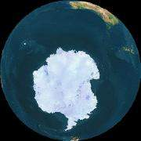
Antarctica
Tundra Biome
Satellite View

Slide 3
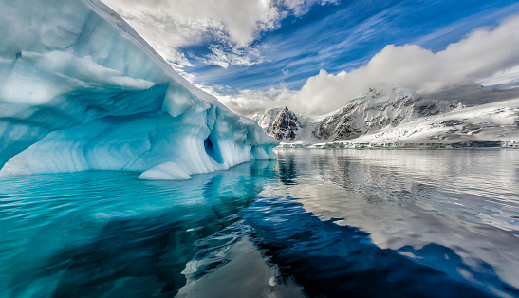

Slide 4
The Antarctic continent is located in the South Pole of our Planet.
Its geography, climate and biological conditions provide a unique enviroment.

Slide 5
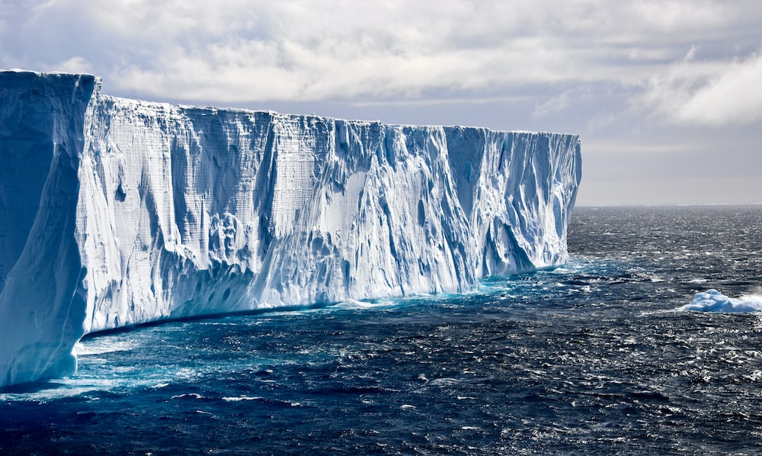

Slide 6
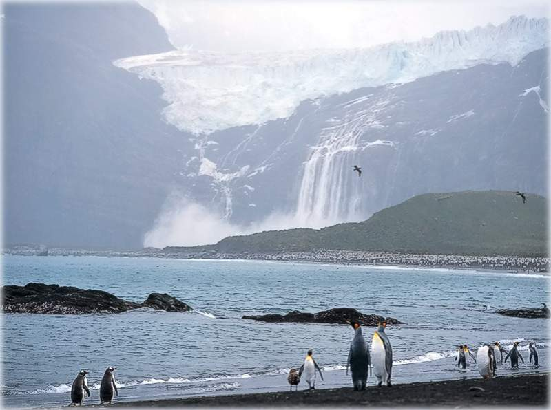

Slide 7
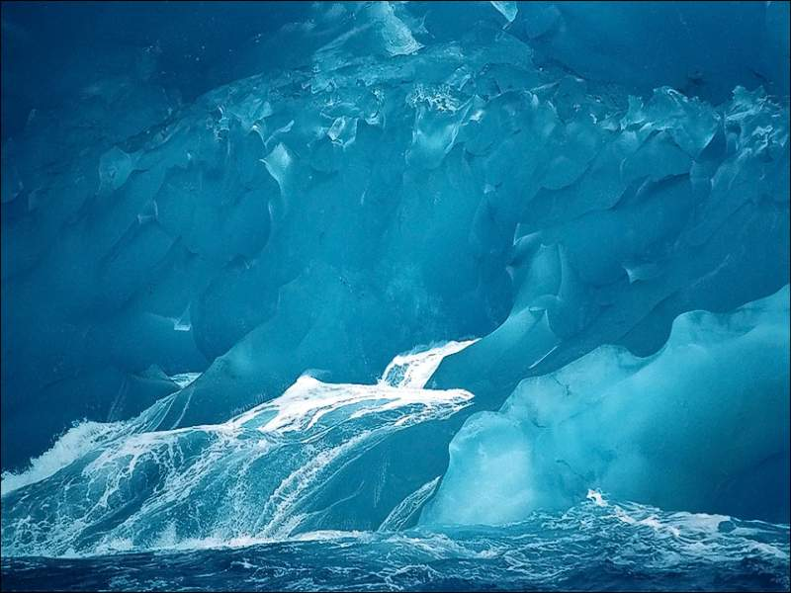

Slide 8
Antarctica has the lowest temperatures in our planet reaching
70° Celsius below zero with winds of 300 km. Per hour.
Containing 90% of the planet’s ice it’s the major reserve of fresh water on Earth.

Slide 9
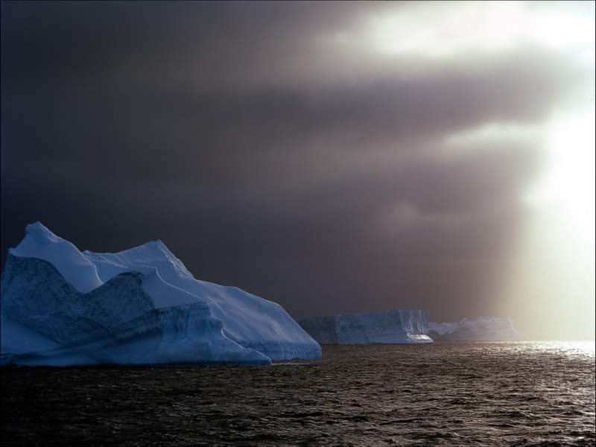

Slide 10
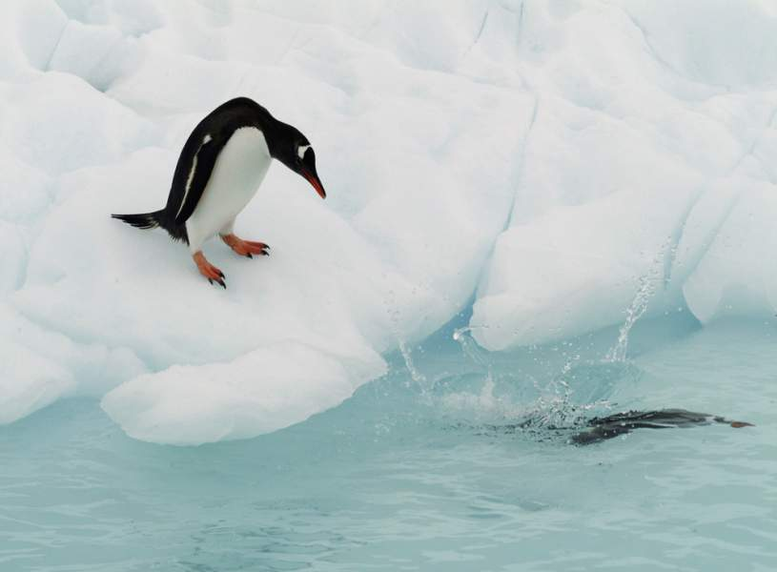

Slide 11
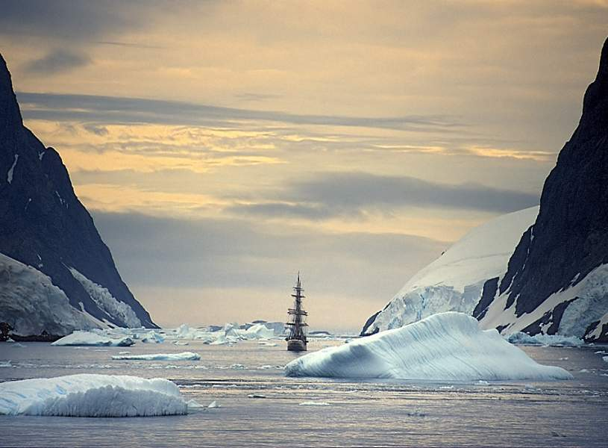

Slide 12
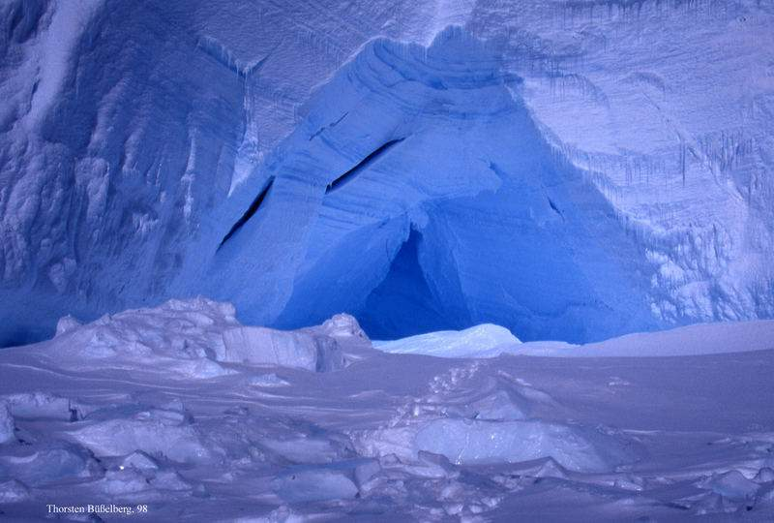

Slide 13
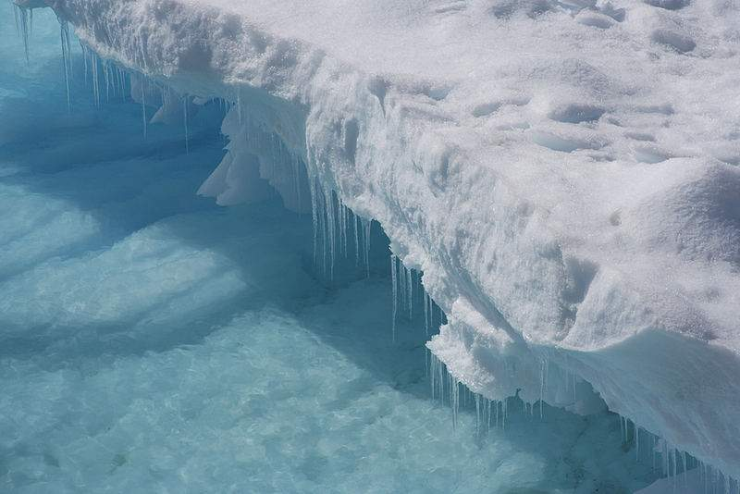

Slide 14
About 99% of Antarctica is covered with ice at an average thickness of 2,500 meters, reaching in some places as deep as 4,776 meters.
If the ice layer would melt all the Earth’s Oceans would rise 70 meters above the actual level.

Slide 15
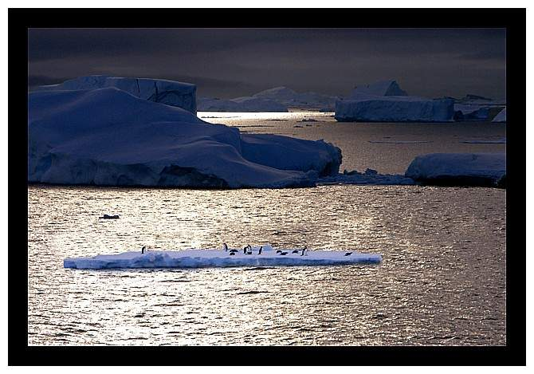

Slide 16
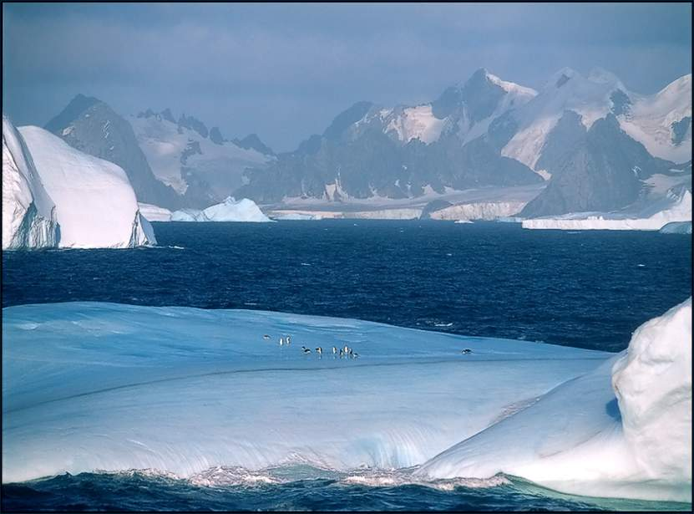

Slide 17
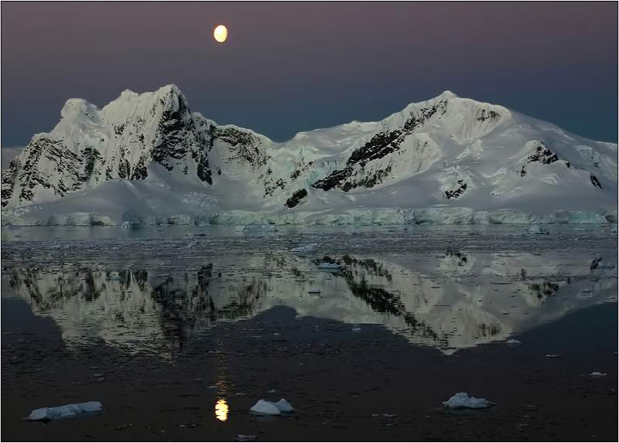

Slide 18
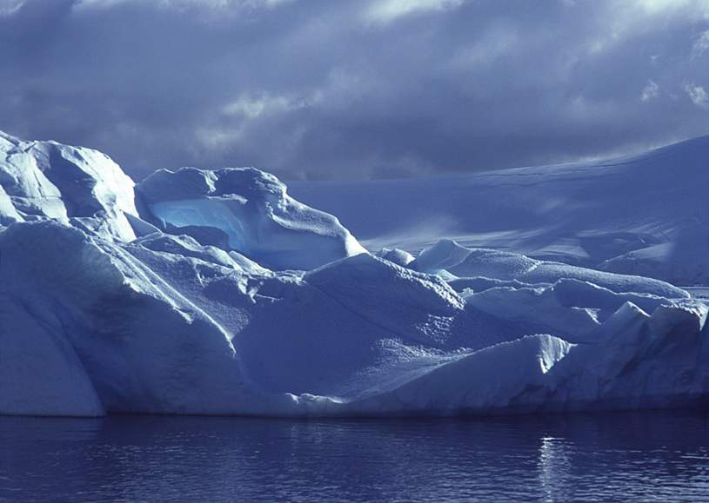

Slide 19
The Antarctic Continent functions as one of Earth’s “refrigerators” regulating the oceanic currents and the world’s climate.
Any significant enviromental impact would alter the global patterns of weather with disastrous consequences.

Slide 20
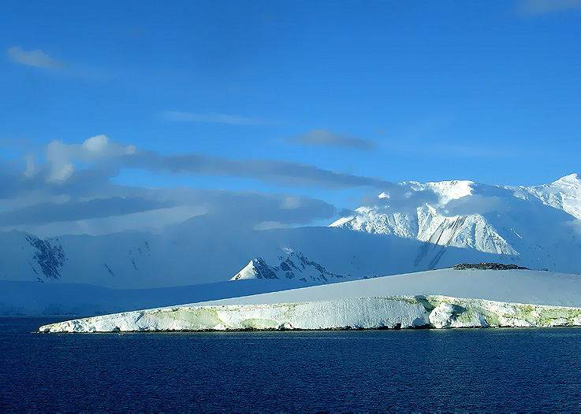

Slide 21
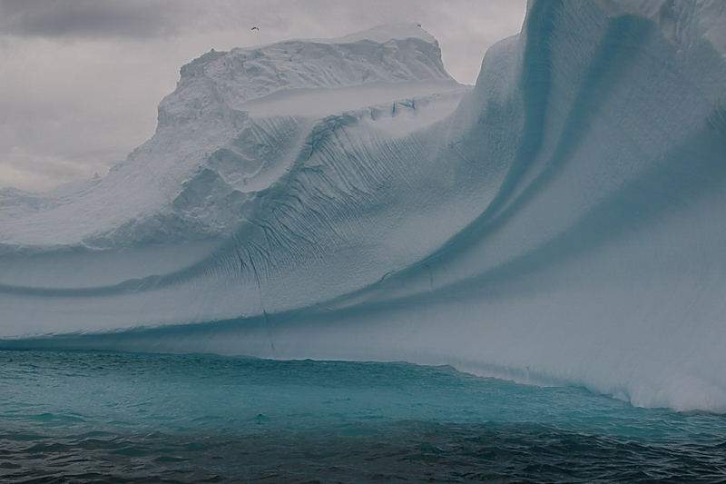

Slide 22
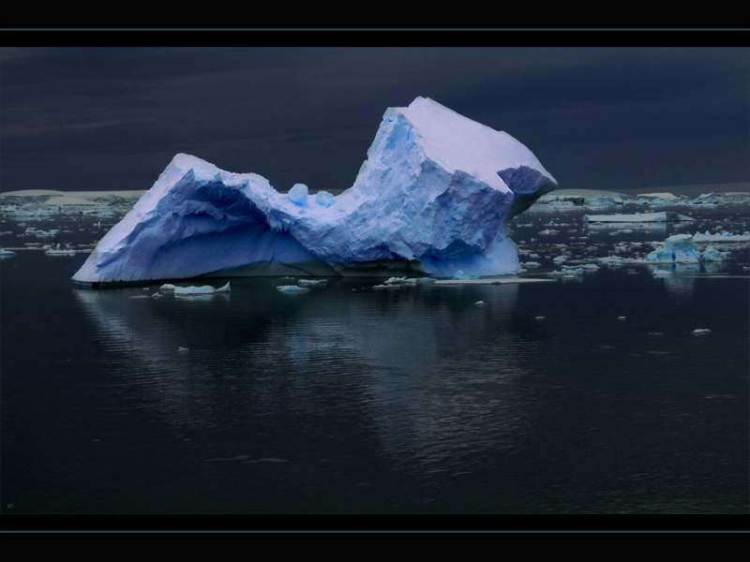

Slide 23
In spite of the severe weather Antarctica has rich animal life amazingly well adapted to the harsh conditions.

Slide 24
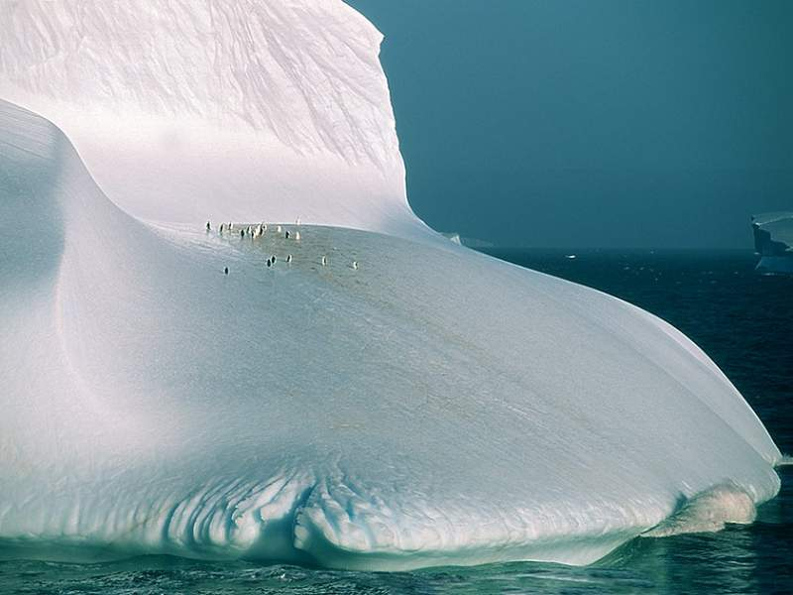

Slide 25
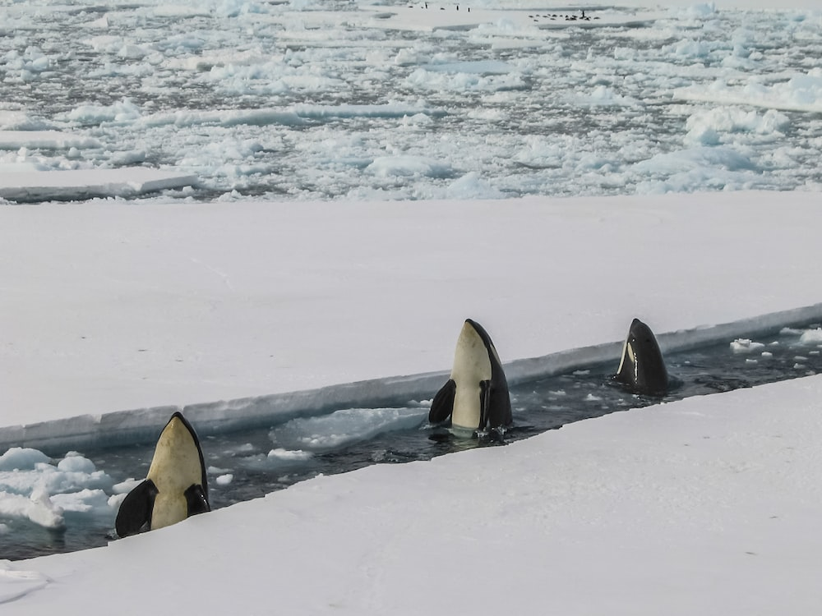

Slide 26
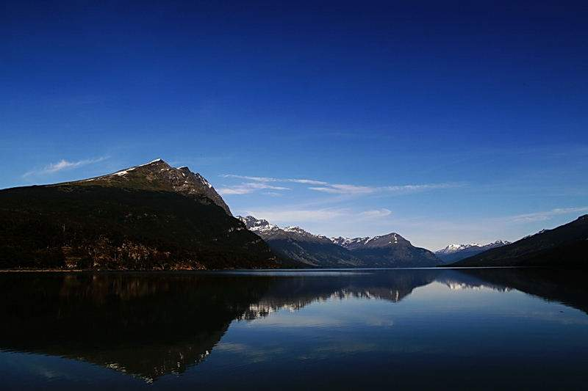

Slide 27
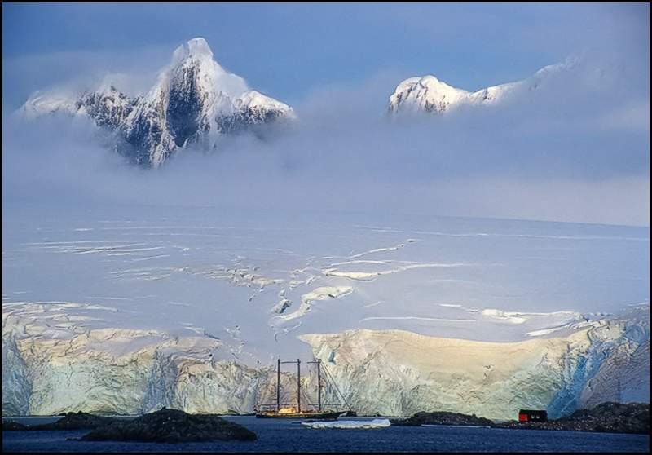

Slide 28
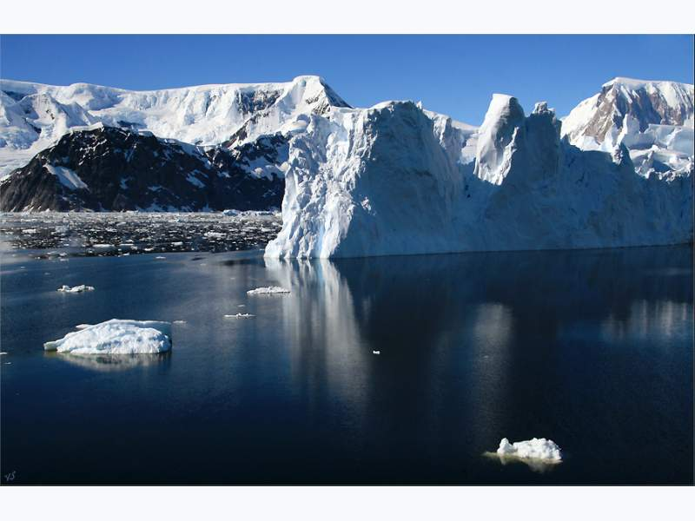

Slide 29
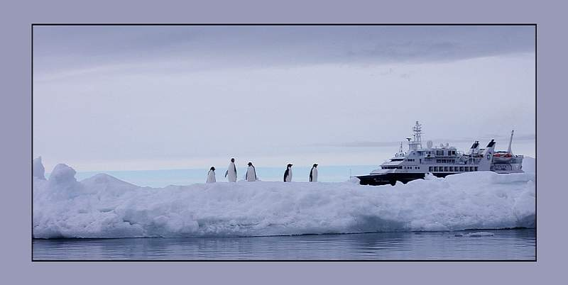

Slide 30
The arrival of the first tourists in the 50’s was a main cause of enviromental concern.
Strict rules and regulations were created
as to protect the ecology of the environment from the visitors such as creating restricted zones , mantain a safe distance from the wild life, do not feed nor touch the animals, and rigid control of waste disposal.

Slide 31
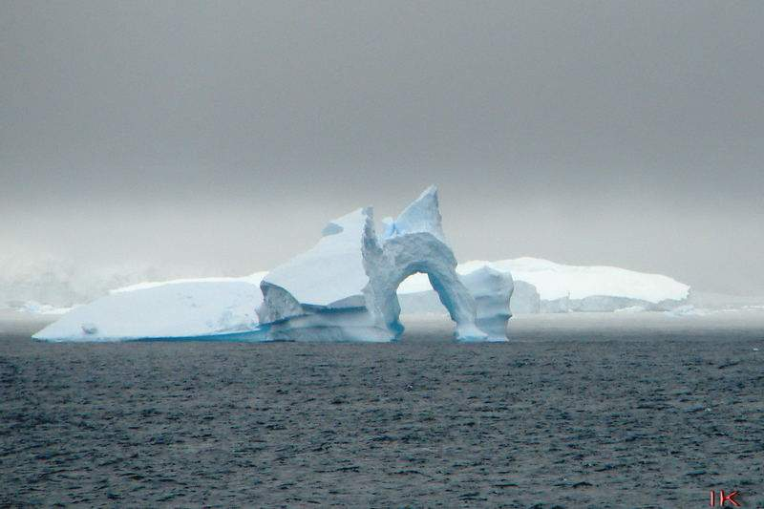

Slide 32
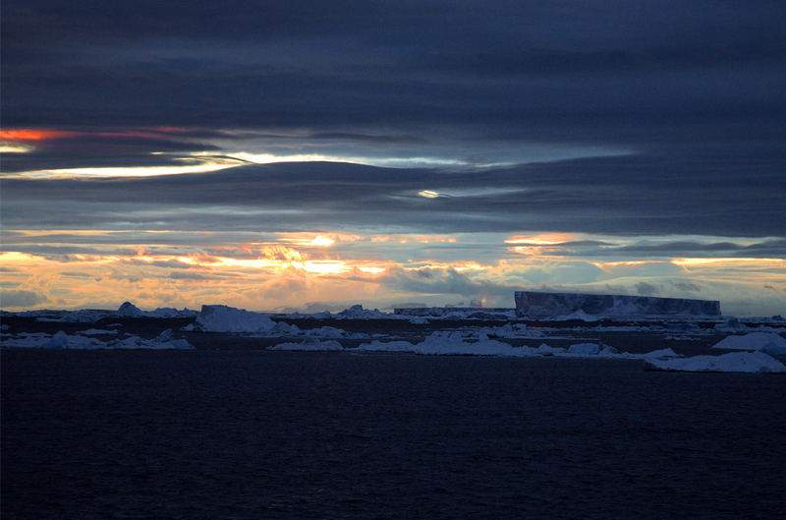

Slide 33
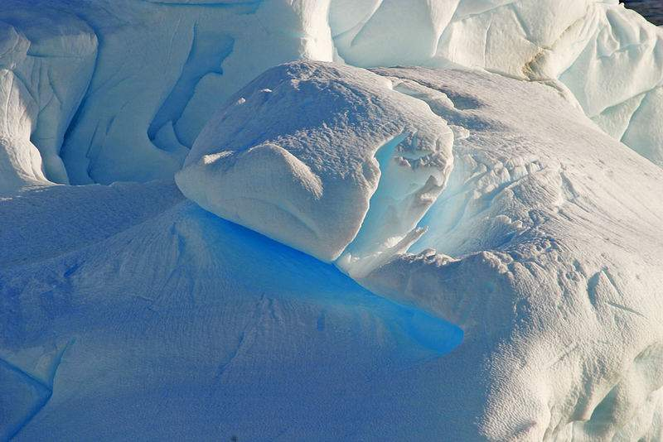

Slide 34
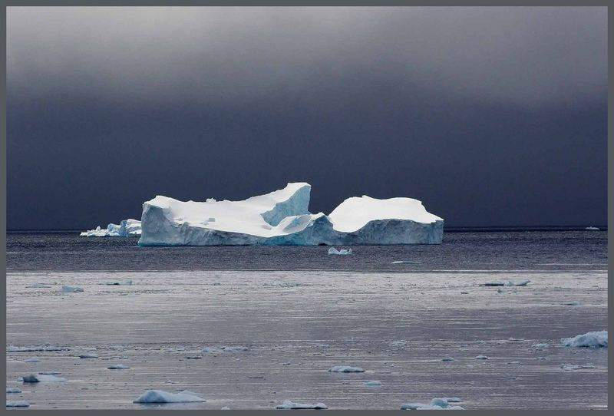

Slide 35
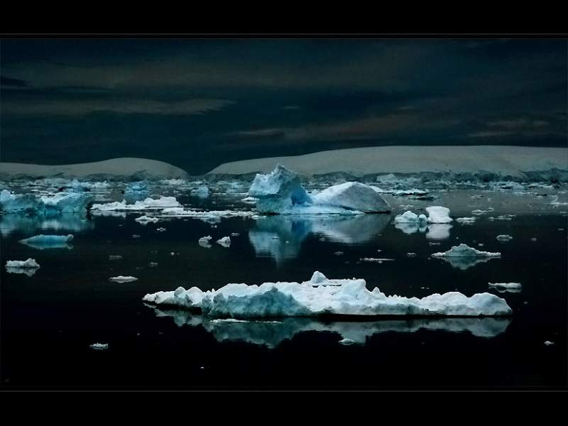

Slide 36
During the summer months (being the pick of the season in January) there is daylight almost 24 hours a day while in winter the days remain on a prolonging half light or penumbra during most of the 24 hours.

Slide 37
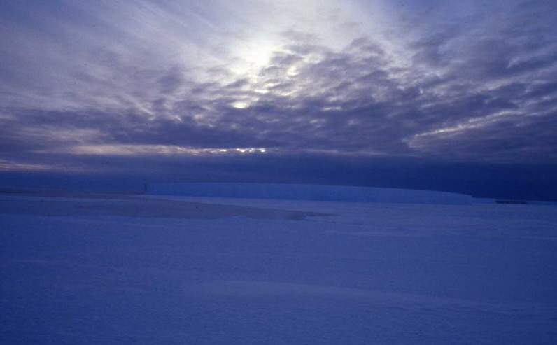

Slide 38
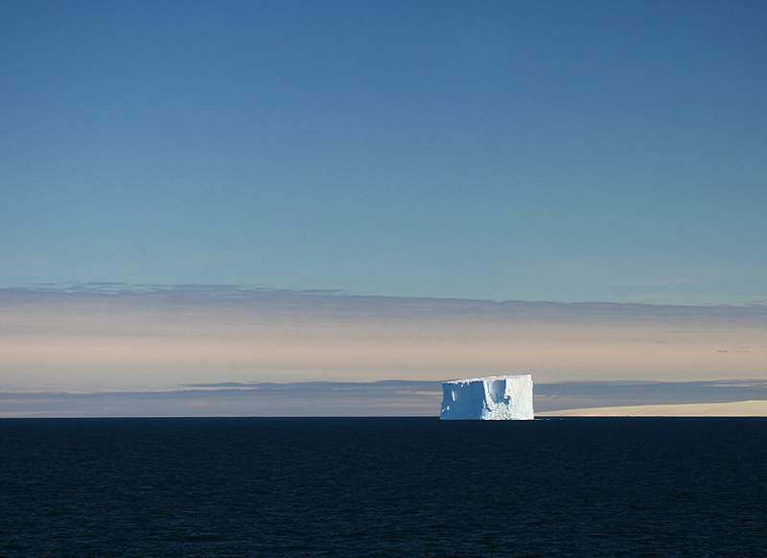

Slide 39
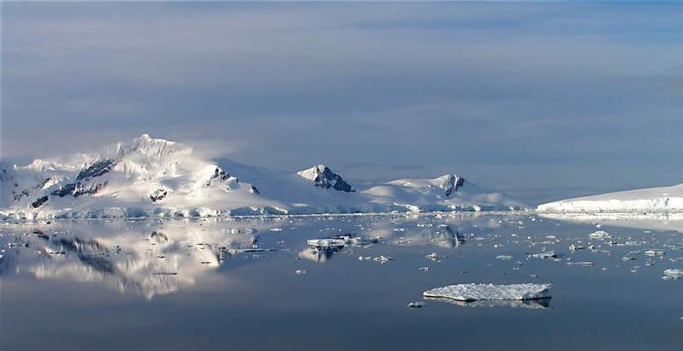

Slide 40
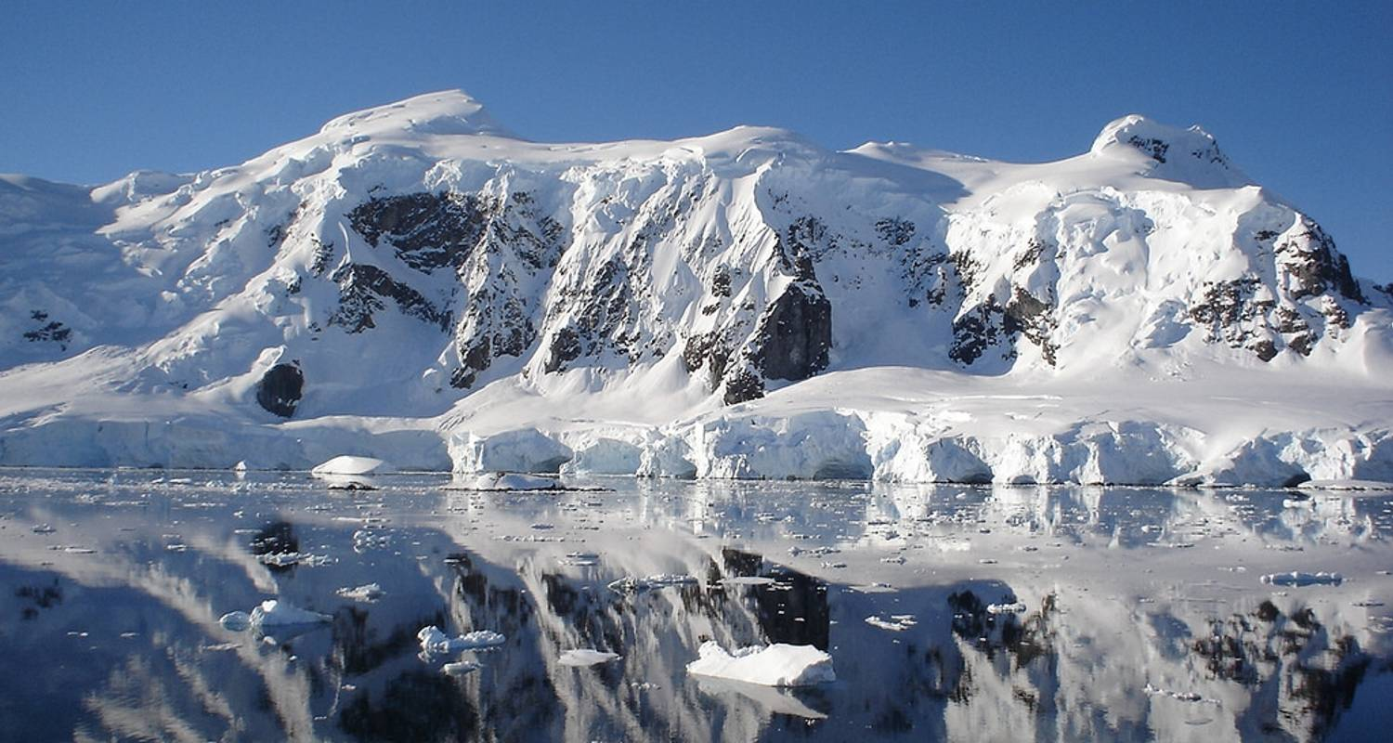

Slide 41
Emperor penguins (Aptenodytes forsteri) are the only animals to breed on mainland Antarctica during the winter.
Leopard seals (named as such for their characteristic spotted coats), are one of the primary predators in Antarctica. In the wild they can survive up to 15 years, and are considered the most fearsome of all seal species.

Slide 42
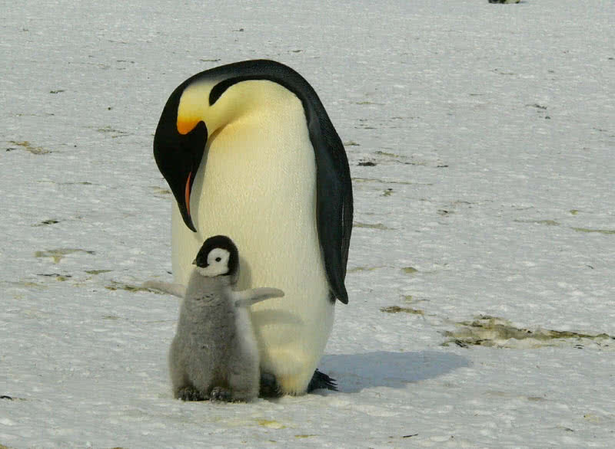

Slide 43
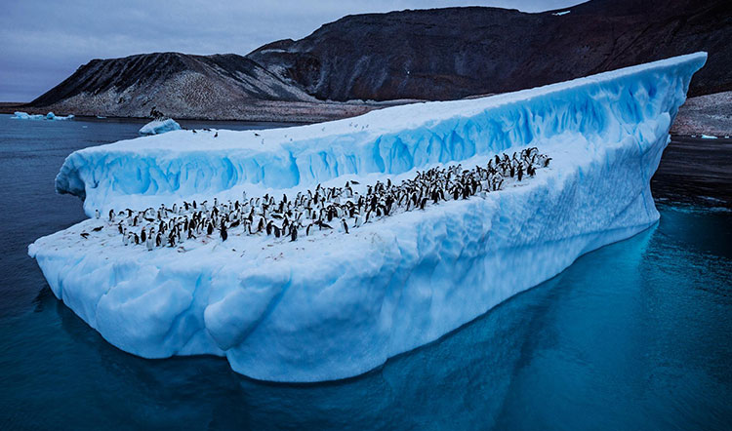

Slide 44
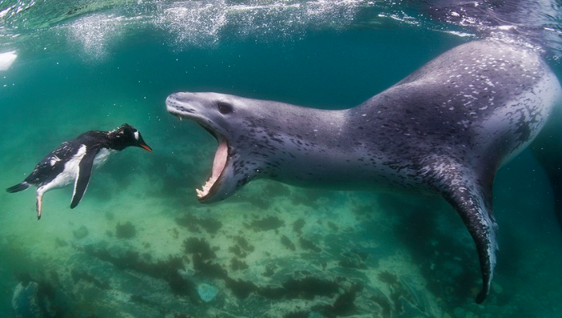

Slide 45
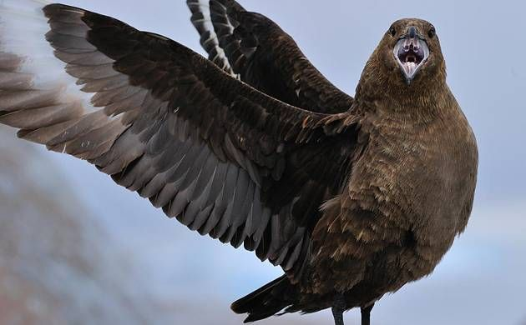

Slide 46
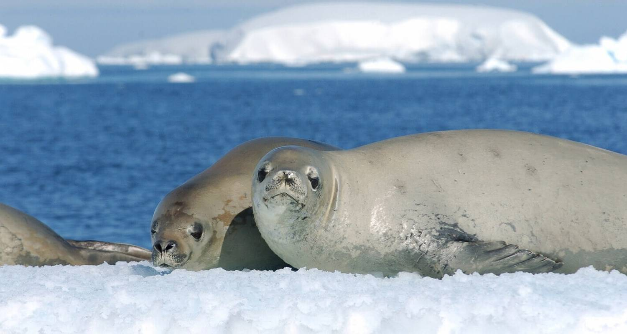

Slide 47
The most abundant and best known animals from the southern continent, penguins, whales, seals, albatrosses, other seabirds and a range of invertebrates you may have not heard of such as krill which form the basis of the Antarctic food web.
Most of the animals of the south polar region are seasonal visitors, conditions are just too hard for most animals to live there in the winter.

Slide 48
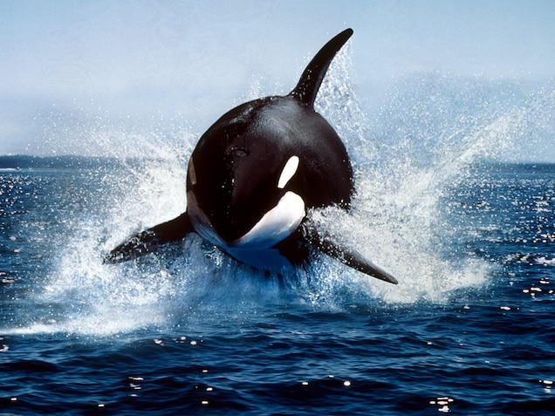

Slide 49
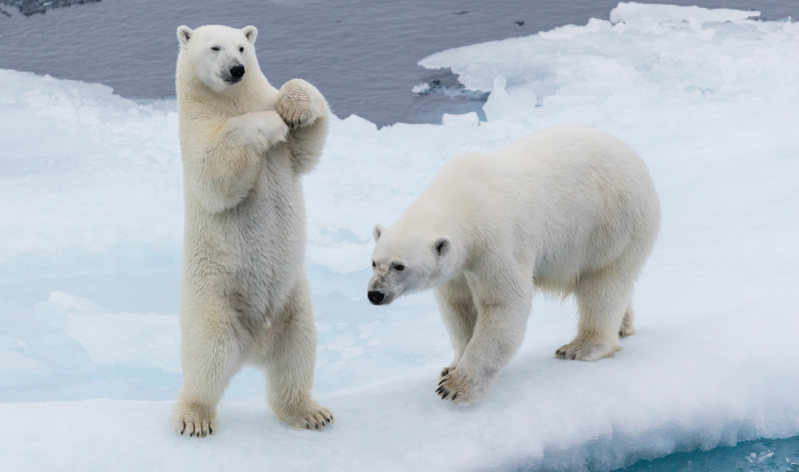

Slide 50
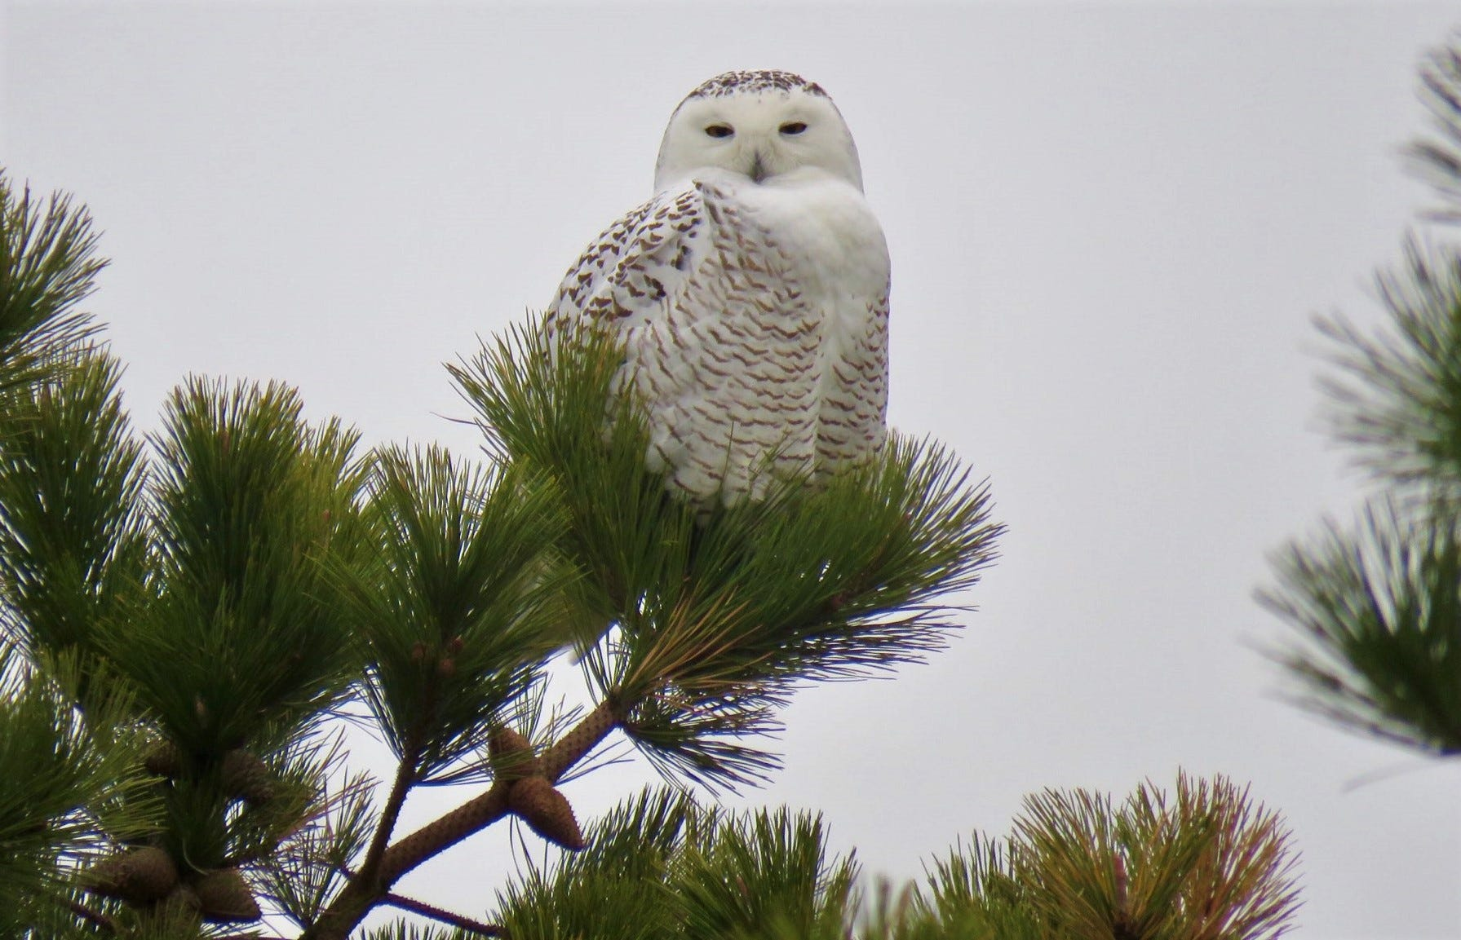

Slide 51
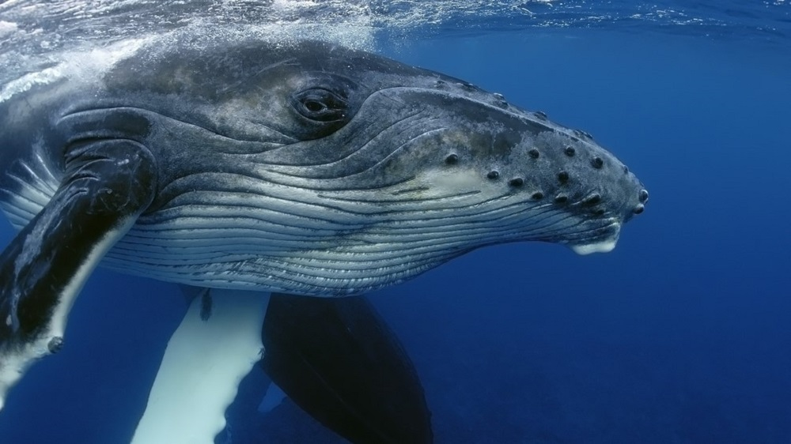

Slide 52
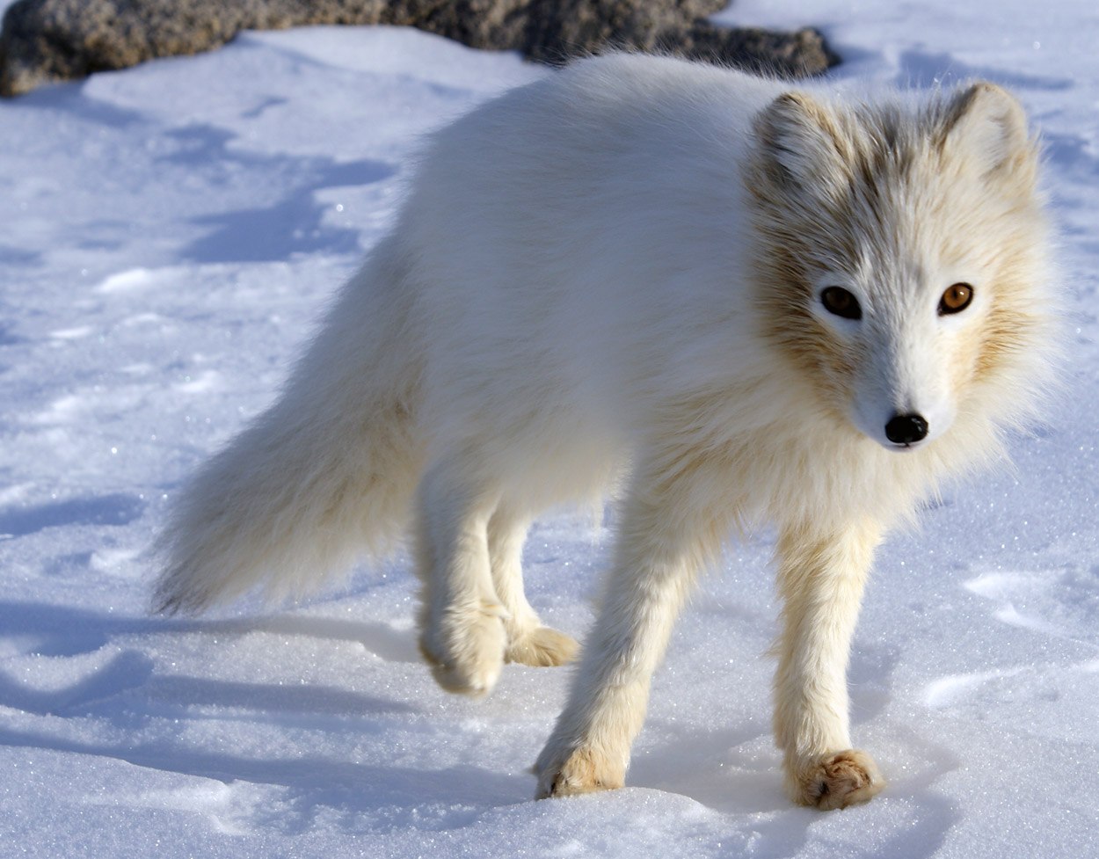

Slide 53
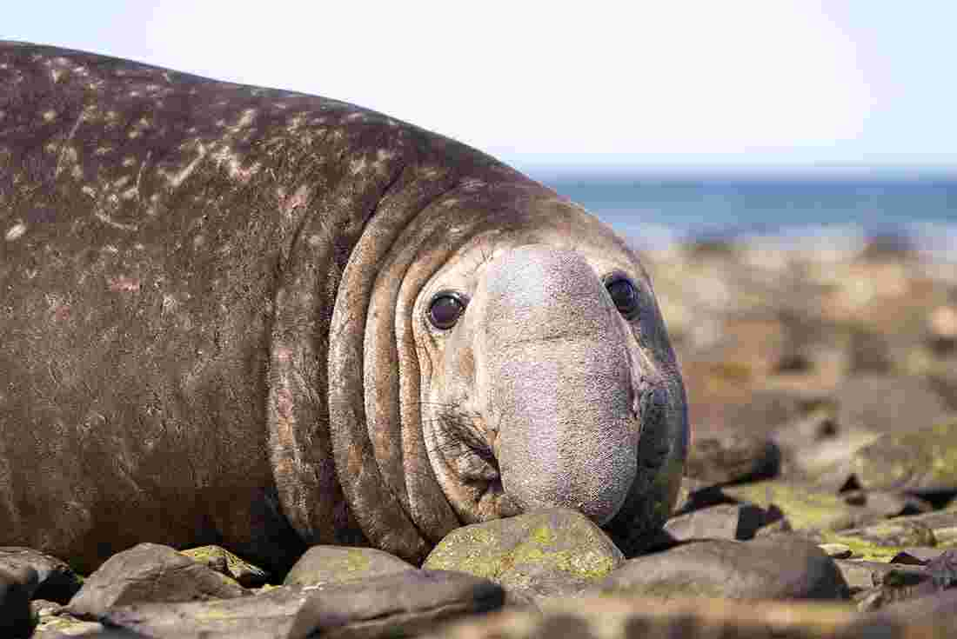

Slide 54
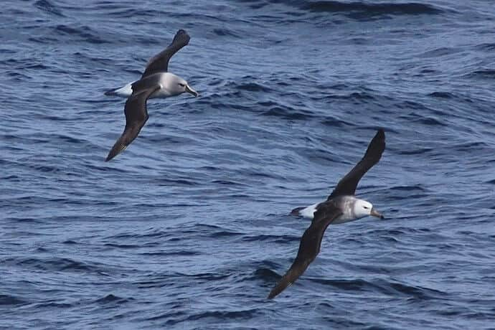

Slide 55
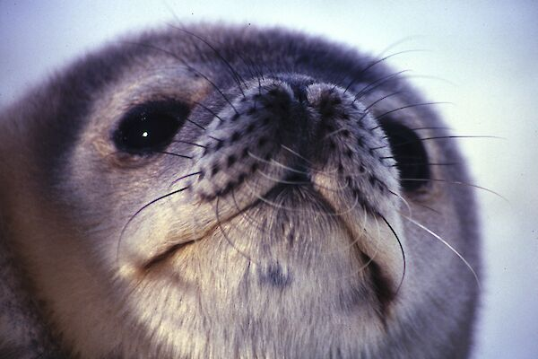

Slide 56
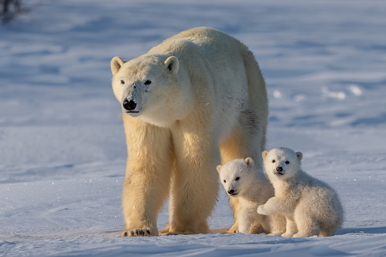

Slide 57
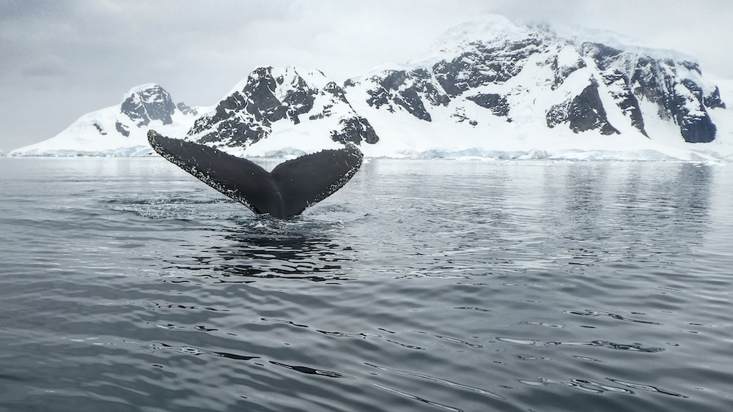

Slide 58
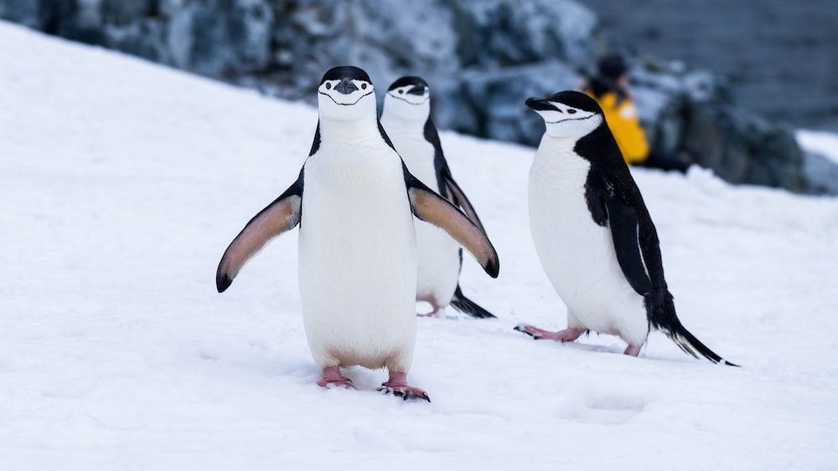

Slide 59
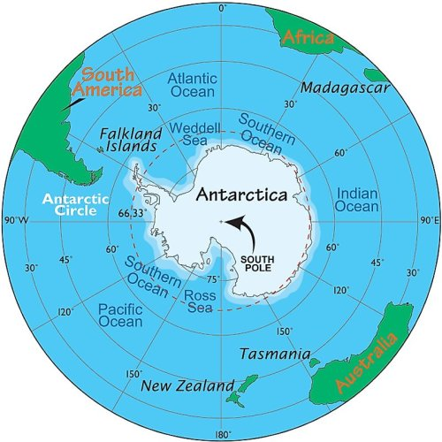

Slide 60
Images :
Hans Rieteco
Thomas Kunz
Veronique Soulier
Thorsten Bübelbergusex
Christa and Berd
Zeitl
J. Ens
J Lowrence
Han Wilhem Prech
Uwe Möokelmann
Unsplash
Internet

Slide 61
Music: Royal Philharmonic
Aria di amore ( Tosca )
Conducted and arranged by Luis de Cobos from Spain.
Created by: Manuel, Mérida, Yucatán, México.
English Version: P@blosonic, Las Vegas NV, USA

