Slide 1
Click on “Slide Show”
Click “Play from Beginning”

Slide 2
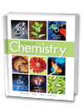


Chapter 14
The Behavior of Gases
Properties of Gases
The Gas Laws
Ideal Gases

Slide 3
Lesson Objectives
  By the end of this lesson, you should be able to:
  State Boyle’s law, Charles’s law, and Gay-Lussac’s law and apply these laws to calculate the relationships between volume, temperature, and pressure.
  Derive the combined gas law from Boyle’s law, Charles’s law, and Gay-Lussac’s law and calculate for pressure, volume, or temperature.
  Define partial pressure and apply Dalton’s law of partial pressures to describe the composition of gases.
  State the Ideal Gas Law (PV = nRT) and calculate moles of a gas, understanding the difference between ideal and real gases.
Notes:
Timing ≈ 0.5 minute
In this lesson, you will use kinetic molecular theory to explore the behavior of gases. Gases follow predictable behavior that can be summarized by several laws, including Boyle’s law, Charles’s law, Gay-Lussac’s law, the combined gas law, and Dalton’s law of partial pressures.

Slide 4
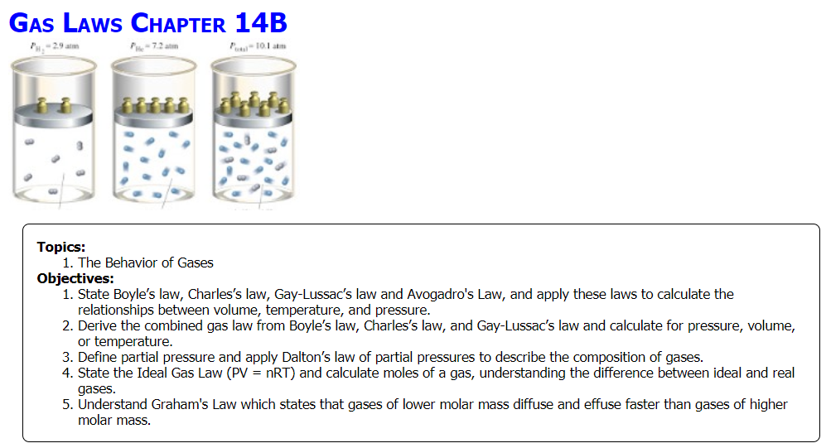
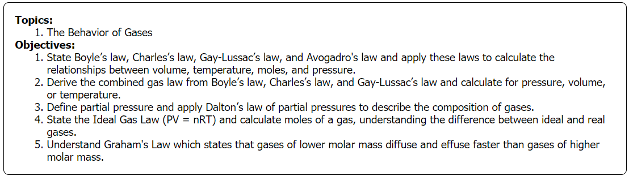

Slide 5
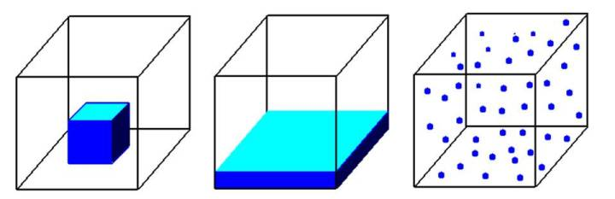
Label the three states of matter in the diagram & describe their shape, volume, density, molecular attractions, compressibility, expansivity, & what might affect it … in relation to each other.
 | Shape | Volume | Density | Molecular Attractions | Compress-ibility | Expansiv-ity | What might affect it
Solid
Liquid
Gas

Slide 6
Solid
Liquid
gas
Label the three states of matter in the diagram & describe their shape, volume, density, molecular attractions, compressibility, expansivity, & what might affect it … in relation to each other.
 | Shape | Volume | Density | Molecular Attractions | Compress-ibility | Expansiv-ity | What might affect it
Solid | definite | definite | greatest | strongest | little | little | little
Liquid | Takes the shape container | definite | middle | middle | little | little | little
Gas | indefinite | fills container | least | weakest | great | great | T, P

Slide 7
Review of Pressure
Watch the video on Learning CTR Online:
https://screencast-o-matic.com/watch/cFeY3gDvx1
Pressure ctr (5:32)
PSI (Breaking a Board using Atmospheric Pressure)
Manometer Readings

Slide 8
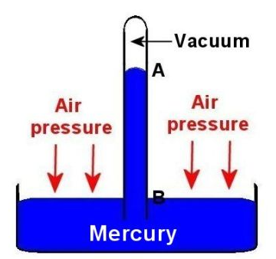
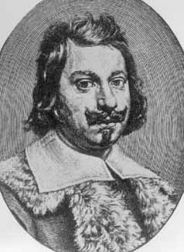
Measuring Gas Pressure
Torricelli developed the “barometer” from baro, meaning weight and meter meaning measure.
He also coined the unit “Torr” which is equal to mm Hg.
What is pressure & its units?
What is STP and its units?
Gas pressure
liquid

Slide 9
Measuring Gas Pressure
Torricelli developed the “barometer” from baro, meaning weight and meter meaning measure.
He also coined the unit “Torr” which is equal to mm Hg.
Gas pressure
What is pressure & its units?
Force/Area → N/m²
What is STP and its units?
1 atm = 101.3 kPa = 760 mm Hg
0º C = 273.15 K
liquid

Slide 10
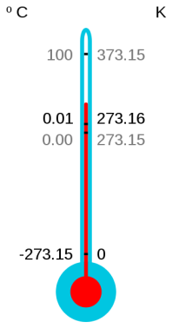
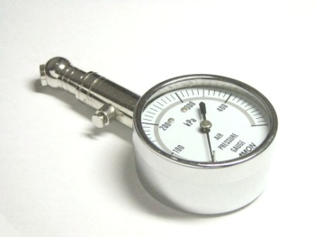
Standard Temperature and Pressure
Standard Temperature and Pressure (STP) standard conditions used to compare gas measurements; defined as an absolute temperature of 273.15 K and a pressure of 101.325 kPa
  Scientists use absolute temperature (K) in all gas calculations.
Notes:
Timing ≈ 1 min
We've seen that pressure, especially for a gas, is highly dependent on temperature and volume, as well as the amount of gas present. Therefore, it can be difficult to directly compare gas samples. To make these comparisons more straightforward, scientists have established a standard set of conditions for comparing gases. This is known as standard temperature and pressure, or STP.
STP is defined to be 273.15 K and 101.325 kPa. By using the phrase "STP" for these conditions, scientists can quickly and easily compare gases without having to spend a lot of time or space identifying specific temperature and pressure conditions.
An important thing to note is that standard temperature is given in kelvins. It's very important when doing any calculations involving gas temperature that you use absolute (kelvin) temperature, not Celsius.
SOURCES
http://commons.wikimedia.org/wiki/File:Air_pressure_gauge.jpg
http://commons.wikimedia.org/wiki/File:CelsiusKelvin.svg

Slide 11
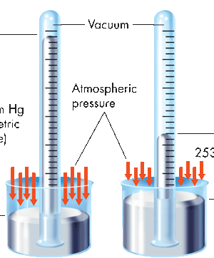
Gas Pressure
Two older units of pressure are still commonly used:
millimeters of mercury (mm Hg) and atmospheres (atm).
One standard atmosphere (atm) is the pressure required to support 760 mm of mercury in a mercury barometer at 25°C.
Gas
760 mm Hg (barometric pressure)
Atmospheric pressure
253 mm Hg
1 atm = 760 mm Hg = 101.3 kPa
Sea level
On top of Mount Everest
Standard temperature & pressure (STP)
0⁰ C or 273.15 K 101.3 kPa, 760 mm Hg, or 1 atm
The pressure in mm Hg inside a vacuum is 0 mm Hg.

Slide 12

Collapsing Can Experiment
Click on the link: (0:47)
https://screencast-o-matic.com/watch/cFQ6XyqEwm
Why did the can collapse?
See the link on Learning CTR Online:
“FUN Pressure Activities” Labs

Slide 13
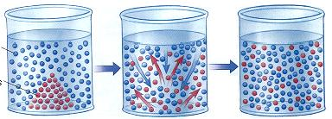
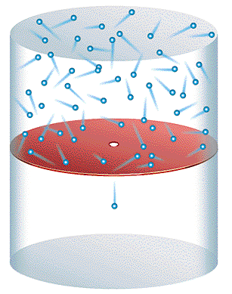
The Nature of Gases
Gases exhibit:
Diffusion
the gradual mixing of molecules of different gases from HIGH to LOW concentration.
Effusion
the movement of molecules through a small hole into an empty container.

Slide 14
Ideal Gas Law
PV = nRT
P = pressure in atm, mm Hg, or kPa
V = volume in liters
n = moles
R = ideal gas constant based on units
= 0.0821 liter•atm / mol•K
= 62.396 liter•mm Hg / mol•K
= 8.317 liter•kPa / mol•K
T = temperature in Kelvins

Slide 15
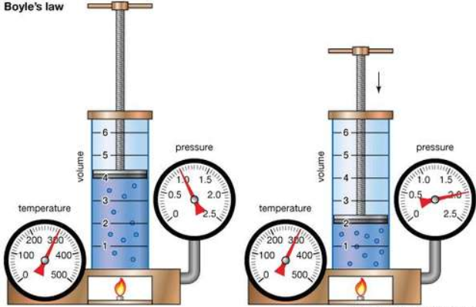
Boyle’s Law
Boyle’s Law describes the relationship between the volume of a gas and its pressure at a constant temperature and number of moles.
A gas can be compressed to take up less space:
The higher the pressure applied to the gas, the smaller the volume it will occupy. (e.g. piston chamber in engines)

Slide 16

Boyle’s Law
The higher the pressure applied to the gas, the smaller the volume it will occupy.
    Example
    Bubbles in a fish tank increase in size as they move toward the surface of the water experiencing LESS pressure.
    Bubbles at the bottom of the tank are smaller, experiencing more pressure than bubbles up higher in the water.

Slide 17
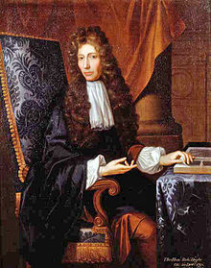
Boyle’s Law
Robert Boyle (1627-1691) decided to experiment with only pressure and volume of a gas, so he held the temperature and number of moles of the gas constant.
PV = nRT → PV = k
What mathematical relationship does this show?

Slide 18

Boyle’s Law
Robert Boyle (1627-1691) decided to experiment with only pressure and volume of a gas, so he held the temperature and number of moles of the gas constant.
PV = nRT → PV = k
Mathematically: P V OR P ∞ 1/V
(take away the constants)
At the same conditions of temperature and moles:
P₁V₁ = k, P₂V₂ = k
Thus: P₁V₁ = P₂V₂

Slide 19
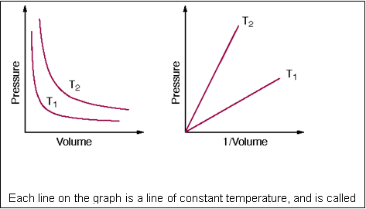
Boyle’s Law
Pressure is inversely proportional to volume:
P₁V₁ = P₂V₂
P ↑ V ↓
Each line on the graph is a line of constant temperature, and is called an isotherm.

Slide 20
Boyle’s Law
Pressure is inversely proportional to volume:
P₁V₁ = P₂V₂
Each line on the graph is a line of constant temperature, and is called an isotherm.
In a plot of P versus 1/V, we see that the isotherms are straight lines with constant slopes.

Slide 21
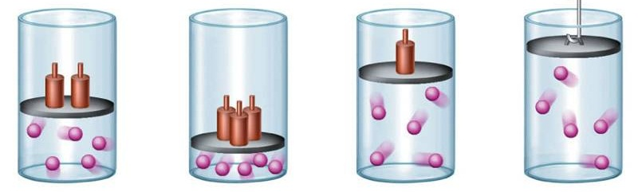
Boyle’s Law
Describe the relationship between pressure and volume in the cylinders. Remember pressure is related to collisions.
Find the volume of a gas which occupies 200. ml at 2.6 atm when it is at standard pressure.

Slide 22
Boyle’s Law
Describe the relationship between pressure and volume in the cylinders. Remember pressure is related to collisions.
P ∞ 1/V … as pressure > volume < or vice versa
When molecules are confined to a smaller space (less volume), there are more collisions (more pressure)
Find the volume (V₂) of a gas which occupies 200. ml (V₁) at 2.6 atm (P₁) when it is at standard pressure (P₂).
P₁V₁ = P₂V₂ … solve for V₂: = P₁V₁ / P₂
V₂ = 200. ml x (2.6 atm/1 atm) = 520 ml (notice P ↓ V ↑)

Slide 23
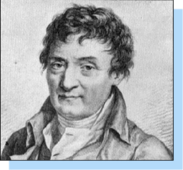
Charles’ Law
Jacques Charles (1746-1823) experimented with only temperature and volume of a gas, so he held the pressure and number of moles of the gas constant.
PV = nRT → V/T = k
What mathematical relationship does this show?

Slide 24

Charles’ Law
Jacques Charles (1746-1823) experimented with only temperature and volume of a gas, so he held the pressure and number of moles of the gas constant.
PV = nRT → V/T = k
Mathematically: V ∞ T (take away the constants)
At the same conditions of pressure and moles:
V₁ = kT₁, V₂ = kT₂
Thus: V₁/T₁ = V₂/T₂

Slide 25
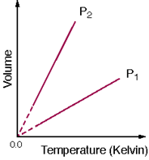
Charles’ Law
Temperature is directly proportional to volume:
V₁/T₁ = V₂/T₂
V ↑ T ↑
Absolute temperature

Slide 26
Charles’ Law
Temperature is directly proportional to volume:
V₁/T₁ = V₂/T₂
In the plot of V-vs-T, the direct relationship is linear, with an intercept of absolute zero on the Kelvin scale.
The slope depends on the pressure and the amount of gas.
The dashed lines on the graph are to represent the fact that you can not achieve absolute zero.
Kelvin includes avg KE & volume.

Slide 27
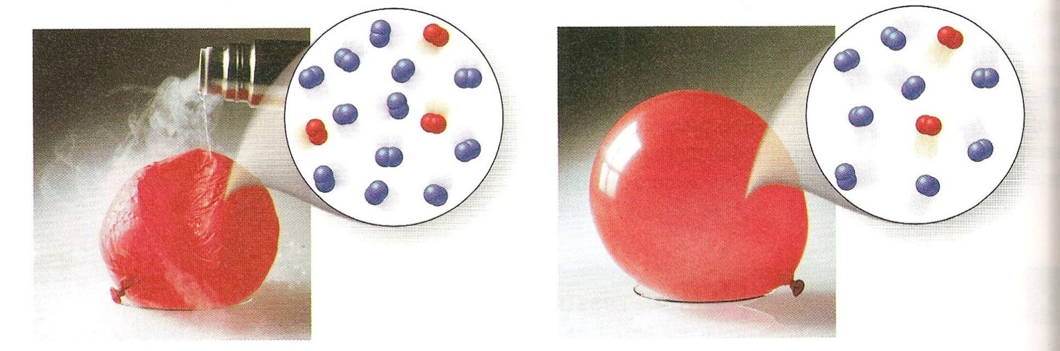
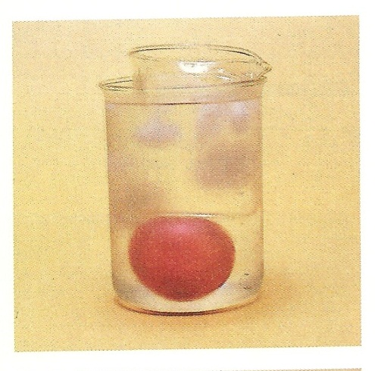
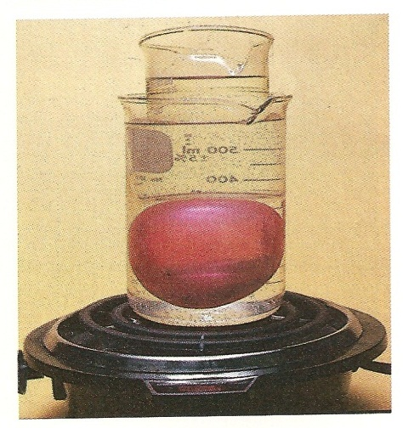
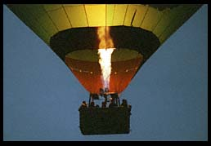
Charles’ Law
Liquid nitrogen poured on a balloon causes it to shrink.
A balloon is smaller in a beaker of ice water than in a beaker of boiling water. The volume of the air in balloon increases with increasing temperature.
Heated gas expands, as in a hot air balloon.

Slide 28
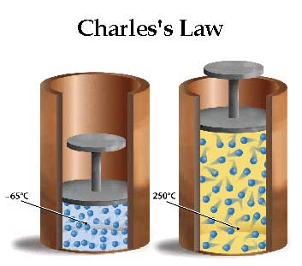
Charles’ Law
Describe the relationship between temperature and volume in the cylinders. Remember temperature is related to average kinetic energy of the molecules.
A scientist has an initial volume of 100. ml of a gas at 25.0º C and constant pressure. If the temperature changes to 100.º C, what is the new volume of the gas?

Slide 29
Charles’ Law
Describe the relationship between temperature and volume in the cylinders. Remember temperature is related to average kinetic energy of the molecules.
The motion of the molecules (T) > as volume > to keep pressure constant.
A scientist has an initial volume of 100. ml (V1) of a gas at 25.0º C (T1) and constant pressure. If the temperature changes to 100.º C (T2) , what is the new volume (V2) of the gas?
V₁ = 100. ml T₁ = 25.0 C = 298 K T₂ = 100. C = 373 K
V₁/T₁ = V₂/T₂ V₂ = V₁T₂ / T₁ V₂ = (100. ml)(373 K) / 298 K
V₂ = 125 ml (notice V ↑ T ↑)

Slide 30
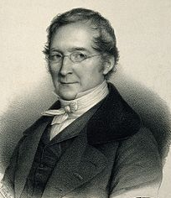
Gay-Lussac’s Law
Gay-Lussac (1746-1823) experimented with only temperature and pressure of a gas, so he held the volume and number of moles of the gas constant.
PV = nRT → P/T = k
What mathematical relationship does this show?

Slide 31
Gay-Lussac’s Law
Gay-Lussac (1746-1823) experimented with only temperature and pressure of a gas, so he held the volume and number of moles of the gas constant.
PV = nRT → P/T = k
Mathematically: P ∞ T (take away the constants)
At the same conditions of volume and moles:
P₁ = kT₁, P₂ = kT₂
Thus: P₁/T₁ = P₂/T₂

Slide 32

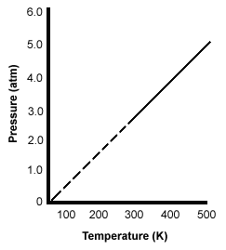
Gay-Lussac’s Law
Pressure is directly proportional to temperature:
P₁/T₁ = P₂/T₂
V
P ↑ T ↑
Absolute temperature

Slide 33
Gay-Lussac’s Law
Pressure is directly proportional to temperature:
P₁/T₁ = P₂/T₂
V
In the plot of P-vs-T, the direct relationship is linear.
The slope depends on the volume and the amount of gas.
The dashed lines on the graph are to represent the fact that you can not achieve absolute zero.
Kelvin includes avg KE & volume.

Slide 34
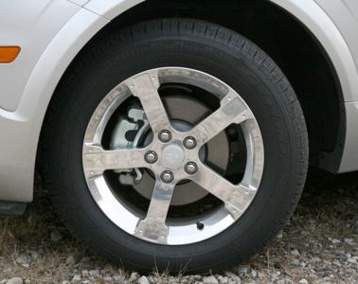
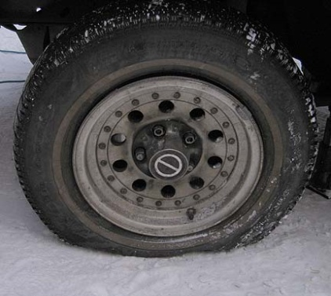
Gay-Lussac’s Law
Using Gay-Lussac’s law, explain when you need to check the tire pressure more often: in the summer or the winter.
The temperature of a sample of gas in a steel tank at 30.0 kPa is increased from –100.0˚C to 25.0˚ C. What is the final pressure inside the tank?

Slide 35
Gay-Lussac’s Law
Using Gay-Lussac’s law, explain when you need to check the tire pressure more often: in the summer or the winter.
As the tires rotate, the temperature of the air in the tires increases due to friction on the road. The pressure of the air also increases (molecules move faster, more collisions).
On a hot summer day, pressure in a car tire increases over what it would be on a cold winter day. Tire pressure often drops significantly in the winter.
The temperature of a sample of gas in a steel tank at 30.0 kPa (P1) is increased from –100.0˚C (T1) to 25.0˚ C (T2) . What is the final pressure (P2) inside the tank?
T₁ = -100.0 C = 173 K T₂ = 25.0 C = 298 K
P₁/T₁ = P₂/T₂ P₂ = P₁T₂ / T₁ P₂ = (30.0 kPa)(298 K)/(173 K)
P₂ = 51.7 kPa (notice T ↑ P ↑ )

Slide 36
Charles’ Law & Gay-Lussac’s Law
Watch the video on Learning CTR Online:
http://somup.com/cFX10cn17m
Charles' Law & Gay-Lussac's Law ctr (3:12)
Volume vs. Temperature
Pressure vs. Temperature

Slide 37
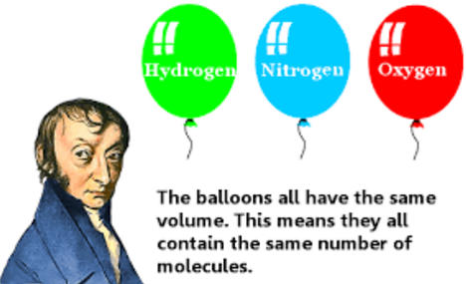
Avogadro’s Law
Amedeo Avogadro (1776-1856) experimented with only volume and moles of a gas, so he held the pressure and temperature of the gas constant.
PV = nRT → V = kn → k = V/n
What mathematical relationship does this show?

Slide 38

Avogadro’s Law
Amedeo Avogadro (1776-1856) experimented with only volume and moles of a gas, so he held the pressure and temperature of the gas constant.
PV = nRT → V = kn → k = V/n
Mathematically: V ∞ n (take away the constants)
At the same conditions of pressure and temperature:
V₁ = kn₁, V₂ = kn₂
Thus: V₁/n₁ = V₂/n₂

Slide 39
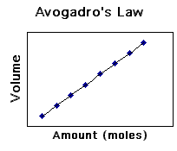
Avogadro’s Law
Volume is directly proportional to moles:
V₁/n₁ = V₂/n₂
V ↑ n ↑

Slide 40
Avogadro’s Law
Volume is directly proportional to moles:
V₁/n₁ = V₂/n₂
In the plot of V-vs-n, the direct relationship is linear.
For a gas:
1 mol = # molecules / 22.4 L
molar volume = 22.4 L
N_{A} = 6.02 x 10²³ particles, etc.

Slide 41

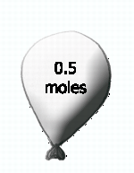
Avogadro’s Law
How many molecules of oxygen gas (O₂) are in 60.0 liters @ STP?
Describe the volume and moles in each balloon:
If the balloons all have the same volume, how do their moles compare?

Slide 42
Avogadro’s Law
How many molecules of oxygen gas (O₂) are in 60.0 liters @ STP?
60.0 L x 1 mol / 22.4 L x 6.02 x 10²³/1 mol = 1.61 x 10²⁴ molecules
The volume and moles increased from left to right as a direct proportion.

Slide 43
Combined gas law:
For a fixed quantity of gas, pressure & volume vary inversely while temperature varies directly with pressure & volume
Boyle’s law
  P₁V₁ = P₂V₂
Charles’s law
Gay-Lussac’s law
What would it look like if we combined all three gas laws?
Notes:
Timing ≈ 1 minute
Each equation contains elements common to the other two equations. It can be shown algebraically that these equations can be combined to yield the combined gas law.
Look over the three individual gas laws and compare them to the combined gas law. You can observe each gas law equation within the equation shown for the combined gas law. (teacher point out each law within the combined gas law--e.g., circle P1V1 = P2V2 and point out that it is Boyle's law, .. Do the same for Charles’s law and Gay-Lussac’s law)
The combined gas law states the relationships between the variables of pressure, volume, and temperature of a gas as long as the amount of gas is fixed.

Slide 44
Combined gas law:
For a fixed quantity of gas, pressure & volume vary inversely while temperature varies directly with pressure & volume
Boyle’s law
  P₁V₁ = P₂V₂
Charles’s law
Gay-Lussac’s law
What would it look like if we combined all three gas laws?
Remember: V ∞ 1 / P V ∞ T P ∞ T
inverse direct direct
Therefore, V ∞ T / P PV ∞ T PV / T = k
combine rearrange equation
Combined gas law
Notes:
Timing ≈ 1 minute
Each equation contains elements common to the other two equations. It can be shown algebraically that these equations can be combined to yield the combined gas law.
Look over the three individual gas laws and compare them to the combined gas law. You can observe each gas law equation within the equation shown for the combined gas law. (teacher point out each law within the combined gas law--e.g., circle P1V1 = P2V2 and point out that it is Boyle's law, .. Do the same for Charles’s law and Gay-Lussac’s law)
The combined gas law states the relationships between the variables of pressure, volume, and temperature of a gas as long as the amount of gas is fixed.

Slide 45
Combined gas law:
For a fixed quantity of gas, pressure & volume vary inversely while temperature varies directly with pressure & volume
Boyle’s law
  P₁V₁ = P₂V₂
Charles’s law
Gay-Lussac’s law
Combined gas law
Notes:
Timing ≈ 1 minute
Each equation contains elements common to the other two equations. It can be shown algebraically that these equations can be combined to yield the combined gas law.
Look over the three individual gas laws and compare them to the combined gas law. You can observe each gas law equation within the equation shown for the combined gas law. (teacher point out each law within the combined gas law--e.g., circle P1V1 = P2V2 and point out that it is Boyle's law, .. Do the same for Charles’s law and Gay-Lussac’s law)
The combined gas law states the relationships between the variables of pressure, volume, and temperature of a gas as long as the amount of gas is fixed.

Slide 46

Combined Gas Law
You must have temperature in Kelvin:
1) K includes volume; 2) you can’t divide by zero (e.g. 0º C).
Cover up Pressure (it remains constant) … what do you have?
Cover up Volume (it remains constant) … what do you have?
Cover up Temperature (it remains constant) … what do you have?

Slide 47
Combined Gas Law
You must have temperature in Kelvin:
1) K includes volume; 2) you can’t divide by zero (e.g. 0º C).
Cover up Pressure (it remains constant) … what do you have?
Charles’ Law
Direct Relationship
Cover up Volume (it remains constant) … what do you have?
Gay-Lussac’s Law
Direct Relationship
Cover up Temperature (it remains constant) … what do you have?
Boyle’s Law
Inverse Relationship
P₁V₁ = P₂V₂

Slide 48
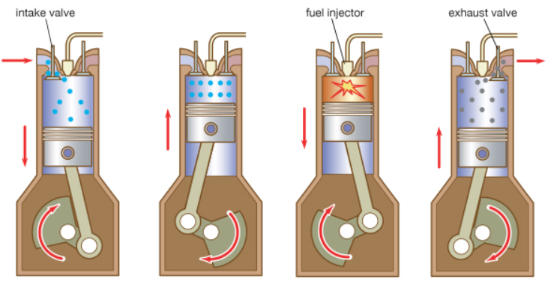
Real World Application of the Combined Gas Law
  Internal Combustion Engines
  Operate on the principle of taking a volume (V) of gas in, compressing it (P), igniting it (T), then pushing the exhaust out.
  The air-fuel mixture enters the piston chamber.
  The air-fuel mixture is compressed (piston moves up)
  The fuel is ignited.
The hot, expanding gases force the piston down and the exhaust gases are expelled from the chamber.
Notes:
Timing ≈ 1 minute
Water heaters in our home heat the water and therefore, temperature inside the hot water tank increases.
The pressure inside the water heater also increases forming a “back pressure”. An overflow valve exists to ensure that the water heater tank does not explode.
However, the pressure in the heater is allowed to back up in the cold water pipes (volume increases). If there is a one-way valve from the street supply, then a thermal expansion unit (adjustable “bladder”) is needed between the water heater and the pipes. [animate: an arrow appears (wiping right) pointing to the place where an adjustable bladder would be]
SOURCE:
http://commons.wikimedia.org/wiki/File:FEMA_-_63_-_Photograph_by_Dave_Saville_taken_on_10-04-1999_in_North_Carolina.jpg

Slide 49
Real World Application of the Combined Gas Law
  Internal Combustion Engines Notice P, V, T
  The volume (V), pressure (P), and temperature (T) interactively vary:
  The air-fuel mixture enters the piston chamber.
  The air-fuel mixture is compressed (piston moves up)
  The fuel is ignited.
P V T
P V T
P V T
P V T
The hot, expanding gases force the piston down and the exhaust gases are expelled from the chamber.
Notes:
Timing ≈ 1 minute
Water heaters in our home heat the water and therefore, temperature inside the hot water tank increases.
The pressure inside the water heater also increases forming a “back pressure”. An overflow valve exists to ensure that the water heater tank does not explode.
However, the pressure in the heater is allowed to back up in the cold water pipes (volume increases). If there is a one-way valve from the street supply, then a thermal expansion unit (adjustable “bladder”) is needed between the water heater and the pipes. [animate: an arrow appears (wiping right) pointing to the place where an adjustable bladder would be]
SOURCE:
http://commons.wikimedia.org/wiki/File:FEMA_-_63_-_Photograph_by_Dave_Saville_taken_on_10-04-1999_in_North_Carolina.jpg

Slide 50
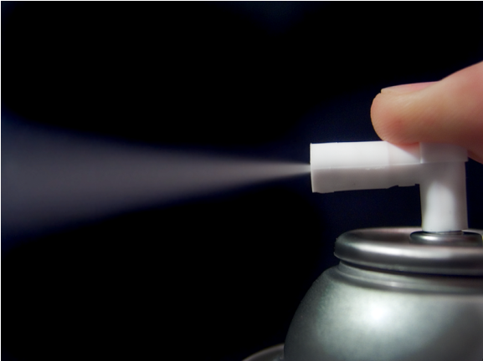
Joule-Thomson Effect
ENRICHMENT
  Spraying a gas from an aerosol can:
  Pressure (P) of gas decreases as it goes from being compressed in the container to being released into the atmosphere. Volume (V) increases substantially.
  Kinetic energies of gas molecules decrease. Gas temperature (T) therefore decreases as it is sprayed.
Notes:
Timing ≈ 0.5 minute
A special case of the combined gas law is commonly observed with aerosol can. This exhibits the Joule-Thomson Effect: when a highly compressed gas effuses (escapes through a small opening), the temperature decreases.
Inside the aerosol can, molecules are compressed, meaning that the pressure is high. Therefore, the kinetic energies of those molecules are relatively high. Once the aerosol is sprayed, the kinetic energies of the escaped molecules are now less than when compressed. As kinetic energy decreases, the temperature decreases.
Try this: hold your palm directly in front of your mouth. Open your mouth wide and “puff” on your palm. Now, use a “whistling” shape and blow on your palm again. Notice the temperature difference? The smaller opening (whistling shape) feels much cooler.
Source: Aerosol can: http://commons.wikimedia.org/wiki/File:Aerosol.png; Creative Commons Attribution ShareAlike 3.0 License; accessed 5/14/12

Slide 51


Real World Application of the Combined Gas Law
Open your hand, palm in, and place near your mouth (~1-2 inches away). Open your mouth wide and blow.
Repeat the same procedure EXCEPT whistle into your palm.
Make your observations and explain what happened.

Slide 52
Real World Application of the Combined Gas Law
Open your hand, palm in, and place near your mouth (~1-2 inches away). Open your mouth wide and blow.
Repeat the same procedure EXCEPT whistle into your palm.
Notice with mouth wide, it feels warmer, but when whistling it feels cooler (air expands).
When whistling, the pressure (P) was relatively high leaving the mouth; Volume (V) INcreased drastically (expansion), Decreasing the perceived temperature (T).

Slide 53
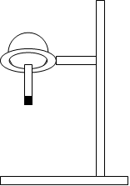
What is the relationship between pressure, temperature, and volume of a gas?
Using ice to make water boil!
http://somup.com/cFXiDHn19g (3:08)
ice
Hot water in the flask forms bubbles
Notes:
Timing ≈ 0.5 min
Recap: In any sample of gas, molecules are in constant motion. Take the example shown in the demonstration on the screen.
Connect: In the demonstration shown, ice is used to make water boil! Observe that molecules of water are present in the gas state above the liquid inside the closed flask. However, notice that even though it is boiling, the water is cooled by ice surrounding the apparatus. What can explain why water can boil when cooled by ice?
Preview: To be able to explain this scenario, you will need to understand and interpret the relationships between temperature, pressure, and volume of a gas. In this next segment, you will learn some fundamental laws that summarize these relationships. You can apply these laws to explain the ice-cold boiling water phenomenon.
SOURCE: sketch from approved outline

Slide 54
What is the relationship between pressure, temperature, and volume of a gas?
Using ice to make water boil!
http://somup.com/cFXiDHn19g (3:08)
Ice cools the gas inside the flask (above the water).
Cooling the gas decreases the pressure of the gas: P ∞ T
The gas pressure is lower so it matches the vapor pressure of the water. Thus, boiling.
Volume (V) changes slightly before equilibrium.
ice
Hot water in the flask forms bubbles
Notes:
Timing ≈ 0.5 min
Recap: In any sample of gas, molecules are in constant motion. Take the example shown in the demonstration on the screen.
Connect: In the demonstration shown, ice is used to make water boil! Observe that molecules of water are present in the gas state above the liquid inside the closed flask. However, notice that even though it is boiling, the water is cooled by ice surrounding the apparatus. What can explain why water can boil when cooled by ice?
Preview: To be able to explain this scenario, you will need to understand and interpret the relationships between temperature, pressure, and volume of a gas. In this next segment, you will learn some fundamental laws that summarize these relationships. You can apply these laws to explain the ice-cold boiling water phenomenon.
SOURCE: sketch from approved outline

Slide 55



Slide 56
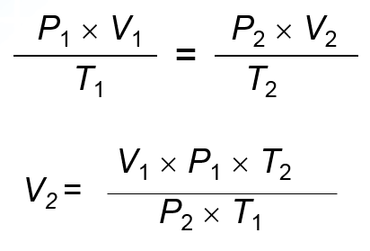
T₁ = 25 C + 273 K = 298 K T₂ = 15 C + 273 K = 288 K
P₁ = 1.0 atm P₂ = 0.30 atm
V₁ = 4.5 m³ V₂ = ?
V₂ = (1.0 atm)(4.5 m³)(288 K) / (298 K)(0.30 atm)
V₂ = 14 m³ (2 sig figs)

Slide 57
Ideal Gases
Ideal gases are imaginary gases that perfectly fit all of the assumptions of the kinetic molecular theory; i.e.,
Gases consist of tiny particles that are far apart relative to their size.
There are no forces of attraction or repulsion between the gas particles.
Collisions between gas particles and between particles and the walls of the container are elastic collisions, so no kinetic energy is lost in those collisions.
There is no gas for which these assumptions are true.
“Kinetic Theory” video (2:01)
Kinetic Theory ctr

Slide 58

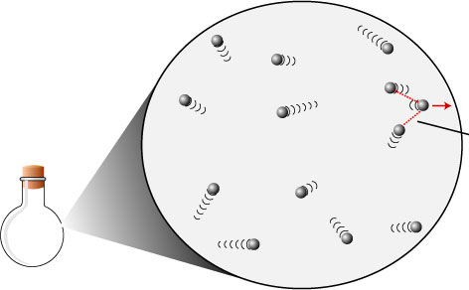
Ideal Gases & Real Gases
A gas will behave in an ideal fashion (PV = nRT) if its temperature is at or greater than 273 K (0⁰ C), and its pressure is near or less than 1.00 atm (101.3 kPa).
Standard Temperature and Pressure.
273 K or higher
101.3 kPa or lower

Slide 59
Ideal Gases & Real Gases
Standard Temperature and Pressure.
Boyle’s Law, Charles’ Law, Gay-Lussac’s Law and Avogadro’s Law work at STP.
They do not work when conditions do not match STP.

Slide 60
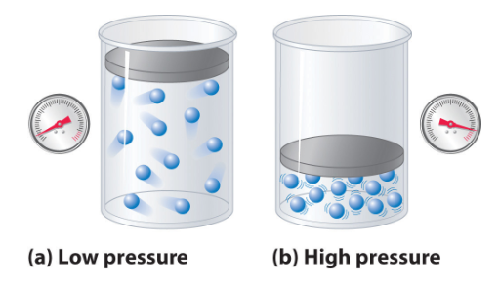
Ideal Gases & Real Gases
When pressure is HIGH as in image (b), the volume that the gas molecules occupy is significant compared to the region in which they are contained.
Particles in such real gases have volume and there are attractions between the particles.
Because of these attractions, a gas can condense, or even solidify, when it is compressed or cooled. Therefore LOW temperatures also cause deviations from the ideal gas law.

Slide 61
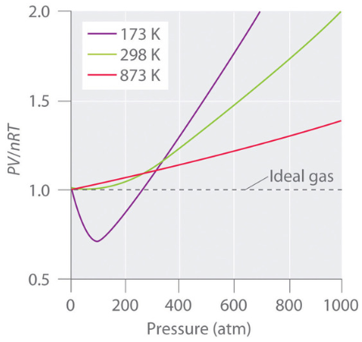
Ideal Gases & Real Gases
Ideal gas behavior exists at STP (dotted line).
LOW temperatures (molecules move slower … more attractions)
and HIGH pressures (more collisions in less volume) show significant deviations from the ideal gas law.

Slide 62
Ideal Gases
Boyle’s Law : volume, V 1/∝ pressure, P
Charles’ Law: volume, V ∝ temperature, T
Gay-Lussac’s Law: Pressure, P ∝ temperature, T
Avogadro’s Law: volume, V ∝ number of moles, n, of gas
So, we could say: V ∝ nT/P
To change a proportionality relationship into an equality, just requires multiplying by a constant, R.
V = R (nT/P) or V = RnT/P
We rearrange this equation to form:
PV = nRT

Slide 63
Ideal Gas Law Problem
Determine the number of moles of air present in 1.35 L at 100. kPa and 17.0°C. (R = 8.317 liter•kPa / mol•K).

Slide 64
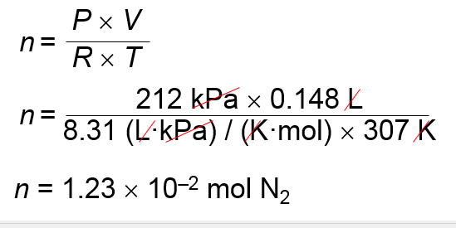
Ideal Gas Law Problem
Determine the number of moles of air present in 1.35 L (V) at 100. kPa (P) and 17.0 ⁰C (T). (R = 8.317 liter•kPa / mol•K).
T = 17.0º C + 273. = 290. K
PV = nRT
n = (100. kPa)(1.35 L)
(8.317 liter•kPa / mol•K)(290. K)
n = 0.0564 mol

Slide 65
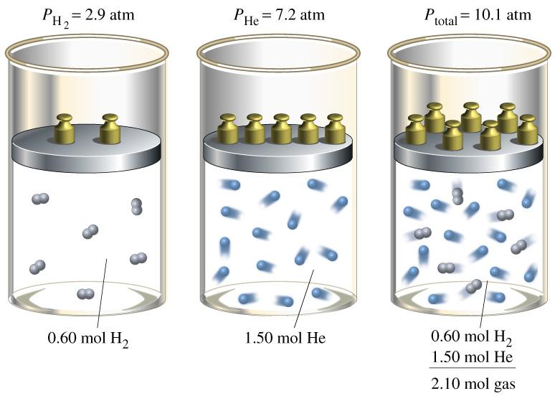
Dalton's Law of Partial Pressures
When two or more ideal gases are mixed together, the total pressure of the mixture is equal to the sum of the pressures of each individual gas.
P_{Total} = P₁ + P₂ + P₃ + ...
The pressure of an ideal gas does not depend on the
identity of the gas.
It depends only on the quantity of that gas!

Slide 66
Dalton's Law of Partial Pressures
Mole Fraction
0.60 mol / 2.10 mol H₂ (g)
1.50 mol / 2.10 mol He (g)

Slide 67
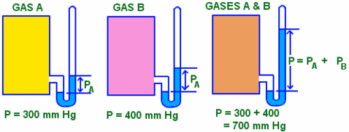
Dalton's Law of Partial Pressures
What is the total pressure of the gases when combined?
P_{B}
P_{B}

Slide 68
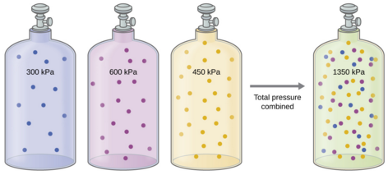
Dalton's Law of Partial Pressures
What is the pressure of the gas in the middle container?

Slide 69
Dalton's Law of Partial Pressures
What is the pressure of the gas in the middle container?
P_{T} = P₁ + P₂ + P₃
P_{T} - P₁ - P₃ = P₂
P₂ = 1350 – 450 – 300
P₂ = 600 kPa

Slide 70
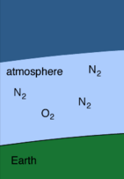
Partial pressure:
The fraction of the total pressure exerted by a mix of gases that is contributed by an individual gas
  Partial pressure:
  refers to pressure of one gas in a mixture of gases
  the pressure of a single gas as if it occupied the container by itself
  the sum of all partial pressures equals total pressure of the mixture
Partial pressure applies when there are two or more gases in the same container. Each gas contributed to the total pressure of the system.
Notes:
Timing ≈ 2 minutes
Suppose you have a mixture of gases. Air is a good example. Air is composed of a mixture of nitrogen, oxygen, argon, water vapor, and carbon dioxide, among other things that are present in very small amounts.
Partial pressure refers to the pressure exerted by one of the gases in a mixture as if it occupied a container of the gas by itself—all other gases removed. Therefore, each gas has its own partial pressure.
The total pressure exerted by the mixture of gases is the sum of the individual partial pressures of the gases in the mixture.
Observe how this works for a sample of air. Notice that nitrogen, oxygen, and argon account for 99.96% of the mixture that makes up air. Therefore, the contribution of water vapor, carbon dioxide, and all other components is negligible.
The partial pressures of nitrogen, oxygen, and argon are shown along with their percentage in the mixture. When you add the partial pressures of these three gases together, the sum equals the pressure of air.
[Data source: http://www.eo.ucar.edu/basics/wx_1_b_1.html ]

Slide 71
Partial pressure:
The fraction of the total pressure exerted by a mix of gases that is contributed by an individual gas
Air
N₂ (g): 78.08% ~593 torr
O₂ (g): 20.95% ~159 torr
Ar (g) 0.93% ~7 torr
____ _______ _______
mixture: 100% 760 torr
Notes:
Timing ≈ 2 minutes
Suppose you have a mixture of gases. Air is a good example. Air is composed of a mixture of nitrogen, oxygen, argon, water vapor, and carbon dioxide, among other things that are present in very small amounts.
Partial pressure refers to the pressure exerted by one of the gases in a mixture as if it occupied a container of the gas by itself—all other gases removed. Therefore, each gas has its own partial pressure.
The total pressure exerted by the mixture of gases is the sum of the individual partial pressures of the gases in the mixture.
Observe how this works for a sample of air. Notice that nitrogen, oxygen, and argon account for 99.96% of the mixture that makes up air. Therefore, the contribution of water vapor, carbon dioxide, and all other components is negligible.
The partial pressures of nitrogen, oxygen, and argon are shown along with their percentage in the mixture. When you add the partial pressures of these three gases together, the sum equals the pressure of air.
[Data source: http://www.eo.ucar.edu/basics/wx_1_b_1.html ]

Slide 72
Gases exhibit:
Diffusion
the gradual mixing of molecules of different gases from HIGH to LOW concentration.
Effusion
the movement of molecules through a small hole into an empty container.

Slide 73
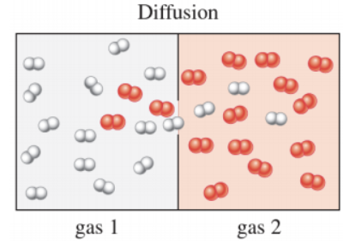
Graham’s Law
Gases diffuse at different rates.

Slide 74
Graham’s Law
Effusion
A gas escapes through a tiny hole in its container.
Gases of lower molar mass diffuse and effuse faster than gases of higher molar mass.
Graham’s law of effusion
the rate of effusion of a gas is inversely proportional to the square root of the gas’s molar mass.
The equation below is ENRICHMENT
Rate_{A}
molar mass_{B}
=
Rate_{B}
molar mass_{A}

Slide 75
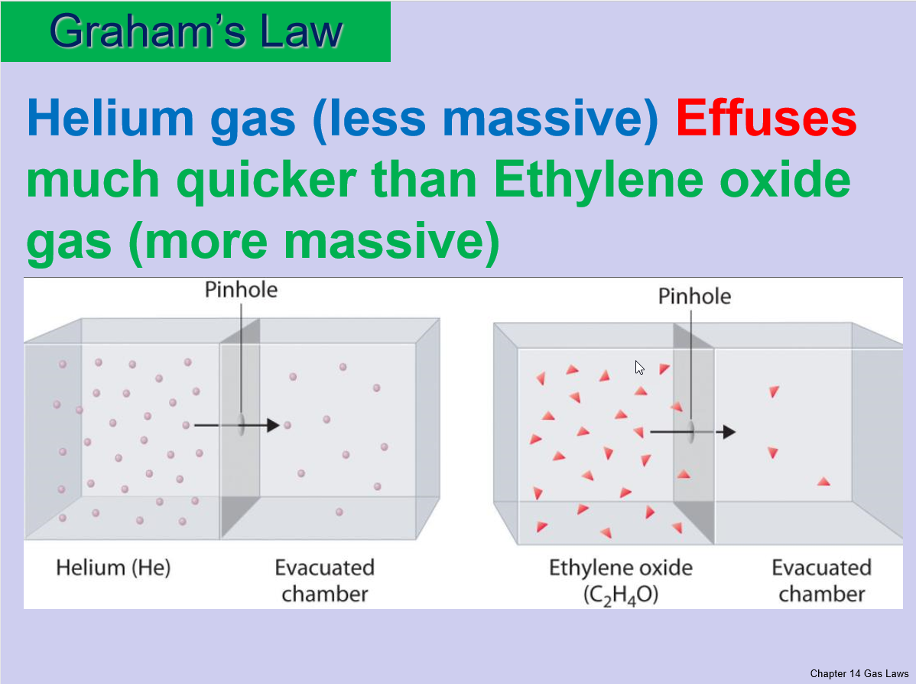

Slide 76
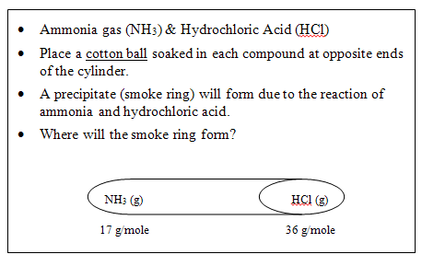
Graham’s Law
Which of the following gas particles will diffuse fastest if all of these gases are at the same temperature and pressure?
SO₂ N₂O
Hg Cl₂

Slide 77
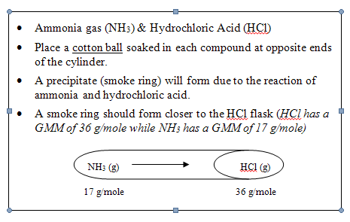
Graham’s Law
N₂O will diffuse fastest of these gases at the same temperature and pressure because its molar mass is least.
SO₂ (64 g/mol) N₂O (44 g/mol) … least mass
Hg (~201 g/mol) Cl₂ (~71 g/mol)

Slide 78
Practice matching graphed relationships to the gas laws.
A
B
Match one graph shown at right to the gas laws named below
Charles’s law
Gay-Lussac’s law
Boyle’s law
V
P
C
T
D
T
P
V
T
E
T
P
V
Notes:
Timing ≈ 2 minutes

Slide 79
Three Gas Laws
D
B
E
Boyle’s law
  P₁V₁ = P₂V₂
Charles’s law
Gay-Lussac’s law
Notes:
Time: ~0.5 minute
The variables in any gas include its pressure, volume, temperature, and quantity of gas. If you use the same sample of gas for a problem, the quantity is fixed and only pressure, volume, and temperature need to be considered.
When temperature is constant, Boyle’s law applies. [animate: left green box appears with graph] According to Boyle’s law, pressure varies inversely with volume in an indirect relationship. P1V1=P2V2 [equation appears]
When pressure is constant, Charles’s law applies. [animate: blue middle box appears with graph] According to Charles’s law, volume varies proportionally with absolute temperature in a direct relationship. V1/T1=V2/T2 [equation appears]
When volume is constant, Gay-Lussac’s law applies. [animate: orange right box appears with graph] According to Gay-Lussac’s law, pressure varies proportionally with absolute temperature in a direct relationship. P1/T1=P2/T2 [equation appears]
Remember that each of these three laws assumes that the quantity of gas is constant.

Slide 80
Torr = mm Hg

Slide 81
V₁
P₁
P₂
V₂
But temperature stays constant,
so denominators cancel out, leaving
Boyle’s Law → P₁V₁ = P₂V₂
P₂ = P₁V₁ / V₂
P₂ = (456 torr) x (3.00 L) / 0.75 L
= 1800 torr … 2 sig figs
= 1.8 x 10³ torr

Slide 82
A balloon contains 30.0 L of helium gas at 103 kPa. What is the volume of the helium when the balloon rises to an altitude where the pressure is only 25.0 kPa? (Assume that the temperature remains constant.)

Slide 83
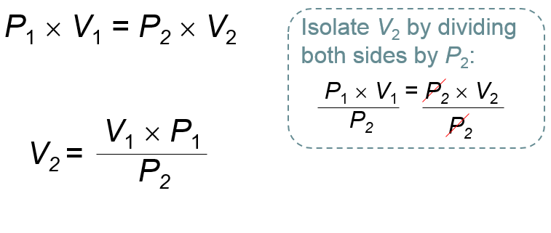
Boyle’s Law Problem 2
A balloon contains 30.0 L (V₁) of helium gas at 103 kPa (P₁) . What is the volume (V₂) of the helium when the balloon rises to an altitude where the pressure is only 25.0 kPa (P₂)? (Assume that the temperature remains constant.)
30.0 L × 103 kPa
V₂ =
25.0 kPa
V₂ = 1.24 × 10² L

Slide 84
A sample of neon gas occupies a volume of 677 mL at 134 kPa. What is the pressure of the sample if the volume is decreased to 642 mL? [Assume constant temperature]

Slide 85
Boyle’s Law Problem 3
A sample of neon gas occupies a volume of 677 mL (V₁) at 134 kPa (P₁). What is the pressure (P₂) of the sample if the volume (V₂) is decreased to 642 mL? [Assume constant temperature]
P₁ × V₁ = P₂ × V₂
V₁ × P₁
P₂ =
V₂
677 mL × 134 kPa
P₂ =
642 mL
P₂ = 141 kPa

Slide 86
A balloon inflated in a room at 24.0ºC has a volume of 4.00 L. The balloon is then heated to a temperature of 58.0ºC. What is the new volume if the pressure remains constant?

Slide 87
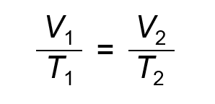
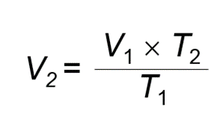
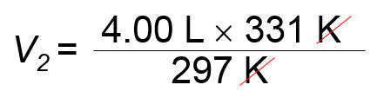

Charles’ Law Problem 1
A balloon inflated in a room at 24.0ºC (T₁) has a volume of 4.00 L (V₁). The balloon is then heated to a temperature of 58.0ºC (T₂). What is the new volume (V₂) if the pressure remains constant?
T₁ = 24.0ºC + 273 = 297 K T₂ = 58.0ºC + 273 = 331 K

Slide 88
What is the temperature of a 2.3 L balloon if it shrinks to a volume of 0.632 L when it is dipped into liquid nitrogen at a temperature of 77 K?

Slide 89
Charles’ Law Problem 2
What is the temperature (T₁) of a 2.3 L (V₁) balloon if it shrinks to a volume of 0.632 L (V₂) when it is dipped into liquid nitrogen at a temperature of 77 K (T₂)?
V₁ × T₂
T₁ =
V₂
2.3 L × 77 K
T₁ =
T₁ = 280 K
0.632 L

Slide 90
Aerosol cans carry labels warning not to incinerate (burn) the cans or store them above a certain temperature. The gas in a used aerosol can is at a pressure of 103 kPa at 25.0ºC. If the can is thrown onto a fire, what will the pressure be when the temperature reaches 928ºC?

Slide 91
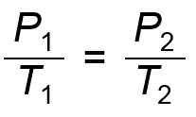



Gay-Lussac’s Law Problem 1
Aerosol cans carry labels warning not to incinerate (burn) the cans or store them above a certain temperature. The gas in a used aerosol can is at a pressure of 103 kPa (P₁) at 25.0ºC (T₁). If the can is thrown onto a fire, what will the pressure (P₂) be when the temperature reaches 928ºC (T₂)?

Slide 92
A pressure cooker containing a roast and some water starts at 298 K and 101 kPa. The cooker is heated, and the pressure increases to 136 kPa. What is the final temperature inside the cooker?

Slide 93

Gay-Lussac’s Law Problem 2
A pressure cooker containing a roast and some water starts at 298 K (T₁) and 101 kPa (P₁). The cooker is heated, and the pressure increases to 136 kPa (P₂). What is the final temperature (T₂) inside the cooker?
401 K

Slide 94
The volume of a gas-filled balloon is 30.0 L at 313 K and 153 kPa pressure. What would the volume be at standard temperature and pressure (STP)?

Slide 95

Combined Gas Law Problem 1
The volume of a gas-filled balloon is 30.0 L (V₁) at 313 K (T₁) and 153 kPa (P₁) pressure. What would the volume (V₂) be at standard temperature (T₂) and pressure (STP) (P₂) ?
STP
273 K
101.3 kPa

Slide 96
Which of the following equations could be used to correctly calculate the final temperature of a gas?
V₁ × P₁ × V₂
A.
B.
C.
D.
T₂ =
P₂ × T₁
V₂ × P₂ × T₁
T₂ =
V₁ × P₁
V₂ × P₁ × T₁
T₂ =
V₁ × P₂
V₁ × P₁ × T₁
T₂ =
V₂ × P₂

Slide 97
Combined Gas Law Problem 2
Which of the following equations could be used to correctly calculate the final temperature of a gas?
V₁ × P₁ × V₂
A.
B.
C.
D.
T₂ =
P₂ × T₁
V₂ × P₂ × T₁
T₂ =
V₁ × P₁
V₂ × P₁ × T₁
T₂ =
V₁ × P₂
V₁ × P₁ × T₁
T₂ =
V₂ × P₂

Slide 98
At 34.0ºC, the pressure inside a nitrogen-filled tennis ball with a volume of 0.148 L is 212 kPa. How many moles of nitrogen gas are in the tennis ball? (R = 8.317 L·kPa/Mol·K)

Slide 99
Ideal Gas Law Problem 1
At 34.0ºC (T) , the pressure inside a nitrogen-filled tennis ball with a volume of 0.148 L (V) is 212 kPa (P) . How many moles (n) of nitrogen gas are in the tennis ball? (R = 8.317 L·kPa/Mol·K)
T = 34ºC + 273 = 307 K
PV = nRT

Slide 100
Air contains oxygen, nitrogen, carbon dioxide, & trace amounts of other gases. What is the partial pressure of oxygen (P_{O2}) at 101.30 kPa of total pressure if the partial pressures of nitrogen, carbon dioxide, and other gases are 79.10 kPa, 0.040 kPa, and 0.94 kPa, respectively?

Slide 101


Dalton's Law of Partial Pressures 1
Air contains oxygen, nitrogen, carbon dioxide, and trace amounts of other gases. What is the partial pressure of oxygen (P_{O2}) at 101.30 kPa (P_{T}) of total pressure if the partial pressures of nitrogen, carbon dioxide, and other gases are 79.10 kPa (P_{N2}) , 0.040 kPa (P_{CO2}) , and 0.94 kPa (P_{Other}) , respectively?
P_{O2} = 21.22 kPa

Slide 102
A tank used by scuba divers has a P_{total} of 2.21 × 10⁴ kPa. If P_{N2} is 1.72 × 10⁴ kPa and P_{O2} is 4.641 × 10³ kPa, what is the partial pressure of any other gases in the scuba tank (P_{other})?

Slide 103
Dalton's Law of Partial Pressures 2
A tank used by scuba divers has a P_{total} of 2.21 × 10⁴ kPa. If P_{N2} is 1.72 × 10⁴ kPa and P_{O2} is 4.641 × 10³ kPa, what is the partial pressure of any other gases in the scuba tank (P_{other})?
P_{total} = P_{O2} + P_{N2} + P_{others}
P_{others} = P_{total} – (P_{N2} + P_{O2})
P_{others} = 2.21 × 10⁴ kPa – (1.72 × 10⁴ kPa + 4.641 × 10³ kPa)
P_{others} = 2.59 × 10² kPa

