Slide 1
Click on “Slide Show”
Click “Play from Beginning”

Slide 2
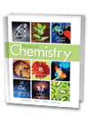


Chapter 9
Chemical Names and Formulas
Naming and Writing Formulas for
Ionic Compounds
Covalent Molecules
Acids and Bases
Law of Definite Proportions
Law of Multiple Proportions

Slide 3
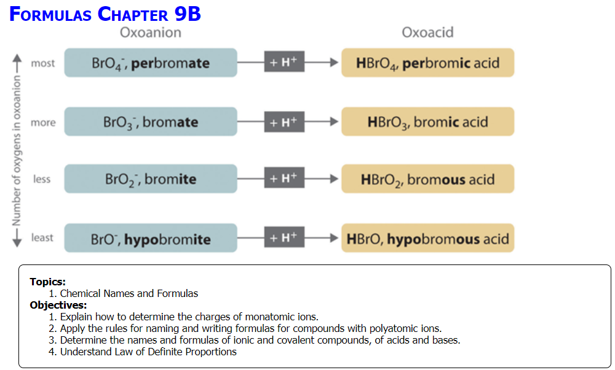

Slide 4
Naming and Making Chemical Formulas
If the formula is provided, name the compound or molecule.
If the formula name is provided, make the formula. (add a second name if appropriate)
Potassium nitride
Potassium chromate
 | Fe₂S₃
 | Ba(C₂H₃O₂)₂
 | Zn₃(PO₄)₂
 | NaBr
 | Cu(ClO₃)
Nitrogen dioxide
 | Hg₂Br₂
Hydrogen peroxide
Potassium hydroxide
 | PF₃
Notes:
Timing ≈ 1 min
Entry Audio: In this warm-up, we review the addition of positive and negative integers. Ionic compounds are made of a positive ion (cation) and a negative ion (anion). Stable ionic compounds are electrically neutral, meaning the overall charge of an ionic compound adds up to zero. While doing this activity, you will notice that the ratio of positive to negative ions can be different than one-to-one.
Exit Audio: Just like integers, oxidation numbers of ions are whole numbers that can be positive or negative. You should have noticed that each of the problems were set to equal zero just like the overall charge of an ionic compound. Last, adjusting the number of positive or negative ions to achieve a zero sum is similar to adjusting the ratio of positive and negative ions in an ionic compound to make the overall charge equal to zero.

Slide 5
Naming and Making Chemical Formulas
If the formula is provided, name the compound or molecule.
Potassium nitride | K⁺¹₃N⁻³
Potassium chromate | K⁺¹₂(CrO₄)⁻²
Ferric sulfide, Iron(III) sulfide, di-iron Trisulfide | Fe⁺³₂S⁻²₃
Barium acetate | Ba⁺²(C₂H₃O₂) ⁻¹₂
Zinc phosphate | Zn⁺²₃(PO₄) ⁻³₂
Sodium bromide | Na⁺¹Br⁻¹
Cuprous chlorate, Copper(I) chlorate, monocopper monochlorate | Cu⁺¹(ClO₃)⁻¹
Nitrogen dioxide, Nitrogen(IV) oxide | N⁺⁴O⁻²₂
Mercury(I) bromide, Mercurous bromide, dimercury dibromide | Hg⁺¹₂Br⁻¹₂
Hydrogen peroxide, dihydrogen dioxide | H⁺¹₂O⁻¹₂
Potassium hydroxide | K⁺¹(OH)⁻¹
Phosphorus TriFluoride | P⁺³F⁻¹₃
Notes:
Timing ≈ 1 min
Entry Audio: In this warm-up, we review the addition of positive and negative integers. Ionic compounds are made of a positive ion (cation) and a negative ion (anion). Stable ionic compounds are electrically neutral, meaning the overall charge of an ionic compound adds up to zero. While doing this activity, you will notice that the ratio of positive to negative ions can be different than one-to-one.
Exit Audio: Just like integers, oxidation numbers of ions are whole numbers that can be positive or negative. You should have noticed that each of the problems were set to equal zero just like the overall charge of an ionic compound. Last, adjusting the number of positive or negative ions to achieve a zero sum is similar to adjusting the ratio of positive and negative ions in an ionic compound to make the overall charge equal to zero.

Slide 6
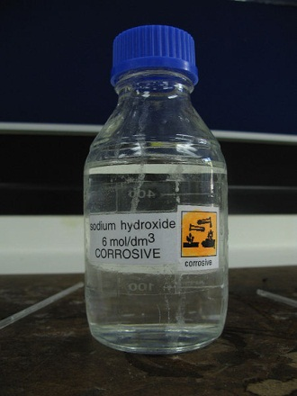
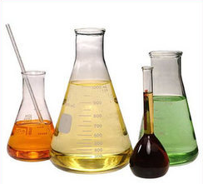
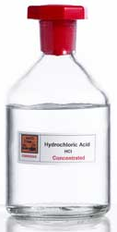
What Is the Method for Naming Acids & Bases?
Notes:
Timing ≈ 0.5 min
Recap: You now know the rules for naming general covalent compounds.
Connect: Two special classes of compounds, acids and bases, have some associated specific naming rules.
Preview: Next, you'll learn about the naming rules for acids and bases.
SOURCES:
https://commons.wikimedia.org/wiki/File:Acidic_drain_cleaner_containing_sulfuric_acid_%28sulphuric_acid%29.jpg
https://commons.wikimedia.org/wiki/File:Sodium_hydroxide_solution.jpg

Slide 7
Acids and Bases (overview of theory)
Acids:
  Increase concentration of H⁺ ions in aqueous (water) solution.
  May be ionic or covalent.
  Generally contain H atoms bonded to other atoms or to polyatomic ions.
  Properties:
  Turn blue litmus paper red.
  Taste sour.
Bases:
  Increase concentration of (OH)– ions in aqueous solution.
  Ionic bases contain OH– in formula.
  Properties:
  Turn red litmus paper blue.
  Feel slippery or soapy.
Notes:
Timing ≈ 2 min
Two common types of compounds are acids and bases. There are various ways to define these terms, but for the purposes of this lesson we will use the definitions shown here [animate first bullet on each side].
Acids are substances that increase the concentration of H+ ions in aqueous solution. Bases increase the concentration of OH- in solution.
[animate 2nd bullet on each side] both acids and bases may be ionic or covalent compounds.
[animate 3rd bullet under acids] Most acids contain hydrogen atoms bonded to as the only positive ion bonded to an ion with a negative charge. They may be covalently bonded, as in HCl, or ionically bonded, as in HNO3. In either case, the H atoms are released into solution as ions, causing the H+ concentration to increase.
[animate 3rd bullet under bases] Some bases are ionic compounds. These compounds contain the hydroxide ion. When they dissolve the hydroxide is released into solution, increasing the OH- concentration.
[animate 4th bullet under bases] However, covalent bases do not contain OH-. These substances raise the OH- concentration in water by accepting an H+ ion from the water molecules. This leaves behind OH- in solution.
[animate properties of acids] Acids have some specific, observable properties. They turn blue litmus paper red. They also taste sour, although you should never taste anything in the chemistry lab unless your teacher specifically tells you to do so. Many common sour foods, such as lemons and vinegar, are sour because they contain acids.
[animate properties of bases] Bases also have some common properties. They turn red litmus paper blue. They also feel slippery, although you should not touch any chemicals with your bare hands unless your teacher says you can. The slippery feel of bleach and ammonia is because both are basic solutions.

Slide 8

Naming Binary Acids
The simplest acids contain Hydrogen and we call these binary acids (example: HCl) which contains only 2 elements.
Acids donate an H+ ion in solution.
  For Naming, use → “hydro _____ ic acid"
  Start with hydro- to indicate H
  Add the root of the nonmetal
  Add -ic
Formula | Solid or Dry gas | Aqueous
HCl
HBr
HF
H₂S

Slide 9
Naming Binary Acids
The simplest acids contain Hydrogen and we call these binary acids (example: HCl) which contains only 2 elements
Acids donate an H+ ion in solution
  For Naming, use → “hydro _____ ic” acid (aq)
  Start with hydro- to indicate H
  Add the root of the nonmetal
  Add -ic
Formula | Solid or Dry gas | Aqueous
HCl | Hydrogen Chloride | Hydrochloric acid HCl aq
HBr | Hydrogen Bromide | Hydrobromic acid HBr aq
HF | Hydrogen Fluoride | Hydrofluoric acid HF aq
H₂S | Hydrogen Sulfide | Hydrosulfuric acid H₂S aq
Remember “hydrogen” in an acid does not follow the covalent molecule naming rules.

Slide 10
Naming Common Acids (non-binary)
Name | Name (anhydrous) | Formula
Sulfuric acid | Hydrogen Sulfate | H₂SO₄
Nitric acid | Hydrogen Nitrate | HNO₃
Acetic acid (Vinegar) | Hydrogen Acetate | HC₂H₃O₂
Phosphoric acid | Hydrogen Phosphate | H₃PO₄
Carbonic acid | Hydrogen Carbonate | H₂CO₃
  Many industrial processes, including steel and fertilizer manufacturing, use acids. Also, food and drink.

Slide 11
Naming Acids Containing Oxygen
These molecules end in “-ate” or “-ite”
Molecules are named based on the number of oxygens in the molecule
  Naming “oxyacids” when placed in water
  The “-ate” is changed to “-ic” OR
  the “-ite” is changed to “-ous”
 | Solid | aqueous | In Water
H₂SO₄ | Hydrogen Sulfate | H₂SO_{4 (aq)}
H₂SO₃ | Hydrogen Sulfite | H₂SO_{3 (aq)}

Slide 12
Naming Acids Containing Oxygen
These molecules end in “-ate” or “-ite”
Molecules are named based on the number of oxygens in the molecule
  Naming “oxyacids” when placed in water
  The “-ate” is changed to “-ic” OR
  the “-ite” is changed to “-ous”
 | Solid | aqueous | In Water
H₂SO₄ | Hydrogen Sulfate | H₂SO_{4 (aq)} | Sulfuric Acid
H₂SO₃ | Hydrogen Sulfite | H₂SO_{3 (aq)} | Sulfurous Acid

Slide 13
Sulfate Series
Dry or Gaseous State | Name | Aqueous State | Acid Name
H₂SO₅ |  | H₂SO_{5 (aq)}
H₂SO₄ |  | H₂SO_{4 (aq)}
H₂SO₃ |  | H₂SO_{3 (aq)}
H₂SO₂ |  | H₂SO_{2 (aq)}
  Use the “–ate” acid as the standard of comparison for the number of oxygen atoms. E.g. Hydrogen Sulfate becomes Sulfuric Acid.
  One more oxygen atom changes the name to “per” (above)
  One less oxygen atom changes the name to “-ite”
  Two less oxygen atoms changes the name to “hypo” (under) … “ite”

Slide 14
Sulfate Series
Dry or Gaseous State | Name | Aqueous State | Acid Name
H₂SO₅ | Hydrogen perSulfate | H₂SO_{5 (aq)} | PerSulfuric Acid
H₂SO₄ | Hydrogen Sulfate | H₂SO_{4 (aq)} | Sulfuric Acid
H₂SO₃ | Hydrogen Sulfite | H₂SO_{3 (aq)} | Sulfurous Acid
H₂SO₂ | Hydrogen hypoSulfite | H₂SO_{2 (aq)} | Hyposulfurous Acid
  Use the “–ate” acid as the standard of comparison for the number of oxygen atoms. E.g. Hydrogen Sulfate becomes Sulfuric Acid.
  One more oxygen atom changes the name to “per” (above)
  One less oxygen atom changes the name to “-ite”
  Two less oxygen atoms changes the name to “hypo” (under) … “ite”

Slide 15
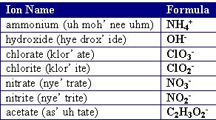
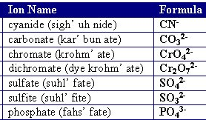
This convention works with any oxygen containing acids.
NO ⁻
NO₂⁻
NO₃⁻ Nitrate
NO₄⁻
Addition of another O
In water
  The “-ate” is changed to “-ic” OR
  the “-ite” is changed to “-ous”

Slide 16
This convention works with any oxygen containing acids.
NO ⁻ hyponitrite
NO₂⁻ Nitrite
NO₃⁻ Nitrate
NO₄⁻ pernitrate
Hyponitrous acid
Nitrous acid
Nitric acid
Pernitric acid
Addition of another O
In water (aq)
  The “-ate” is changed to “-ic” OR
  the “-ite” is changed to “-ous”

Slide 17
Chlorate Series
Dry or Gaseous State | Name | Aqueous State | Name
HClO₄ |  | HClO_{4 (aq)}
HClO₃ |  | HClO_{3 (aq)}
HClO₂ |  | HClO_{2 (aq)}
HClO |  | HClO _{(aq)}
Phosphate Series
Dry or Gaseous State | Name | Aqueous State | Name
H₃PO₅ |  | H₃PO_{5 (aq)}
H₃PO₄ |  | H₃PO_{4 (aq)}
H₃PO₃ |  | H₃PO_{3 (aq)}
H₃PO₂ |  | H₃PO_{2 (aq)}

Slide 18
Chlorate Series
Dry or Gaseous State | Name | Aqueous State | Name
HClO₄ | Hydrogen perchlorate | HClO_{4 (aq)} | Perchloric Acid
HClO₃ | Hydrogen Chlorate | HClO_{3 (aq)} | Chloric Acid
HClO₂ | Hydrogen Chlorite | HClO_{2 (aq)} | Chlorous Acid
HClO | Hydrogen hypoChlorite | HClO _{(aq)} | HypoChlorous Acid
Phosphate Series
Dry or Gaseous State | Name | Aqueous State | Name
H₃PO₅ | Hydrogen Perphosphate | H₃PO_{5 (aq)} | Perphosphoric Acid
H₃PO₄ | Hydrogen Phosphate | H₃PO_{4 (aq)} | Phosphoric Acid
H₃PO₃ | Hydrogen Phosphite | H₃PO_{3 (aq)} | Phosphorous Acid
H₃PO₂ | Hydrogen hypoPhosphite | H₃PO_{2 (aq)} | HypoPhosphorous Acid

Slide 19
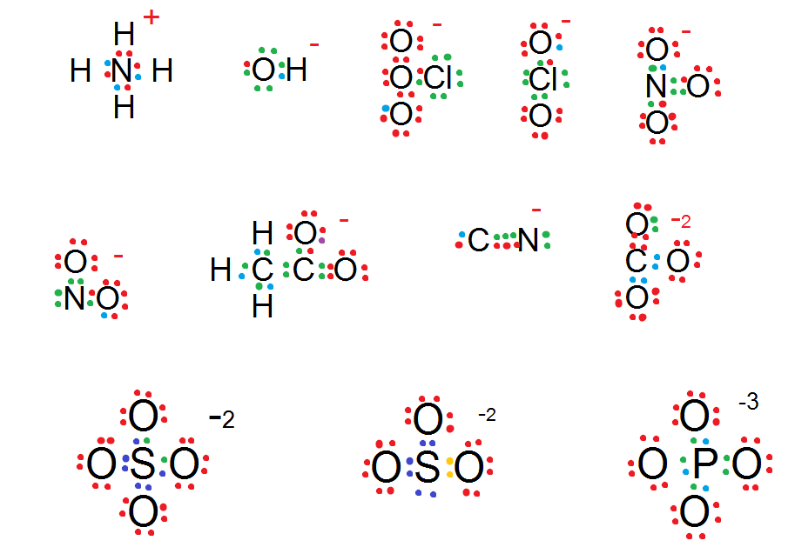
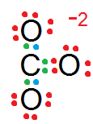
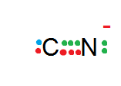

              Polyatomic Ion Lewis Structures
All of these polyatomic ions can form acid in water.
Ammonium Hydroxide Chlorate Chlorite Nitrate
Nitrite Acetate Cyanide Carbonate
Sulfate Sulfite Phosphate

Slide 20
Name the Acid or Give its Formula
HNO_{2 (aq)}
HI _{(aq)}
HClO_{4 (aq)}
HClO _{(aq)}
HCN _{(aq)} (cyanide)
Carbonic acid in carbonated beverages
Hydrofluoric acid
Phosphoric acid in soft drinks, teeth whitener, preserving foods
Notes:
Timing ≈ 1 min
Entry audio: Apply what you have learned about naming acids to answer these questions.
Hint1 audio: Remember that oxyacids do not contain the prefix hydro.
Exit audio: Just as there are rules for naming acids, there are rules for naming bases.

Slide 21
Name the Acid or Give its Formula
HNO_{2 (aq)}
nitrous acid
HI _{(aq)}
hydroiodic acid
HClO_{4 (aq)}
perchloric acid
HClO _{(aq)}
hypochlorous acid
HCN _{(aq)} (cyanide)
hydrocyanic acid (treated as binary)
Carbonic acid in carbonated beverages
H₂CO_{3 (aq)}
Hydrofluoric acid
HF _{(aq)}
Phosphoric acid in soft drinks, teeth whitener, preserving foods
H₃PO_{4 (aq)}
Notes:
Timing ≈ 1 min
Entry audio: Apply what you have learned about naming acids to answer these questions.
Hint1 audio: Remember that oxyacids do not contain the prefix hydro.
Exit audio: Just as there are rules for naming acids, there are rules for naming bases.

Slide 22
Naming Bases
Simple bases are ionic compounds which produce hydroxide ions (OH)– when dissolved in water (aq).
Bases are named in the same way as other ionic compounds → the name of the cation is followed by the name of the anion.
Sodium hydroxide (NaOH) dissociates into sodium cations (Na⁺) and hydroxide anions (OH)–.
Formula | Base Name
NaOH aq
KOH aq
Ca(OH)₂ aq

Slide 23
Naming Bases
Simple bases are ionic compounds which produce hydroxide ions (OH)– when dissolved in water.
Bases are named in the same way as other ionic compounds → the name of the cation is followed by the name of the anion.
Sodium hydroxide (NaOH) dissociates into sodium cations (Na⁺) and hydroxide anions (OH)–.
Formula | Base Name
NaOH aq | Sodium hydroxide
KOH aq | Potassium hydroxide
Ca(OH)₂ aq | Calcium hydroxide

Slide 24
Naming Bases
To write the formula for a base:
Write the symbol for the metal cation
Then write the formula for the hydroxide ion.
Then, balance the ionic charges just as you would for any ionic compound.
Write the formula and give the name for the base formed when Aluminum is dissolved in water:

Slide 25
Naming Bases
To write the formula for a base:
Write the symbol for the metal cation
Then write the formula for the hydroxide ion.
Then, balance the ionic charges just as you would for any ionic compound.
Write the formula and give the name for the base formed when Aluminum is dissolved in water:
Aluminum cation (Al³⁺) hydroxide anion (OH)–
Al³⁺(OH)–
Aluminum hydroxide: Al(OH)_{3 (aq)}

Slide 26
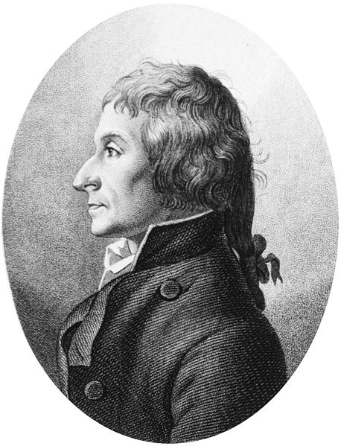
The Law of Definite Proportions
  Proust’s discovery:
  Samples of a compound have the same ratio of elements.
  CopperII carbonate was composed of 1 part carbon, 4 parts oxygen, and 5 parts copper by weight.
  Law of definite proportions: pure reactants always combine in the same proportion to produce a given substance.
Notes:
Timing ≈ 1 min
Dalton’s work was based on that of [Animate stem and picture] Joseph Proust, a Frenchman, who had discovered [Animate bullet 1] that regardless of whether a sample of copper carbonate was created in the lab or obtained from nature, the compound was composed of 1 part carbon, 4 parts oxygen, and 5 parts copper by weight.
[Animate bullet 2] This allowed Proust to theorize that pure reactants always combine in the same proportion to produce the same substance, in other words, Proust had discovered that each compound contains the exact same proportion of elements by mass. Proust’s ‘Law of Definite Proportions’ provided a foundation for Dalton’s work on determining the structure of the atom, which in turn, helped explain Proust’s findings.
source: http://commons.wikimedia.org/wiki/File:Proust_joseph.jpg

Slide 27
The Law of Definite Proportions
  CopperII carbonate was composed of 1 part carbon, 4 parts oxygen, and 5 parts copper by weight. Prove definite proportions.
Notes:
Timing ≈ 1 min
Dalton’s work was based on that of [Animate stem and picture] Joseph Proust, a Frenchman, who had discovered [Animate bullet 1] that regardless of whether a sample of copper carbonate was created in the lab or obtained from nature, the compound was composed of 1 part carbon, 4 parts oxygen, and 5 parts copper by weight.
[Animate bullet 2] This allowed Proust to theorize that pure reactants always combine in the same proportion to produce the same substance, in other words, Proust had discovered that each compound contains the exact same proportion of elements by mass. Proust’s ‘Law of Definite Proportions’ provided a foundation for Dalton’s work on determining the structure of the atom, which in turn, helped explain Proust’s findings.
source: http://commons.wikimedia.org/wiki/File:Proust_joseph.jpg

Slide 28
The Law of Definite Proportions
  CopperII carbonate was composed of 1 part carbon, 4 parts oxygen, and 5 parts copper by weight:
  Cu⁺²(CO₃)⁻² total mass of 124 g/mol (see periodic table)
  Cu (~64 g/mol) Carbon (12 g/mol) Oxygen 3(16) = 48 g/mol
  64/124 = .5 12/124 = 0.1 48/124 = 0.4
  0.1 : 0.4 : 0.5 = 1 : 4 : 5
  Law of definite proportions: Copper, carbon, and oxygen will always combine in the same proportion to produce Cu⁺²(CO₃)⁻².
Notes:
Timing ≈ 1 min
Dalton’s work was based on that of [Animate stem and picture] Joseph Proust, a Frenchman, who had discovered [Animate bullet 1] that regardless of whether a sample of copper carbonate was created in the lab or obtained from nature, the compound was composed of 1 part carbon, 4 parts oxygen, and 5 parts copper by weight.
[Animate bullet 2] This allowed Proust to theorize that pure reactants always combine in the same proportion to produce the same substance, in other words, Proust had discovered that each compound contains the exact same proportion of elements by mass. Proust’s ‘Law of Definite Proportions’ provided a foundation for Dalton’s work on determining the structure of the atom, which in turn, helped explain Proust’s findings.
source: http://commons.wikimedia.org/wiki/File:Proust_joseph.jpg

Slide 29
The Law of Definite Proportions
  Example Set Up:
  Magnesium sulfide (MgS) is composed of magnesium cations and sulfide anions.
  Use the periodic table and “molar” masses of the elements
  Mg = ?
  S = ?
  The Mg:S ratio of these masses is ?

Slide 30
The Law of Definite Proportions
  Example Set Up:
  Magnesium sulfide (MgS) is composed of magnesium cations and sulfide anions.
  Use the periodic table and “molar” masses of the elements
  Mg = 24.3 g/mol
  S = 32.1 g/mol
  The Mg:S ratio of these masses is 24.3/32.1 or 0.757:1; this ratio never changes.

Slide 31
The Law of Definite Proportions
  Example:
  Magnesium sulfide (MgS) is composed of magnesium cations and sulfide anions.
  When a 100.00 g sample of magnesium sulfide is decomposed into its elements, 43.13 g of magnesium and 56.87 g of sulfur result.
  The Mg:S ratio of these masses is 43.13 / 56.87 or 0.758 : 1; this ratio never changes.
  Magnesium sulfide obeys the Law of Definite Proportions, which states that in samples of any chemical compound, the masses of the elements are always in the same proportions.

Slide 32
Law of Multiple Proportions (Dalton)
  When one element combines with another to form more than one compound, the mass ratios of the elements in the compounds are simple whole numbers of each other.
  Law of Definite Proportions compares S to O within EACH compound.
  Sulfate series SO₄⁻² … SO₅⁻² , SO₄⁻² , SO₃⁻² , SO₂⁻²
  Law of Multiple Proportions compares the amount of “Oxygen” BETWEEN each compound.

Slide 33
Law of Multiple Proportions (Dalton)
  When one element combines with another to form more than one compound, the mass ratios of the elements in the compounds are simple whole numbers of each other.
  Phosphate series PO₄⁻³ … PO₅⁻³ , PO₄⁻³ , PO₃⁻³ , PO₂⁻³
  Chlorate series ClO₃⁻¹ … ClO₄⁻¹ , ClO₃⁻¹ , ClO₂⁻¹ , ClO⁻¹
  Nitrate series NO₃⁻¹ … NO₄⁻¹ , NO₃⁻¹ , NO₂⁻¹ , NO⁻¹
  Consider the ratio of “Oxygen” BETWEEN each compound.

Slide 34
Law of Multiple Proportions (Dalton)
  When two elements combine to form more than one compound, the masses of one element which combines with a fixed mass of the other element are in a ratio of small whole numbers.
  Two familiar compounds:
  water, H₂O and hydrogen peroxide H₂O₂,
  are formed from the same two elements.
  Although these compounds are formed by the elements hydrogen and oxygen, they have different physical and chemical properties.

Slide 35
Law of Multiple Proportions (Dalton)
  Two familiar compounds, water, H₂O, and hydrogen peroxide H₂O₂, are formed from the same two elements.
  DEFINITE PROPORTIONS:
  In hydrogen peroxide, H₂O₂, ___ g of oxygen are present for ___ g of hydrogen. The mass ratio of oxygen to hydrogen is always ___.
  In water, H₂O, the mass ratio of oxygen to hydrogen is always ___ or ___.
  MULTIPLE PROPORTIONS:
__ g O (in H₂O₂ sample that has 1 g H)
=
=
= ___
__ g O (in H₂O sample that has 1 g H)

Slide 36
Law of Multiple Proportions (Dalton)
  Two familiar compounds, water, H₂O, and hydrogen peroxide H₂O₂, are formed from the same two elements.
  DEFINITE PROPORTIONS:
  In hydrogen peroxide, H₂O₂, 32.0 g of oxygen are present for 2.0 g of hydrogen. The mass ratio of oxygen to hydrogen is always 16:1.
  In water, H₂O, the mass ratio of oxygen to hydrogen is always 16:2 or 8:1.
  MULTIPLE PROPORTIONS:
16 g O (in H₂O₂ sample that has 1 g H)
16
2
=
=
= 2:1
8 g O (in H₂O sample that has 1 g H)
8
1

Slide 37
Laws of Definite & Multiple Proportion Application
The small paper clip’s mass is 0.5 g, the large 1.5 g
Determine the Definite & Multiple Proportions:
Definite Proportion Multiple Proportion
Comparing # of small clips in first molecule to the other molecules
_____ : _____
_____ : _____ ____ : ____
_____ : _____ ____ : ____
_____ : _____ ____ : ____

Slide 38
Laws of Definite & Multiple Proportion Application
The small paper clip’s mass is 0.5 g, the large 1.5 g
Determine the Definite & Multiple Proportions:
Definite Proportion Multiple Proportion
AX
0.5 g
1.5 g
__1__ : __3__
[E.g. CO, NO, PbO]
0.5 g / 1.5 g
0.5 g
AX₂
0.5 g
1.5 g
__2__ : __3__ __1_ : __2__
2(0.5 g) / 1.5 g
[E.g. CO₂, ClO₂, SO₂, NO₂]
AX₃
0.5 g
0.5 g
0.5 g
1.5 g
__3__ : __3__ __1_ : __3__
3(0.5 g) / 1.5 g
[E.g. CO₃, ClO₃, SO₃, NO₃, PO₃]
AX₄
0.5 g
0.5 g
__4__ : __3__ __1_ : __4__
1.5 g
0.5 g
0.5 g
4(0.5 g) / 1.5 g
[E.g. ClO₄, SO₄, PO₄, CrO₄]

Slide 39
Laws of Definite & Multiple Proportion Application
Definite proportions compares the mass of the elements WITHIN the same molecule.
(small paper clip : large paper clip)
Multiple proportions compares the mass of same element BETWEEN different molecules.
(the SMALL paper clip in the first compound
to the SMALL paper clip in the other compounds)

Slide 40
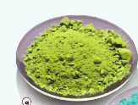
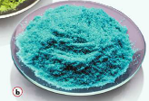
Laws of Definite & Multiple Proportion Application
Cu⁺¹Cl⁻¹
Cu⁺²Cl₂⁻¹
Definite proportions compares the mass of the two elements WITHIN the same molecule.
    Copper(I) chloride [CuCl] and copper (II) chloride [CuCl₂] both contain chlorine. We can compare the mass of copper to chlorine WITHIN each molecule (Definite Proportions).
Multiple proportions compares the mass of same element BETWEEN different molecules.
    We can compare the mass of chlorine to chlorine BETWEEN each molecule (Multiple Proportions).

Slide 41
Laws of Definite & Multiple Proportion Application
Fixed mass of Nitrogen | Empirical Formula | General Formula | Mass of Oxygen reacted with 1 g Nitrogen | Ratio of Oxygen to Oxygen
N₂O | N₂O | A₂B | ? 16 g/28 g | ?
N₂O₂ | NO | AB | ? 32 g/28 g | ?
N₂O₃ | N₂O₃ | A₂B₃ | ? 48 g/28 g | ?
N₂O₄ | NO₂ | AB₂ | ? 64 g/28 g | ?
N₂O₅ | N₂O₅ | A₂B₅ | ? 80 g/28 g | ?
Chlorate series [give the multiple proportion of each series]
perchlorate (ClO₄⁻), chlorate (ClO₃⁻), chlorite (ClO₂⁻), hypochlorite (ClO⁻)
Phosphate series
perphosphate (PO₅⁻³), phosphate (PO₄⁻³), phosphite (PO₃⁻³), hypophosphite (PO₂⁻³)
Chromate series
perchromate (CrO₅⁻²), chromate (CrO₄⁻²), chromite (CrO₃⁻²), hypochromite (CrO₂⁻²)

Slide 42
Laws of Definite & Multiple Proportion Application
Definite Proportions
Multiple Proportions
Fixed mass of Nitrogen | Empirical Formula | General Formula | Mass of Oxygen reacted with 1 g Nitrogen | Ratio of Oxygen to Oxygen
N₂O | N₂O | A₂B | 0.5711 16g/28g | 1
N₂O₂ | NO | AB | 1.1422 32g/28g | 2
N₂O₃ | N₂O₃ | A₂B₃ | 1.7134 48g/28g | 3
N₂O₄ | NO₂ | AB₂ | 2.2845 64g/28g | 4
N₂O₅ | N₂O₅ | A₂B₅ | 2.8557 80g/28g | 5
Chlorate series [4:3:2:1]
perchlorate (ClO₄⁻), chlorate (ClO₃⁻), chlorite (ClO₂⁻), hypochlorite (ClO⁻)
Phosphate series [5:4:3:2]
perphosphate (PO₅⁻³), phosphate (PO₄⁻³), phosphite (PO₃⁻³), hypophosphite (PO₂⁻³)
Chromate series [5:4:3:2]
perchromate (CrO₅⁻²), chromate (CrO₄⁻²), chromite (CrO₃⁻²), hypochromite (CrO₂⁻²)

Slide 43
Calculating Mass Ratios
Carbon (C) reacts with oxygen (O) to form two compounds.
Compound A contains 2.41 g of carbon for each 3.22 g of oxygen.
Compound B contains 6.71 g of carbon for each 17.9 g of oxygen.
Are these the same compound? What is the lowest whole-number mass ratio of carbon that combines with a given mass of oxygen for compounds A and B?
Practice problem

Slide 44
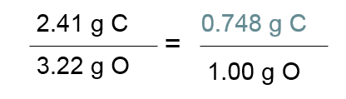
Calculating Mass Ratios
Carbon (C) reacts with oxygen (O) to form two compounds.
Compound A contains 2.41 g of carbon for each 3.22 g of oxygen.
Compound B contains 6.71 g of carbon for each 17.9 g of oxygen.
Practice problem
First, calculate grams of carbon per gram of oxygen in compound A. (Definite Proportions)
Then, calculate grams of carbon per gram of oxygen in compound B. (Definite Proportions)
6.71 g C
=
0.375 g C
17.9 g O
1.00 g O

Slide 45
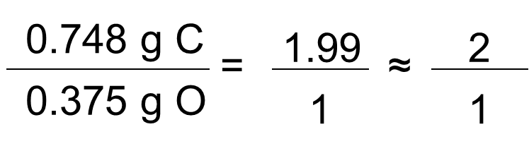
Practice problem
Since the definite proportion ratios are not the same, the two compounds are not the same.
Compound A 0.748:1 C = 12 g/mol
Compound B 0.375:1 O = 16 g/mol 12/16 = 0.748
Calculate the mass ratio to compare the two compounds.
Express the mass ratio as the lowest whole-number ratio. The mass ratio of carbon per gram of oxygen in the two compounds is 2:1. These molecules could be CO₂ and CO.

Slide 46
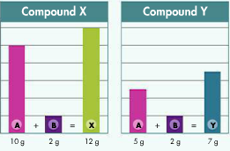
Are compound X and Y the same compound?
What is the mass ratio of element A in the two compounds?
Explain your answers.

Slide 47
Are compound X and Y the same compound?
What is the mass ratio of element A in the two compounds?
Explain your answers.
DEFINITE PROPORTIONS:
Since element B is the same (2 g) in both compounds, we can focus on element A to answer this question.
  Mass ratio of elements (A:B) →
  10 g / 2 g = 5 : 1 in compound X, but
  5 g / 2 g = 2.5 : 1 in compound Y,
  showing that “X” and “Y” are DIFFERENT compounds.

Slide 48
Are compound X and Y the same compound?
What is the mass ratio of element A in the two compounds?
Explain your answers.
10 g / 2 g = 5 : 1 in compound X,
5 g / 2 g = 2.5 : 1 in compound Y
MULTIPLE PROPORTIONS:
Compound X → A₂B
Compound Y → AB
5 g O “A” (in “X” sample that has 1 g B)
5
2
= 2:1
=
=
2.5 g “A” (in “Y” sample that has 1 g B)
2.5
1

Slide 49
Laws of Definite & Multiple Proportion Application
Two compounds contain hydrogen and oxygen. Compound 1 contains 2 grams of hydrogen and 16 grams of oxygen. Compound 2 contains 4 grams of hydrogen and 64 grams of oxygen. Are these compounds the same? If not, what are they? [Show the laws of definite and multiple proportions.]

Slide 50
Laws of Definite & Multiple Proportion Application
Two compounds contain hydrogen and oxygen. Compound 1 contains 2 grams of hydrogen and 16 grams of oxygen. Compound 2 contains 4 grams of hydrogen and 64 grams of oxygen. Are these compounds the same? If not, what are they? [Show the laws of definite and multiple proportions.]
DEFINITE PROPORTIONS:
Compound 1
Hydrogen : Oxygen = 2 g : 16 g = 1:8
Compound 2
Hydrogen : Oxygen = 4 g : 64 g = 1:16

Slide 51
Laws of Definite & Multiple Proportion Application
Two compounds contain hydrogen and oxygen. Compound 1 contains 2 grams of hydrogen and 16 grams of oxygen. Compound 2 contains 4 grams of hydrogen and 64 grams of oxygen. Are these compounds the same? If not, what are they? [Show the laws of definite and multiple proportions.]
MULTIPLE PROPORTIONS:
16 g O (per 1 g H)
16
2
= 2:1
=
=
8 g O (per 1 g H)
8
1
The ratio of the mass of oxygen in the two compounds is exactly 2:1 meaning that one molecule has 2 times the oxygen by mass. This is Multiple Proportions.
H₂O and H₂O₂

Slide 52
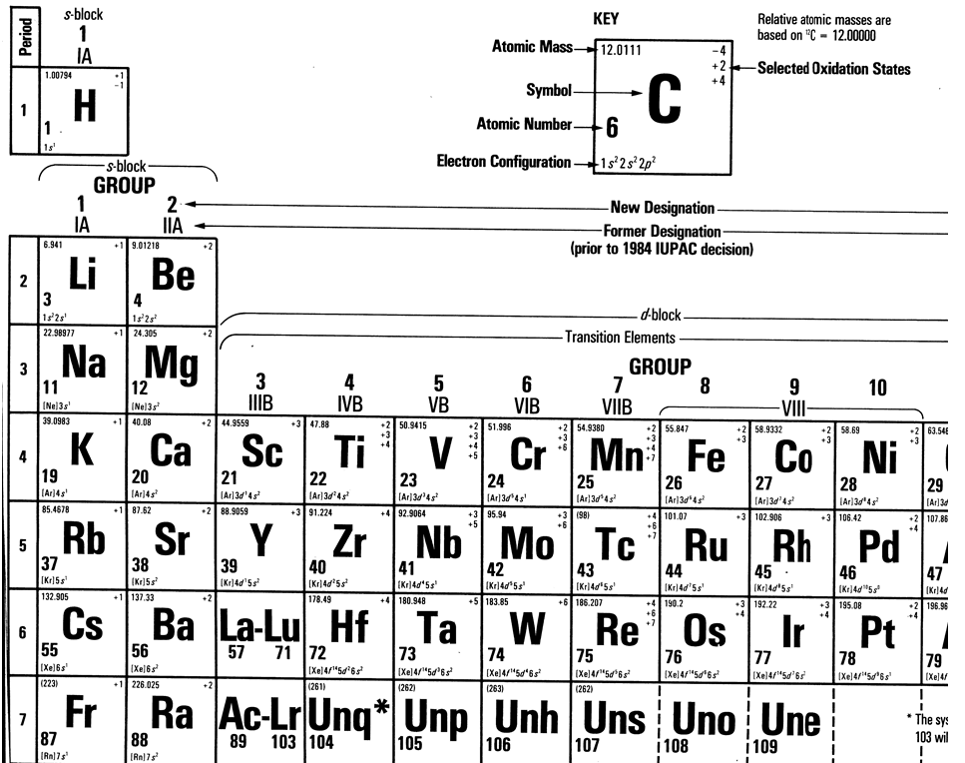

Slide 53
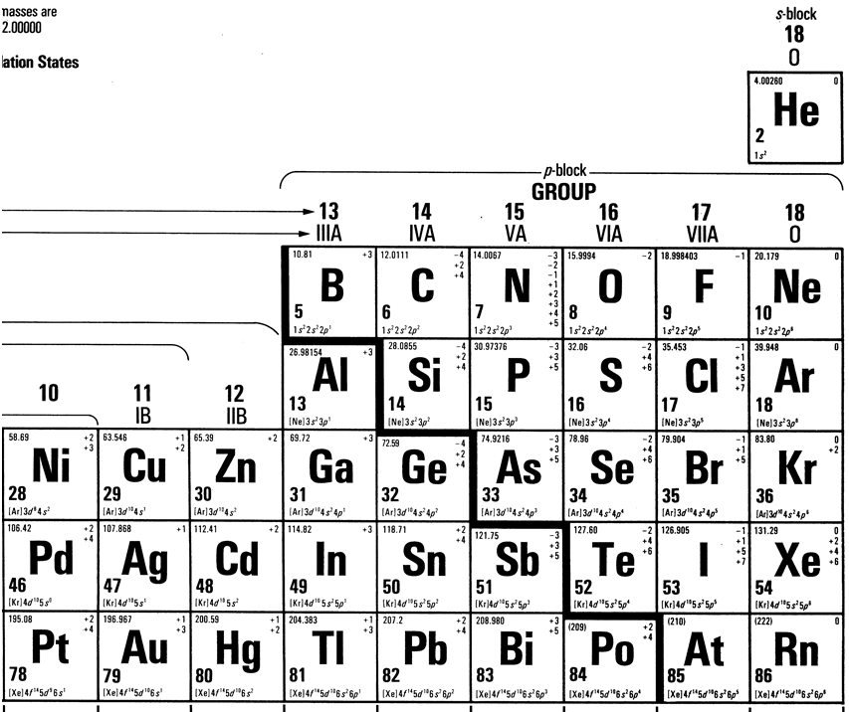

Slide 54
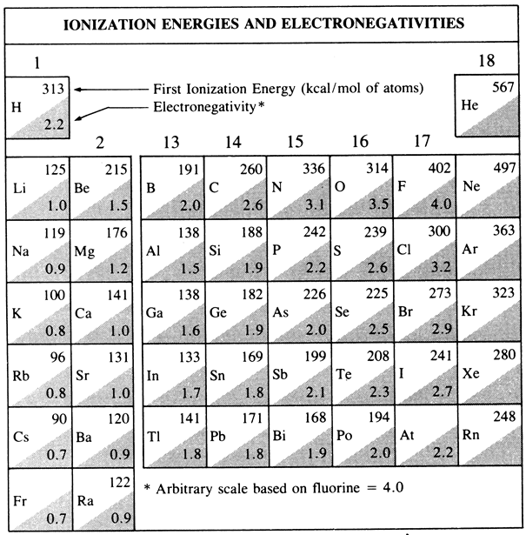

Slide 55
