Slide 1
Go to the “Slide Show” shade above
Click on “Play from Beginning”

Slide 2

Chapter 1: Introduction to BIOLOGY

Slide 3
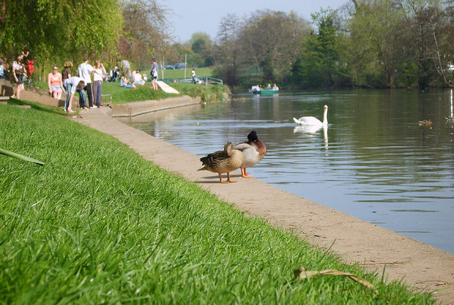
Lesson Objectives
Discuss the Characteristics of all Living Organisms.
Explore the principles and practices of the Scientific Method.

Slide 4
Activity
List or come up with a model, sketch, diagram of “What defines Life?” or “What characterizes Life?” or “What constitutes living things?”

Slide 5
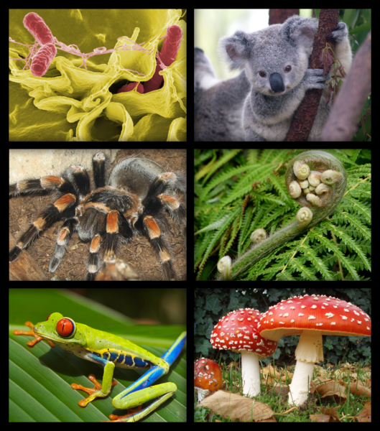
What is Biology?
Biology is the scientific study of LIFE
Living things are called Organisms
Organisms include bacteria, protists, fungi, plants, and animals

Slide 6
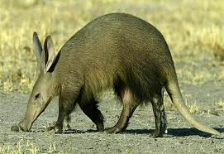
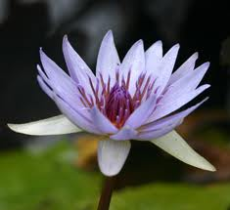
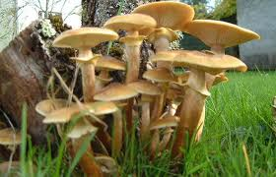
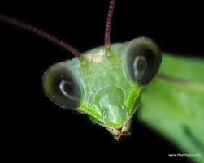
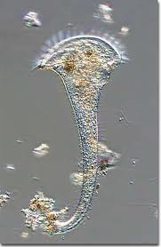
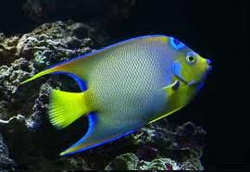
The Characteristics of Life
All organisms….
…no matter how different from each other they may be….
….share a set of common characteristics.

Slide 7
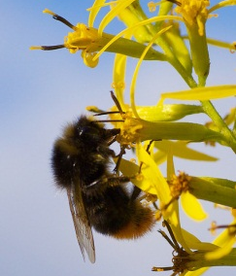
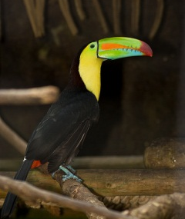
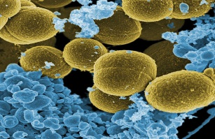
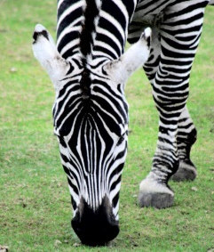
Diversity of Life
Microscopic bacteria

Slide 8
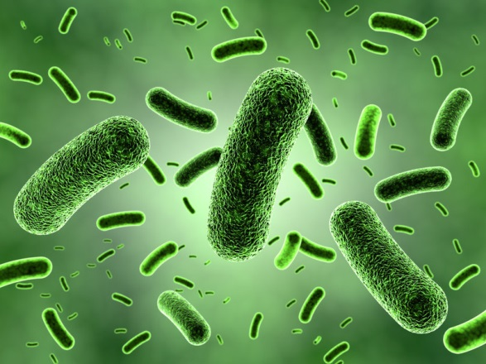
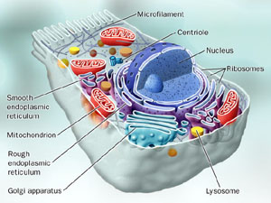
1) All Organisms are Made of Cells:
Cells: structural and functional units of life
Two Basic Types:
  Prokaryotic:
    “Simpler cells”
    E.g. Bacteria
  Eukaryotic:
    Internal organelles with membranes
    Nucleus with DNA
    E.g. Plants, Animals, Fungi, Protists

Slide 9
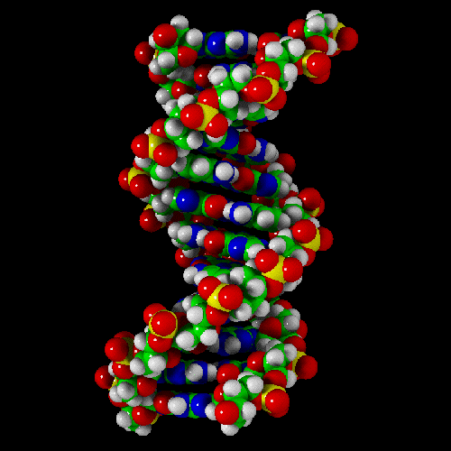
2) All organisms contain DNA in their Cells
DNA (deoxyribonucleic acid) is the chemical substance of genes.
Genes are the units of inheritance that transmit information from parents to offspring.
Genes control ALL the activities of the cells.
DNA is the reason that all organisms look and act the way they do. It is what makes all organisms unique.

Slide 10
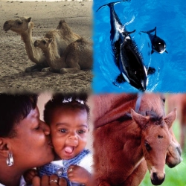
3) All Organisms Reproduce
Ability of organisms to reproduce their own kind
Reproduction is controlled by DNA

Slide 11
4) All Organisms are Complex & Organized
Largescale Levels of Organization:
  Biosphere—all of the environments on Earth that support life
  Ecosystem—all the organisms living in a particular area and the physical components with which the organisms interact
  Community—the entire array of organisms living in a particular ecosystem
  Population—all the individuals of a species living in a specific area

Slide 12
4) All Organisms are Complex & Organized
Levels of Organization for Individuals:
  Organism—an individual living thing
  System—several organs that cooperate in a specific function
  Organ—a structure that is composed of tissues
  Tissue—a group of similar cells that perform a specific function
  Cell—the fundamental unit of life
  Molecule—a cluster of small chemical units called atoms held together by chemical bonds

Slide 13
Levels of Organization
Cell
Tissue
Organ
Organ system
Organism
Notes:
Timing ≈ 0.5
[Animations: 5]
There are five levels of organization inside an organism.
These levels perform specific functions for the organism and are listed in hierarchical order from the smallest unit to the largest, most complex unit: cell, tissue, organ, organ system, organism. [explain how the build on each other.]
SOURCES:

Slide 14
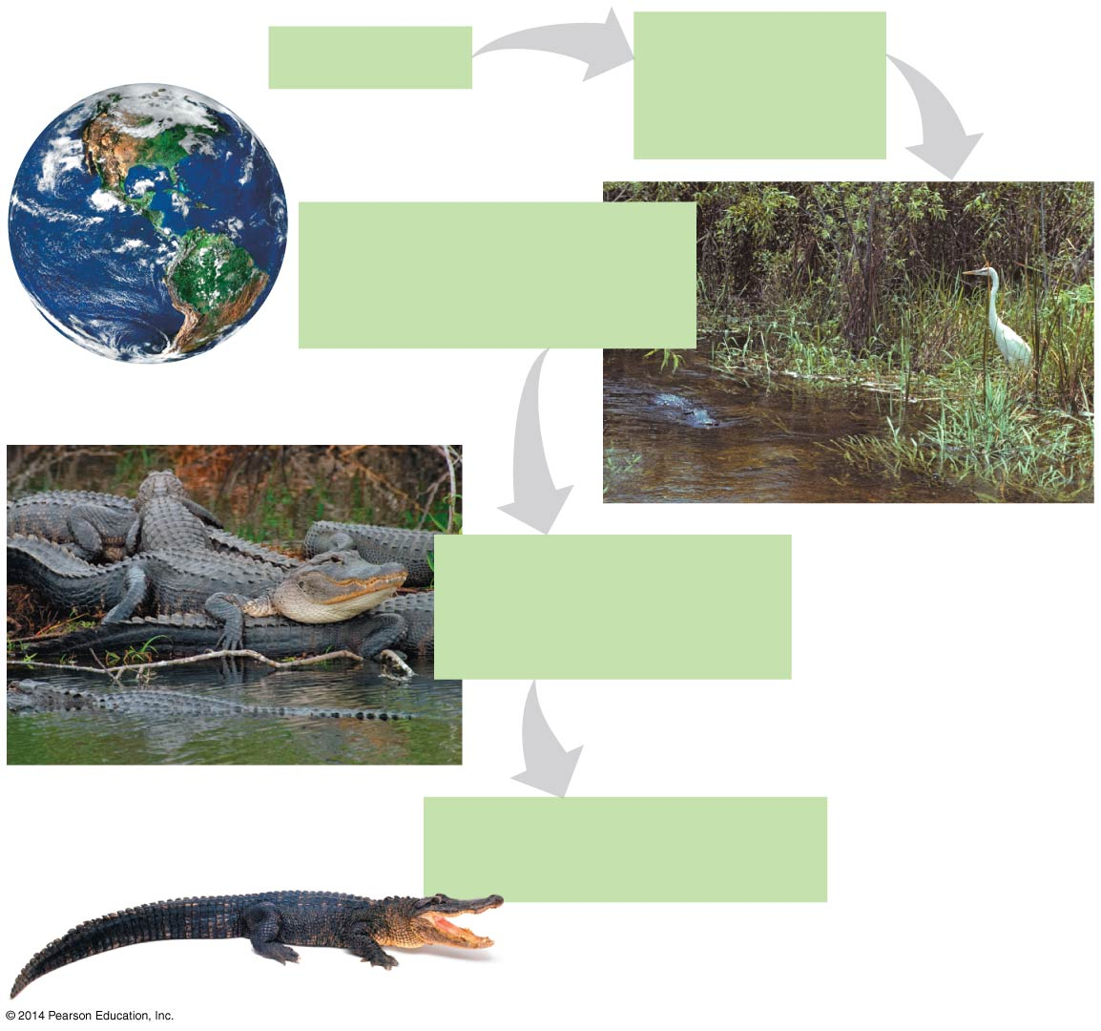
Figure 1.2-1
Biosphere
Ecosystem
Florida
Everglades
Florida
Community
All organisms in this
wetland ecosystem
Population
All alligators living
in the wetlands
Organism
an American alligator

Slide 15
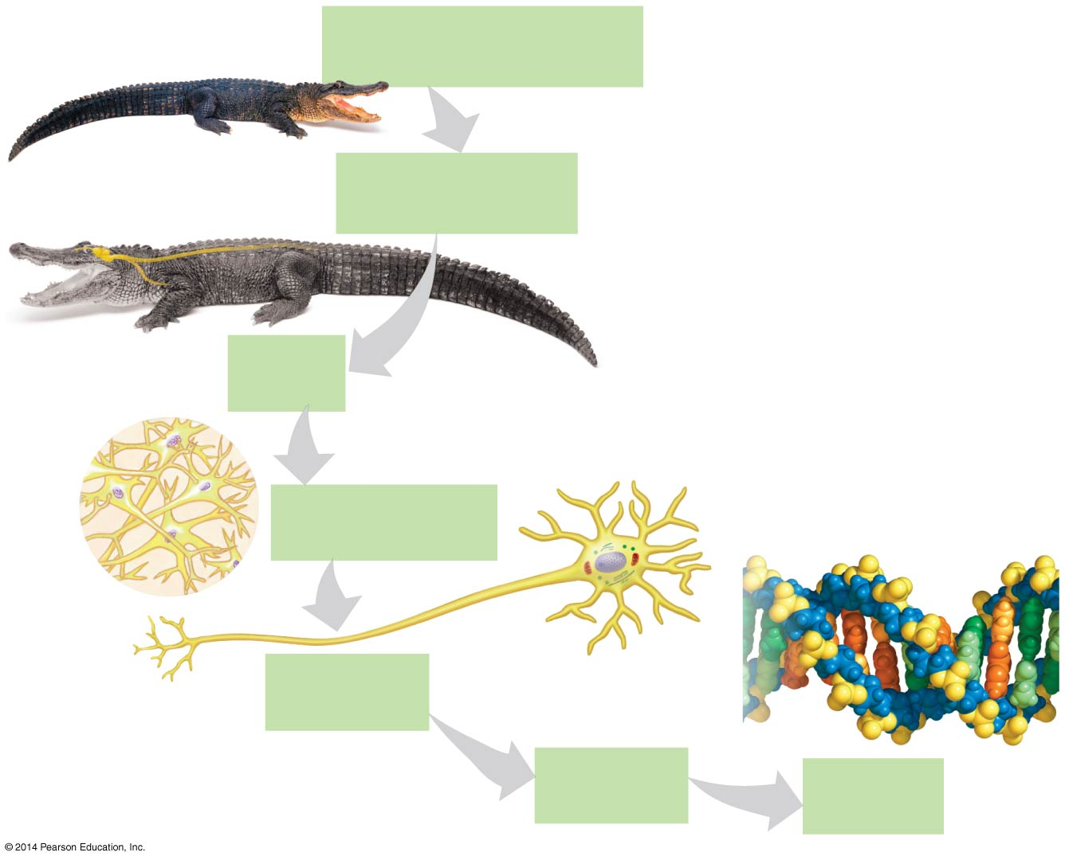
Figure 1.2-2
Organism
an American alligator
Spinal
cord
Organ system
Nervous system
Nerve
Brain
Organ
Brain
Tissue
Nervous tissue
Atom
Cell
Nerve cell
Nucleus
Organelle
Nucleus
Molecule
DNA
Notes:
Figure 1.2-2 Life’s hierarchy of organization (part 2)

Slide 16
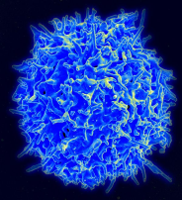
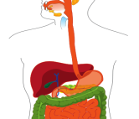
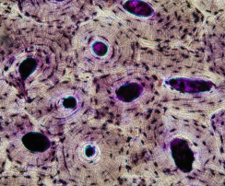
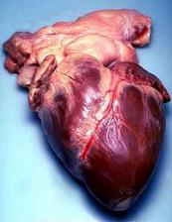
Identify the Levels of Organization in a Multicellular Organism
For each picture shown, choose the level of organization depicted.
Image by Reytan
1 2
3 4
Notes:
#frame
Timing ≈ 1 min
Entry audio: You now should be able to identify the level of organization in multicellular organisms. For each picture shown, label the level of organization depicted.
Hint audio: Remember that tissue is made of many microscopic cells and that organ systems contain many organs that work together.
Exit audio: The only level of organization not shown is an organism, which is a complete living being — like you!
SOURCES:
Healthy Human T Cell. “Healthy Human T Cell.jpg,” National Institute of Health. 2010 as PD, Digital Image. http://commons.wikimedia.org/wiki/File:Healthy_Human_T_Cell.jpg (accessed March 16, 2012).
Compact bone tissue. “Compact bone - ground cross section.jpg,” Reytan. 2006 as CC-SA/GNU, Digital Image. http://commons.wikimedia.org/wiki/File:Compact_bone_-_ground_cross_section.jpg (accessed March 16, 2012).
Human heart. “Humhrt2.jpg,” Stanwhit607. 2007 as PD, Digital Image. http://commons.wikimedia.org/wiki/File:Humhrt2.jpg (accessed March 16, 2012).
Digestive system. “Digestive system whitout labels.svg,” Mariana Ruiz Villarreal. 2008 as PD, Digital Image. http://commons.wikimedia.org/wiki/File:Digestive_system_whitout_labels.svg (accessed March 16, 2012).

Slide 17
Identify the Levels of Organization in a Multicellular Organism
For each picture shown, choose the level of organization depicted.
Cell
Organ system
Tissue
organ
Image by Reytan
1 2
3 4
Notes:
#frame
Timing ≈ 1 min
Entry audio: You now should be able to identify the level of organization in multicellular organisms. For each picture shown, label the level of organization depicted.
Hint audio: Remember that tissue is made of many microscopic cells and that organ systems contain many organs that work together.
Exit audio: The only level of organization not shown is an organism, which is a complete living being — like you!
SOURCES:
Healthy Human T Cell. “Healthy Human T Cell.jpg,” National Institute of Health. 2010 as PD, Digital Image. http://commons.wikimedia.org/wiki/File:Healthy_Human_T_Cell.jpg (accessed March 16, 2012).
Compact bone tissue. “Compact bone - ground cross section.jpg,” Reytan. 2006 as CC-SA/GNU, Digital Image. http://commons.wikimedia.org/wiki/File:Compact_bone_-_ground_cross_section.jpg (accessed March 16, 2012).
Human heart. “Humhrt2.jpg,” Stanwhit607. 2007 as PD, Digital Image. http://commons.wikimedia.org/wiki/File:Humhrt2.jpg (accessed March 16, 2012).
Digestive system. “Digestive system whitout labels.svg,” Mariana Ruiz Villarreal. 2008 as PD, Digital Image. http://commons.wikimedia.org/wiki/File:Digestive_system_whitout_labels.svg (accessed March 16, 2012).

Slide 18
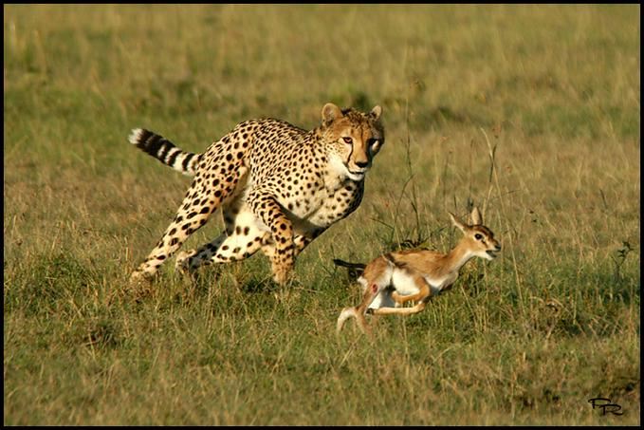
5) All Organisms Respond to their Environment
Organisms Respond to environmental stimuli (Temperature, Water, Food Supplies, etc.) in order to Survive and Reproduce
The ability to respond is controlled by Receptors.
Helps them to locate food, find shelter and find a mate.

Slide 19
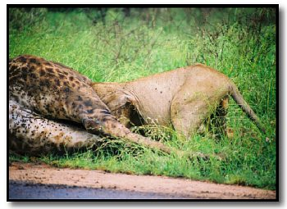
6) All Organisms Interact with their Environment, exchanging Matter & Energy

Slide 20
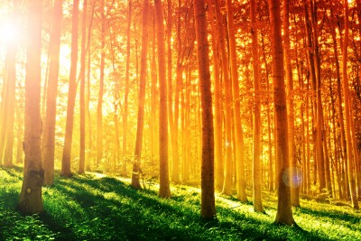
6) All Organisms Interact with their Environment, exchanging Matter & Energy
Metabolism:
Process by which an organism extracts energy from its surroundings and uses it to sustain itself.
All organisms require energy
Sunlight is the ultimate energy source for life on Earth

Slide 21
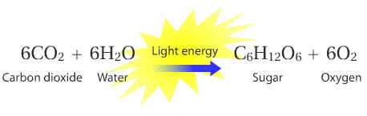
6) All Organisms Interact with their Environment, exchanging Matter & Energy
Photosynthesis:
Series of chemical reactions in which plants use light energy to make sugar molecules (food) using energy from the sun.
Plants use this food to obtain the energy needed to run vital chemical reactions in the cells

Slide 22
6) All Organisms Interact with their Environment, exchanging Matter & Energy
Animals cannot make their own sugar molecules (food)
Animals eat “pre-made” sugar molecules (food) to obtain energy that is used to run vital chemical reactions in the cells.
Cellular Respiration
  Process by which an animal or plant uses sugar molecules to make energy molecules
  6O₂ + C₆H₁₂O₆ → 6CO₂ + 6H₂O + Energy

Slide 23
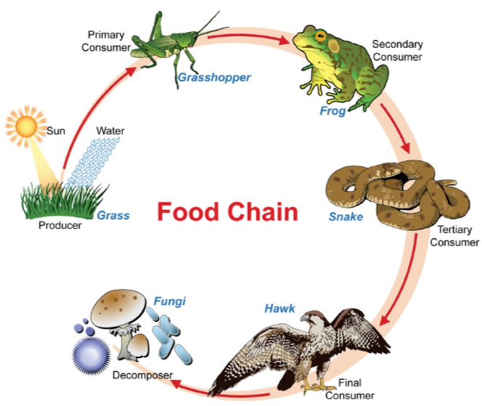
6) All Organisms Interact with their Environment, exchanging Matter & Energy
Food Chain:
  Process of transfering energy from
  the sun →
  producers →
  consumers →
  decomposers

Slide 24
6) All Organisms Interact with their Environment, exchanging Matter & Energy
Producers – organisms that use photosynthesis to produce its own energy source. E.g. Plants
Consumers – organisms that use a producer or other consumer for its energy source. E.g. Animals
  Herbivores eat plants
  Carnivores eat meat
  Omnivores eat plants and animals
Decomposers – act as recyclers of matter by eating the dead remains of another organism to obtain energy
  In the process they are changing complex matter into simpler chemicals that plants can absorb and use

Slide 25
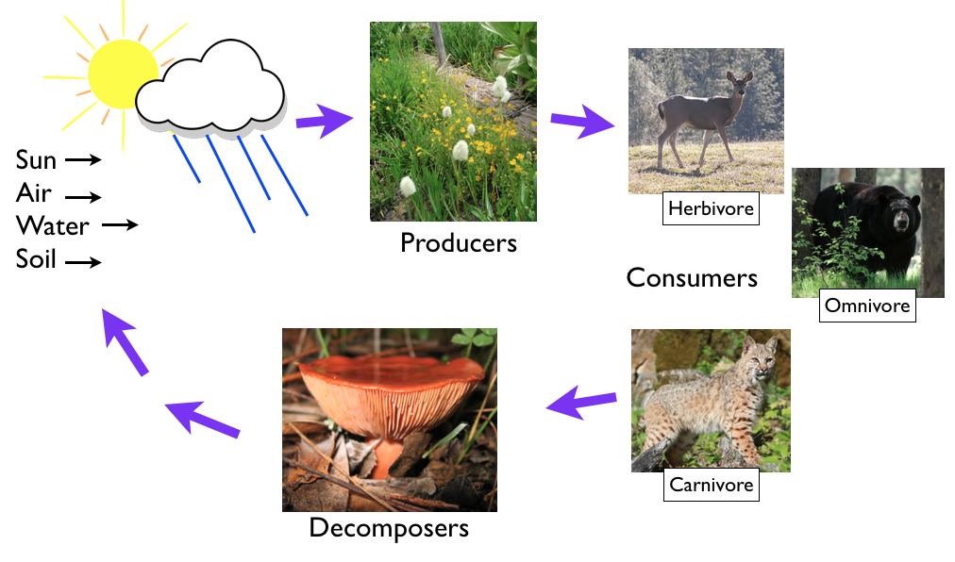
6) All Organisms Interact with their Environment, exchanging Matter & Energy … What is the CYCLE?

Slide 26
6) All Organisms Interact with their Environment, exchanging Matter & Energy
The dynamics of ecosystems include two major processes:
  the recycling of chemical nutrients from the atmosphere and soil through producers, consumers, and decomposers back to the air and soil
  the one-way flow of energy through an ecosystem, entering as sunlight and exiting as heat.
Notes:
26

Slide 27
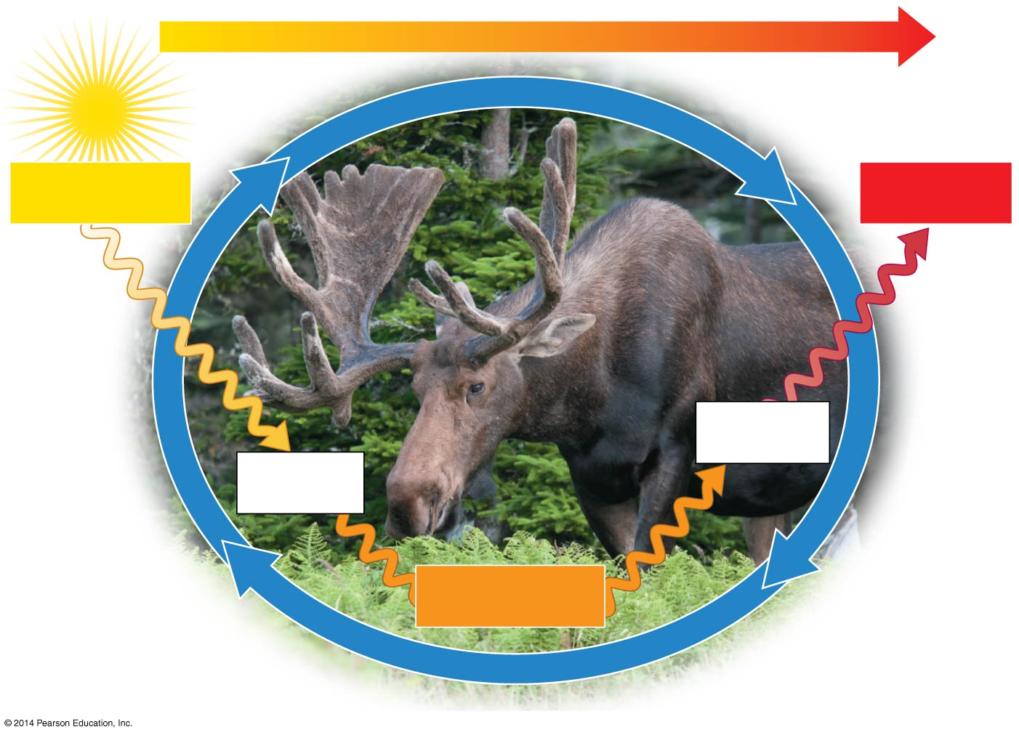

Figure 1.4-0
ENERGY FLOW
Sun
Inflow of
light energy
Outflow of
heat
Consumers
(animals)
Producers
(plants)
Chemical energy
in food
Leaves take up
CO₂ from air; roots
absorb H₂O and
minerals from soil
Decomposers such
as worms, fungi,
and bacteria return
chemicals to soil
Notes:
Figure 1.4-0 The cycling of nutrients and flow of energy in an ecosystem

Slide 28
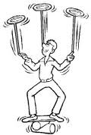
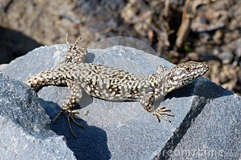
7) All Organisms Maintain Homeostasis
This occurs when organisms are able to maintain a stable internal environment …
…within the ranges required for life (includes pH, temperature, water balance, etc.)

Slide 29
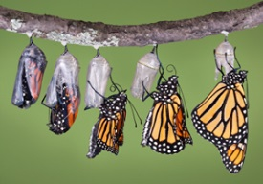
8) All Organisms Grow and Develop
Organisms grow by producing more cells or by cell enlargement
Organisms develop as they mature into an adult organism

Slide 30
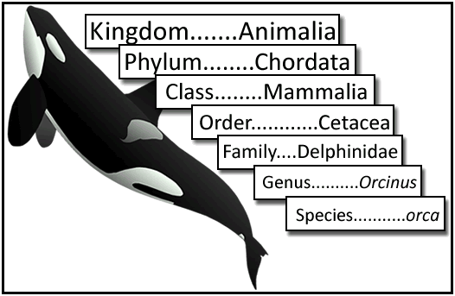
9) All Organisms can be Systematically Classified
What is TAXONOMY?
Branch of Biology that studies the arrangement of organisms into orderly groups based on their similarities

Slide 31
9) All Organisms can be Systematically Classified
The diversity of life can be arranged into three higher levels called DOMAINS:
  BACTERIA are the most diverse and widespread prokaryotes
  ARCHAEA are prokaryotes that often live in Earth’s extreme environments
  EUKARYA have eukaryotic cells & include
    Unicellular (single-celled) protists
    Multicellular fungi, animals, and plants

Slide 32
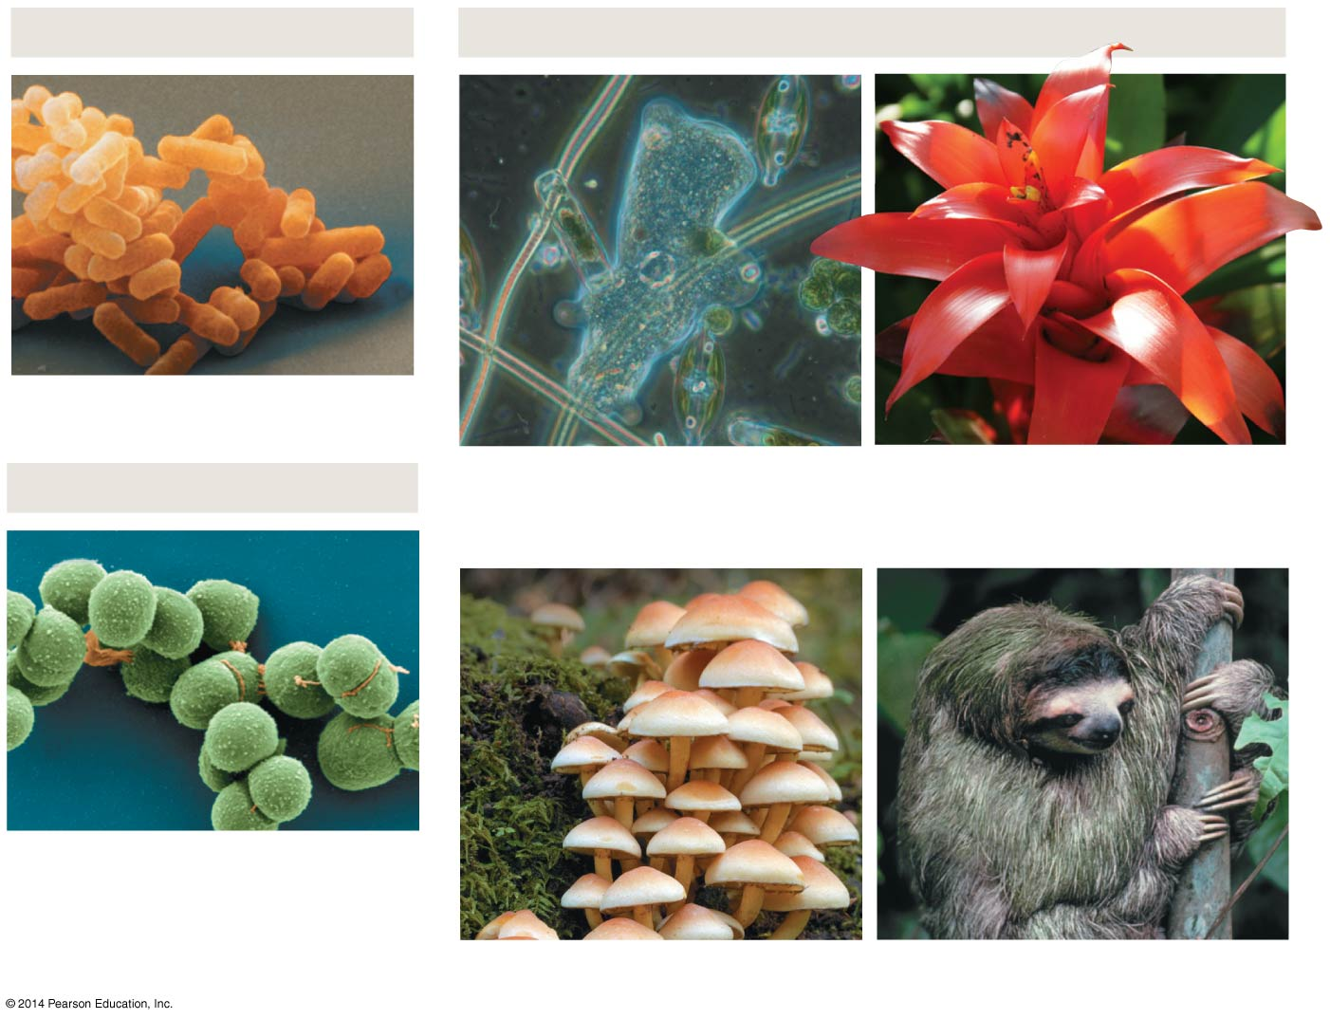
DOMAIN BACTERIA
DOMAIN EUKARYA
Bacteria
DOMAIN ARCHAEA
Kingdom Protista
Kingdom Plantae
Archaea
Kingdom Fungi
Kingdom Animalia
Notes:
Figure 1.6-0 The three domains of life

Slide 33
Characteristics of All Living Things:

Slide 34
Characteristics of All Living Things:
Basic Unit is the Cell
They contain DNA
They Reproduce
They are Complex and Organized
They Respond to their Environment
They Interact with their Environment, exchanging Matter and Energy
They maintain Homeostasis
They Grow and Develop
They can be Systematically Classified

Slide 35
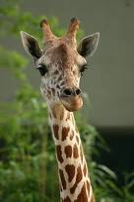
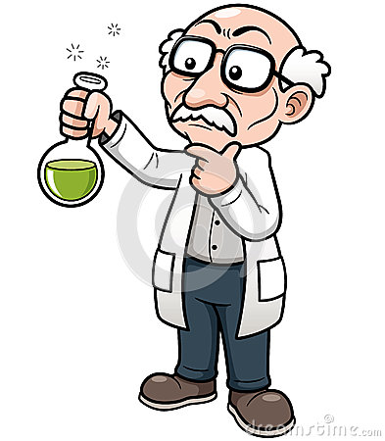
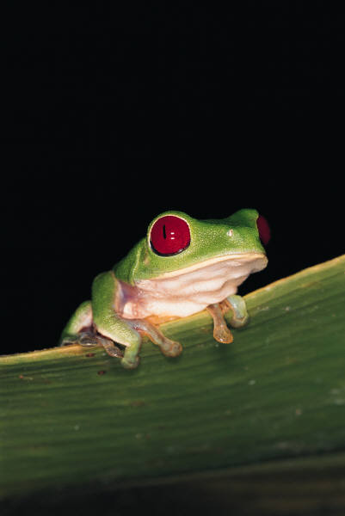
What is SCIENCE?
1) Science is a way of knowing what stems from our curiosity about ourselves and the world around us.
2) Scientists typically:
Make Observations
Form HYPOTHESIS: proposed solutions for a set of observations
Test Hypothesis
3) Science is based upon INQUIRY:
The search for information and explanations of natural phenomena

Slide 36


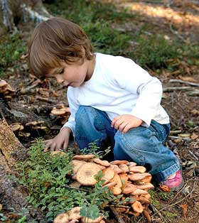
How is Science Done?
Science begins with an observation.
This is the process of gathering information about events or processes in a careful, orderly way.
DATA is the information gathered from making observations.

Slide 37
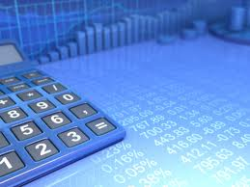
There are two types of data:
Quantitative Data:
“Amounts” involving numbers obtained by counting or measuring.
Qualitative Data:
descriptions involving characteristics that cannot be counted.

Slide 38
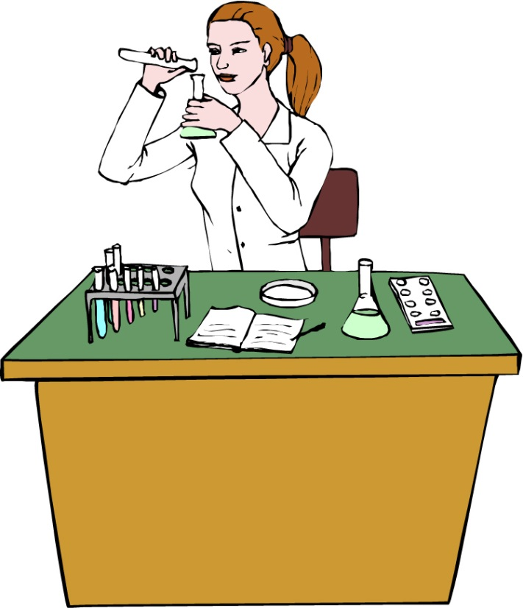
SCIENTIFIC METHOD
The scientific method is:
A series of steps used by scientists to solve a problem or answer a question.
Steps to the Scientific Method
Observation / Asking a Question
Form a Hypothesis
Design a Controlled Experiment
Record and Analyze Results
Draw Conclusions
Communication

Slide 39

Step 1:
Observation / Asking a Question
A problem to solve or a question must first be identified.
Uses the senses (touch, taste, smell, sight, hearing, pressure/pain
Collects data & Organizes the data
How much water can a root hair absorb?
Why does a plant stem bend toward the light?
What effect does temperature have on heart rate?

Slide 40

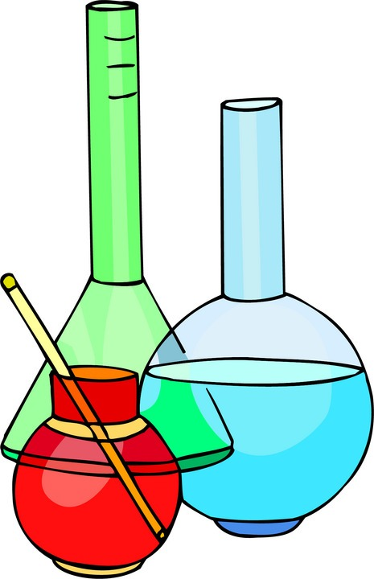
Step 2: Form a Hypothesis
Hypothesis
A possible solution to the question or problem based on accurate observation. It is simply a prediction and has not yet been proven or disproven.
It must be stated in a way that is testable.
A statement is considered “testable” if evidence can be collected that either does or does not support it.
“If… then…” statement

Slide 41
Step 3: Designing a Controlled Experiment
1. The factors in an experiment that can be changed are called variables. Some example of variables could be: changing the temperature, the amount of light present, time, concentration of solutions used.
2. A controlled experiment works with one variable at a time. If several variables were changed at the same time, the scientist would not know which variable was responsible for the observed results. All other variables should be unchanged or “controlled”.

Slide 42
Step 3: Designing a Controlled Experiment
3. An experiment is based on the comparison between a control group with an experimental group.
a) Ideally, these two groups are identical EXCEPT for ONE factor.
b) The control group serves as the comparison and usually is the independent variable. It is the same as the experiment group, except that the one variable that is being tested is removed.
c) The experimental group shows the effect of the variable that is being tested (dependent variable).

Slide 43
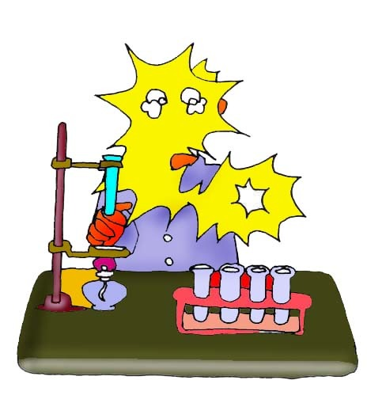

Example: In order to test the effectiveness of a new vaccine, 50 volunteers are selected and divided into two groups. One group will be the control group and the other will be the experimental group. Both groups are given a pill to take that is identical in size, shape, color and texture.
Describe the control group.
Describe the experimental group.
What variables are kept constant?
What variable is being changed?

Slide 44
Example: In order to test the effectiveness of a new vaccine, 50 volunteers are selected and divided into two groups. One group will be the control group and the other will be the experimental group. Both groups are given a pill to take that is identical in size, shape, color and texture.
Even though the volunteers are given identical looking pills, the control group will not actually receive the vaccine.
Describe the control group.
Describe the experimental group.
What variables are kept constant?
What variable is being changed?
This group will receive the vaccine.
The size, shape, color, and texture of the pill.
Whether or not the pill contains the vaccine.

Slide 45
There are two variables in an experiment:
INDEPENDENT VARIABLE
The variable that does NOT depend on the other variables and is deliberately manipulated by the scientist.
Establishes the relationship (direct or inverse) between variables.
DEPENDENT VARIABLE
The variable that depends on other factors and is observed (for change) during the experiment.
The data collected is a result of manipulating the independent variable.

Slide 46
There are two variables in an experiment:
Example:
In order to test the effectiveness of a new vaccine, 50 volunteers are selected and divided into two groups.
One group will be the control group and the other will be the experimental group.
Both groups are given a pill to take that is identical in size, shape, color and texture.
What is the independent variable?
What is the dependent variable?

Slide 47
There are two variables in an experiment:
Example:
In order to test the effectiveness of a new vaccine, 50 volunteers are selected and divided into two groups.
One group will be the control group and the other will be the experimental group.
Both groups are given a pill to take that is identical in size, shape, color and texture.
What is the independent variable?
It is the addition of the vaccine to the pills that were given to the volunteers.
What is the dependent variable?
The observed health of the people receiving the pills.

Slide 48
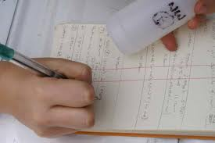
Step 4: Recording and Analyzing Results
1. The data that has been collected must be organized and analyzed to determine whether the data are reliable.
2. Does the data support or not support the hypothesis?

Slide 49
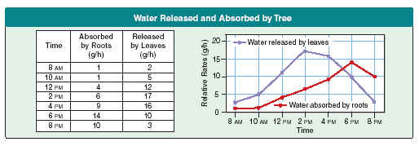
Step 4: Recording & Analyzing Results
Involves placing observations and measurement (data) in order
  Graphs, charts, tables, or maps
  The independent variable is plotted on the x-axis and is the first variable shown in a table or chart (for comparison).

Slide 50

Step 5: Drawing Conclusions
The evidence from the experiment is used to determine if the hypothesis is proven or disproven.
Experiments must be repeated over and over.
A valid conclusion can only be reached if the results are repeatable (always the same).

Slide 51
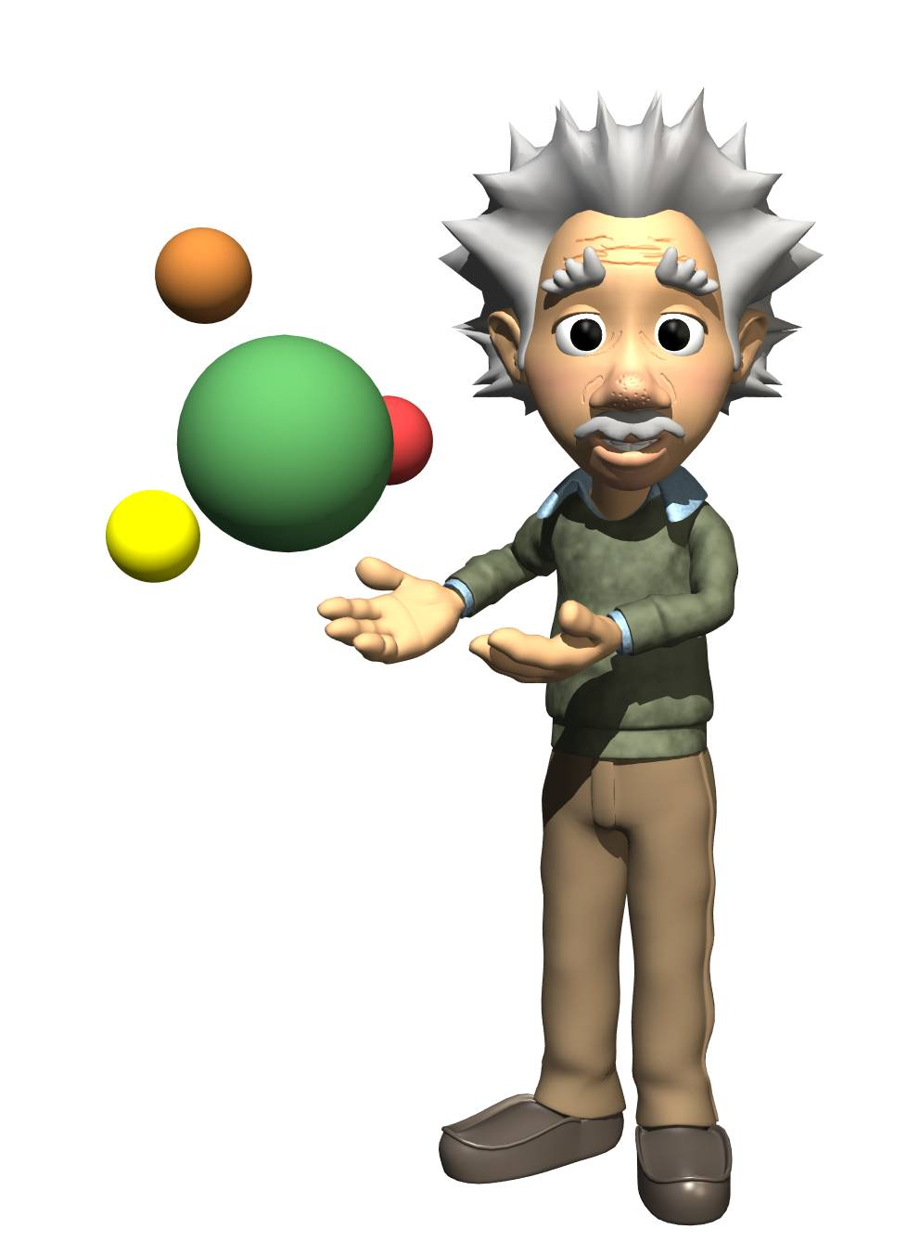
Forming a Theory
A theory may be only formed after the hypothesis has been tested many times and is supported by much evidence.
Theory:
A well-substantiated explanation based on repeated observation & testing.
Recognizable patterns that form reliable accounts of the real world.
A theory can be modified.

Slide 52
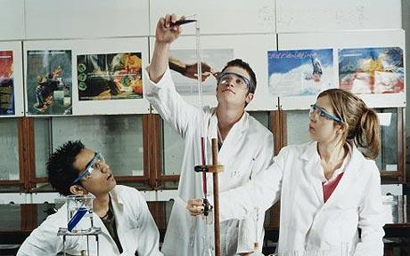
Step 6: Communication
Scientists must share the results of their studies with other scientists (peers)
Publish findings in journals
Present their findings at scientific meetings
Scientists must be unbiased
  Should not tamper with their data
  Only publish and report tested and proven ideas

Slide 53
Step 6: Communication
Sharing of information is essential to scientific process.
Subject to examination and verification by other scientists.
Allows scientists to build on the work of others.

Slide 54

Practice Problem:
You want to determine the effects of a certain fertilizer on the growth of orchids grown in a greenhouse.
Materials that are available to you include: greenhouse, 100 orchid plants, water, fertilizer, and soil.
You want to know if the orchids will grow best with a weak concentration of fertilizer, a medium concentration of fertilizer, or a high concentration of fertilizer.
How will you design an experiment to test different concentrations of this fertilizer?
State your Hypothesis:
Possible answer:

Slide 55
Practice Problem:
You want to determine the effects of a certain fertilizer on the growth of orchids grown in a greenhouse.
Materials that are available to you include: greenhouse, 100 orchid plants, water, fertilizer, and soil.
You want to know if the orchids will grow best with a weak concentration of fertilizer, a medium concentration of fertilizer, or a high concentration of fertilizer.
How will you design an experiment to test different concentrations of this fertilizer?
State your Hypothesis:
Possible answer:
“If a medium concentration of fertilizer is used, then the orchids will grow best.”

Slide 56
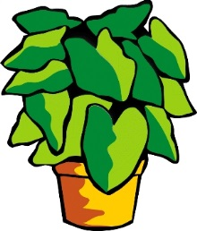
How will you set up a controlled experiment?
Here is one possibility:
The 100 plants will be divided into 4 groups as follows:
Group 1: 25 plants will receive plain water.
Group 2: 25 plants will receive a weak concentration of fertilizer.
The plants will be watered daily.
The plants will be measured over a period of 1 month to see which ones grew the tallest.
Group 3: 25 plants will receive a medium concentration of fertilizer.
Group 4: 25 plants will receive a high concentration of fertilizer.

Slide 57

Control Group
Experimental Group
What is the control group in the experiment?
What is the experimental group in the experiment?

Slide 58
Control Group
Experimental Group
What is the control group in the experiment?
The 25 plants that are receiving plain water.
What is the experimental group in the experiment?
The 75 plants that are receiving various concentrations of fertilizer.

Slide 59

In a “controlled experiment”, all variables must be kept constant except the one variable that is being changed.
What variables must be kept constant in this experiment?
All plants must receive the same amount of fluid each day.
All plants are grown in pots of equal size.
All plants are grown at the same temperature.
All plants receive the same amount of sunlight.

Slide 60
In a “controlled experiment”, all variables must be kept constant except the one variable that is being changed.
What variables must be kept constant in this experiment?
All plants must receive the same amount of fluid each day.
All plants are grown in pots of equal size.
All plants are grown at the same temperature.
All plants receive the same amount of sunlight.
What variable is being changed in this experiment?
The variable being changed is the amount of fertilizer received by each group of plants (dependent variable).

Slide 61
After one month of measuring the orchids, the following data is obtained:
Group 1 (Control Group): Grew to an average height of 15 cm.
Group 2 (Weak conc.): Grew to an average height of 35 cm.
Group 3 (Medium conc.): Grew to an average height of 28 cm.
Group 4 (High conc.): Grew to an average height of 10 cm.
Is your hypothesis supported or disproved by these results?

Slide 62
After one month of measuring the orchids, the following data is obtained:
Group 1 (Control Group): Grew to an average height of 15 cm.
Group 2 (Weak conc.): Grew to an average height of 35 cm.
Group 3 (Medium conc.): Grew to an average height of 28 cm.
Group 4 (High conc.): Grew to an average height of 10 cm.
Is your hypothesis supported or disproved by these results?
We hypothesized that the orchids would grow best with a medium concentration of fertilizer.
The results do not support this.
The results disprove our hypothesis.

Slide 63
After one month of measuring the orchids, the following data is obtained:
Group 1 (Control Group): Grew to an average height of 15 cm.
Group 2 (Weak conc.): Grew to an average height of 35 cm.
Group 3 (Medium conc.): Grew to an average height of 28 cm.
Group 4 (High conc.): Grew to an average height of 10 cm.
What is your conclusion based on these results?

Slide 64
After one month of measuring the orchids, the following data is obtained:
Group 1 (Control Group): Grew to an average height of 15 cm.
Group 2 (Weak conc.): Grew to an average height of 35 cm.
Group 3 (Medium conc.): Grew to an average height of 28 cm.
Group 4 (High conc.): Grew to an average height of 10 cm.
What is your conclusion based on these results?
Orchids grow best with a weak concentration of fertilizer.
At medium to high concentrations, plant growth is inhibited.

Slide 65
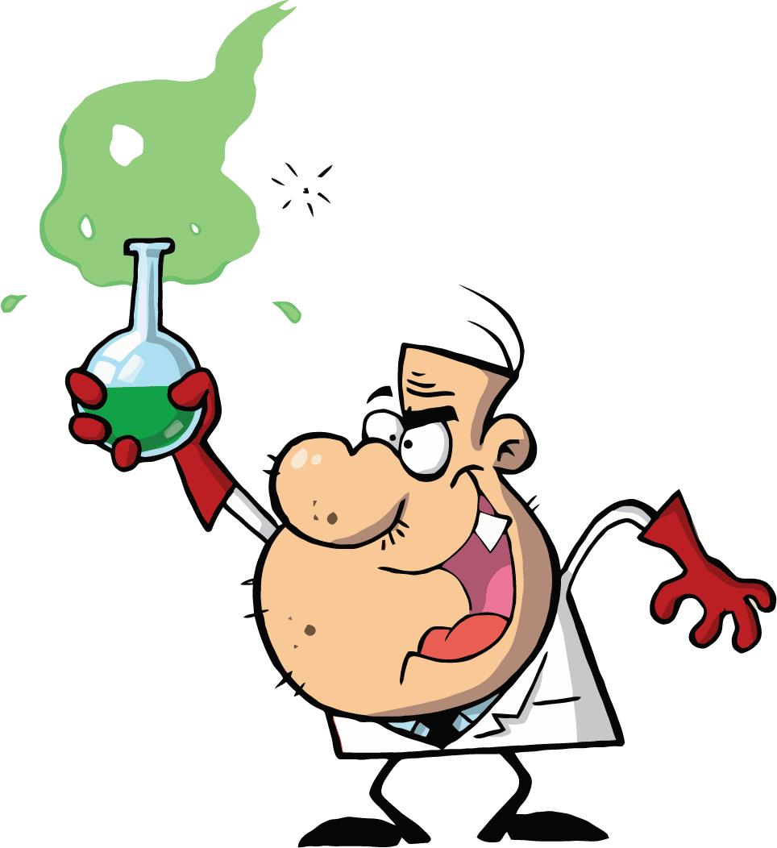
Analysis Questions
Why is it so important that a scientist accurately describes the procedure used in the experiment?

Slide 66
Analysis Questions
Why is it so important that a scientist accurately describes the procedure used in the experiment?
It allows other scientists to repeat the experiment and verify the results.

Slide 67
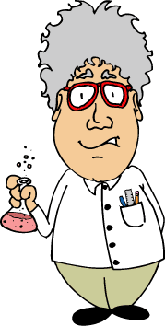
Analysis Questions
What is the importance of the control?

Slide 68
Analysis Questions
What is the importance of the control?
The control remains the same throughout an experiment.
The control provides the basis for comparison, so one can observe how the experimental factor affected the results.
The control is often the independent variable.

Slide 69
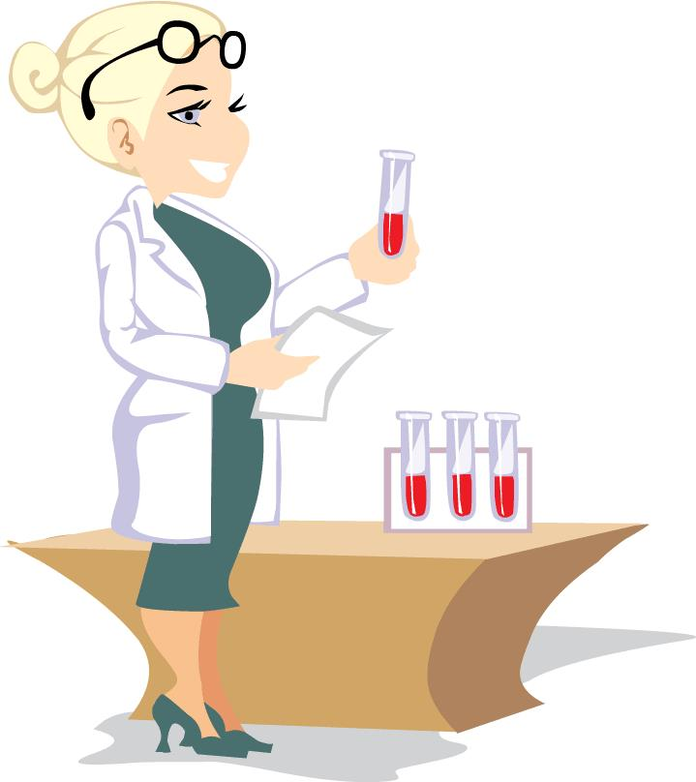
Analysis Questions
What is the difference between the independent and the dependent variables in an experiment?

Slide 70
Analysis Questions
What is the difference between the independent and the dependent variables in an experiment?
The independent variable that does NOT depend on the other variables and is deliberately manipulated by the scientist.
The dependent variable that depends on other factors and is observed (for change) during the experiment.
The data collected is a result of manipulating the independent variable.

Slide 71
Analysis Questions
In a “controlled experiment”, why must all of the variables, except one, be kept constant throughout the experiment?

Slide 72
Analysis Questions
In a “controlled experiment”, why must all of the variables, except one, be kept constant throughout the experiment?
If several variables were changed at the same time, the scientist would not know which variable was responsible for the observed results.

Slide 73
Analysis Questions
Why is it important to repeat the experiment many times?

Slide 74
Analysis Questions
Why is it important to repeat the experiment many times?
Experiments should be repeated to see if the same results are obtained each time. This gives validity to the test results.

Slide 75

Analysis Questions
How is a theory different than a hypothesis?

Slide 76
Analysis Questions
How is a theory different than a hypothesis?
A hypothesis is an “educated guess” based on accurate observation that is testable through further observations & experimentation.
A theory is an explanation and recognizable pattern based on many experiments & considerable amounts of data.

