Slide 1
Go to the “Slide Show” shade above
Click on “Play from Beginning”

Slide 2

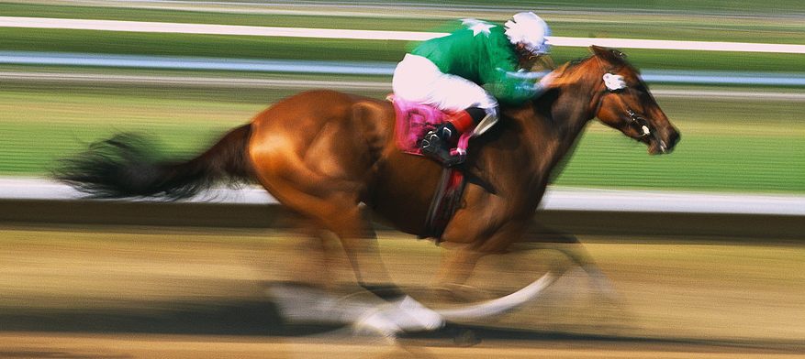
Organic Chemistry
Carbon Chemistry

Slide 3
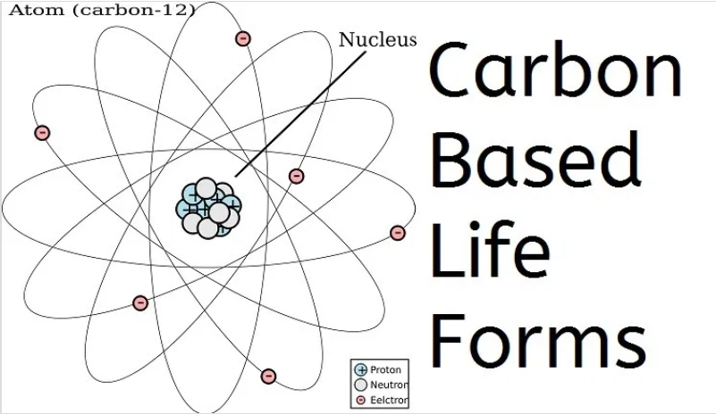

What do all living things have in common?

Slide 4
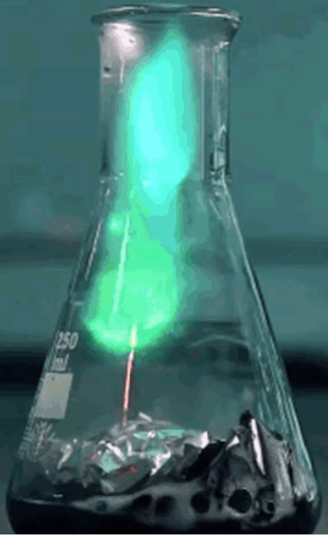
Carbon Chemistry
Focus Points
Identify three forms of carbon.
Explain "organic" chemistry based on carbon, giving examples of carbon-based compounds.
Define factors that determine the properties of a hydrocarbon and distinguish types of unsaturated hydrocarbons (alkenes, alkynes, and aromatic).
Describe fossil fuels and their importance in the world, including combustion.

Slide 5
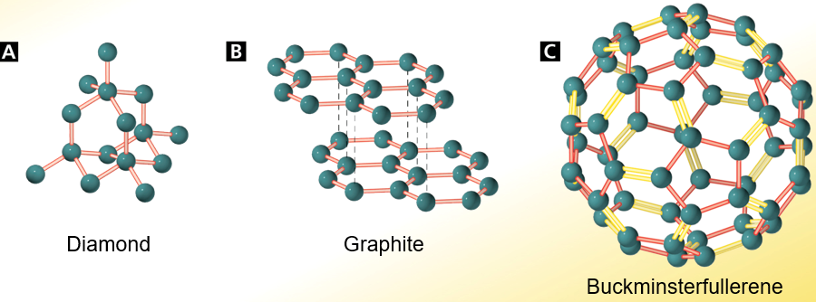
Carbon Based Life Forms
Carbon has three forms:
Diamond
Graphite
Fullerenes

Slide 6
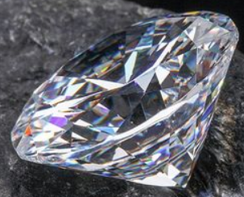
Carbon Based Life Forms
Diamond
Diamond is an example of a network solid, in which all the atoms are linked by covalent bonds.
  Covalent bonds connect each carbon atom to four other carbon atoms.
  The three-dimensional structure is rigid, compact, and strong.
  Diamond is harder than other substances because cutting a diamond requires breaking many covalent bonds.

Slide 7
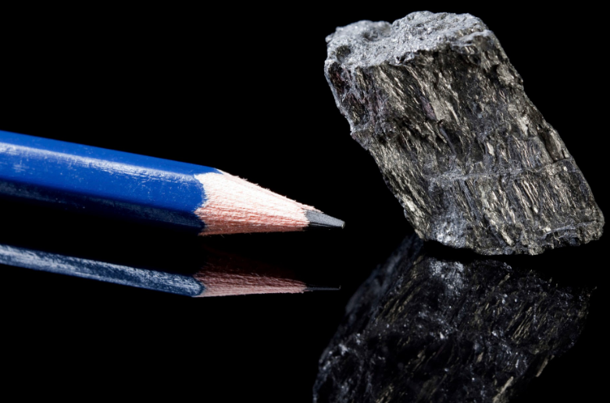
Carbon Based Life Forms
Graphite
Graphite is extremely soft and slippery.
  Carbon atoms are arranged in widely spaced layers.
  Within each layer, carbon atoms form strong covalent bonds with three other carbon atoms.
  Between layers the bonds are weak, so layers slide easily past one another.

Slide 8
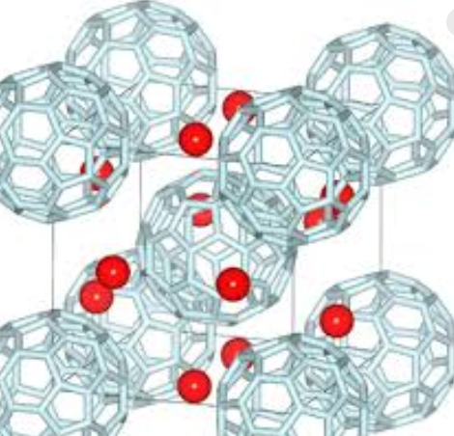
Carbon Based Life Forms
Fullerenes
Fullerenes are large hollow spheres or cages of carbon.
Fullerenes are used in the medical field as light-activated antimicrobial agents.
It is also used in several biomedical applications including the design of high-performance MRI contrast agents, X-ray imaging contrast agents, photodynamic therapy and drug and gene delivery.

Slide 9
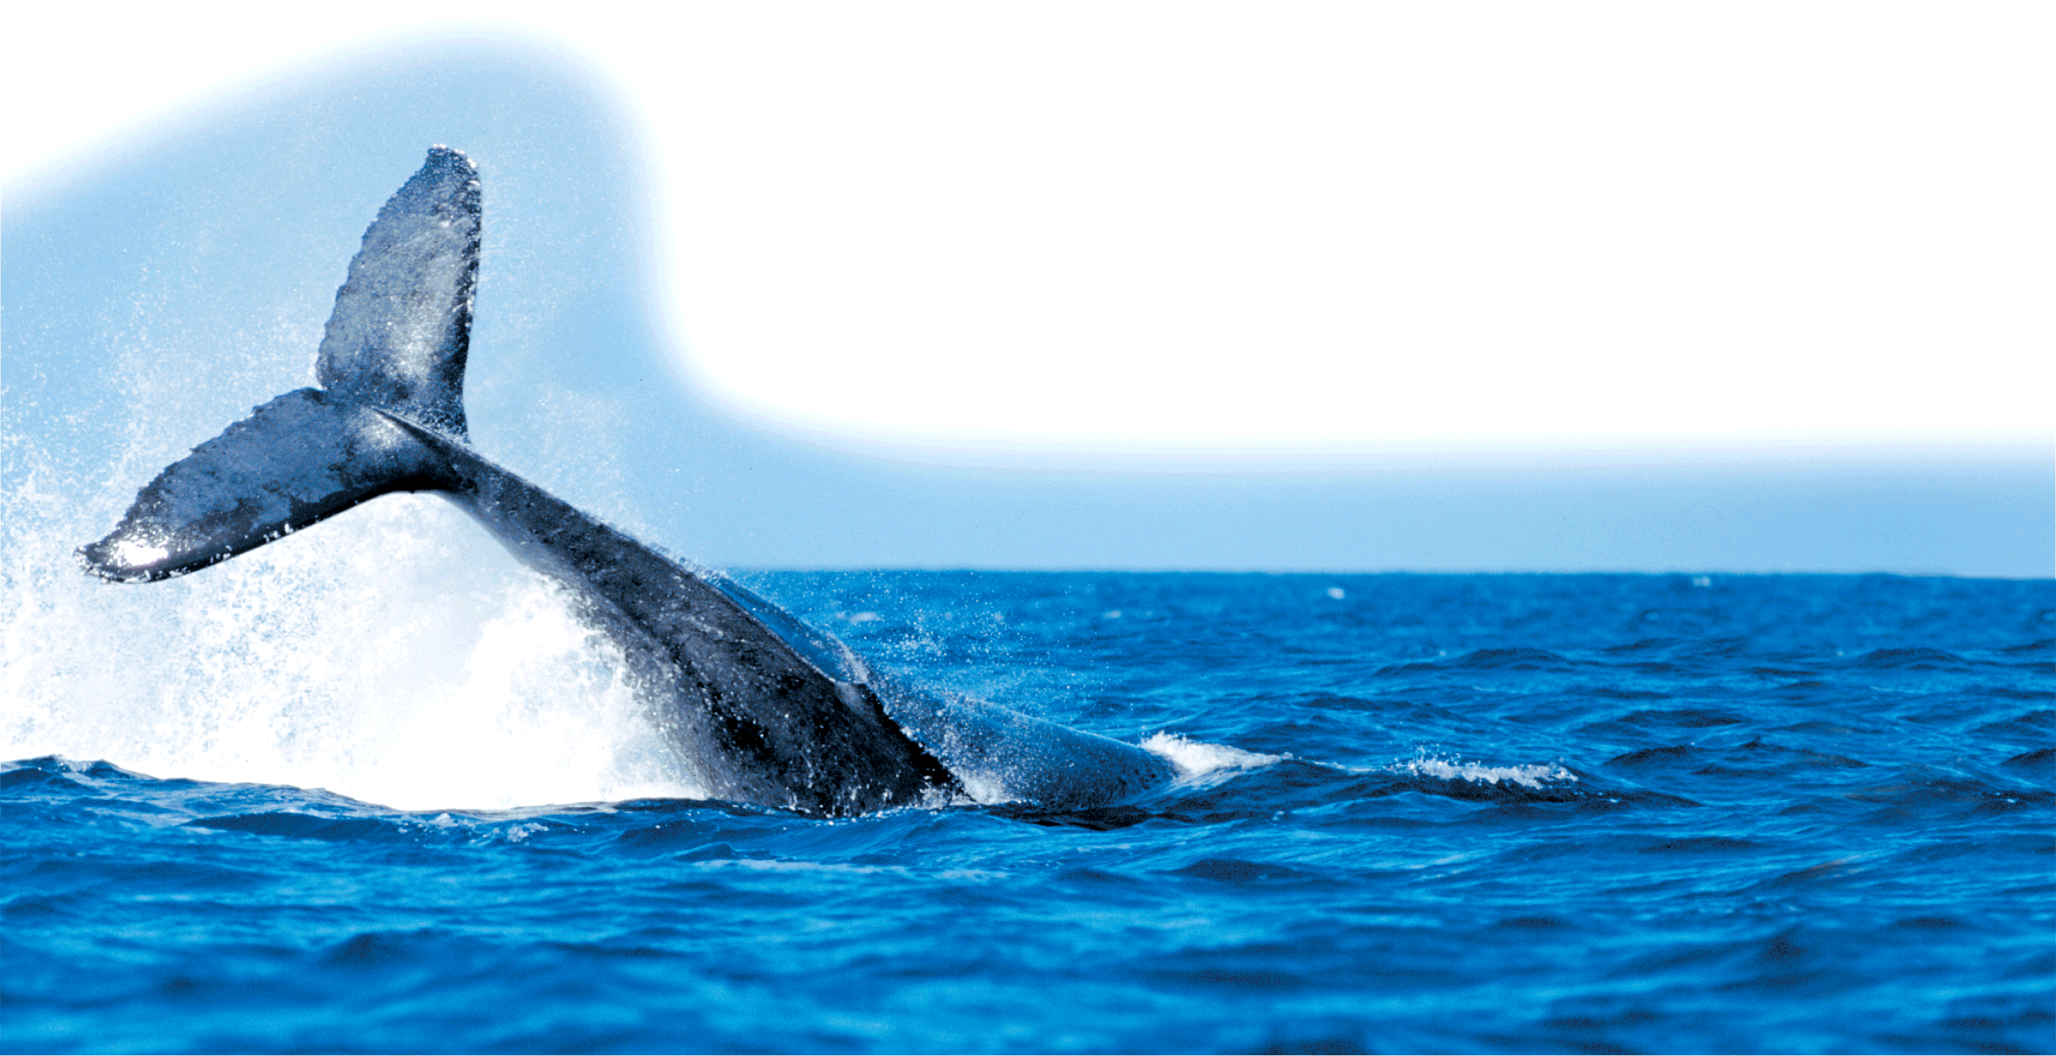
Carbon Based Life Forms
An organic compound contains carbon and hydrogen, often combined with a few other elements such as oxygen and nitrogen.
There are millions of organic compounds—more than 90 percent of all known compounds.

Slide 10
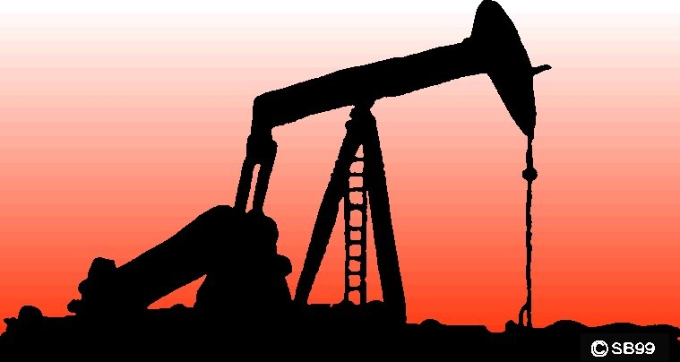
Origin of Organic Molecules
Naturally occurring organic molecules are found in PLANTS, animals, and fossil fuels

Slide 11
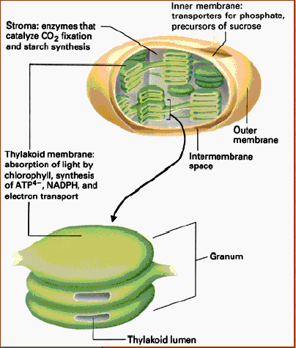
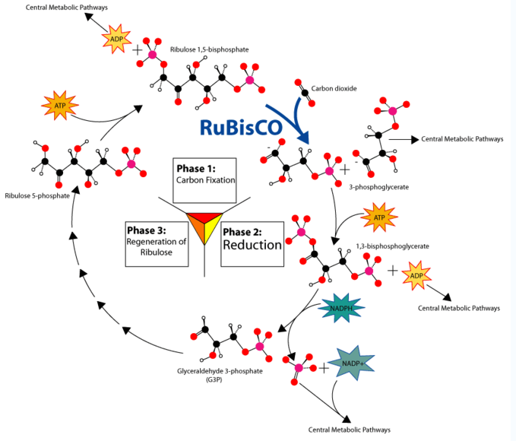
Origin of Organic Molecules
PLANTS take carbon dioxide from the atmosphere to produce most of the chemicals and molecules that comprise life:
Carbon gets “fixed”
into molecules to produce:
carbohydrates, proteins, fats, oils, nucleic acids, fatty acids, vitamins

Slide 12
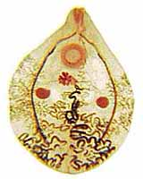
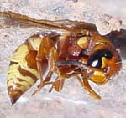
Origin of Organic Molecules
Animals are composed of organic molecules (carbon based life forms) … mainly proteins.

Slide 13
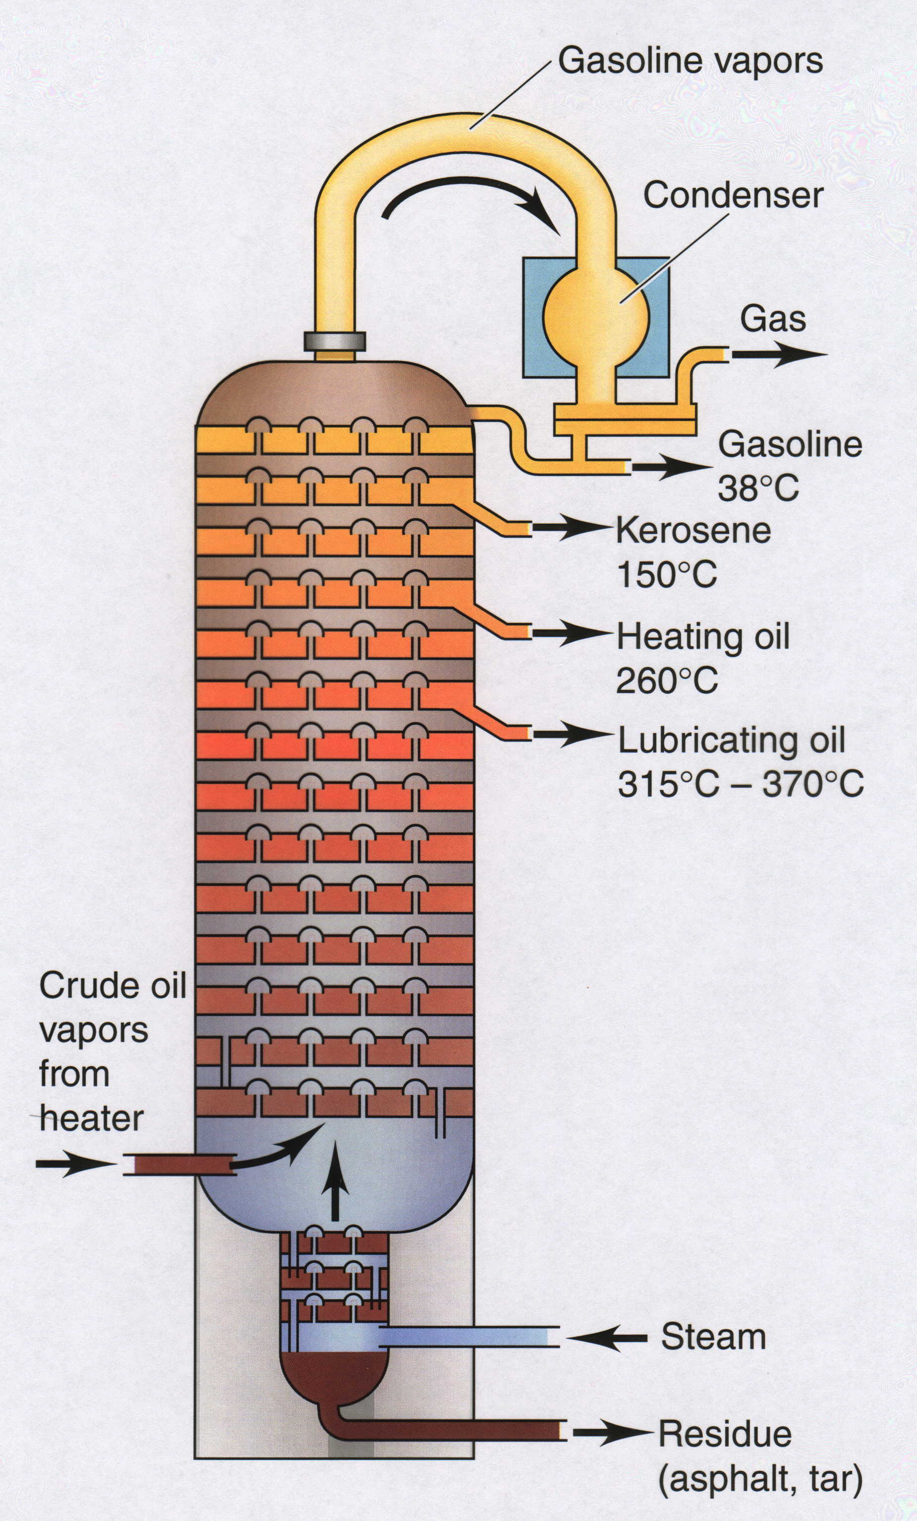
Origin of Organic Molecules
Fossil Fuels include coal, natural gas, petroleum (oil, diesel, etc.)
Synthetic organic molecules are derived from fossil fuels or plant material

Slide 14
So what’s a “Fossil Fuel?”
Plants and animals die and are buried for many years under high temperature and pressure, produces fossil fuels.
The type of fossil fuel depends on the origin of the organic (formerly alive) material and the conditions of temperature and pressure under which they decay.

Slide 15
So what’s a “Fossil Fuel?”
Coal
Giant tree ferns and other plants were buried in swamps.
After many of years of pressure, the plant remains produced a mixture of hydrocarbons.
Natural Gas
Natural gas formed from the remains of marine organisms.
The main component of natural gas is methane. Natural gas also contains ethane, propane, and isomers of butane.
Natural gas is used for heating and cooking.
Petroleum
Petroleum also formed from marine organisms.
Petroleum is pumped from deep beneath Earth’s surface.

Slide 16
How do we use “Fossil Fuels?”
Fossil fuels are burned in combustion reactions.
CH + O₂ → CO₂ + H₂0
Hydrocarbon + Oxygen → Carbon Dioxide + Water
Burning fossil fuels gives off pollutants (SO₂ and NO_{x}) and damages the environment.

Slide 17
Incomplete Combustion
If there is not enough oxygen available for complete combustion of all the fuel, carbon monoxide is produced.
Carbon monoxide is a colorless, odorless gas that is poisonous. It keeps hemoglobin from carrying oxygen to cells.
2C₃H₈ + O₂ → 6CO + 8H₂0
Hydrocarbon + Oxygen → Carbon monoxide + Water

Slide 18

Distinguishing Properties of Compounds.
Graphite is soft and slippery because its carbon atoms
  are arranged in layers with weak attractions between layers.
  have a large, interlocking network.
  contain individual atoms with very weak bonds to other carbon atoms.
  share a weak bond with hydrogen atoms.
Name three major fossil fuels:
  Name three forms of Carbon:
Notes:
Timing ≈ 1 min
Entry: Even if you do not know the electronegativity of elements, you can use the periodic table to predict the charge of the ions formed by atoms and whether two elements form an ionic compound. Start by predicting the charge of the ions formed by the given elements.
Hint1: Atoms of metals form positive ions; atoms of nonmetals tend to form negative ions.
Hint2: When metals join with nonmetals to form compounds, the bond is most likely ionic.
Exit: The type of ion formed by the atoms of an element depends on the number of valence electrons that atom has. Metals tend to lose electrons to form positive ions and nonmetals tend to gain electrons to form negative ions so that the resulting ions have full valance levels. Ionic compounds form between the positive and negative ions.

Slide 19
Distinguishing Properties of Compounds.
Graphite is soft and slippery because its carbon atoms
  are arranged in layers with weak attractions between layers.
  have a large, interlocking network.
  contain individual atoms with very weak bonds to other carbon atoms.
  share a weak bond with hydrogen atoms.
  Name three major fossil fuels:
  Coal
  Natural gas
  Oil (petroleum)
  Name three forms of Carbon:
  Diamond
  Graphite
  Fullerenes
Notes:
Timing ≈ 1 min
Entry: Even if you do not know the electronegativity of elements, you can use the periodic table to predict the charge of the ions formed by atoms and whether two elements form an ionic compound. Start by predicting the charge of the ions formed by the given elements.
Hint1: Atoms of metals form positive ions; atoms of nonmetals tend to form negative ions.
Hint2: When metals join with nonmetals to form compounds, the bond is most likely ionic.
Exit: The type of ion formed by the atoms of an element depends on the number of valence electrons that atom has. Metals tend to lose electrons to form positive ions and nonmetals tend to gain electrons to form negative ions so that the resulting ions have full valance levels. Ionic compounds form between the positive and negative ions.

Slide 20
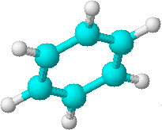
Carbon is the BACKBONE
the
center
of
all
organic molecules

Slide 21
Carbon forms four bonds
Carbon usually forms FOUR strong covalent bonds, with other elements.
Notice that around each “carbon” atom are FOUR dashes.
(each representing 1 bond of 2 electrons)

Slide 22
Carbon forms four bonds
The FOUR bonds to the carbon atom can be represented in many ways …

Slide 23
Organic Molecules Can be Divided into GROUPS
The largest group of Organic Molecules are the “HYDROCARBONS”
The second largest group of Organic Molecules contain OXYGEN
Other groups contain NITROGEN and / or PHOSPHORUS and / or SULFUR

Slide 24
Organic Molecules Can be Divided into GROUPS
We will focus on the “HYDROCARBONS”
And the Organic Molecules containing OXYGEN

Slide 25
Hydrocarbons
are the simplest and most abundant class of organic compounds.
• consist entirely and ONLY of carbon and hydrogen.

Slide 26
There are FOUR types of Hydrocarbons:
1. Alkanes — contain only carbon-hydrogen and carbon-carbon SINGLE COVALENT bonds.
2. Alkenes — contain at least one carbon-carbon DOUBLE COVALENT bond.
3. Alkynes — contain a least one carbon-carbon TRIPLE COVALENT bond.
4. Aromatics — contain RING of SIX carbon atoms that can be drawn with alternating single and double bonds.

Slide 27
Hydrocarbons
Alkanes
C C
Alkenes
C C
Alkynes
C C
Aromatics

Slide 28
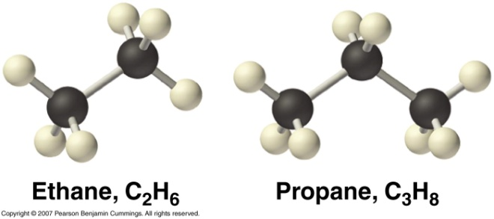
Saturated Hydrocarbons
In a saturated hydrocarbon, all of the bonds are single bonds.
  A saturated hydrocarbon contains the maximum possible number of hydrogen atoms for each carbon atom.
  Saturated hydrocarbons are also called alkanes. Their names end in –ane.
  Saturated hydrocarbons can be straight-chains or branched.

Slide 29
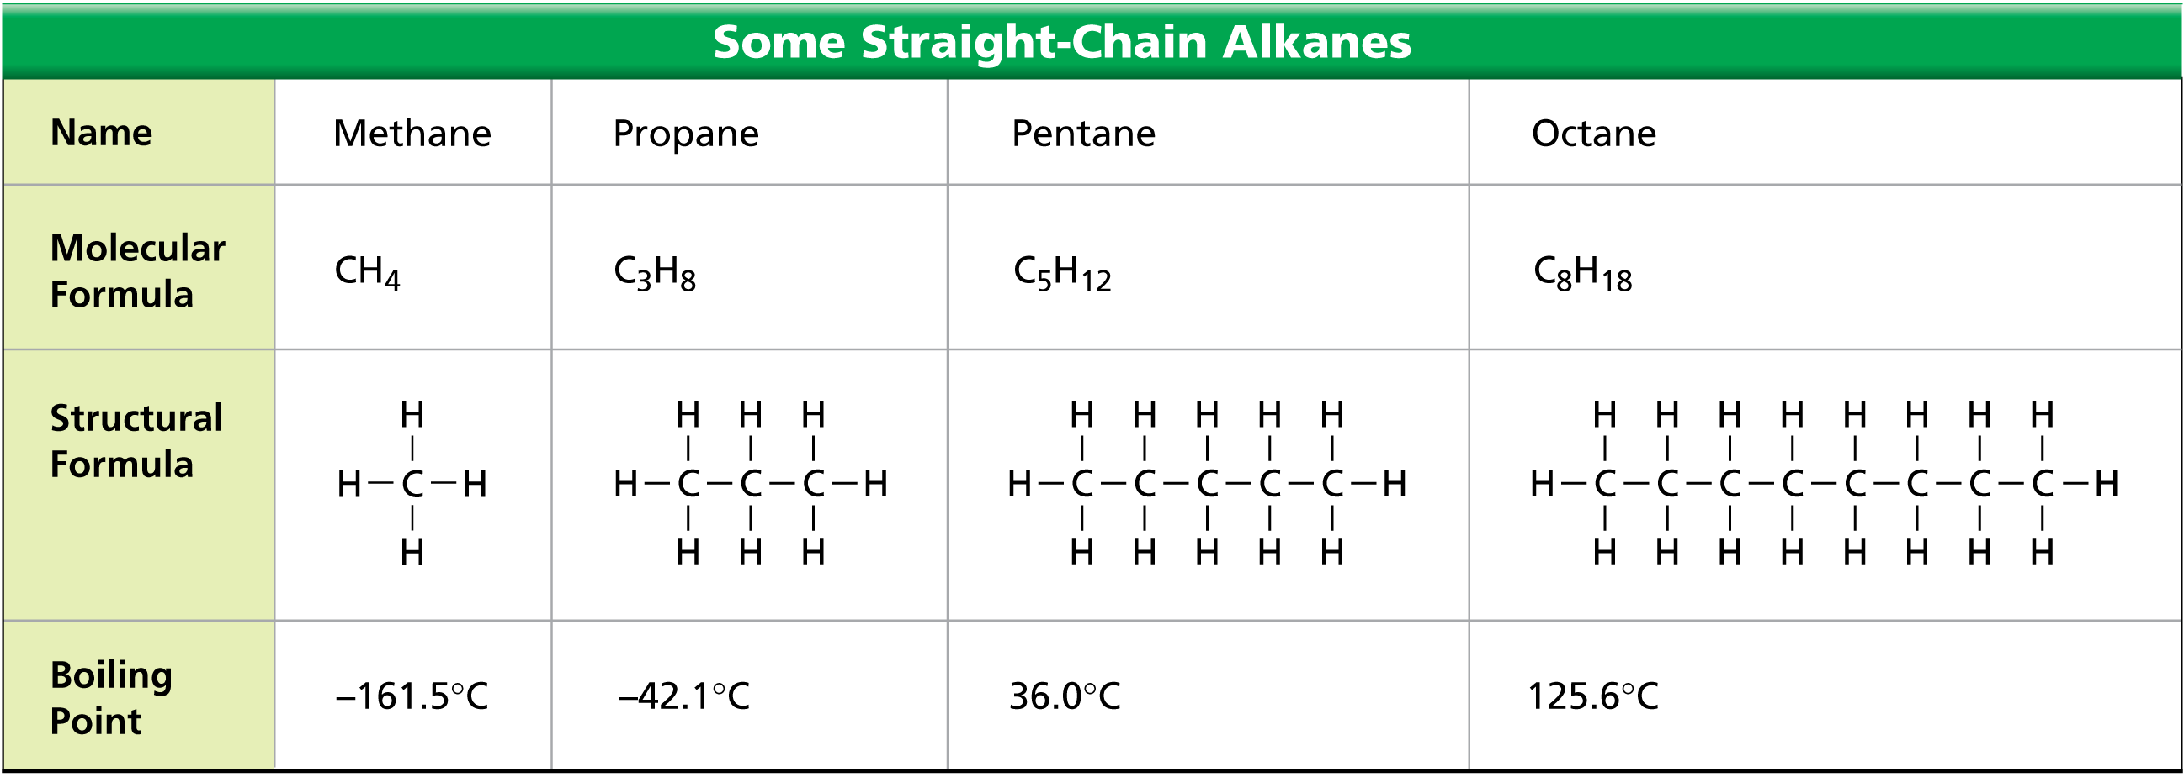
Saturated Hydrocarbons
Straight-chain saturated hydrocarbons all have SINGLE bonds. Notice that their properties vary based on size (e.g. boiling point).

Slide 30
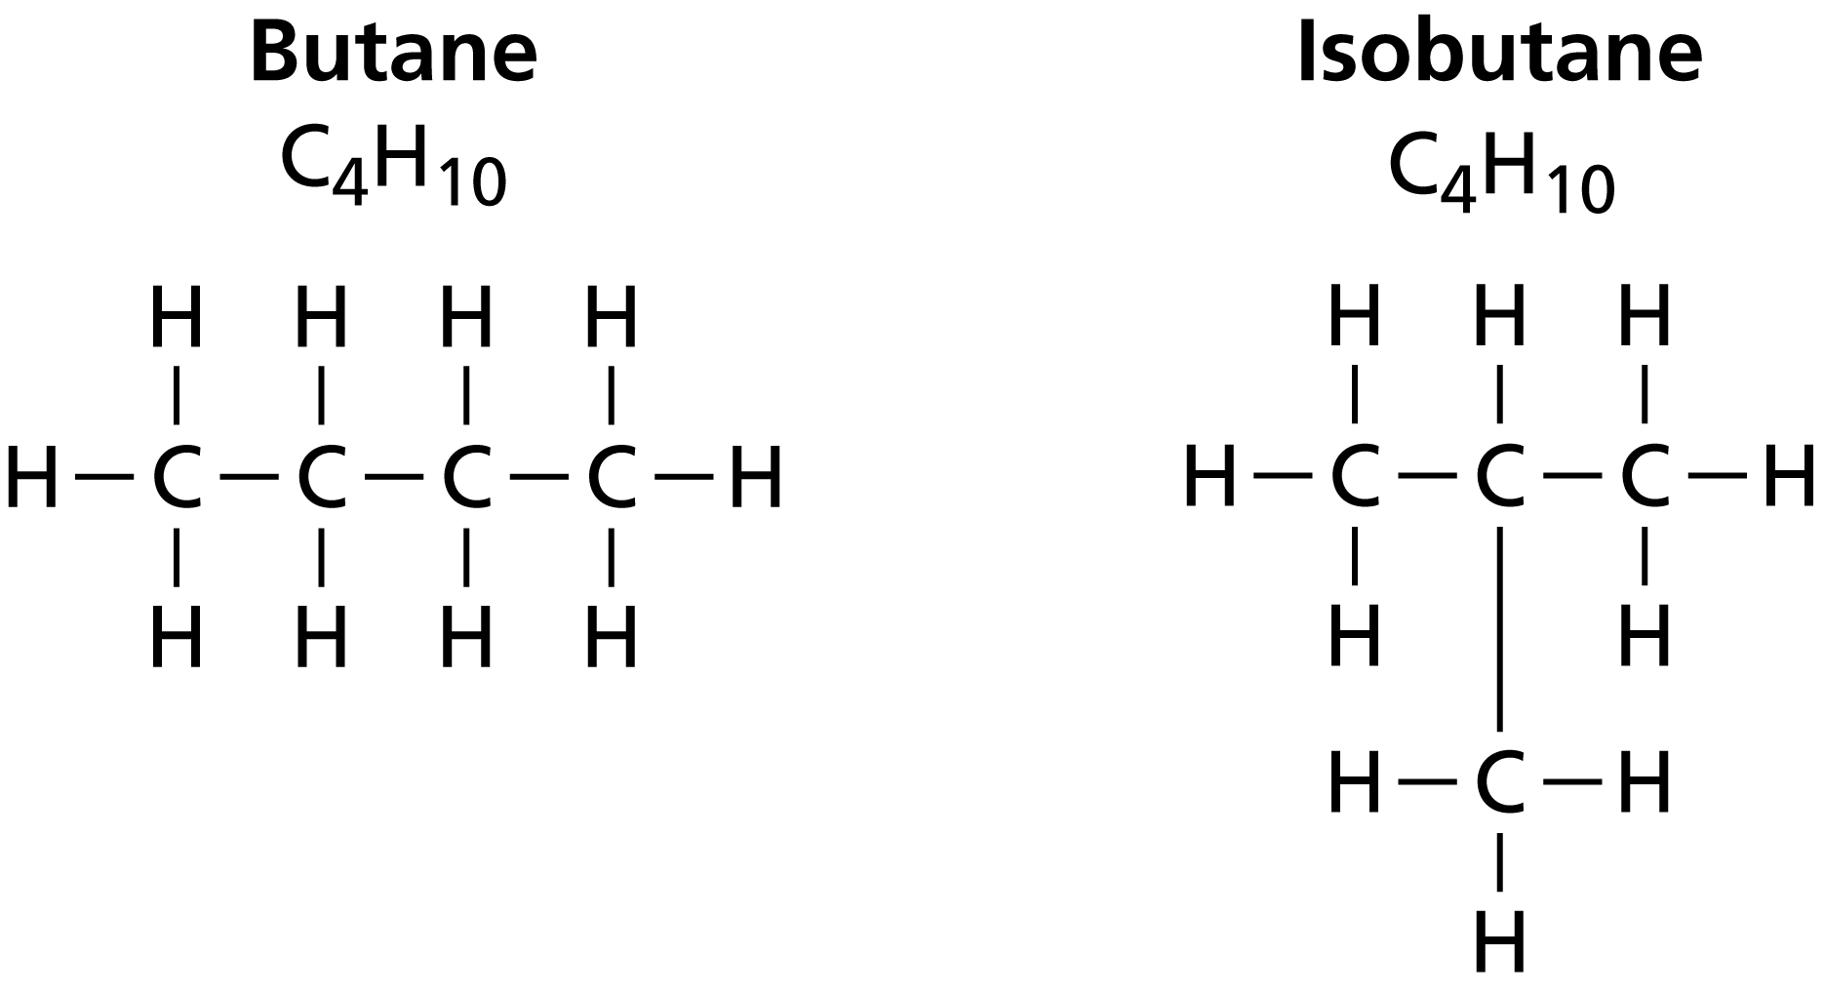
Saturated Hydrocarbons
Branched Chains
Butane and isobutane both have a molecular formula of C₄H₁₀, but their structural formulas are different.
Branched
Unbranched

Slide 31
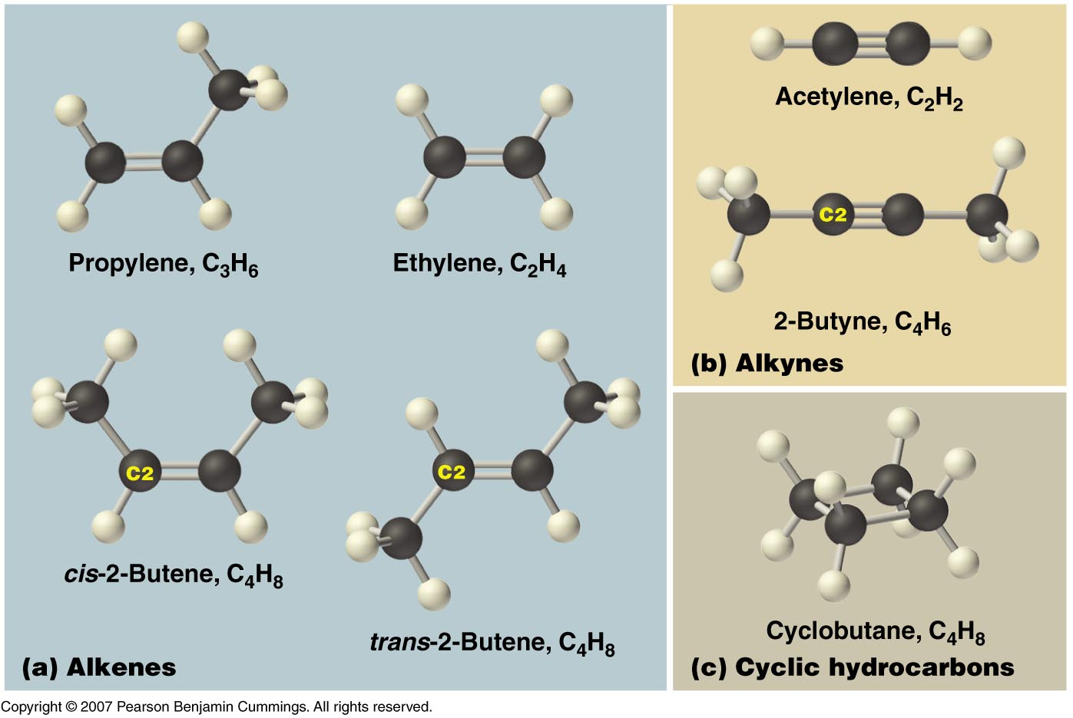
Unsaturated Hydrocarbons
A hydrocarbon that contains one or more double or triple bonds is an unsaturated hydrocarbon.
There are three types of unsaturated hydrocarbons—alkenes, alkynes, and aromatic hydrocarbons.

Slide 32
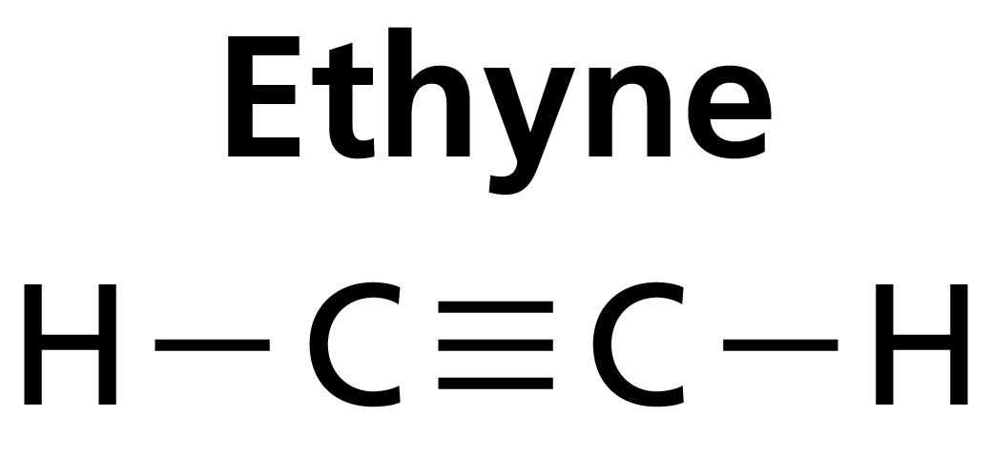
Unsaturated Hydrocarbons
Ethyne (C₂H₂) is an alkyne. Alkynes are straight- or branched-chain hydrocarbons that have one or more triple bonds. Alkyne names end in –yne.

Slide 33
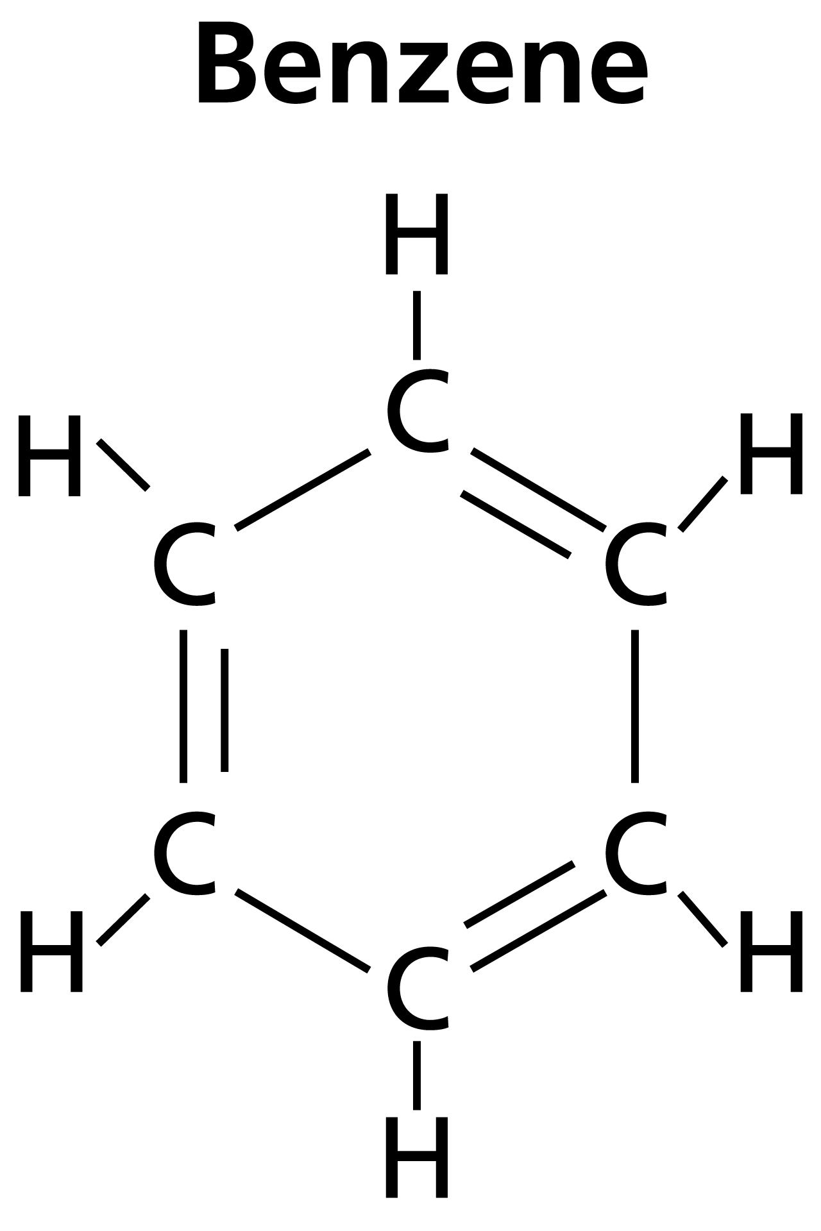
Unsaturated Hydrocarbons
Hydrocarbons that contain similar ring structures are known as aromatic hydrocarbons. The name was chosen because many of these compounds have strong aromas, or odors.

Slide 34
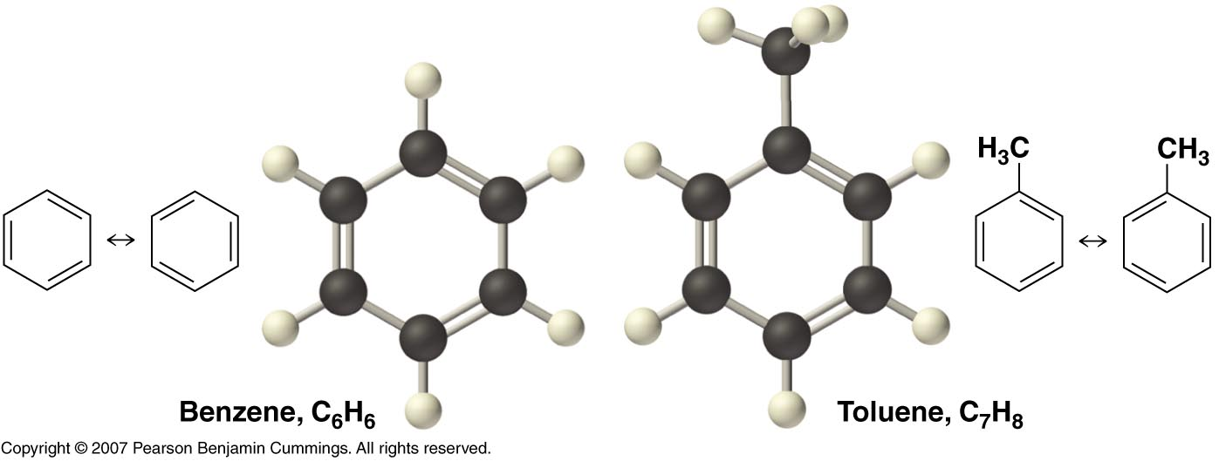
Aromatic Hydrocarbons
Although the formulas show alternating single and double bonds, the six BONDS IN THE RING ARE IDENTICAL. All six carbon atoms share six of the valence electrons.
This is known as RESONANCE.

Slide 35
We use Latin Prefixes to describe them
Naming Hydrocarbons (nomenclature)

Slide 36
Mnemonic for first four prefixes
First four prefixes
Meth-
Eth-
Prop-
But-
  Monkeys
  Eat
  Peeled
  Bananas

Slide 37
Other prefixes
Pent-
5
Oct-
8
Hex- … Hept- … Non-
6 7 9
Decade
Decimal
Decathalon
Dec-
10

Slide 38
Other prefixes
Pent-
5
Oct-
8
Hex- … Hept- … Non-
6 7 9
Decade
Decimal
Decathalon
Dec-
10

Slide 39
Names of Linear Alkanes
# of
C atoms
Alkane
1
2
3
4
5
6
7
8
9
10
CH₄
CH₃CH₃
CH₃CH₂CH₃
CH₃CH₂CH₂CH₃
methane
ethane
propane
butane
pentane
hexane
heptane
octane
nonane
decane
2
4
1
5
3
Carbons are numbered
Notes:
39

Slide 40
Names of Alkyl Substituents
# of
C atoms
Alkyl substituents
Alkane
1
2
3
4
CH₄
CH₃CH₃
CH₃CH₂CH₃
CH₃CH₂CH₂CH₃
methane
ethane
propane
butane
-CH₃
-CH₂CH₃
-CH₂CH₂CH₃
-CH3CH2CH2CH3
methyl
ethyl
Propyl
Butyl
Alkyl Groups:
The alkane groups are used as “BRANCHES” in other hydrocarbons.
Notes:
40

Slide 41
Names of Alkyl Substituents
# of
C atoms
Alkyl substituents
Alkane
1
2
3
CH₄
CH₃CH₃
CH₃CH₂CH₃
CH₃CH₂CH₂CH₃
methane
ethane
propane
butane
-CH₃
-CH₂CH₃
-CH₂CH₂CH₃
-CH3CH2CH2CH3
methyl
ethyl
Propyl
Butyl
METHYL Alcohol → contains 1 carbon
ETHYL Alcohol → contains 2 carbons
PROPYL Alcohol → contains 3 carbons
BUTYL Alcohol → contains 4 carbons
Notes:
41

Slide 42
R is an ALKYL group of any other C atom or arrangement of C atoms in the organic molecule.
H
H
H
H
C
H
H
C
C
H
H
H
H
Methane
CH₄
Ethane
C₂H₆
H
H
H
?
R
C
H
R
?
C
C
H
H
H
H
Methyl group
-CH₃
Ethyl group
-C₂H₅
Notes:
42

Slide 43
R is an alkyl group of any other C atom or arrangement of C atoms in the organic molecule.
H
H
H
H
H
H
H
H
C
C
C
H
H
C
C
C
C
H
H
H
H
H
H
H
H
Propane
C₃H₈
Butane
C₄H₁₀
H
H
H
H
H
H
H
?
C
C
C
H
R
R
?
C
C
C
C
H
H
H
H
H
H
H
H
Propyl group
-C₃H₇
Butyl group
-C₄H₉
Notes:
43

Slide 44
Distinguishing Properties of Compounds.
  Define “Hydrocarbon”.
  Distinguish each hydrocarbon:
  Alkane →
  Alkene →
  Alkyne →
  Aromatic →
Which of compounds formed during the combustion of fossil fuels and then react with water in the air to form acid rain?
  The compound that is an indicator of incomplete combustion of hydrocarbons is ___ ___.
Notes:
Timing ≈ 1 min
Entry: Even if you do not know the electronegativity of elements, you can use the periodic table to predict the charge of the ions formed by atoms and whether two elements form an ionic compound. Start by predicting the charge of the ions formed by the given elements.
Hint1: Atoms of metals form positive ions; atoms of nonmetals tend to form negative ions.
Hint2: When metals join with nonmetals to form compounds, the bond is most likely ionic.
Exit: The type of ion formed by the atoms of an element depends on the number of valence electrons that atom has. Metals tend to lose electrons to form positive ions and nonmetals tend to gain electrons to form negative ions so that the resulting ions have full valance levels. Ionic compounds form between the positive and negative ions.

Slide 45
Distinguishing Properties of Compounds.
  Define “Hydrocarbon”.
  Organic molecules containing only C and H atoms bonded together.
  Distinguish each hydrocarbon:
  Alkane → single C to C bonds
  Alkene → double C=C bonds
  Alkyne → triple C to C bonds
  Aromatic → Carbon ring
Which of compounds formed during the combustion of fossil fuels and then react with water in the air to form acid rain?
Sulfur dioxide, nitrogen oxides
  The compound that is an indicator of incomplete combustion of hydrocarbons is carbon monoxide.
Notes:
Timing ≈ 1 min
Entry: Even if you do not know the electronegativity of elements, you can use the periodic table to predict the charge of the ions formed by atoms and whether two elements form an ionic compound. Start by predicting the charge of the ions formed by the given elements.
Hint1: Atoms of metals form positive ions; atoms of nonmetals tend to form negative ions.
Hint2: When metals join with nonmetals to form compounds, the bond is most likely ionic.
Exit: The type of ion formed by the atoms of an element depends on the number of valence electrons that atom has. Metals tend to lose electrons to form positive ions and nonmetals tend to gain electrons to form negative ions so that the resulting ions have full valance levels. Ionic compounds form between the positive and negative ions.

Slide 46
There are specialized groups that bonds with hydrocarbons
We call these FUNCTIONAL groups.
“Alkyl” groups are one kind of functional group.
But there are many other specialized groups.

Slide 47
Organic Chemistry:
Functional Groups

Slide 48
Functional groups
Functional groups are parts of organic molecules that result in characteristic features:
Properties such as melting point, boiling point, solubility change due to functional groups
About 100 functional groups exist, we will focus on a few more (besides “alkyl” groups)

Slide 49
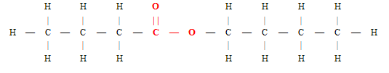
EXAMPLES of “functional Groups” are:
ester
Esters that have fragrant odors are used as a constituent of perfumes, essential oils, food flavorings, cosmetics, etc.
They are used as an organic solvent. Natural esters are found in pheromones.
Naturally occurring fats and oils are esters.

Slide 50
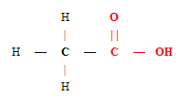
EXAMPLES of “functional Groups” are:
Carboxylic acid
Vinegar contains acetic acid, aspirin is acetylsalicylic acid, vitamin C is ascorbic acid, lemons contain citric acid, and spinach contains oxalic acid.

Slide 51
EXAMPLES of “functional Groups” are:
aldehyde
Aldehydes are present in many organic materials, everything from rose, citronella, vanilla, cinnamon, and orange rind.
Scientists also can create these compounds synthetically to use as ingredients for sweet-smelling perfumes and colognes.

Slide 52
EXAMPLES of “functional Groups” are:
ketone
Ketones are used as excellent solvent in industry, acetone is used as a nail paint remover and paint thinner.
They are also used in medicine , textiles, varnishes, plastics, paint remover, paraffin wax etc.

Slide 53
EXAMPLES of “functional Groups” are:
ether
Ethers are used as cleansing agents in our daily life. For example, Glycol ether is used as cleaners for window glasses, carpets, floors, etc.
As ethers are highly volatile compounds, their vapors are used as insecticides, miticides, and fumigants for soil microorganisms.
Formerly used for anesthesia.

Slide 54
EXAMPLES of “functional Groups” are:
alcohols
Alcohols are found in Liquid medications, like Dayquil. Breath strips, which have a small amount of alcohol like mouthwash.
Aftershave, hairspray, mousse, and some body washes. Astringents for skin care. Bug sprays.

Slide 55
EXAMPLES of “functional Groups” are:
ester
Carboxylic acid
aldehyde
ketone
ether
alcohols

Slide 56
Hydroxyl, Carbonyl, Carboxyl
Probably the most common
functional groups:
“Hydroxyl” refers to –OH
“Carbonyl” refers to C=O
“Carboxyl” refers to COOH
For more lessons, visit www.chalkbored.com

Slide 57
Hydroxyl, carbonyl, carboxyl
Which organic molecules contain a hydroxyl group?
A: alcohols, carboxylic acids
Carboxylic acid
alcohols
For more lessons, visit www.chalkbored.com

Slide 58
Hydroxyl, carbonyl, carboxyl
Which organic molecules contain a carbonyl group?
aldehydes, ketones, carboxylic acids, esters
ester
ketone
aldehyde
Carboxylic acid
For more lessons, visit www.chalkbored.com

Slide 59
Hydroxyl, carbonyl, carboxyl
Which organic molecules contain a carboxyl group?
A: carboxylic acids
Carboxylic acid
For more lessons, visit www.chalkbored.com

Slide 60
Isomers
C₆H₁₂O₆
is a molecular formula for
THREE
different organic compounds
Notes:
60

Slide 61
Isomers
C₆H₁₂O₆
Can be glucose (blood sugar)
Can be fructose (fruit sugar)
Can be galactose (milk sugar)
So how can we tell which is which?
Notes:
61

Slide 62
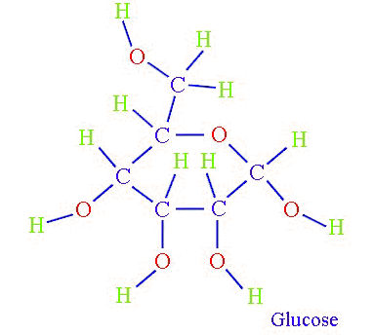
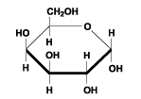
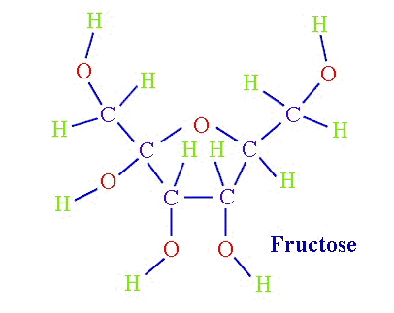
Isomers
C₆H₁₂O₆
C₆H₁₂O₆
Notice the different STRUCTURAL formulas
C₆H₁₂O₆
galactose
Notes:
62

Slide 63

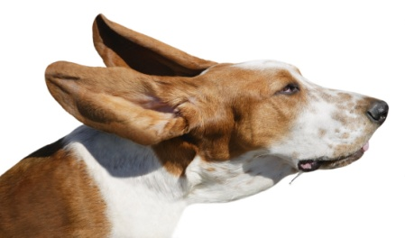
Isomers
“Iso” means similarity
“Mer” means unit
Notice that we could call each
of the animals above a “dog”
Notes:
63

Slide 64
Isomers
Yet, each is clearly unique
and can be classified differently
How would we tell them apart?
Notes:
64

Slide 65
Isomers
Let’s assume we make a statement using common words.
LIKE
The fat dog shook himself,
and then rolled over on the wet rug.
Is it possible to reuse these exact same words, yet say something completely different?
Notes:
65

Slide 66

Isomers
The fat dog shook himself,
and then rolled over on the wet rug.
Could be rearranged to say:
The dog shook the fat rug,
then rolled over and wet on himself.
Notes:
66

Slide 67
Isomers
The fat dog shook himself,
and then rolled over on the wet rug.
OR
The dog shook the fat rug,
then rolled over and wet on himself.
These two statements use the same words...
but have very different meanings!
Likewise, ISOMERS may have the same formula, but have very different STRUCTURES…
Notes:
67

Slide 68
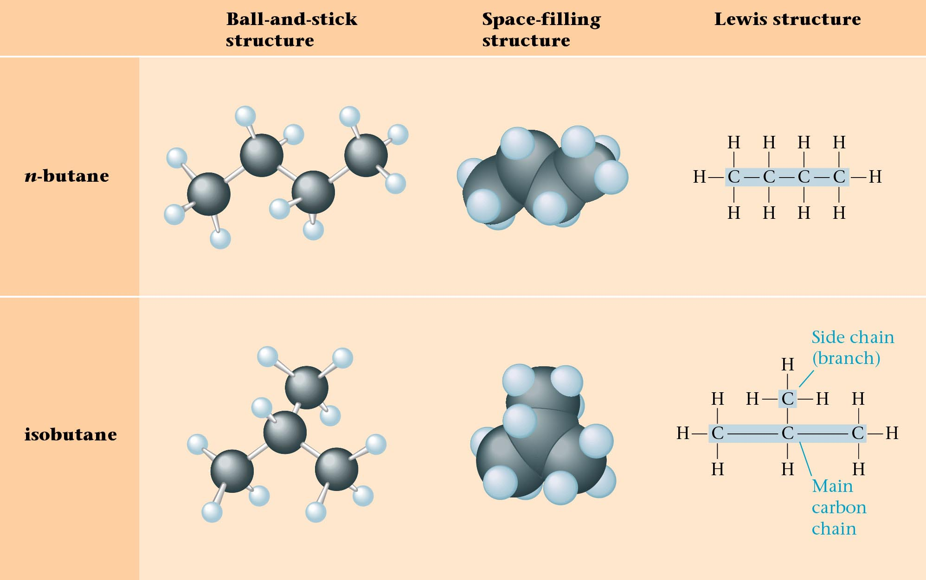
Structural Isomers of C₄H₁₀
Butane contains 4 Carbon Atoms
Can the atoms of Butane be rearranged to form another molecule?
Notes:
68

Slide 69
Structural Isomers of C₄H₁₀
2-methylpropane
or
Notes:
69

Slide 70
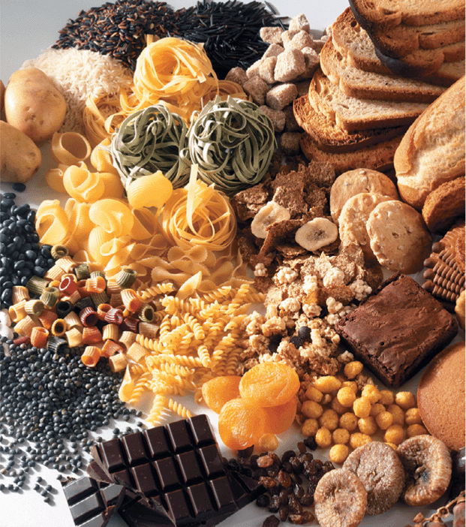
Polymers
A polymer is a large molecule that forms when many smaller molecules are linked together by covalent bonds.
  The smaller molecules that join together to form a polymer are monomers.
Many important types of biological molecules are natural polymers (e.g. silk and cotton fabrics). Organisms produce these polymers in their cells.
Synthetic polymers are developed by chemists in research laboratories and manufactured in factories (polar fleece).
Notes:
70

Slide 71
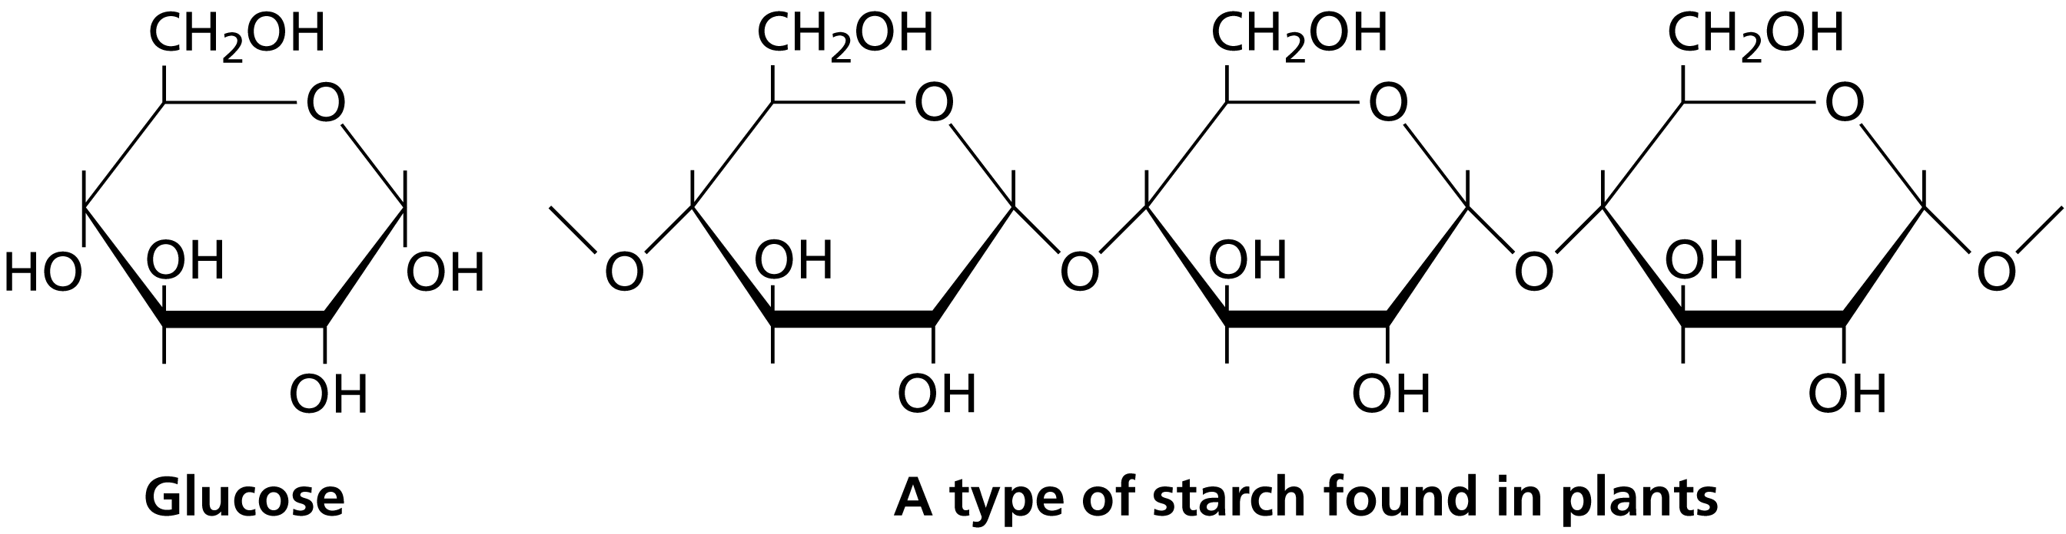
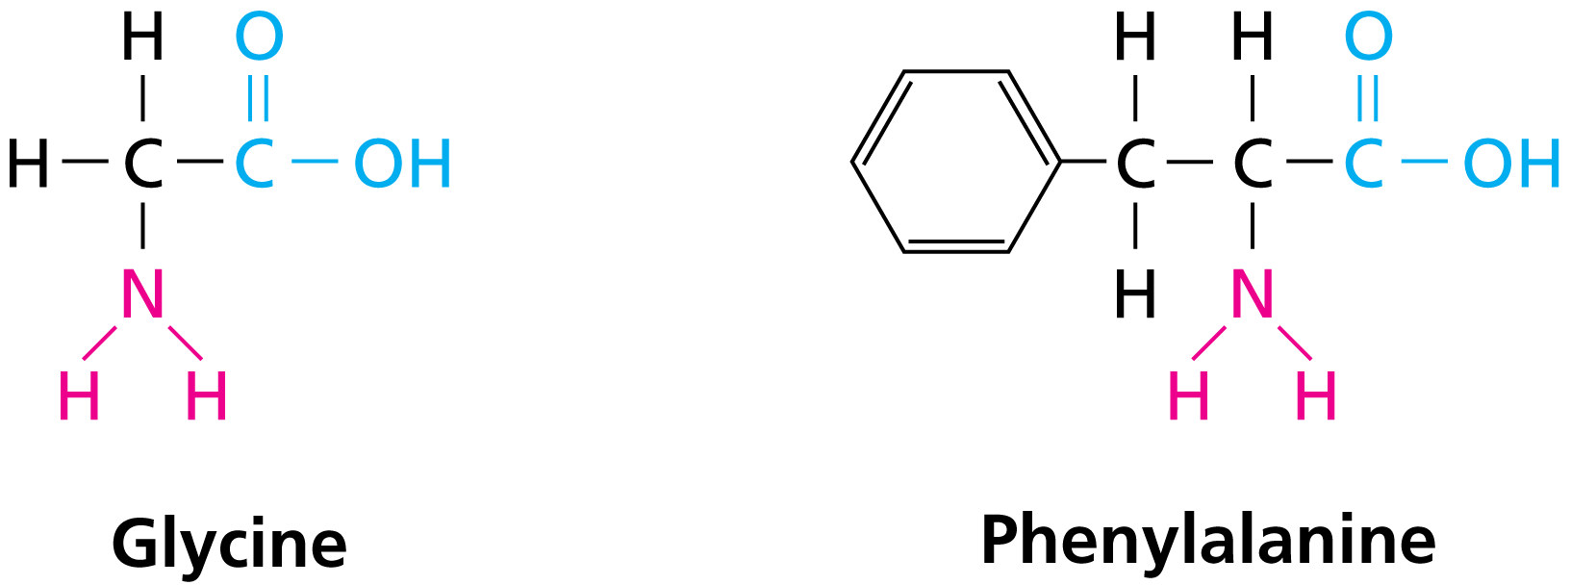
Natural Polymers
Starches / Cellulose
Simple sugars (monomers) combine. Carbohydrates.
Proteins
Organic acids contain a –COOH group, and organic bases contains an –NH₂ group.
An amino acid is a compound that contains both carboxyl and amino functional groups in the same molecule.
Notes:
71

Slide 72
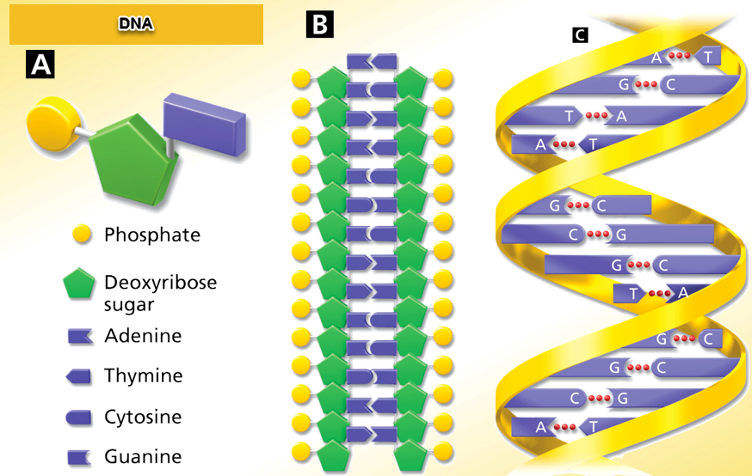
Natural Polymers
Nucleic acids are large nitrogen-containing polymers found in the nuclei of cells. There are two types of nucleic acid, deoxyribonucleic acid (DNA) and ribonucleic acid (RNA).
Notes:
72

Slide 73
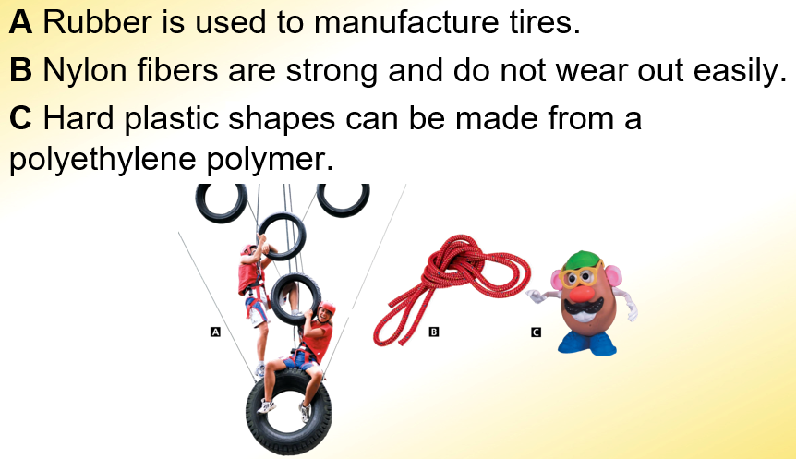
Synthetic Polymers
Rubber, nylon, polyethylene.
Notes:
73

Slide 74
Distinguishing Properties of Compounds.
The strong natural fiber, cellulose, is a polymer made of long chains of what type of molecule?
  amino acid
  organic bases
  hydrocarbons
  Sugar
An alcohol is formed by replacing at least one hydrogen in a hydrocarbon with a(n)
  carboxyl group.
  hydroxyl group.
  amino group.
  carbon group.
A synthetic polymer that can be formed into strong fibers suitable for making cloth and rope is
  silk.
  high-density polyethylene.
  natural rubber.
  nylon.
  Small, repeating units of organic molecules are called ___. They make up larger molecules that linked together by covalent bonds called ___.
Notes:
Timing ≈ 1 min
Entry: Even if you do not know the electronegativity of elements, you can use the periodic table to predict the charge of the ions formed by atoms and whether two elements form an ionic compound. Start by predicting the charge of the ions formed by the given elements.
Hint1: Atoms of metals form positive ions; atoms of nonmetals tend to form negative ions.
Hint2: When metals join with nonmetals to form compounds, the bond is most likely ionic.
Exit: The type of ion formed by the atoms of an element depends on the number of valence electrons that atom has. Metals tend to lose electrons to form positive ions and nonmetals tend to gain electrons to form negative ions so that the resulting ions have full valance levels. Ionic compounds form between the positive and negative ions.

Slide 75
Distinguishing Properties of Compounds.
The strong natural fiber, cellulose, is a polymer made of long chains of what type of molecule?
  amino acid
  organic bases
  hydrocarbons
  Sugar
An alcohol is formed by replacing at least one hydrogen in a hydrocarbon with a(n)
  carboxyl group.
  hydroxyl group.
  amino group.
  carbon group.
A synthetic polymer that can be formed into strong fibers suitable for making cloth and rope is
  silk.
  high-density polyethylene.
  natural rubber.
  nylon.
  Small, repeating units of organic molecules are called monomers. They make up larger molecules that linked together by covalent bonds called polymers.
Notes:
Timing ≈ 1 min
Entry: Even if you do not know the electronegativity of elements, you can use the periodic table to predict the charge of the ions formed by atoms and whether two elements form an ionic compound. Start by predicting the charge of the ions formed by the given elements.
Hint1: Atoms of metals form positive ions; atoms of nonmetals tend to form negative ions.
Hint2: When metals join with nonmetals to form compounds, the bond is most likely ionic.
Exit: The type of ion formed by the atoms of an element depends on the number of valence electrons that atom has. Metals tend to lose electrons to form positive ions and nonmetals tend to gain electrons to form negative ions so that the resulting ions have full valance levels. Ionic compounds form between the positive and negative ions.

