Slide 1
Go to the “Slide Show” shade above
Click on “Play from Beginning”

Slide 2
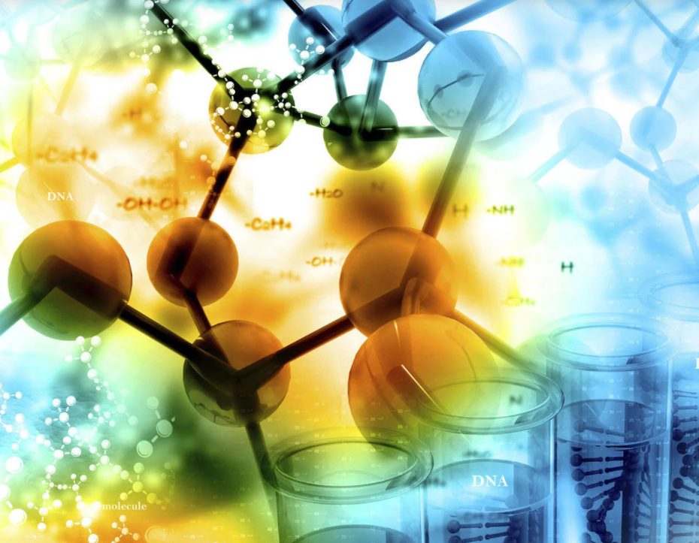
Chapter 3:
Basic Biochemistry of the Molecules of Life

Slide 3
Chemistry of LIfe
A(n) _________ is a pure substance that cannot be broken down into a simpler form
The FOUR most abundant elements in nature: ______.
_____ are the simplest chemical unit. Atomic number is the # of _______ in the nucleus of an atom. Atomic ____ includes protons and neutrons in the nucleus. A charged atom is called a(n) ____.
Water is a ______ molecule that exhibits _______ bonds, causing solid ice to be ______ dense than liquid water. Water has high _________ (sticks to other things) and __________ (sticks to itself) and resists __________ in temperature.
Water is the universal ______ that determines acids (___ ions) & bases (___ ions). pH below __ is acidic. ______ resist pH changes.
Notes:
#frame
Timing ~ 1 minute.
Entry Audio: After reviewing the five characteristics of life, use these criteria to identify the objects that are living.
Hint Audio: Determine whether each item is missing one of the characteristics. If it is, then don’t check it — it’s not living.
SOURCES:
Flower. “Flowers,” Domenico Salvagnin. 2005 as CC, Digital Image. http://www.flickr.com/photos/dominiqs/137546658/ (accessed April 9, 2012).
Rock. “Diorite.jpg,” Siim Sepp. 2005 as CC-SA/GNU, Digital Image. http://commons.wikimedia.org/wiki/File:Diorite.jpg (accessed April 20, 2011).
Lightning. “Lightning,” Tim . 2008 as CC, Digital Image. http://www.flickr.com/photos/seabamirum/2726998568/ (accessed April 20, 2011).
Mushroom. “IMG_3008.JPG,” Badeendjuh. 2009 as Free Photo, Digital Image. http://www.morguefile.com/archive/display/629267 (accessed April 20, 2011).

Slide 4
Chemistry of LIfe
A(n) element is a pure substance that cannot be broken down into a simpler form
The FOUR most abundant elements in nature: CHON.
Atoms are the simplest chemical unit. Atomic number is the # of protons in the nucleus of an atom. Atomic mass includes protons and neutrons in the nucleus. A charged atom is called a(n) ion.
Water is a polar molecule that exhibits hydrogen bonds, causing solid ice to be less dense than liquid water. Water has high adhesion (sticks to other things) and cohesion (sticks to itself) and resists changes in temperature.
Water is the universal solvent that determines acids (H+ ions) and bases (OH- ions). pH below 7 is acidic. Buffers resist pH changes.
Notes:
#frame
Timing ~ 1 minute.
Entry Audio: After reviewing the five characteristics of life, use these criteria to identify the objects that are living.
Hint Audio: Determine whether each item is missing one of the characteristics. If it is, then don’t check it — it’s not living.
SOURCES:
Flower. “Flowers,” Domenico Salvagnin. 2005 as CC, Digital Image. http://www.flickr.com/photos/dominiqs/137546658/ (accessed April 9, 2012).
Rock. “Diorite.jpg,” Siim Sepp. 2005 as CC-SA/GNU, Digital Image. http://commons.wikimedia.org/wiki/File:Diorite.jpg (accessed April 20, 2011).
Lightning. “Lightning,” Tim . 2008 as CC, Digital Image. http://www.flickr.com/photos/seabamirum/2726998568/ (accessed April 20, 2011).
Mushroom. “IMG_3008.JPG,” Badeendjuh. 2009 as Free Photo, Digital Image. http://www.morguefile.com/archive/display/629267 (accessed April 20, 2011).

Slide 5
Lesson Objectives
  By the end of this lesson, you should be able to:
  Describe the structures and functions of each of the four groups of Macromolecules of Life: Carbohydrates, Lipids, Proteins, and Nucleic Acids.
  Investigate how the four groups of Macromolecules of Life are metabolized by cells.
Science Practice: Biomolecules Lab
Notes:
#frame
instructional video
Timing ≈ 0.5 minutes
Living organisms share the same characteristics, including elements.
You will begin learning about elements in the first segment when you differentiate between elements and substances formed from elements.
Next you will Identify the six most common elements found in living organisms and then
Illustrate the importance of the six most common elements to living organisms
Science Practice: Demonstrate how to read a Material Safety Data Sheet (MSDS)
Sources: XXX

Slide 6

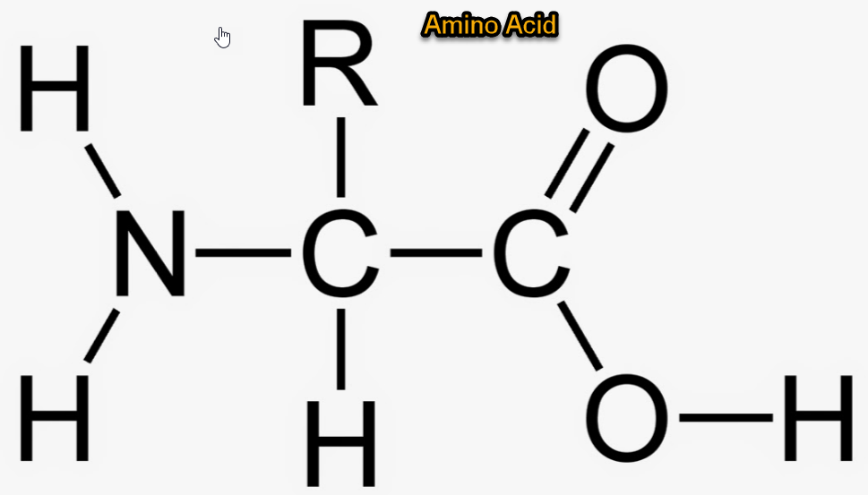
Organic Molecules
Life’s molecular diversity is based on the properties of the CARBON atom.
Almost all the molecules a cell makes are composed of carbon bonded to
  other carbons
  Hydrogen, oxygen, & nitrogen
  Carbon-based molecules (when combined with hydrogen or possessing a long carbon chain including oxygen or nitrogen) are called ORGANIC MOLECULES.

Slide 7
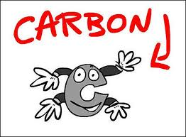
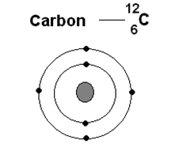
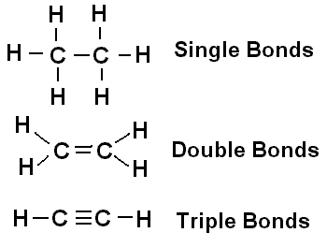
Carbon Atom
CARBON is essential for life
“the backbone of life”
“carbon-based life forms”
Contains 4 electrons in its outer shell (for bonding).
Each carbon atom creates 4 bonds: single, double, or triple bonds.
“Swiss Army Knife of Chemistry”

Slide 8
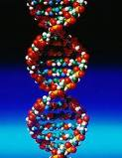
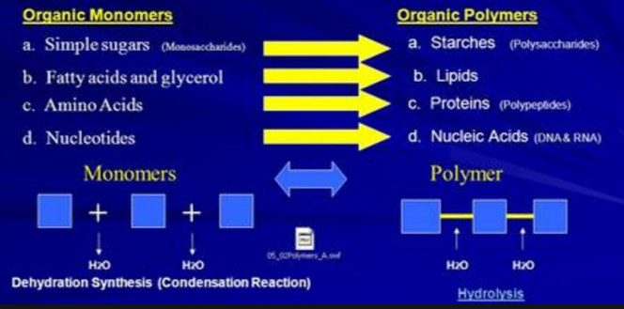
Macromolecules or Polymers
Macromolecules (larger) are built from smaller molecules called MONOMERS (“one unit”).

Slide 9
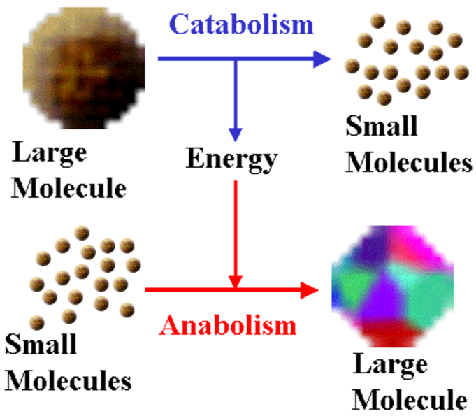
Organic Reactions
Anabolic Reactions: BUILD macromolecules from monomers.
Catabolic Reactions: BREAK macromolecules into its components (monomers).

Slide 10
Dehydration Synthesis
Also called a “condensation reaction”
Anabolic Reactions which form macromolecules by combining monomers by “removing water”.
HO
H
HO
H
H₂O
HO
H
Polymer (Macromolecule)

Slide 11
Hydrolysis
Catabolic Reactions which break down macromolecules by removing monomers one at a time [opposite of condensation reaction].
Separates monomers by “adding water”.
HO
H
H₂O
HO
H
HO
H

Slide 12
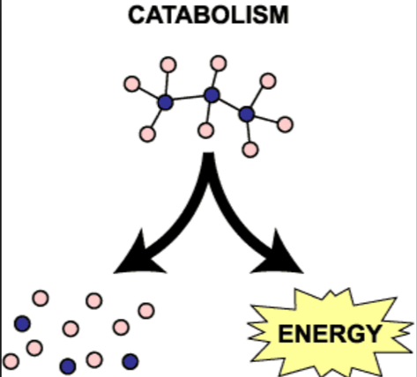
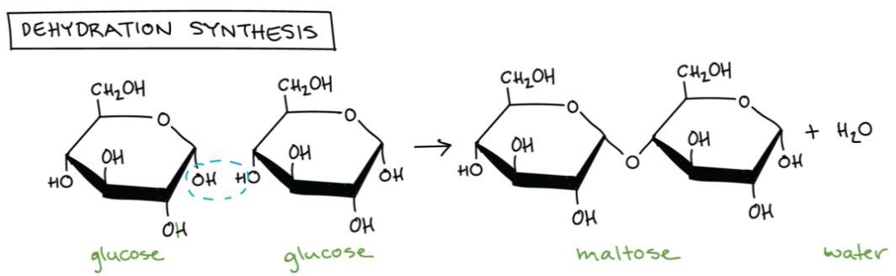
Review
What does “organic” mean in Biology?
What organic reaction took place? →
What organic reaction took place ↓
(Distinguish monomer, polymer, macromolecule)

Slide 13
Review
What does “organic” mean in Biology?
Contains carbon (& hydrogen, oxygen, nitrogen)
What organic reaction took place? →
Catabolism, hydrolysis
What organic reaction took place ↓
(Distinguish monomer, polymer, macromolecule)
Condensation
Polymer (Macromolecule)
Monomer

Slide 14
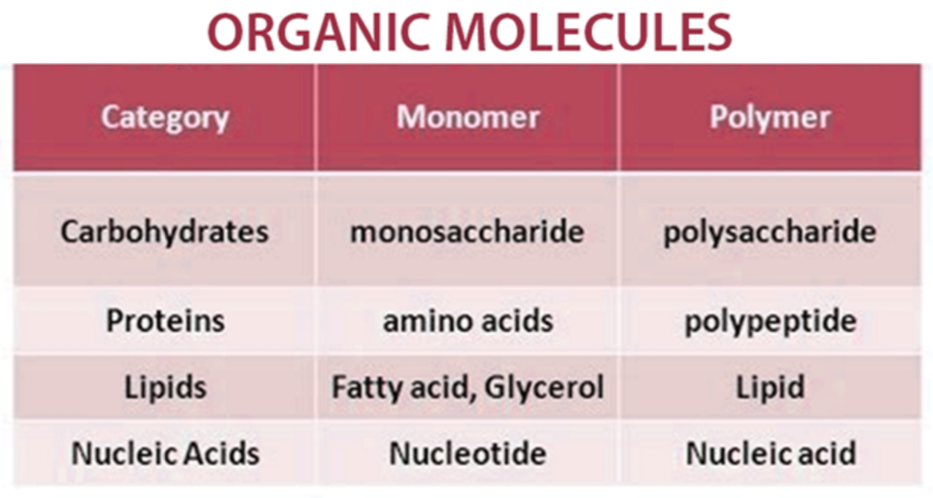
Biochemical Molecules

Slide 15
Biochemical Molecules

Slide 16
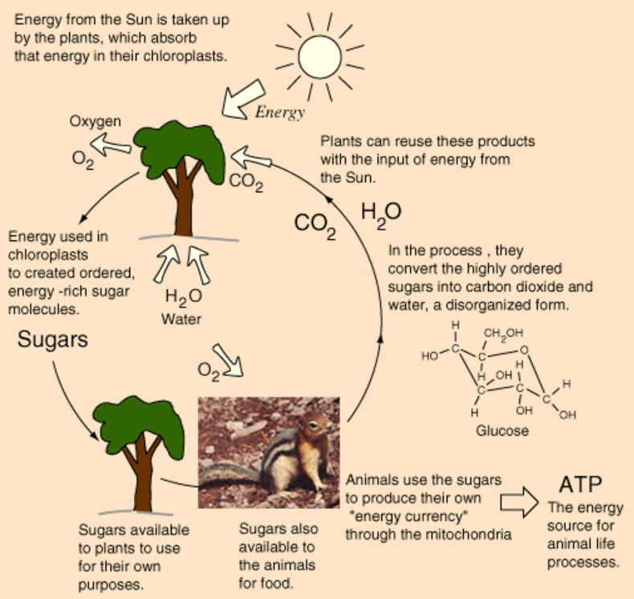
Carbohydrates

Slide 17
Carbohydrates
Important Source of Energy for all life forms (e.g. glucose).
Made of only Carbon, Hydrogen, and Oxygen (1:2:1) – CH₂O [C + water]
Includes simple sugars and starches (complex sugars).
Classified according to the number of sugar molecules they contain.
Monomer: Monosaccharides

Slide 18
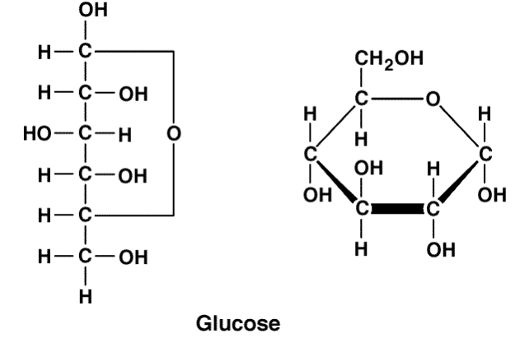
Monosaccharides
Called “Simple Sugars”
MONOMERS or Building Blocks of Carbohydrates
Glucose: Universal Fuel of Cells - C₆H₁₂O₆
Fructose (fruit sugar) and Galactose (milk sugar)
Exist in the following forms:
  Cyclic (aqueous in cells)
  Straight Chain
Straight
Cyclic

Slide 19
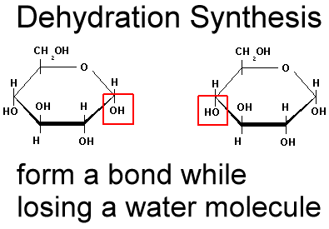
Carbohydrate Synthesis
Cells link monosaccharides together by Dehydration Synthesis to form more complex sugars and polysaccharides.
Remove H
H₂O Forms
Remove OH

Slide 20
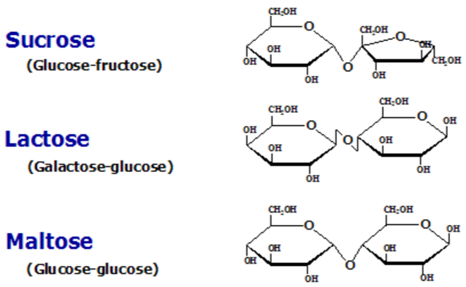
Disaccharides
“Double sugar”
Formed by joining two monosaccharides by Dehydration Synthesis.
Sucrose (table sugar)
Lactose (milk sugar)
Maltose (grain sugar)
Form a bond called a GLYCOSIDIC bond.
Most simple sugars in nature are disaccharides

Slide 21
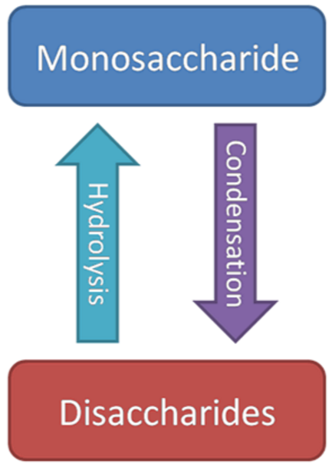
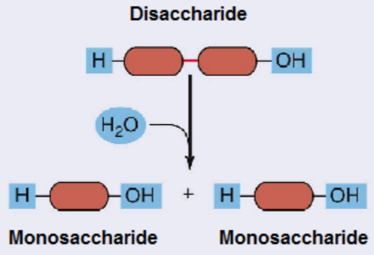
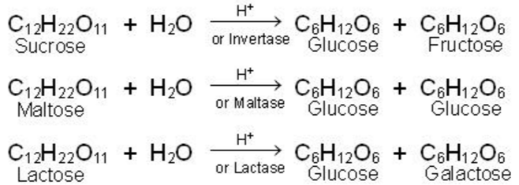
Hydrolysis of Disaccharides

Slide 22
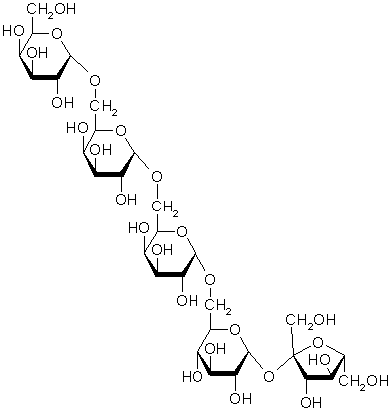
Polysaccharides
“Many Sugars”
Chains of thousands of Monosaccharides.
Also called “Complex Carbohydrates”.
Functions:
  Energy Storage Molecules
  Structural Molecules
Too large to leave the cell.

Slide 23
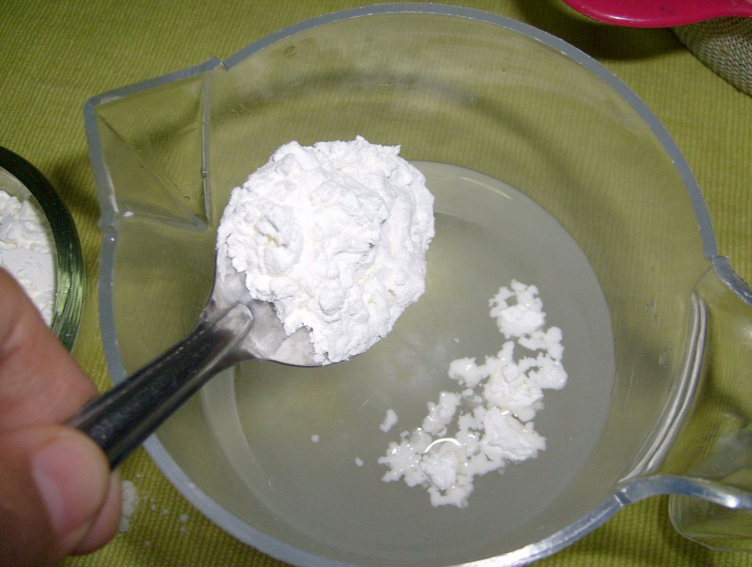
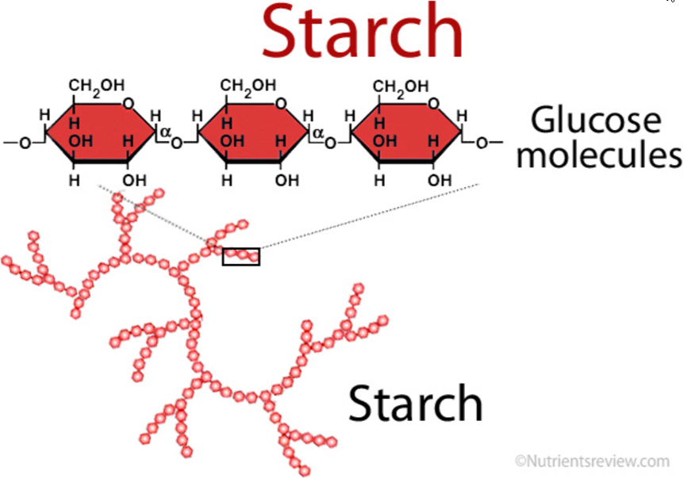
Polysaccharides
Energy Storage Molecules:
  Starch
    Chain of molecules of Glucose formed by Plants.
    This is the way plants store excess glucose.
    We consume it in products like potatoes and carrots.

Slide 24
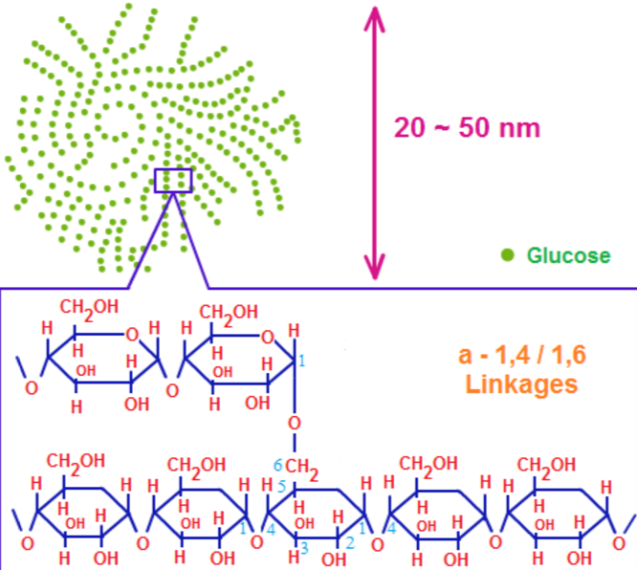
Polysaccharides
Energy Storage Molecules:
  Glycogen
    Chain of molecules of Glucose formed by Animals.
    This is the way animals store excess glucose.
    Stored in liver and muscles.

Slide 25

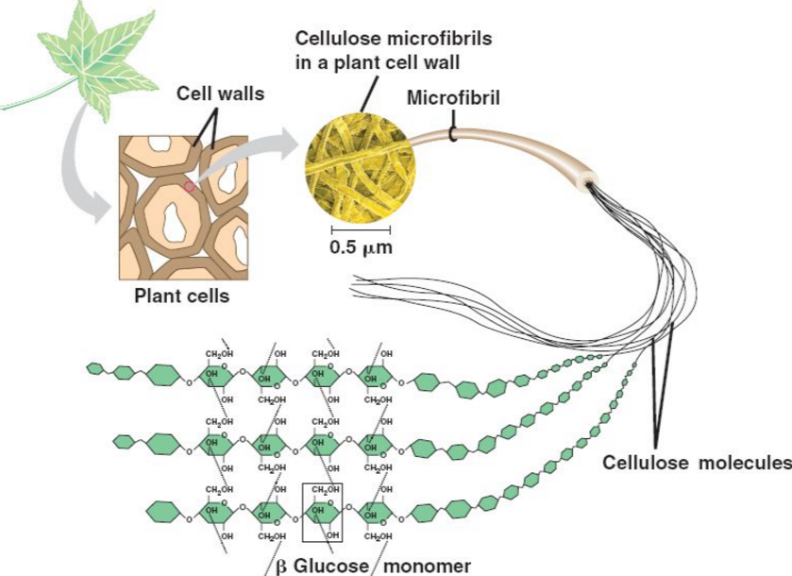
Polysaccharides
Structural Molecules:
  Cellulose
    Chain of molecules of Glucose.
    Primary constituent of Plant Cell Walls.
    Major component of wood and paper.
    Indigestible by most animals.

Slide 26
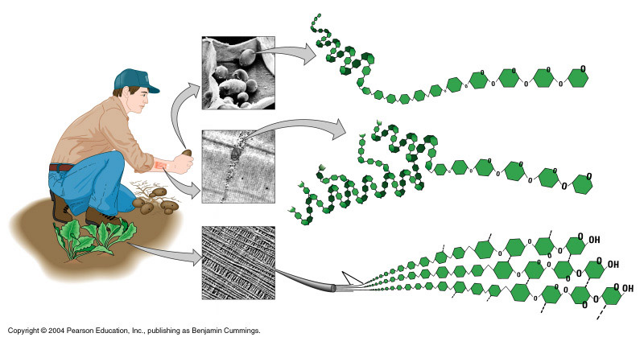
Polysaccharides
Glucose Monomer
Starch
Glycogen
Cellulose

Slide 27
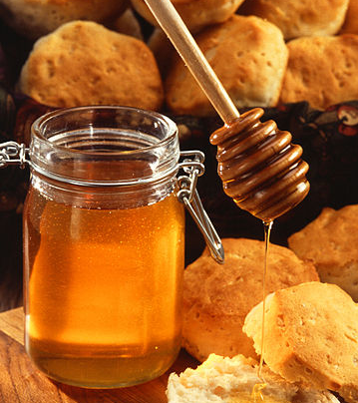
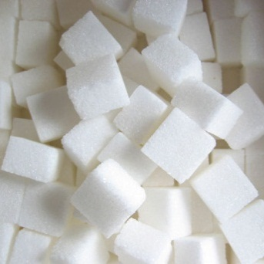
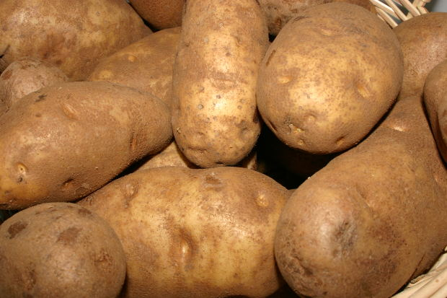
Types of Carbohydrates
There are three kinds of carbohydrates.
Monosaccharides
Disaccharides
Polysaccharides
Notes:
Timing ≈ 1.0 min
Carbohydrates are classified by the number of building blocks they contain. There are three kinds of carbohydrates.
[Animate the honey photo and monosaccharide label:] A monosaccharide is the simplest carbohydrate. It is made of only one sugar molecule. Honey gets its sweetness from the monosaccharides glucose and fructose. The monosaccharide fructose is also found in many fruits.
[Animate the sugar photo and disaccharide label:] A disaccharide is made of two sugar molecules. Table sugar (sucrose) is a disaccharide. Lactose, the sugar in milk, is also a disaccharide.
[Animate the potato photo and polysaccharide label:] A polysaccharide is made of many sugar molecules linked in a chain. The starch in potatoes is a polysaccharide. Polysaccharides are also found in vegetables and grains, such as wheat and rice.
SOURCES:
Lotha, Gloria and Kara Rogers. “starch.” In Encyclopedia Britannica Online. Encyclopedia Britannica, Inc., 2012. Accessed May 22, 2012. http://www.britannica.com/EBchecked/topic/563582/starch.
Rogers, Kara. “disaccharide.” In Encyclopedia Britannica Online. Encyclopedia Britannica, Inc., 2012. Accessed May 22, 2012. http://www.britannica.com/EBchecked/topic/165150/disaccharide.
Rogers, Kara and Shukla Gaurav. “polysaccharide.” In Encyclopedia Britannica Online. Encyclopedia Britannica, Inc., 2012. Accessed May 22, 2012. http://www.britannica.com/EBchecked/topic/469090/polysaccharide.
Singh, Shiveta. “monosaccharide.” In Encyclopedia Britannica Online. Encyclopedia Britannica, Inc., 2012. Accessed May 22, 2012. http://www.britannica.com/EBchecked/topic/390074/monosaccharide.
Honey. “Runny hunny.jpg,” Scott Bauer, USDA. 2007 as PD, Digital Image. http://commons.wikimedia.org/wiki/File:Runny_hunny.jpg (accessed May 10, 2012).
Sugar cubes. “sugar.JPG,” Frenchbyte. 2004 as Free Photo, Digital Image. http://morguefile.com/archive/display/9511 (accessed May 10, 2012).
Potatoes. “IMG_0313_f.JPG,” Xandert. 2006 as Free Photo, Digital Image. http://morguefile.com/archive/display/138480 (accessed May 10, 2012).

Slide 28
Review
Explain how biochemical molecules are formed.
List the general types of carbohydrates from simplest to most complex, giving examples/definitions of each.
What monomer exists in all the above di- & polysaccharides?
  The TWO major functions of complex sugars:

Slide 29
Review
Explain how biochemical molecules are formed.
Monomers combined through dehydration synthesis to form polymers.
List the general types of carbohydrates from simplest to most complex, giving examples/definitions of each.
Monosaccharide (glucose, fructose, galactose),
Disaccharide (sucrose [table], maltose [grain], lactose [milk])
Polysaccharide (starch [plant excess glucose], glycogen [animal excess glucose], cellulose [plant cell walls])
What monomer exists in all the above di- & polysaccharides? Glucose
  The TWO major functions of complex sugars:
  Energy Storage Molecules & Structural Molecules

Slide 30
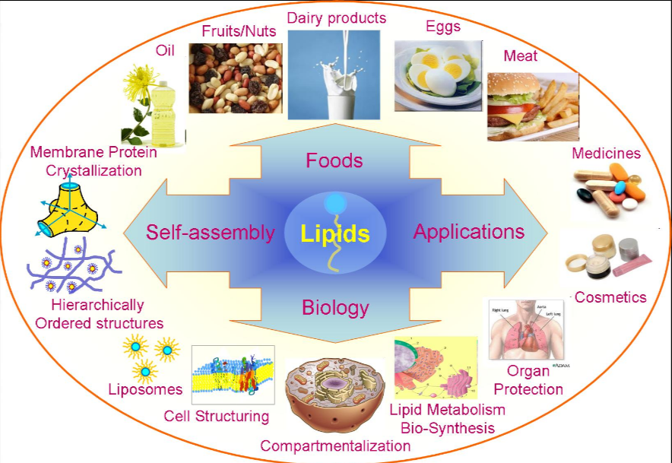
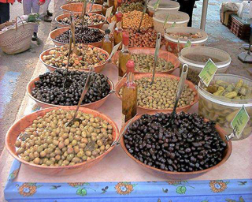
Lipids

Slide 31
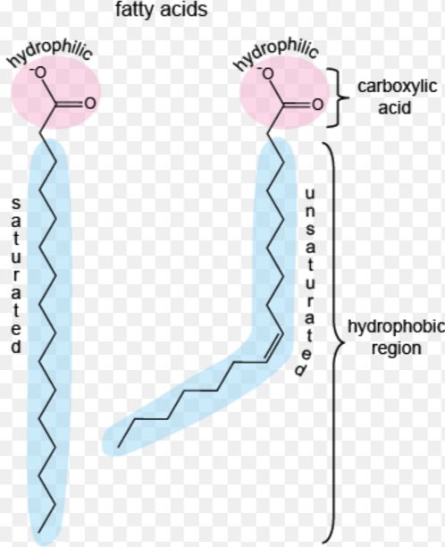
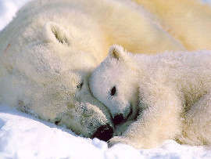
Lipids
Contain Carbon, Hydrogen, & Oxygen.
Hydrophobic – “Water-fearing”; Insoluble in water.
Protects & insulates body organs.
Mostly Energy-Storage molecules.
Type of Lipid we will consider: Fats (Triglycerides)

Slide 32
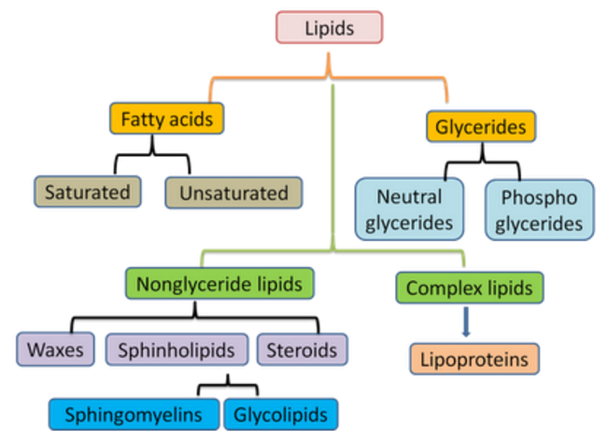
Lipids

Slide 33
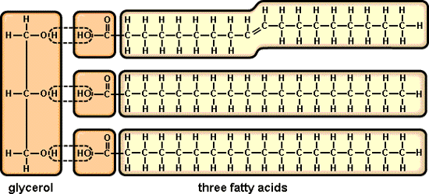
Lipids Triglycerides (Fats)
Lipids are composed of two MONOMERS,
glycerol (1 molecule) + fatty acids tails (3)

Slide 34
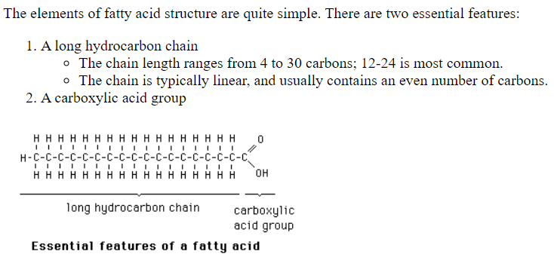
Lipids Triglycerides (Fats)
The components of fatty acids (2 essential features):
A long hydrocarbon chain.
  Chain length ranges from 4 to 30 carbons
  The chain is typically linear, containing an even number of carbon atoms bonded to each other.
A carboxylic acid group

Slide 35
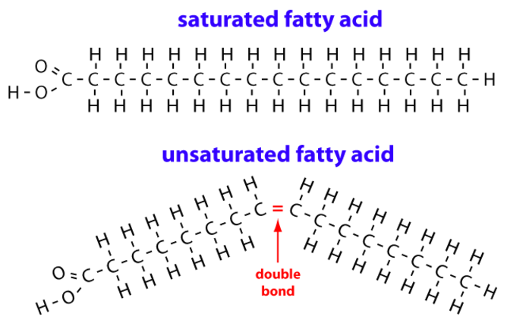
Lipids Triglycerides (Fats)
Types of Fatty Acids tails:
  Saturated fatty acids have the maximum number of hydrogens bonded to the carbons (all single covalent bonds between carbons); Animal Fats.
  Unsaturated fatty acids contain one or more double bonds; Oils.

Slide 36
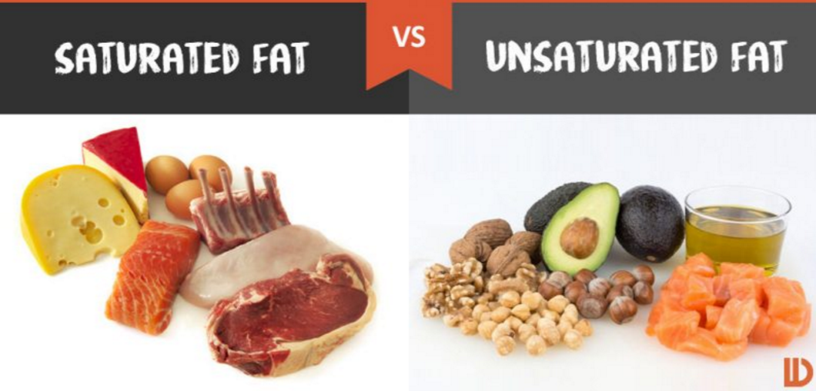
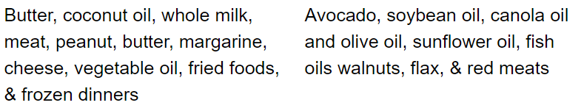
Types of Fatty Acids
  Saturated fatty acids
  liquids at room temperature
  Unsaturated fatty acids
  solids at room temperature

Slide 37
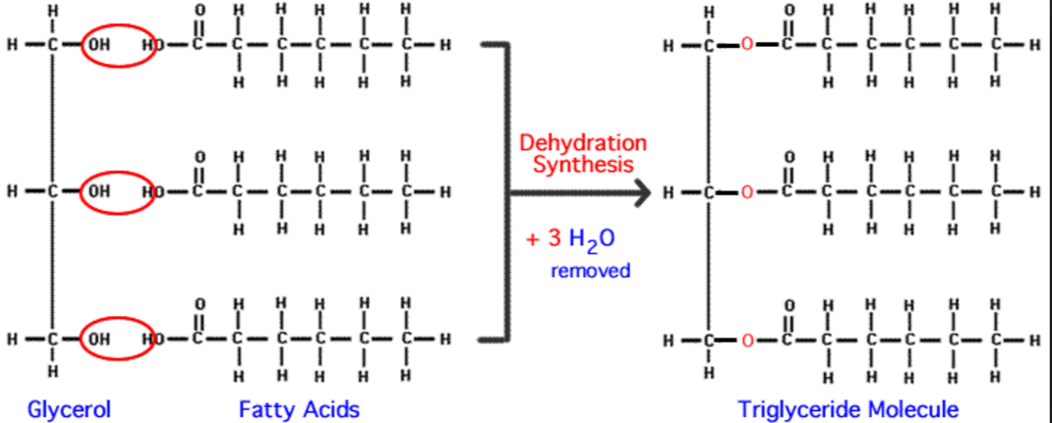
Lipids Triglycerides (Fats)
Triglycerides are made by the
Dehydration Synthesis of
1 Glycerol + 3 Three Fatty Acids
forming ESTER BONDS

Slide 38
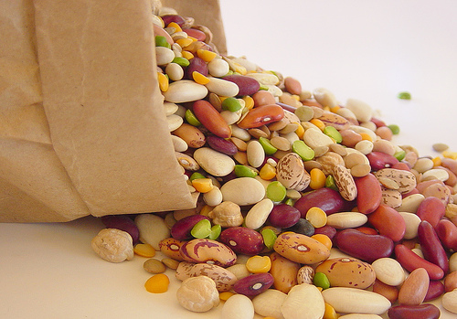
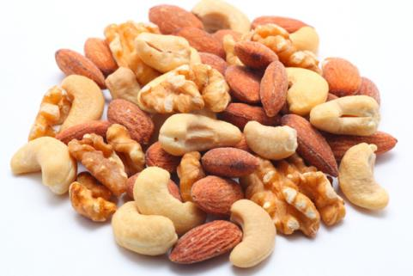
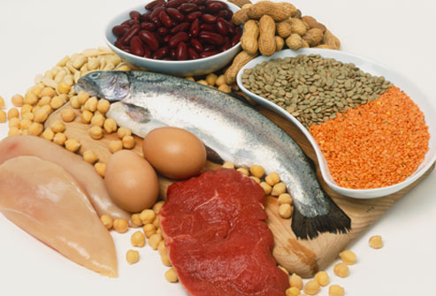
Proteins

Slide 39
Proteins
Account for over half of the body’s organic matter (skin, bones, hair, muscle, organs, tissues, enzymes, hormones)
Main Functions:
  Provide the construction materials for body tissues.
  Play a vital role in cell function.
  Act as enzymes, hormones, and antibodies.
Contain Carbon, Hydrogen, Oxygen, Nitrogen, and sometimes Sulfur.
MONOMERS: Amino Acids (20 types in humans)

Slide 40
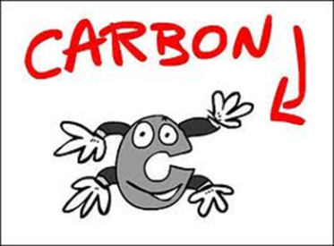
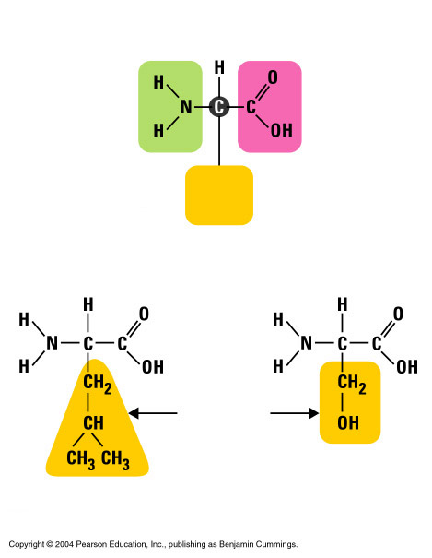
Proteins
Amino acids have a central carbon with 4 groups attached to it:
Amino Group: NH₂
Carboxyl Group: COOH
Hydrogen: H
Side group: R
Amino
group
Carboxyl
group
R
group
Side groups
Leucine
Serine

Slide 41
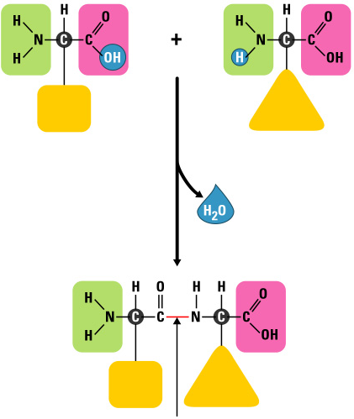
Proteins
Amino
group
carboxyl
group
Amino
group
carboxyl
group
Cells link amino acids together to make proteins by dehydration synthesis.
PEPTIDE BONDS form to hold the amino acids together.
Dehydration Synthesis
Amino
group
carboxyl
group
Peptide Bond

Slide 42
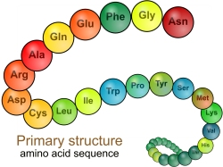
Protein Structure
The functions of different types of proteins depend on their individual shapes.
A polypeptide chain contains hundreds or thousands of amino acids linked by peptide bonds.
The amino acid sequence causes the polypeptide to assume a particular shape.

Slide 43
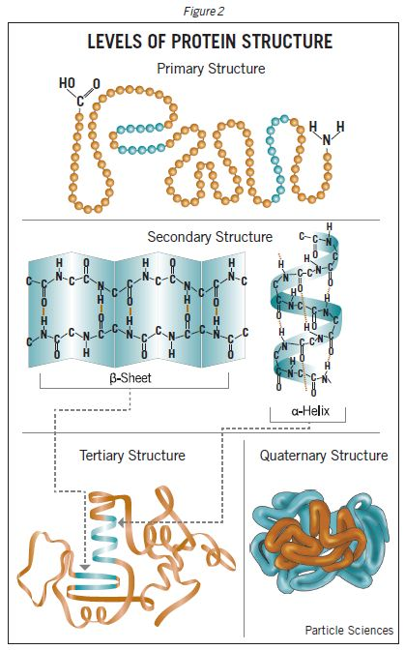
Protein Structure
Sequences with fewer than 50 amino acids are generally referred to as peptides, while the terms protein or polypeptide are used for longer sequences.
The amino acid sequence makes up the primary structure of the protein.
Stretches or strands of peptides compose secondary structure, depending on hydrogen bonding.

Slide 44
Protein Structure
The overall three-dimensional shape of an entire protein molecule is the tertiary structure. The protein molecule will bend and twist in such a way as to achieve maximum stability or lowest energy state.
The quaternary structure refers to how these protein subunits interact with each other and arrange themselves to form a larger aggregate protein complex.

Slide 45
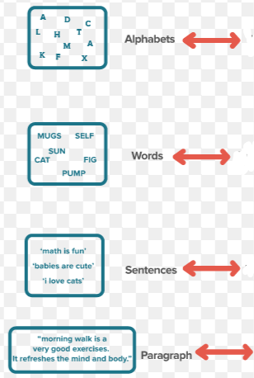
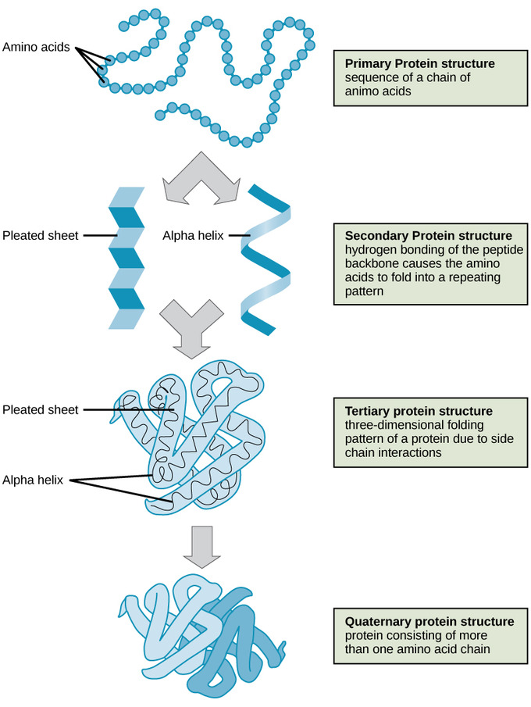
Protein Structure

Slide 46
Protein Structure

Slide 47
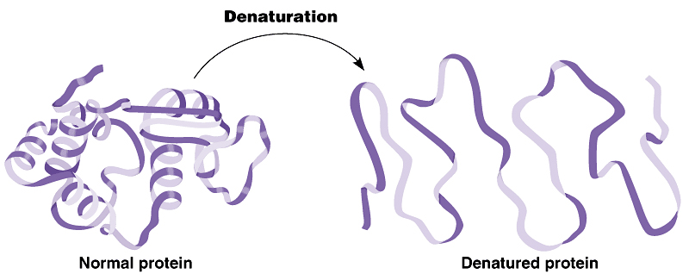
Protein Structure
If a protein’s shape is altered, it can no longer function.
In the process of denaturation, a protein
  unravels
  loses its specific shape
  loses its function.
Proteins can be denatured by changes in salt concentration, changes in pH, or high heat.

Slide 48
Review
What are the monomers of lipids?
Function of Lipids?
Distinguish the types of fatty acids.
Monomer & function of proteins?
Describe how to produce an amino acid.
What determines the shape of proteins?
What is denaturation & what causes it?

Slide 49
Review
What are the monomers of lipids?
Glycerol (1) & fatty acids (3)
Function of Lipids?
Protects, insulates, stores energy
Distinguish the types of fatty acids.
  Saturated (all single bonds with carbon) … liquids, animal fat
  Unsaturated (at least one double/triple bond with carbon) … solids, oils
Monomer & function of proteins?
  Amino acids; construction materials, enzymes, hormones, antibodies
Describe how to produce an amino acid.
  Amine group + carboxyl group (dehydration synthesis) forming a peptide bond
What determines the shape of proteins? Amino acid sequence
What is denaturation & what causes it?
A protein’s shape is altered; changes in salt concentration, changes in pH, high heat

Slide 50
NUCLEIC ACIDS

Slide 51
Nucleic Acids
Make up the GENES: units of inheritance.
Determine what type of organism you will be.
Controls growth and development mainly by dictating protein structure.
Composed of: Carbon, Hydrogen, Oxygen, Nitrogen, and Phosphorous.
Two types exist:
  Deoxyribonucleic Acid (DNA)
  Ribonucleic Acid (RNA)

Slide 52
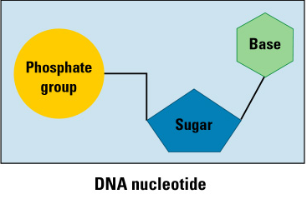

Nucleic Acids
Built from NUCLEOTIDES (Monomers):
  Pentose (5-carbon) Sugar
    Ribose in RNA
    Deoxyribose in DNA
  Phosphate Group
  Nitrogenous Base:
    A = Adenine
    G = Guanine
    C = Cytosine
    T = Thymine (only in DNA)
    U = Uracil (only in RNA)

Slide 53


Nucleic Acids
Deoxyribonucleic acid (DNA)
  The genetic material found within the cell’s nucleus.
  Provides instructions for every protein in the body.
  Organized by complimentary bases to form a double-stranded helix.
  Contains the sugar deoxyribose and the nitrogen bases Adenine, Thymine, Cytosine, & Guanine.
  Replicates before cell division.

Slide 54

Nucleic Acids
Ribonucleic acid (RNA)
  Carries out DNA’s instructions for Protein Synthesis (Translation) in the cytoplasm.
  Created from a template of DNA (Transcription) in the nucleus.
  Organized by complimentary bases to form a single-stranded helix.
  Contains ribose sugar and nitrogen bases
  Adenine, Uracil, Cytosine, & Guanine.

Slide 55

Bonding in Nucleic Acids
Hydrogen Bonds:
Hydrogen bonds form between the 2 Nucleic Acid strands (in DNA).
A :: T 2 H bonds
G ::: C 3 H bonds

Slide 56

Bonding in Nucleic Acids
Sugar-Phosphate Backbone
Sugar of one Nucleotide subunit is connected to Phosphate of the next nucleotide (dehydration synthesis).

Slide 57



RNA

Slide 58


DNA

Slide 60
Review
What elements are each macromolecule made of?
What are the components of a nucleotide?
Which nitrogenous bases bond with which … & how?
Distinguish between RNA & DNA
What is the ultimate function of nucleic acids?

Slide 61
Review
What elements are each macromolecule made of?
Carbohydrates → C, H, O … 1:2:1
Lipid → C, H, O
Proteins → C, H, O, N, S
Nucleic Acids → C, H, O, N, P
What are the components of a nucleotide?
Sugar (ribose, deoxyribose), phosphate group, nitrogen base
Which nitrogenous bases bond with which … & how?
A :: T with 2 H bonds; G ::: C with 3 H bonds … RNA has U instead of T
Distinguish between RNA & DNA
  RNA: single stranded; mainly operates in the cytoplasm
  DNA: double stranded; located in the nucleus
What is the ultimate function of nucleic acids?
  Protein synthesis; controlling cell function

Slide 62
Review: General Terms
?
?
?
?
?
?
?
?
?

Slide 63
Review: General Terms

Slide 64
Macromolecules
?
?
?
Bonds: ?
?
?
?
?
?
?
Bonds: ?

Slide 65
Macromolecules
Bonds: Glycosidic
glycogen
Bonds: Ester

Slide 66

Macromolecules
?
?
?
?
?
Bonds: ?
?
?
?
?
?
Bonds: ?
?

Slide 67
Macromolecules
Bonds: Peptide
Bonds: Hydrogen

