Slide 1
Just For Fun!
Here are some VERY fun lab activities you can do at home!
The Gas Laws
Chemistry is “CHOOL!”

Slide 2
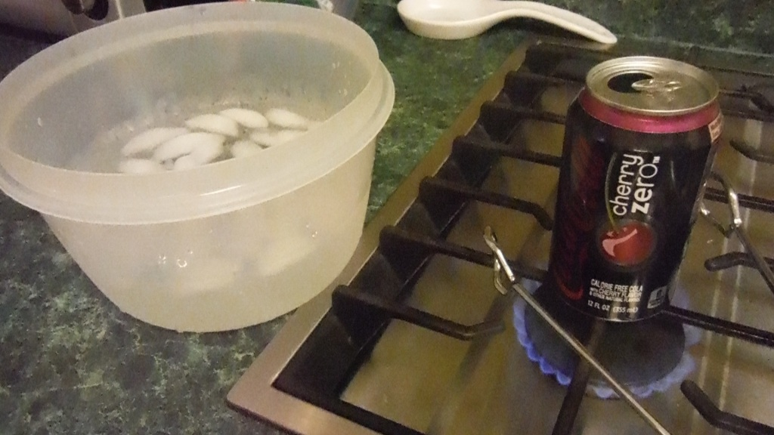
Materials
Ice bath ● Tongs,
safety goggles ● empty soda pop can
Heat source ● 10-15 ml of water
FUN Lab 1
Ice Bath

Slide 3
Prepare an ice bath as shown. Heat a small amount of water (10-15 ml) in the can until you see some steam exiting the can.
Ice Bath

Slide 4
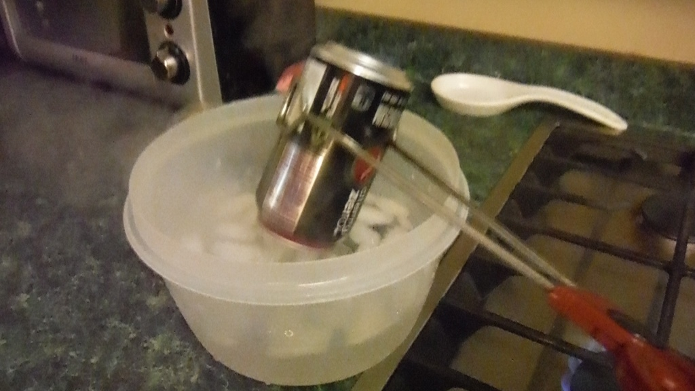
Turn can upside down INTO the ice bath & hold it there. (Inverting the can is equivalent to placing a cover on the can to hold the gases in.)

Slide 5
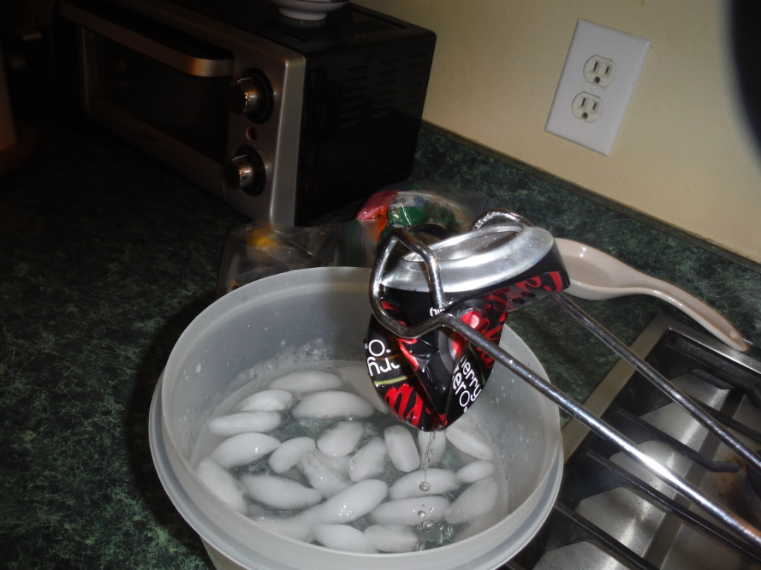
KAZAAAM! The Can collapses!

Slide 6
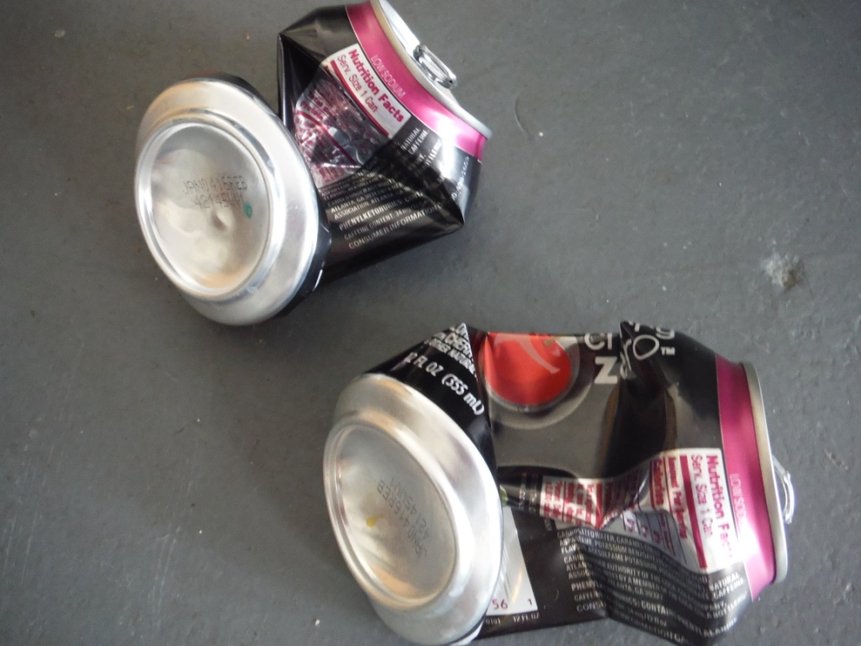
That was so much fun we did it twice!

Slide 7
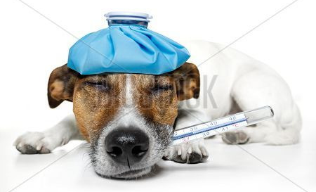
Collapsing Can Experiment
Click on the link: (0:47)
https://screencast-o-matic.com/watch/cFQ6XyqEwm
Why did the can collapse?

Slide 8
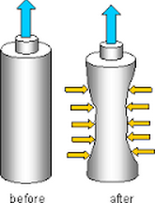
Atmospheric Pressure
Then, after adding boiling water (really it was the steam), the can collapses. Why?
The can originally did not collapse. Why?

Slide 9
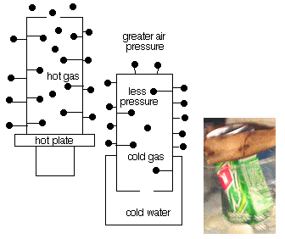
Atmospheric Pressure
Notice the air molecules “before” & “after”

Slide 10
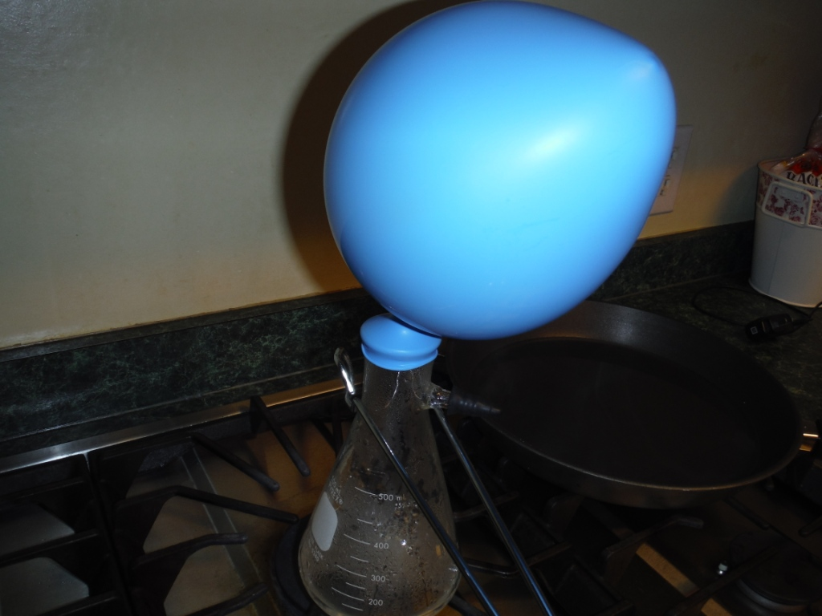
Materials
A 250 – 500 ml flask or glass bottle with a smaller opening.
Tongs ● Safety goggles
Large Balloon ● Ice bath (see lab 1)
Heat source
25-30 ml of water (added to the flask or bottle)
FUN Lab 2

Slide 11
Heat the water in the flask to boiling
The balloon expands

Slide 12
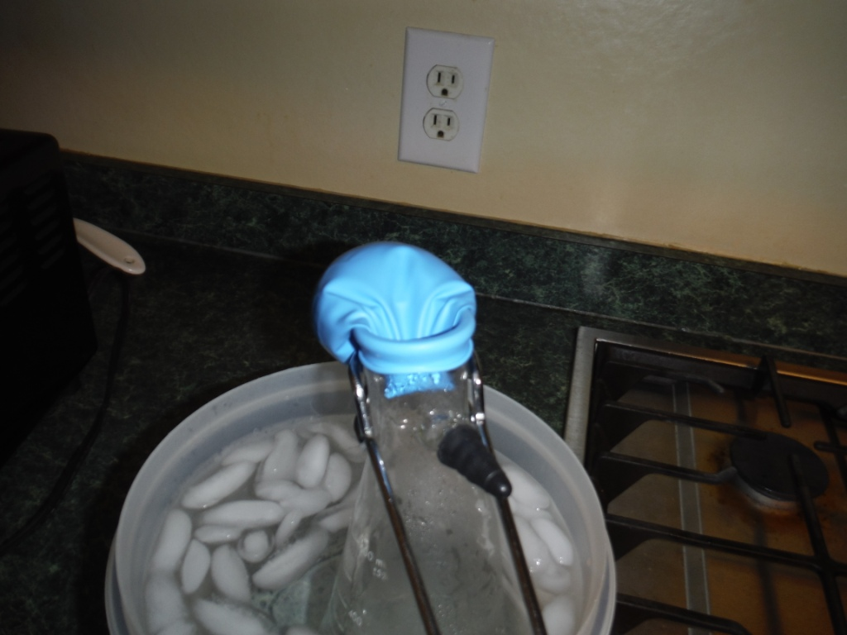
Submerge the flask (using tongs) into the ice bath.
As the flask cools the balloon gets sucked inside the flask.

Slide 13
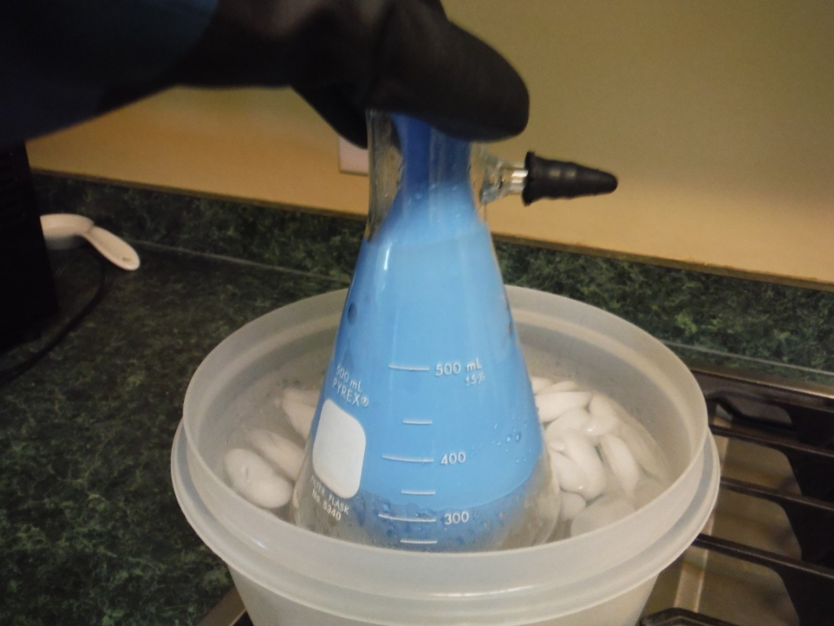

Slide 14
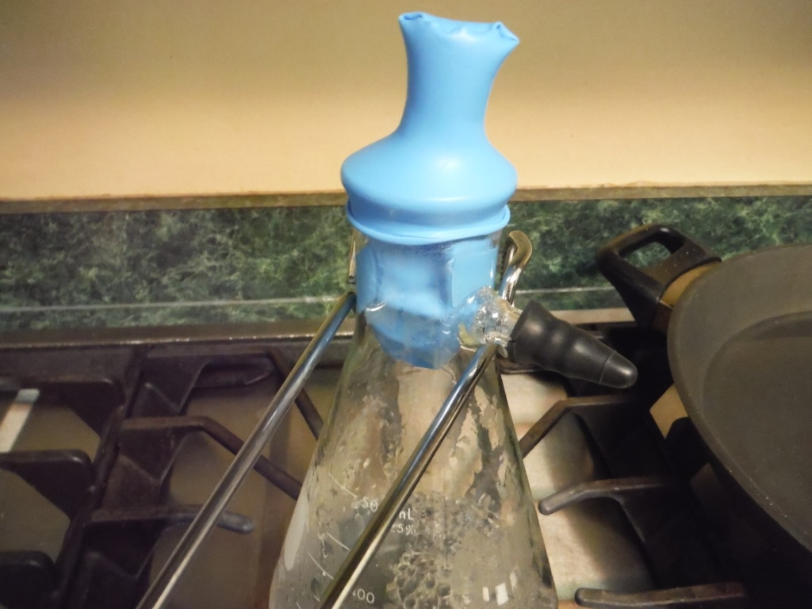
Reheat the flask – the balloon refills

Slide 15
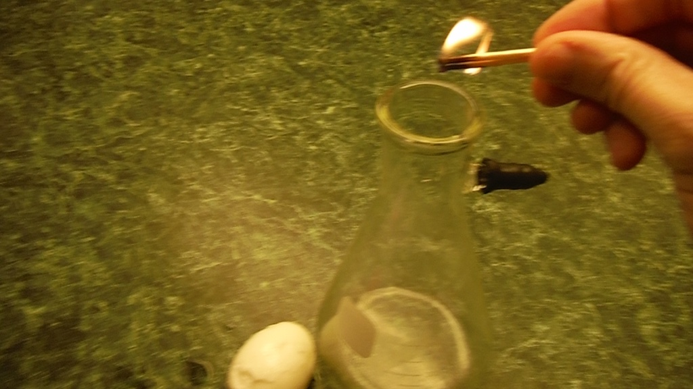
Materials
Match ● PEALED hard boiled egg
250-500 ml flask ● empty soda pop can
FUN Lab 3
Playing with Pressure!

Slide 16
Make a hard boiled egg (small pan, boiling water that covers the egg, egg in shell for 10 minutes)
Peal the hard boiled egg.
Light a match, let it burn 2-3 seconds directly above the flask and then drop it into the flask.
Place burning match inside flask

Slide 17
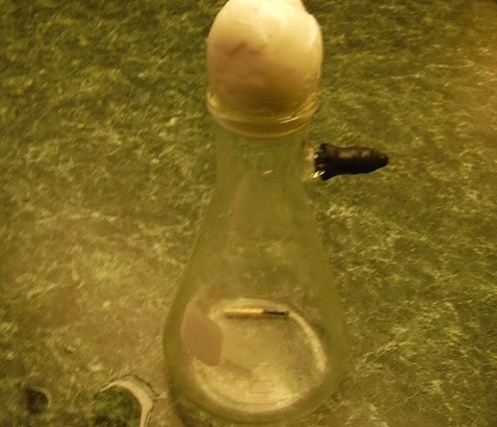
Place the pealed (hard boiled) egg on top of flask with narrow end “IN” the flask.

Slide 18
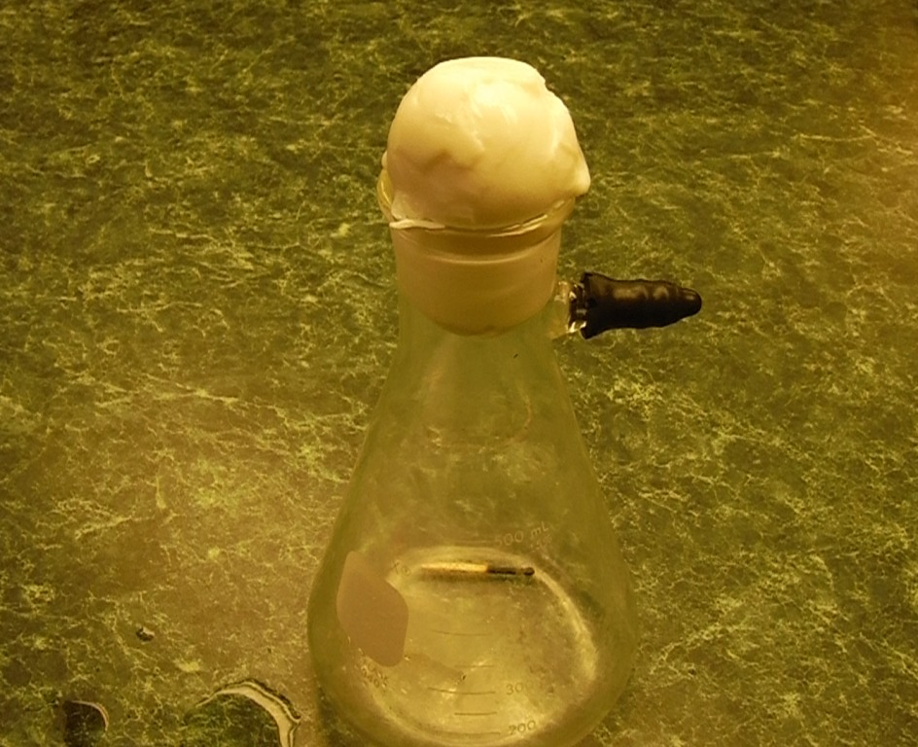
The egg gets sucked inside flask

Slide 19
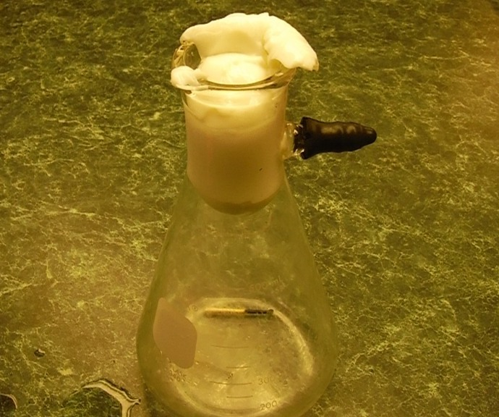

Slide 20
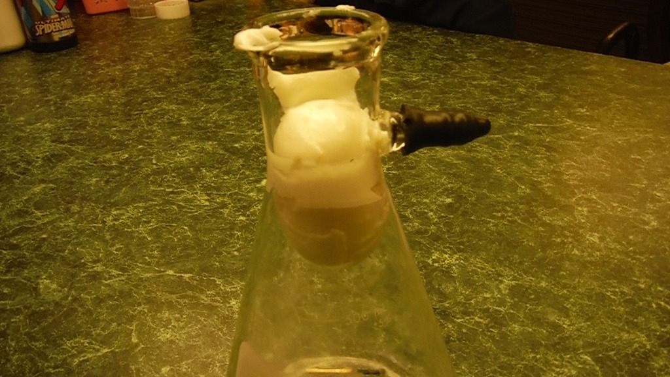

Slide 21
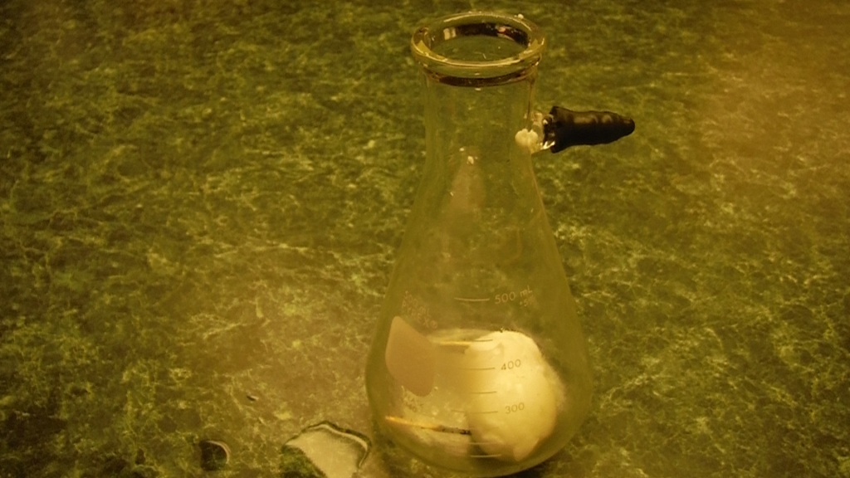
It’s no YOKE folks!
It came out EGGxactly as it should have!

