Slide 1
Lab
Stressing
Equilibrium

Slide 2
Click on: http://www.harpercollege.edu/tm-ps/chm/100/dgodambe/thedisk/equil/8perform.htm
Go to the URL link above.
Scroll down to find “Equilibrium and LeChatelier’s Principle.”
Click on the “Experiments” tab.
OR
http://somup.com/cYhhY3jcmo

Slide 3
Click on the “Cobalt System”

Slide 4
Cobalt System
This chemical equation has “Heat” on the right side of the arrows, meaning that heat is given off or released as a product.
This is an EXOthermic reaction.

Slide 5
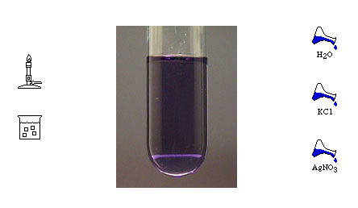
Notice that BEFORE the reaction proceeds, the solution is BLUE.
heat
cold
Cobalt system

Slide 6
Predict what will happen if you ADD heat to the system.
heat
cold
Cobalt system

Slide 7
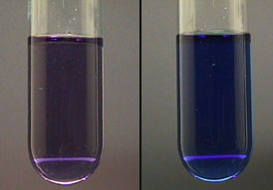
This reaction is EXOthermic (heat is a product). Therefore, adding heat will STRESS the system.
heat

Slide 8
To relieve the stress, the reaction will go toward the reactants to remove the heat.

Slide 9
Predict what will happen if you click on the COLD.
heat
cold
Cobalt system

Slide 10
This reaction is ENDOthermic (taking heat away from the product side) and STRESSing the system.
heat
cold
Cobalt system

Slide 11
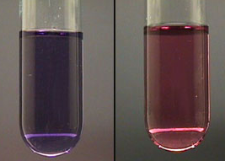
To relieve the stress, the reaction will go toward the products to replace the heat.

Slide 12
Predict what will happen if you click on the water.
heat
cold
Cobalt system

Slide 13
Adding water (REACTANT) will STRESS the system with too much reactant.

Slide 14
To relieve the stress the reaction will go towards more product to remove the excess water.

Slide 15
Predict what will happen if you click on the KCl.
heat
cold
Cobalt system

Slide 16
KCl dissociates (splits up) into K+ and Cl- ions, making more Cl- ions available on the product side, and STRESSING the system.
heat
cold
Cobalt system

Slide 17
Adding KCl will, therefore, push the reaction towards the reactants to remove the excess Cl- ions.

Slide 18
Predict what will happen if you click on the Silver Nitrate.
heat
cold
Cobalt system

Slide 19
Silver Nitrate dissociates (splits up) into cations/anions. The Silver (Ag+) cations bond with the Cl- ions, removing them from solution. The STRESS is that now there are not enough Cl- ions on the product side of the reaction.

Slide 20
Adding silver nitrate removes the Cl- ions from the product side. To remove the STRESS, the reaction adjusts to make more Cl- ions (product).

Slide 21
Click on the Iron Thicyanate system

Slide 22
Iron Thiocyanate system
This chemical equation has “Heat” on the right side of the arrows, meaning heat is given off or released as a product.
This is an EXOthermic reaction.

Slide 23
Notice that the product is RED in color as the reaction proceeds.
Iron Thiocyanate system

Slide 24
Predict what will happen if you ADD heat to the system.
Iron Thiocyanate system

Slide 25
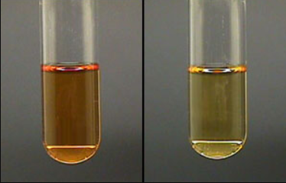
This reaction is EXOthermic (heat is a product). Therefore, adding heat will push the reaction toward the reactants to remove the heat.

Slide 26
Predict what will happen if you click on the KSCN.
Iron Thiocyanate system

Slide 27
KSCN dissociates (splits up) into cations/anions. Potassium (K+) cations form and SCN- anions also form, meaning there is MORE SCN- reactants in solution. This stresses the system.

Slide 28
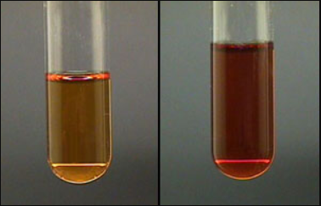
To relieve the stress, the reaction will go toward the products to remove the excess SCN- anions.

Slide 29
Predict what will happen if you click on the Fe(NO₃)₃.
Iron Thiocyanate system

Slide 30
Fe(NO₃)₃ dissociates (splits up) into cations/anions. Iron (Fe⁺³) cations form, meaning there are MORE Fe⁺³ reactants in solution. This stresses the system.

Slide 31
To relieve the stress, the reaction will go toward the products to remove the excess Fe⁺³ anions.

Slide 32
Predict what will happen if you click on the Na₂(HPO₄).
Iron Thiocyanate system

Slide 33
Na₂(HPO₄) dissociates (splits up) into cations/anions. HPO₄ bonds with the Iron (Fe⁺³) cations, removing the (Fe⁺³) cations from the reactant side. This stresses the system.

Slide 34
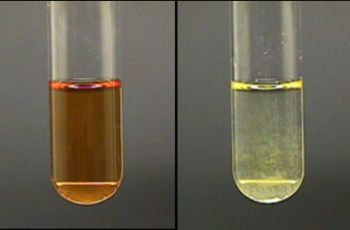
To relieve the stress, the reaction will go toward the reactants to replace the Fe⁺³ anions.

Slide 35
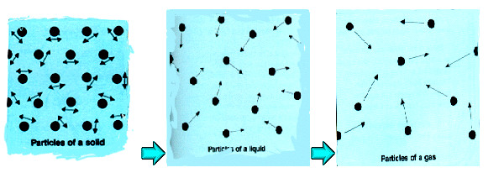
Consider Gases

Slide 36
Assume a reaction is taking place in the gas phase
What would be the effect on equilibrium position of increasing the pressure inside the container?

Slide 37
Assume a reaction is taking place in the gas phase
What would be the effect on equilibrium position of increasing the pressure inside the container?
Pressure would affect the gases IF there is an unequal number of moles of reactants than products.
e.g. squeeze a balloon on the left side and it pushes to the right … and vice versa

Slide 38
Define “Pressure” in terms of molecules in a container
How does pressure affect a solid?
How does pressure affect a liquid?
How does pressure affect a gas?

Slide 39
Define “Pressure” in terms of molecules in a container
How does pressure affect a solid?
Very little
How does pressure affect a liquid?
Very little
How does pressure affect a gas?
Gases are extremely compressive and expansive

